Slide 2
WELCOME TO PARTIS
Imagine having a partner that doesn't just help you shape your business strategy but can actively help implement it, ensuring operational excellence and accelerating your performance while reducing risk.
At Partis we are more than advisors, we are Gaming experts with decades of operational experience.
We are the Gaming industry's leading specialist advisor and go-to implementation partner, delivering a broad range of consulting, M&A and managed services solutions to 400+ clients since 2013.
We provide:
Industry Expertise
An Unrivalled Global Network
Comprehensive Solutions

Slide 3
WE OFFER SERVICES VIA TWO DIVISIONS
Partis Capital provides corporate advisory services including fund raising, buy-side and sell-side M&A advisory to the Gaming sector. Partis Solutions provides strategic consultancy and implementation solutions via consulting and managed services models.
Partis Capital
Partis Solutions
Buy-side M&A
Sell-side M&A
Fundraising
Buyside Strategy
Due Diligence
Post Merger Integration
Strategic Consulting
Business Development
Interim Management
Marketing Services

Slide 4
A UNIQUE SUITE OF COMPREHENSIVE SOLUTIONS
We provide end-to-end support to help clients in the Gaming industry execute strategies and transactions. Embracing a consultative methodology, we deliver holistic solutions spanning both of our divisions.
New Market Entry
Strategy Development
Market overview Value proposition Options evaluation Business plan
Buyside M&A
Strategy Deal origination Negotiation Due diligence
Buyside Partnerships
Market access Vendor selection Marketing partnerships
Launch Support
Pre-launch preparation Launch management Interim management post launch Transition
Operational Effectiveness
Performance Improvement
Strategic reviews Implementation support
Marketing Services
Pre-launch preparation User acquisition CRM Creative
Value Realisation
Sellside M&A/Fundraise
Pre-sale preparation Marketing Negotiation Completion
Sellside Partnerships
Market access Marketing partnerships IP/product BD
*Marketing Services – Delivered by InclineBet, a trusted member of our group and the foremost expert in user acquisition and CRM for the global gaming industry

Slide 5
PARTIS CAPITAL BRINGS SCALE, REACH AND RESOURCES TO DRIVE A SUCCESSFUL M&A PROCESS
Differentiated by unmatched sector knowledge, global footprint and a collaborative business model.
Extensive Industry Expertise
Broad network and substantial knowledge of the global buyer landscape at every scale.
Highly Experienced Team
Partis’ team previously held operational leadership roles in some of the largest Gaming companies globally.
Deep Valuation Knowledge
Thorough understanding of value drivers within the industry.
Competitive Fee
Competitive fee structure, delivering value far in excess of fees charged.
Transaction Experts
Considerable expertise in running successful auctions to create competitive tension.
Hands-On Approach
Hands-on management; partner-led approach and highly qualified team.
Well-known and highly regarded throughout the investor and strategic community – a key value driver for our clients.

Slide 6
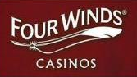
PARTIS CLIENTS

Slide 7
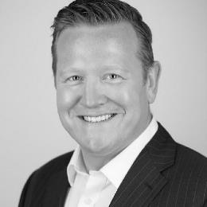
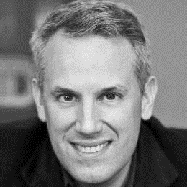
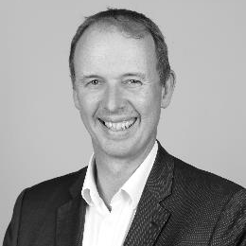
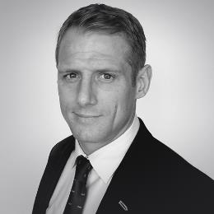
PARTIS SENIOR TEAM
Rob Dowling
Co-Founder & Managing Partner | London
Rob co-founded Partis in 2013 and leads Partis' M&A Advisory practice, with 20+ years' experience of deal-making in the Gaming industry
Co-Founder of The Conexus Group, a portfolio of companies delivering human and corporate capital solutions to the Gaming industry
Unrivalled network across all betting and gaming verticals
Gideon Bierer
Co-Founder & Managing Partner | New York
Gideon co-founded Partis in 2013 and heads Partis’ Solutions division, as well as leading Partis in the N.America region
Formerly EVP Interactive at IGT, Advisor to McKinsey’s Gaming practice and EVP Digital at Viacom
Delivered over 150+ Partis projects. Clients include 50% of US land casinos, multiple tier 1 suppliers and global media companies
Paul Richardson
Partner | London
Paul brings 20+ years’ advisory and operational experience of building companies and corporate deal making in the betting and Gaming sector
Industry roles include MD International and CSO for Rank Group Plc and SVP International for Galaxy Entertainment
Investment banking senior roles with CIBC World Markets and Global Leisure Partners
Daniel Beard
Partner | London
Daniel has 15+ years’ experience in the gaming industry with 8+ years of B2B M&A experience
Previously led the Openbet Casino Commercial team, including games division
Delivered multiple projects on origination for sell-side mandates for European B2C and B2B games studios
Deep global network of leading B2C and B2B businesses

Slide 8
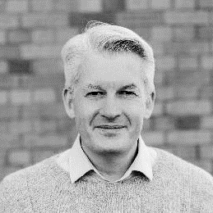
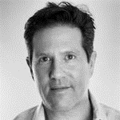
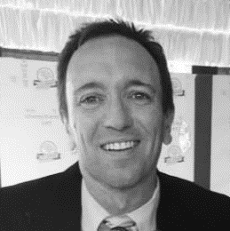
PARTIS SENIOR TEAM
Éamonn Toland
Partner | New York
Eamonn has over 10 years management consultancy experience (McKinsey, Accenture)
16 years Gaming experience, former President of North America for Paddy Power, leading strategy and corporate development
Led strategy and M&A projects in North America and LatAm for B2C, B2B and media companies
Jeff Berman
Partner | Philadelphia
Jeff is a seasoned commercial executive with extensive experience in Gaming, betting and sports
General Manager of N.America and CCO at GAN (NASDAQ: GAN)
Industry roles include commercial leadership positions at StubHub, Ticketmaster, CBS Sports.com and Sentient Technologies
Pete Laverick
CEO | Incline | San Francisco
Pete is one of the most senior Gaming marketing executives in the US with 20+ years’ industry experience
President and CEO of InclineBet, Partis’ Marketing Services subsidiary
Clients include FanDuel, Super Group, Four Winds Casino, Wind Creek Casino, Gamewise, Resorts Casino and Mohegan Sun

Slide 9
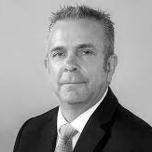
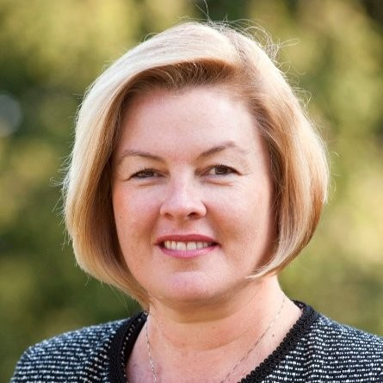
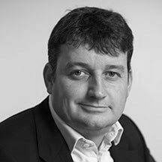
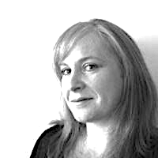
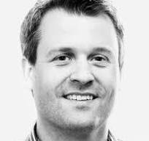
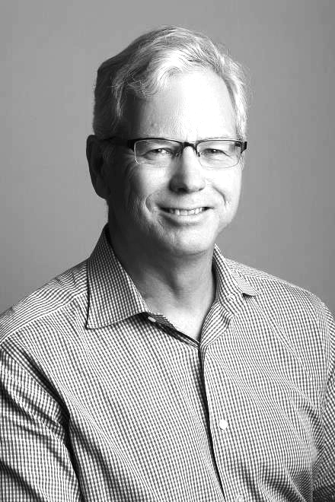
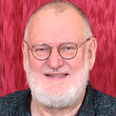
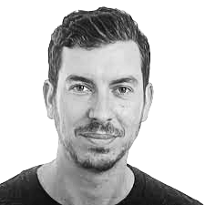
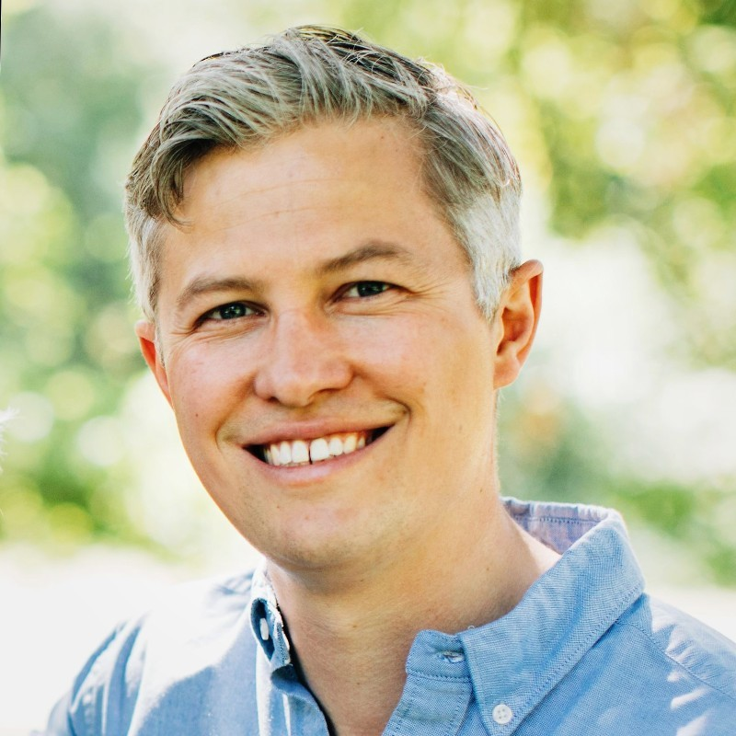
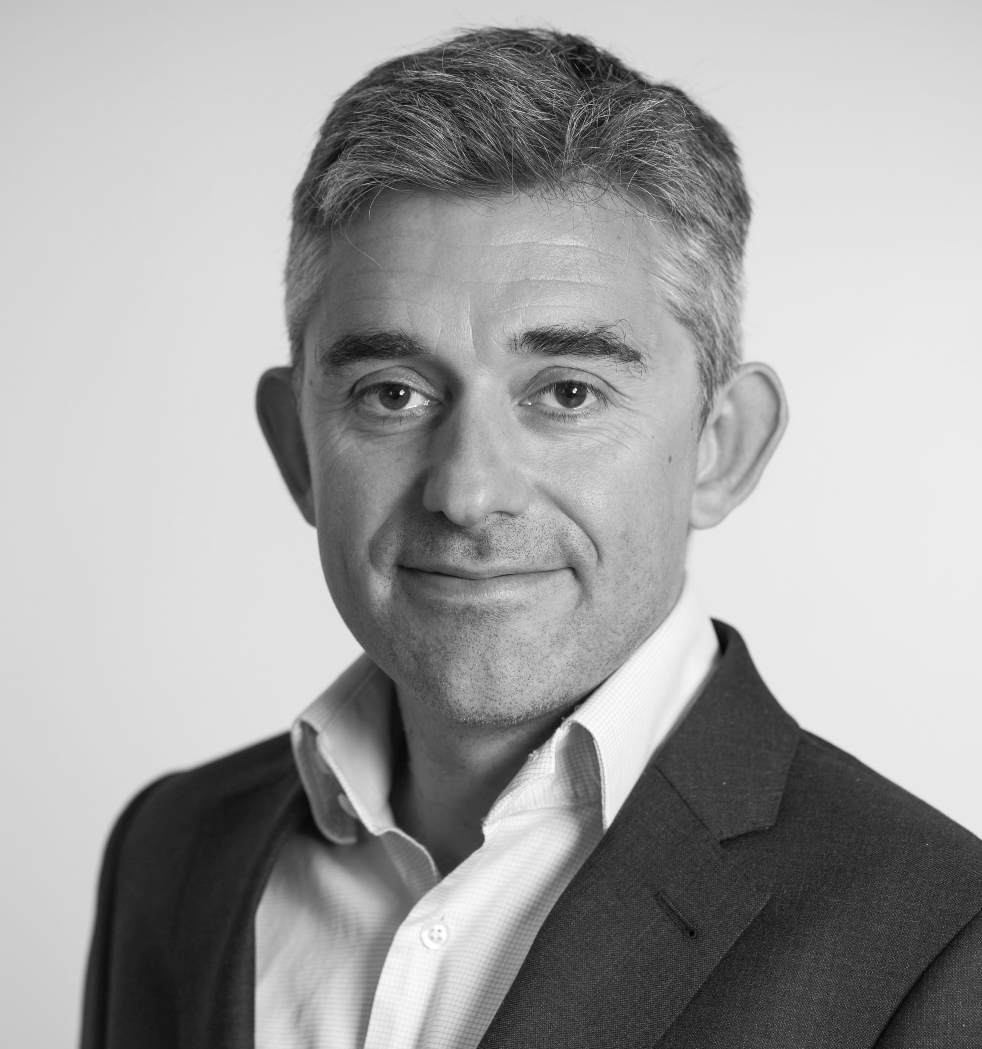
CORE TEAM IS REINFORCED BY ADVISORY PARTNERS WITH EXTENSIVE EXPERIENCE
Partis Advisory Partner Network: Uniting Industry Experts for Strategic Guidance
William Scott
Significant roles:
VP Commercial Development/ Head of Commercial (GTech/IGT)
Non-Exec Director (Ithuba National Lottery)
Cath Burns
Significant roles:
COO (Anaxi)
EVP Customer Experience (Aristocrat)
CEO (TCSJOHNHUXLEY)
SVP (Scientific Games)
VP APAC (Bally)
Simon Collins
Significant roles:
Co-Founder (Gaming Realms)
Chairman (Jogo Global)
MD Gaming (News UK)
MD (River iGaming)
Director (Cashcade)
Operating Partner (New Game Capital)
Gill Leivesley
Significant roles:
Restructuring Programme Director (JackpotJoy/Bally)
Integration and Transformation Director (GVC/Entain)
MD/Commercial Director/Board member (Victor Chandler)
Sam Hobcraft
Significant roles:
CEO (Omnia)
MD Casino (PokerStars)
Director of Gaming (Betfair)
David Sargeant
Significant roles:
Leading independent Sports Betting Advisor and Investor
Bob Stevens
Significant roles:
VP Corporate Strategy (Light & Wonder)
Partner (Mgmt Consulting) (Mercer)
Lorenzo Caci
Significant roles:
Director BD and Strategic Partnerships (Sportradar)
UBO and CEO (We Are Technology)
Keith Laidlaw
Significant roles:
IT & Infrastructure Director (Party)
Interim CTO (Ongame)
CTO (GVC/Entain)
Daniel Graetzer
Significant roles:
Founder/President (Carousel)
CEO (MaximBet)
Executive Director/ COO/ CPO (MediaTech)
Alistair Boston-Smith
Significant roles:
Chief Strategy Officer and Board Advisor (Bede Gaming)
Corporate Development Director (GAN)
Patrick Southon
Significant roles:
CEO (Gaming Realms)
Founder & MD (Cashcade)
Board Director (Jogo Global)
Managing Partner (New Game Capital)
GAMING EXPERTS | OPERATIONAL EXPERTISE | GLOBAL MARKET INTELLIGENCE | C-LEVEL NETWORK | STRATEGIC GUIDANCE

Slide 10
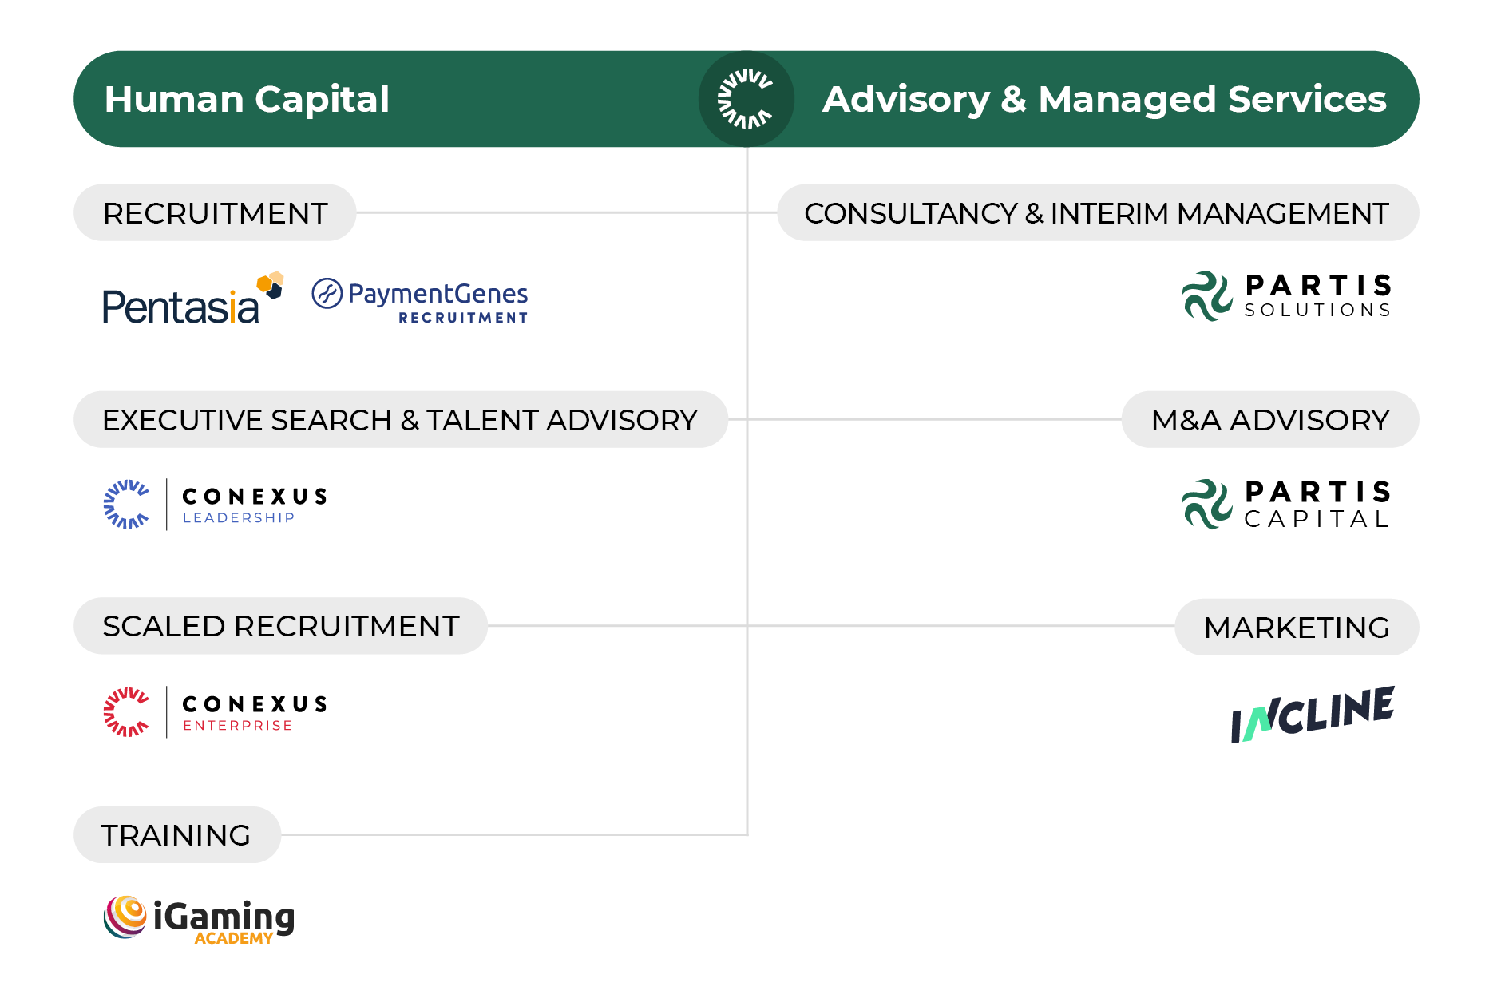
PARTIS BACKGROUND
Partis was founded in 2013 by Rob Dowling and Gideon Bierer to provide specialised and scaled advisory services to the iGaming industry globally.
Partis is part of The Conexus Group, a portfolio of professional services firms providing industry-leading Human Capital and Advisory & Managed Services solutions to the iGaming and Payments industries.

