Slide 1

Changes in motor functions in children with cerebral palsy after the course of Intensive Neurophysiological Rehabilitation: a single-blind study.
International Rehabilitation Clinic
Ternopil National Medical University
Notes:
Сегодня вашему вниманию я хочу представить

Slide 2

Published in International Neurological Journal, 2019, 5 (107)
DOI: 10.22141/2224-0713.5.107.2019.176700

Slide 3
Aim of the study
to assess changes in gross motor functions, muscle spasticity and passive range of motion (PROM) in children with spastic forms of Cerebral Palsy (CP) after the two-week INRS treatment course

Slide 4
Patients
Inclusion criteria:
Spastic bilateral cerebral palsy
Age 4-12 years
GMFCS II-IV levels
Exclusion criteria:
Severe epileptic syndrome
Ongoing antispastic medication intake
Inability to understand and comply with instructions

Slide 5
Demographic characteristics
(n=57)
Parameter | N (%)
Gender Male Female | 33 (58%) 24 (43%)
Age (years): Average ± SD | 7,1 ± 2,2
GMFCS Level II Level III Level IV | 19 (33%) 26 (46%) 12 (21%)
MACS Level I Level II Level III Level IV | 5 (9%) 28 (49%) 17 (30%) 7 (12%)

Slide 6
Pre - post single blinded study
Patients were evaluated before and after two-weeks treatment course
Performance of gross motor functions was recorded on video
Video was assessed independently by two blinded reviewers, not knowing which (pre or post) video they were rating

Slide 7

Outcome measures
Notes:
Чтобы оценить изменения исследуемых параметров, мы применили следующие методы

Slide 8
Gross Motor Function Measure
The GMFM-66 is a valid and reliable tool consisting of 66 activities that range in difficulty from lying and reaching for a toy to walking, running, and jumping.
Individual item scores are converted into the total score with the dedicated software Gross Motor Ability Estimator

Slide 9
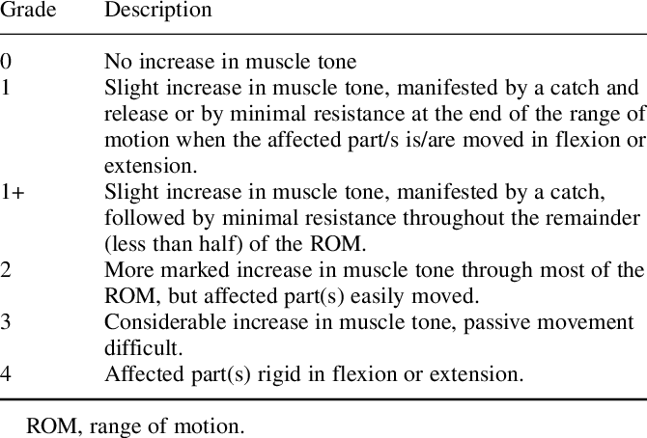
Spasticity measurement
(Modified Ashworth scale)
Hip Flexion
Hip Adduction
Knee Flexion
Knee Extension
Foot dorsiflexion

Slide 10
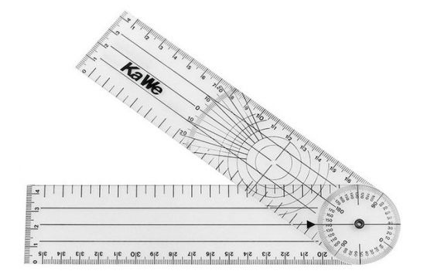
Passive range of motion
Measurement of Hip, Knee and Foot passive range of motion using handheld Goniometer

Slide 11
Results

Slide 12
GMFM scores at baseline and post intervention
Group of participants | Number of cases | Baseline Mean (SD) | Post intervention Mean (SD) | Difference Mean (SD)
GMFM score whole group | 57 | 58.8 (11.6) | 60.2 (11.4) | 1.4 (2.9) *
--’’-- GMFCS Level II | 19 | 71.3 (8.3) | 72.9 (7.3) | 1.7 (3.1) *
--’’-- GMFCS Level III | 26 | 55.7 (5.7) | 56.4 (5.8) | 0.7 (2.9)
--’’-- GMFCS Level IV | 12 | 46.1 (5.1) | 48.4 (5.0) | 2.3 (2.8) *
--’’-- age 4-6 years | 26 | 57.9 (11.9) | 59.4 (11.7) | 1.4 (3.0)
--’’-- age 7-9 years | 21 | 56.5 (9.7) | 58.5 (9.9) | 2.0 (2.4) *
--’’-- age 10-12 years | 10 | 66.2 (12.7) | 66.0 (12.5) | - 0.2 (3.7)

Slide 13
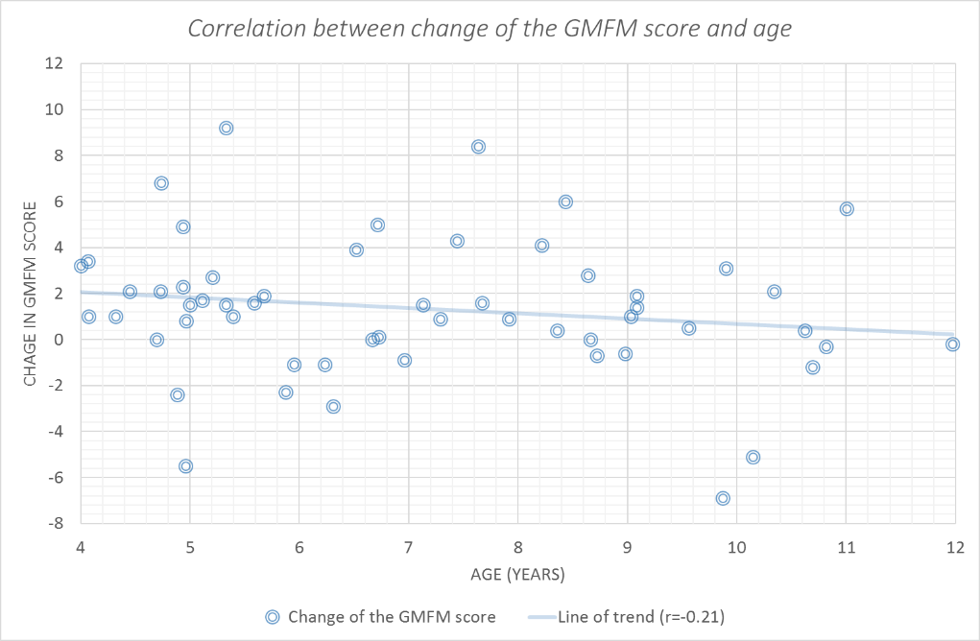
Correlation between change of the GMFM score and age

Slide 14
Passive range of motion
Measured Joint | Baseline Mean (SD) | Post intervention Mean (SD) | Pre-post difference Mean (SD)
Hip abduction | 30 (9,6) | 38 (10.4) | 8 (5.8) *
Hip flexion | 117 (9.6) | 121 (7.2) | 4 (5.0)
Hip extension | -3 (6.4) | 2 (7.0) | 5 (6.8)
Knee popliteal angle | 49 (18.5) | 42 (17.5) | -7 (7.7) *
Knee extension | -4 (6.6) | -2 (5.4) | 2 (3.5)
Foot dorsiflexion with flexed knee | 3 (6.0) | 10 (7.7) | 7 (6.1) *
Foot dorsiflexion with extended knee | -9 (7.2) | -1 (6.9) | 8 (6.1) *

Slide 15
Muscle spasticity
Muscles groups | Baseline |  |  | Post intervention |  |  | Pre-post difference
 | Median | IQR | Mean | Median | IQR | Mean | 95% CI | Mean | Sign (P)
Hip Flexion | 2 | 1.5-3 | 2.18 | 2 | 1-3 | 1.93 | 0.06- 0.44 | 0,25 | 0.01 *
Hip Adduction | 3 | 2-3 | 2.70 | 3 | 2-3 | 2.44 | 0.08-0.51 | 0,30 | 0.02 *
Knee Flexion | 3 | 2-3 | 2.41 | 2 | 2-3 | 2.25 | -0.01 -0.34 | 0,16 | 0.07
Knee Extension | 2 | 1-2 | 1.74 | 2 | 1-2 | 1.62 | -0.07 – 0.30 | 0.11 | 0.24
Foot dorsiflexion | 3 | 2-3 | 2.82 | 3 | 2-3 | 2.66 | -0.04 – 0.36 | 0.16 | 0.10
* Statistically significant difference (p<0.05) calculated using Wilcoxon signed rank test for related samples

Slide 16
Conclusion
Improvements of gross motor functions, increase in PROM and reduction of muscle spasticity in lower extremities were noted in children with CP after the two-week intensive multimodal INRS treatment course.
More detailed investigation of the INRS treatment requires further studies, including double-blinded randomized controlled trials.

