Slide 1
Changes of Motor Development in Children With Cerebral Palsy Undergoing Rehabilitation According to the Professor Kozyavkin Method: A Retrospective Study
Kozyavkin V., Lysovych V.,
Kushnir A., Kachmar O., Matiushenko О.
International Clinic of Rehabilitaiton
(Truskavets, Ukraine)

Slide 2
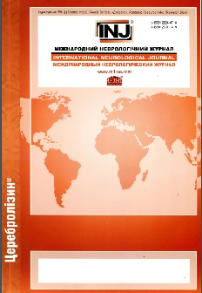
The results were published in the International Neurological Journal in 2018
International Neurological Journal.- 3 (97).- p.14-22

Slide 3
Aim of the Study
This study assessed changes of the key developmental parameters in children with CP during the Intensive Neurophysiological Rehabilitation course by retrospective analysis of medical records.

Slide 4
Study Design
Baseline examination
4,309 participants,
12,785 courses
Rehabilitation
Excluded:
- Not cerebral palsy
- Insufficient data
9,462 courses
Second examination

Slide 5
Medical Information System
Collects, stores, and manages medical data
Automates routine tasks
Optimizes work processes
Operates in four languages
Allows scientific analysis

Slide 6
Electronic Patient Card
Faster data entry
Optimal algorithm of examination
Monitoring of changes in the patient’s condition

Slide 7
Patient Distribution by Age
and Diagnosis

Slide 8
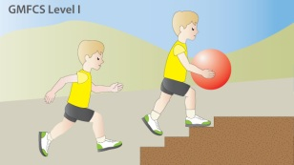
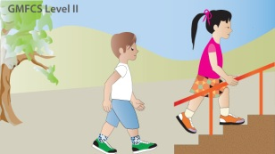
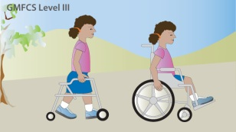
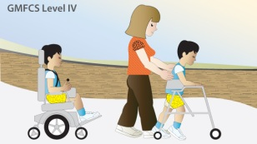
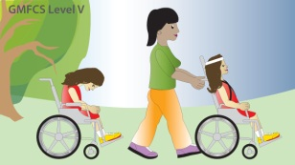
Patient Distribution by Motor Development (GMFCS)
GMFCS Level | Description |  | Participants
Level I | Can walk, climb stairs, run, and jump, but speed, balance, and coordination are limited. |  | 13 %
Level II | Can walk in most settings and climb stairs holding onto a railing. |  | 28 %
Level III | Can walk a hand-held mobility device in most indoor settings. |  | 26 %
Level IV | Can use devices that require assistance or powered mobility in most settings. |  | 21 %
Level V | Are transported in a manual wheelchair in all settings. |  | 12 %
Illustrations - www.cerebralpalsy.org.au

Slide 9
Methods

Slide 10
Electronic patient card extracts
Studied Parameters | Description
Muscle tone | Measured by medical doctor according to the modified Ashworth scale (MAS)
Range of Active and Passive Motion | Goniometric measurements of the shoulder, elbow, wrist, hip, knee, and ankle joints
Gross motor functions | Video recording of the head control, crawling, sitting, standing, walking
Hand function | How the manual ability has changed
Speech and emotional state | Changes of speech, quality of sleep, mood
Autonomic NS functions | Changes of salivation, perspiration, body temperature

Slide 11
Results

Slide 12
Change of the Muscle Tone in
Patients With Spastic Cerebral Palsy

Slide 13
Changes of the Active and Passive Range of Motion in Spastic Cerebral Palsy

Slide 14
Development of Gross Motor Functions in Patients With CP

Slide 15
Development of Other Functions in
Patients With Cerebral Palsy

Slide 16
Conclusions
The study describes changes in motor function in children with cerebral palsy who underwent rehabilitation according to the Professor Kozyavkin Method.
Promising findings encourage further research of the rehabilitation system, particularly randomized controlled trials.
Notes:
Efficacy of spinal manipulation and mobilization for low back pain and neck pain: a systematic review and best evidence synthesis
Bronfort, Gert et al.
The Spine Journal , Volume 4 , Issue 3 , 335 - 356

