Slide 1


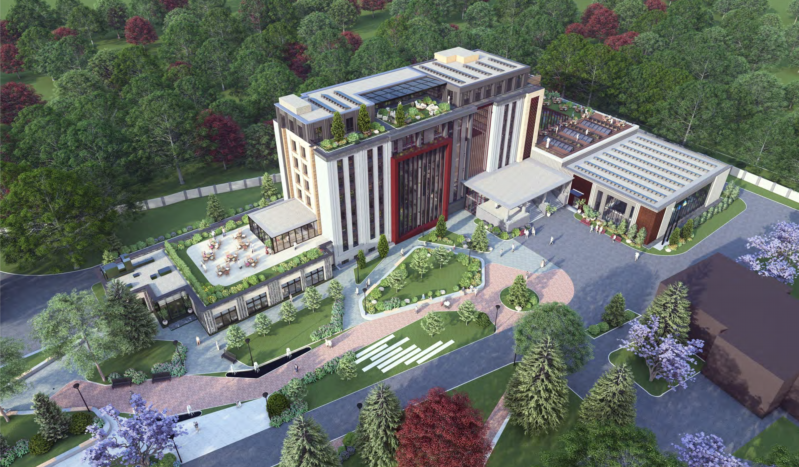
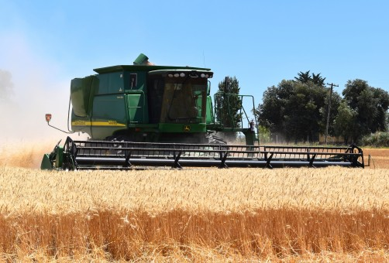
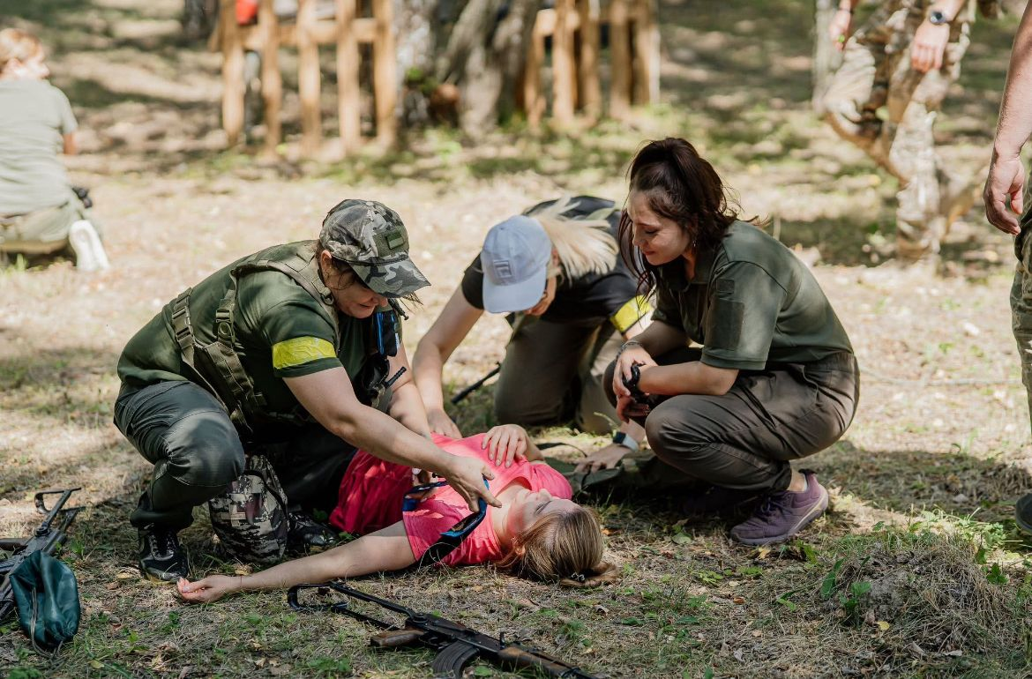
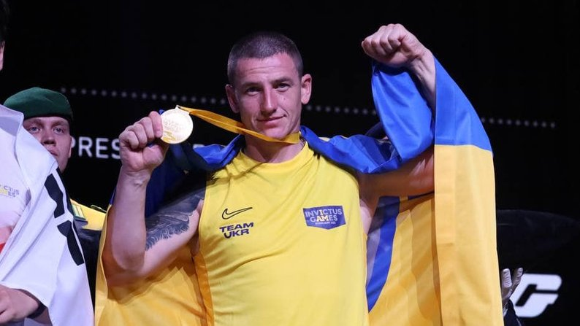
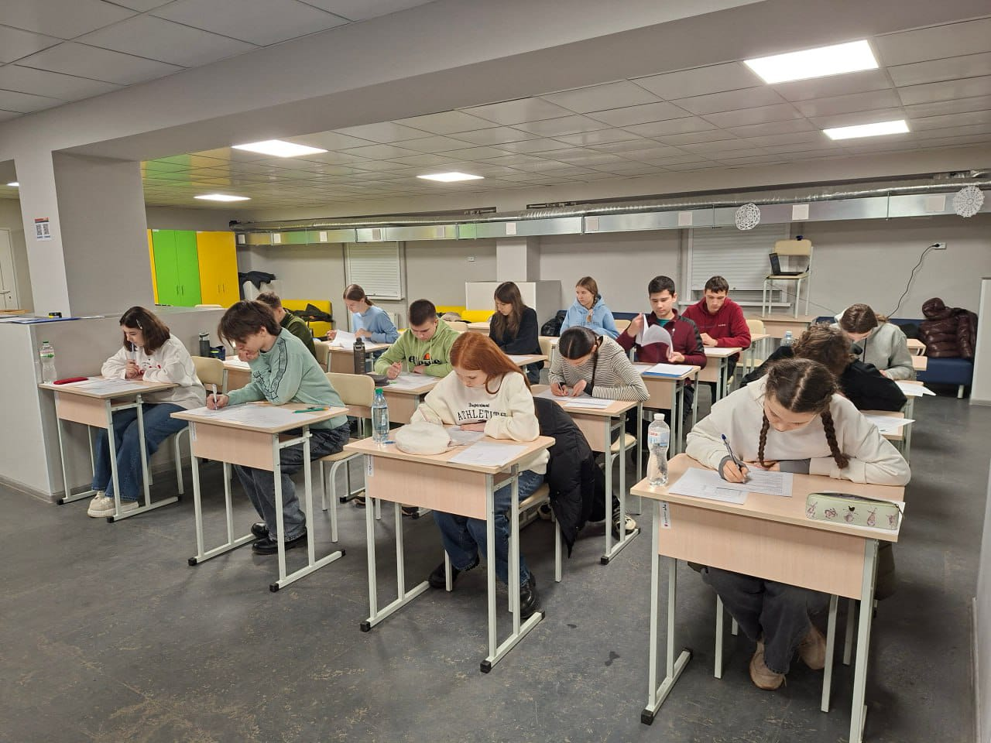
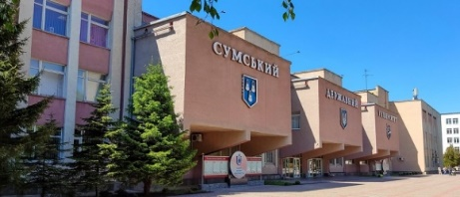
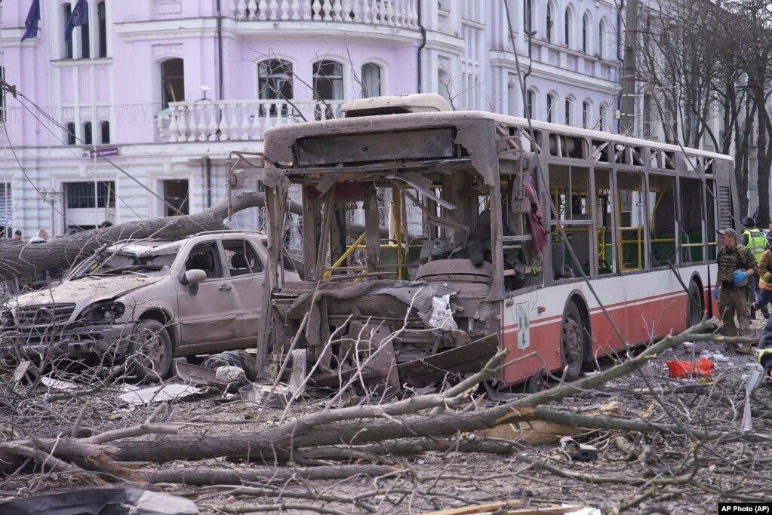
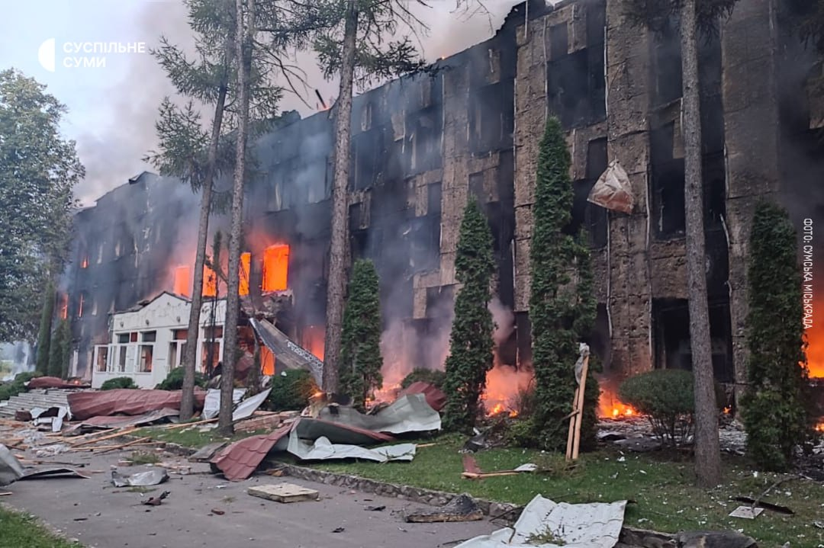
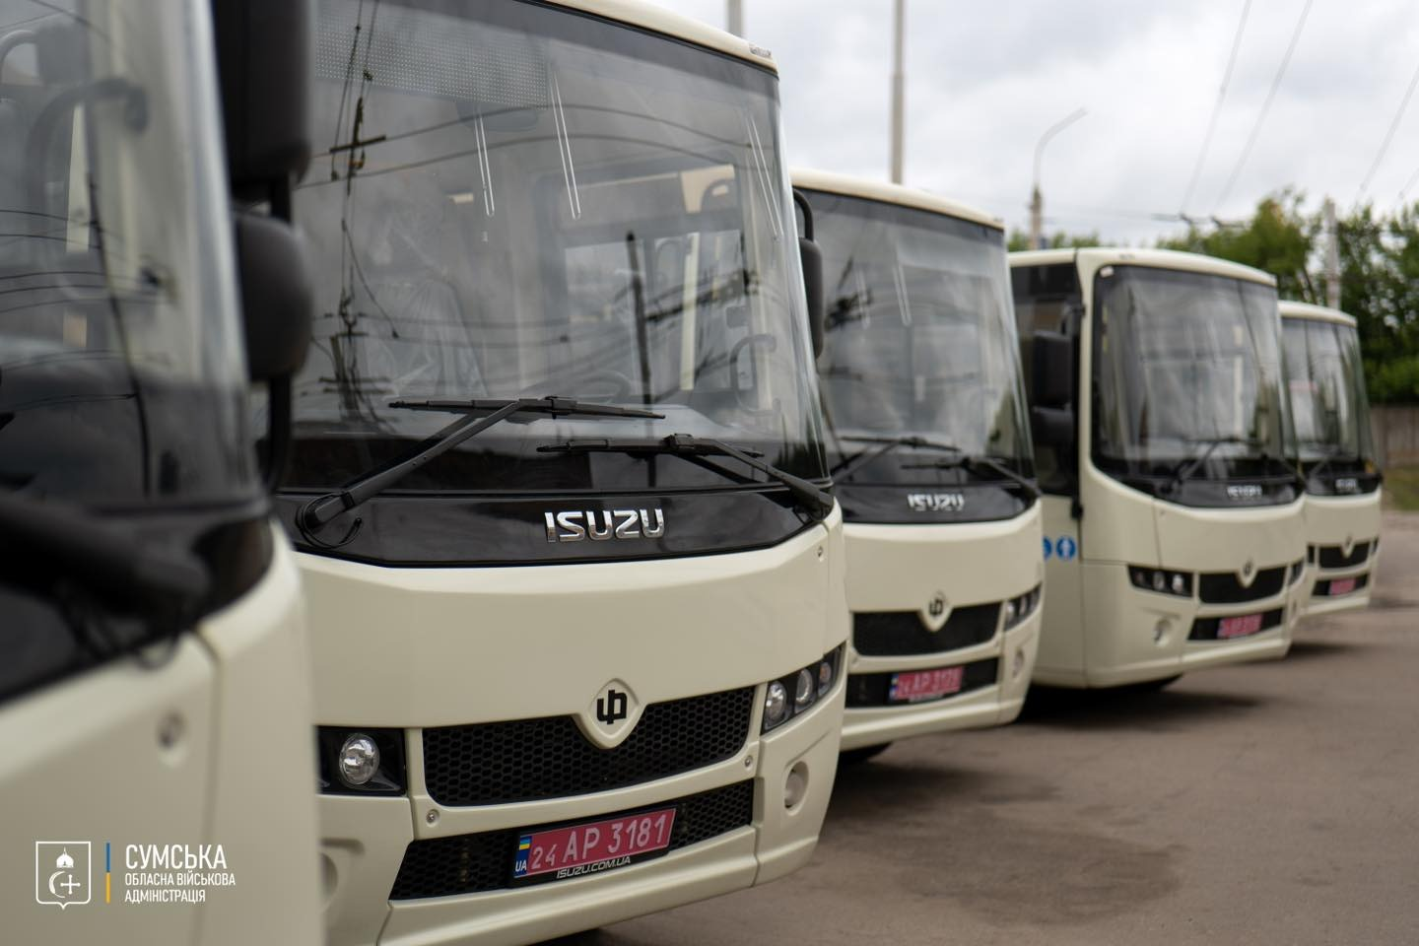
SUMY REGION:
A PATH OF RESILIENCE, INNOVATION, AND PARTNERSHIP

Slide 2
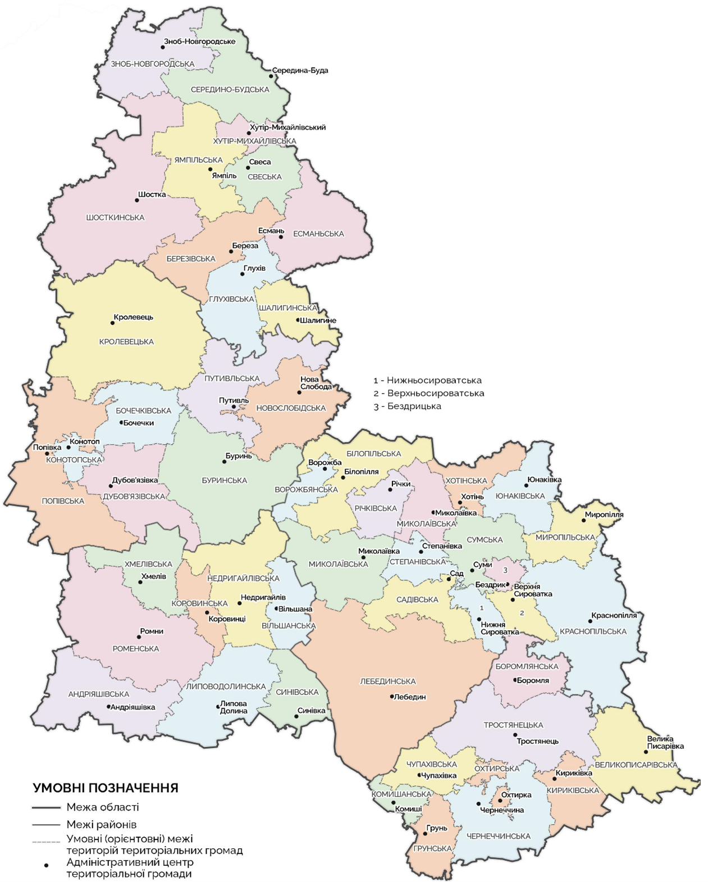

ABOUT SUMY REGION
51 communities
Our Partners:
Abruzzo Region, Italy
Murcia Region, Spain
Lubusz Voivodeship, Poland
Muğla Province, Turkey
Telšiai County, Lithuania
Partnerships are being established with:
France
Norway
United Kingdom
Netherlands
TERRITORY
23.8 THOUSAND SQ. KM
POPULATION
As of January 1, 2022 | As of December 1, 2025
1,035.8 thousand people | 978.2 thousand people

Slide 3
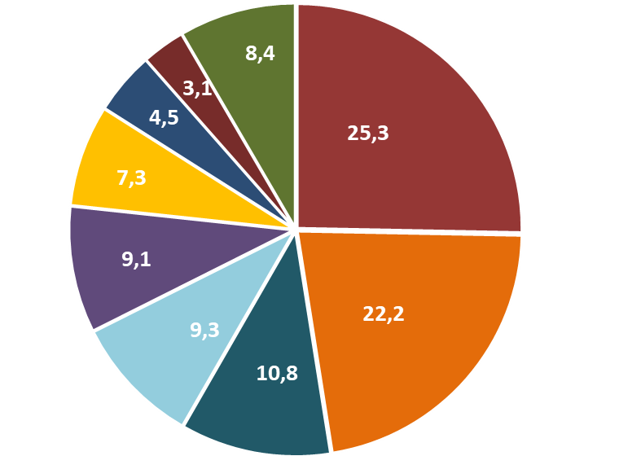











SUMY REGION: ECONOMIC SITUATION
OPERATING ENTERPRISES
SECTORAL STRUCTURE OF GROSS VALUE ADDED, %
 | 2021 | 2022 | 2024
TOTAL | 6132 | 4916 | 4991
large | 10 | 6 | 12
medium and small | 6122 | 4910 | 4889
Agriculture
Industry
Public administration and
defense, insurance
Education, healthcare
Trade; repair of motor vehicles
Real estate transactions
Transportation, warehousing
Information and telecommunications
Other
As of 2021
992
NUMBER OF INDUSTRIAL ENTERPRISES
As of 2024
796
INVESTMENT PRIORITIES
mechanical engineering
light industry

Slide 4
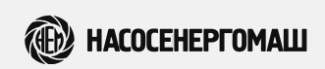
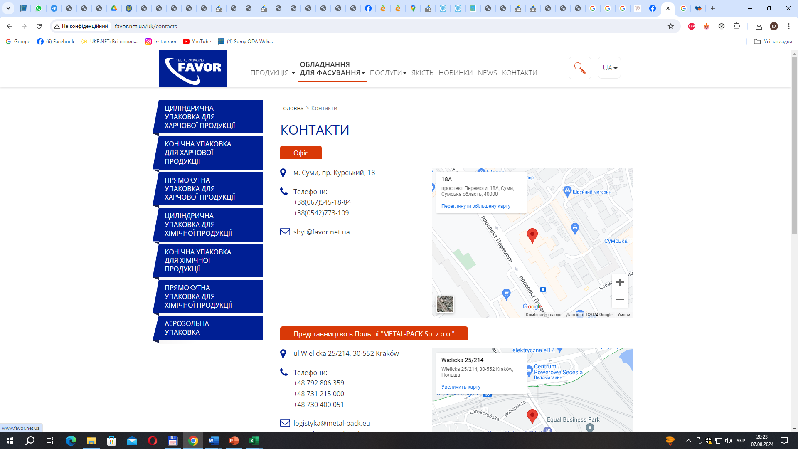


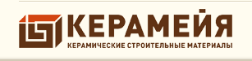
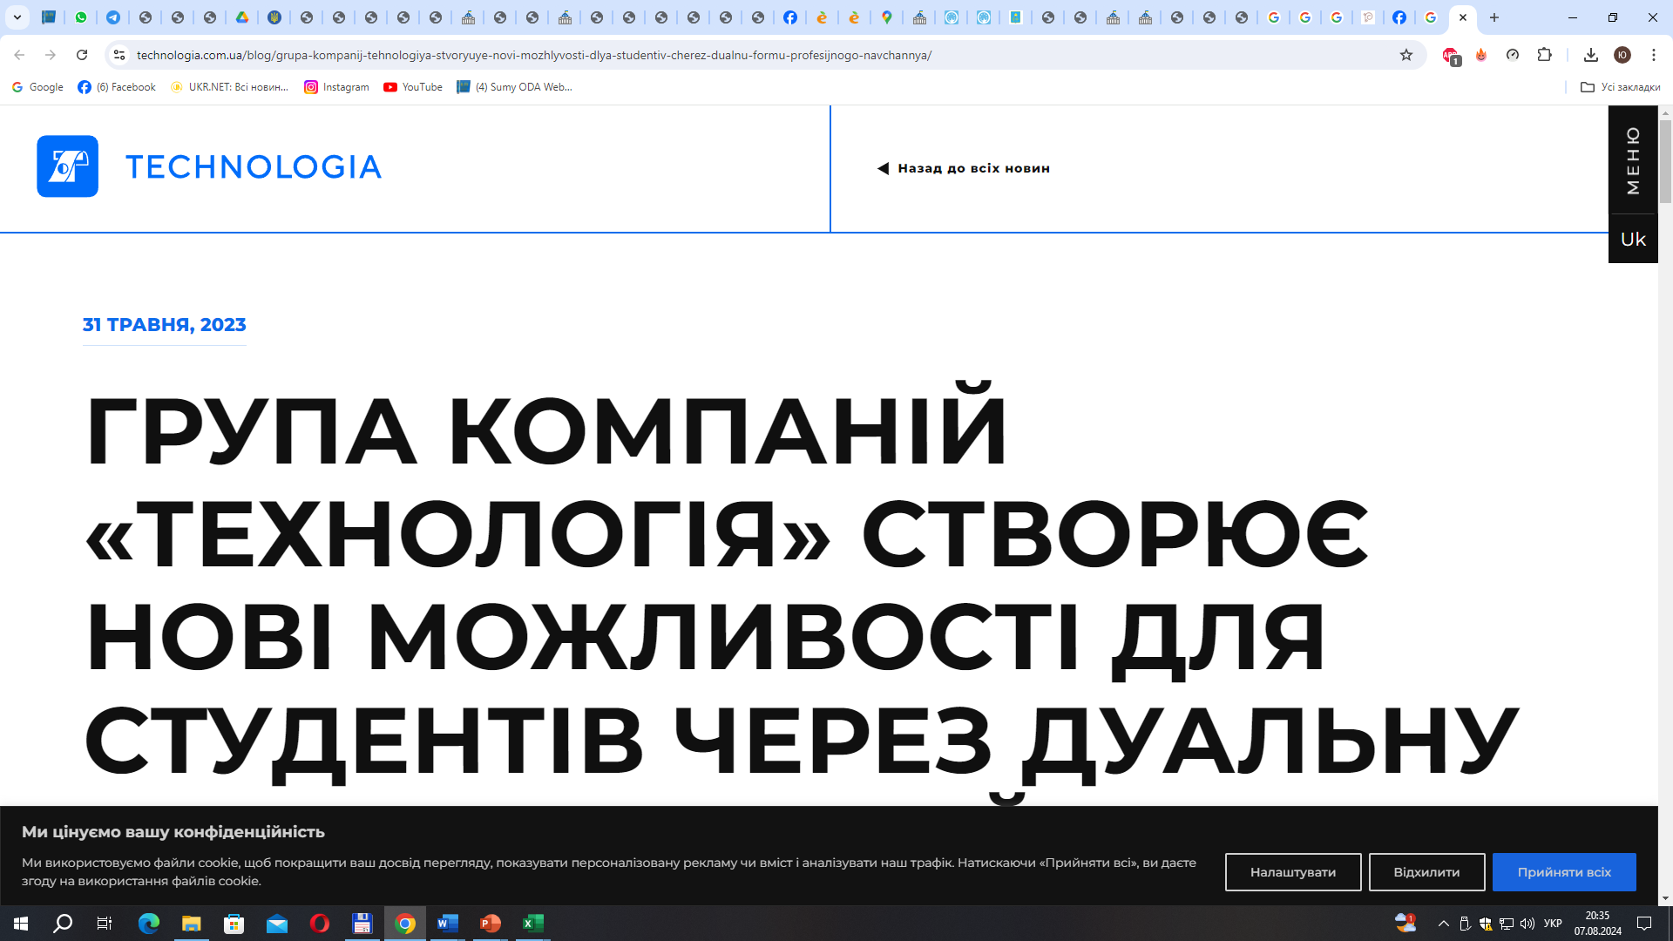
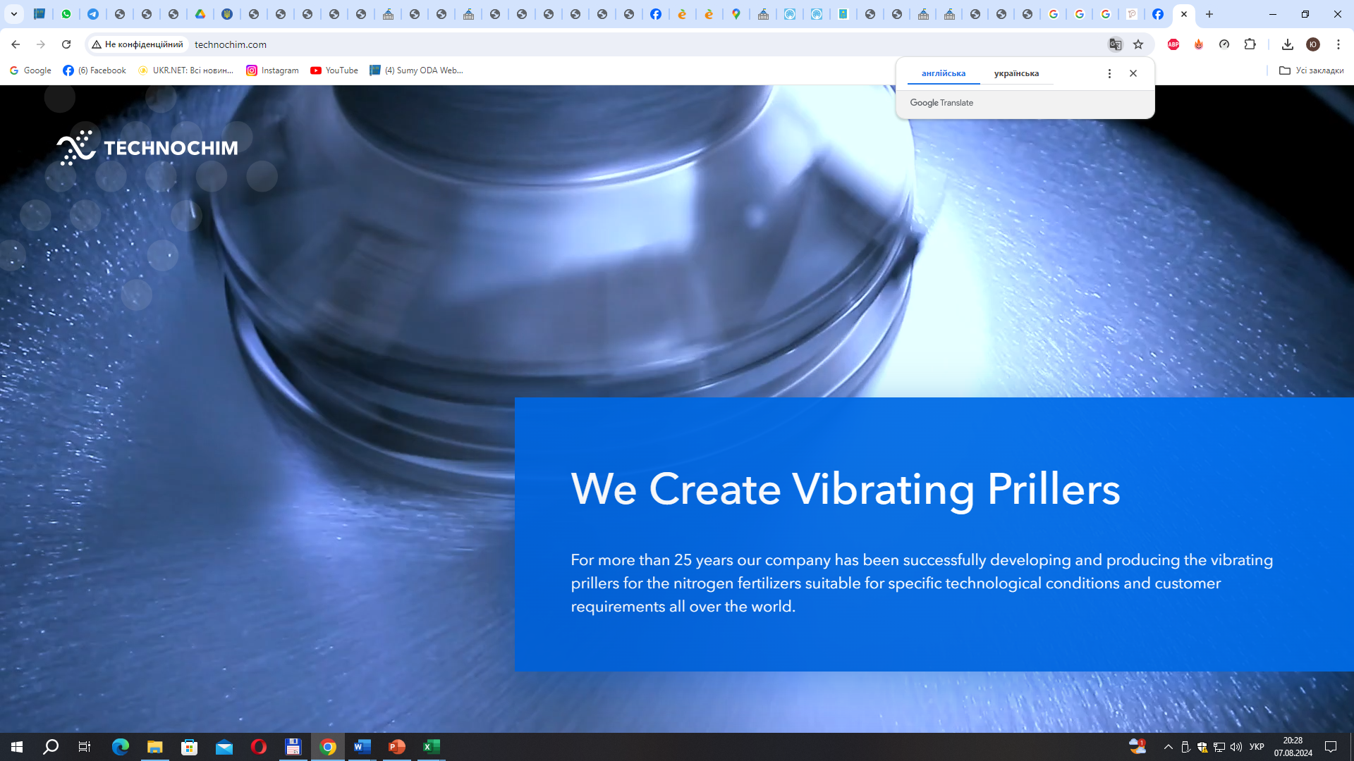

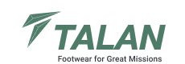
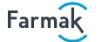
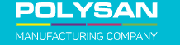
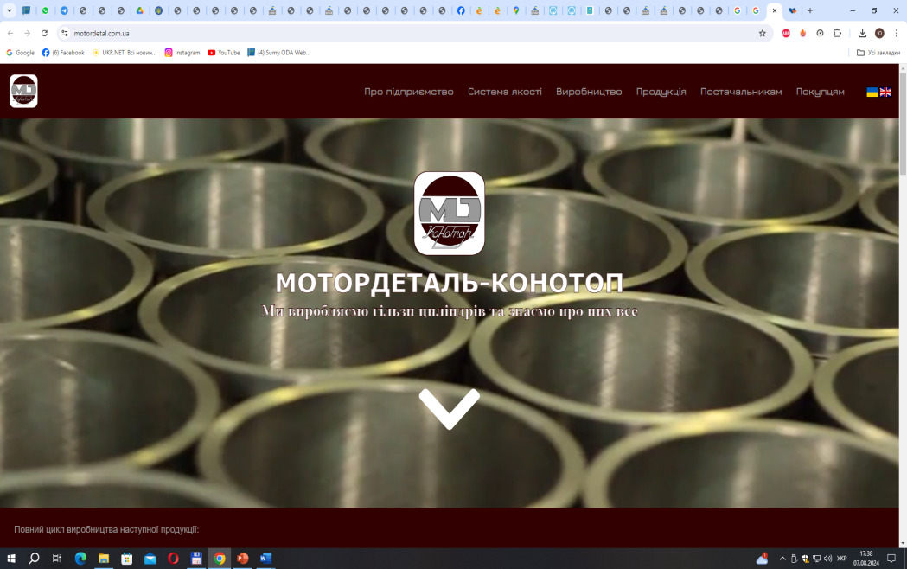
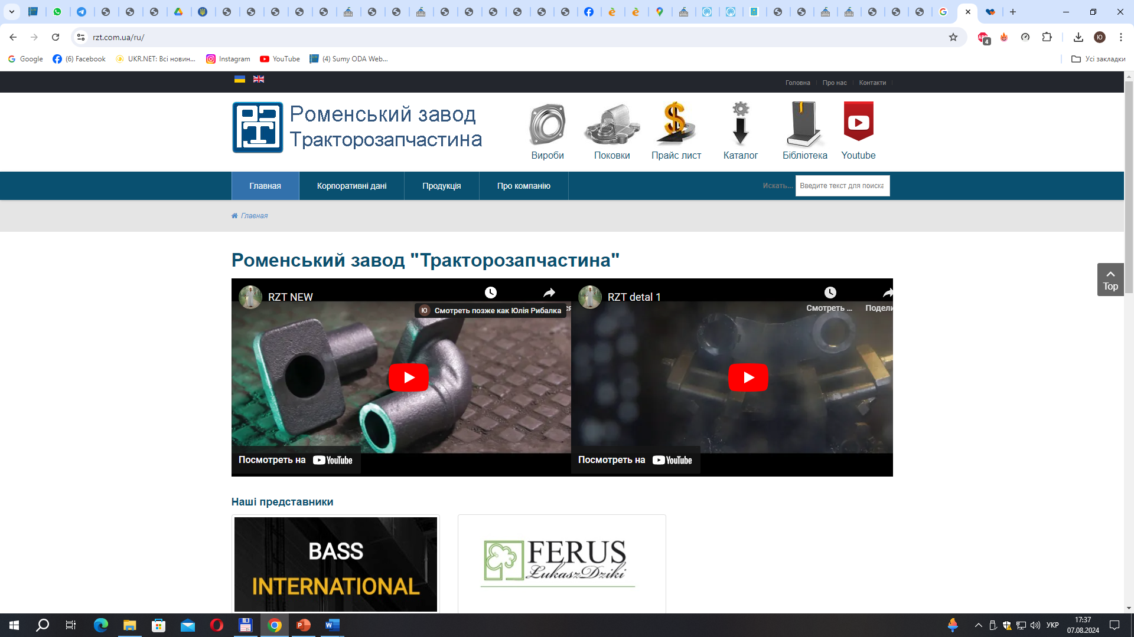
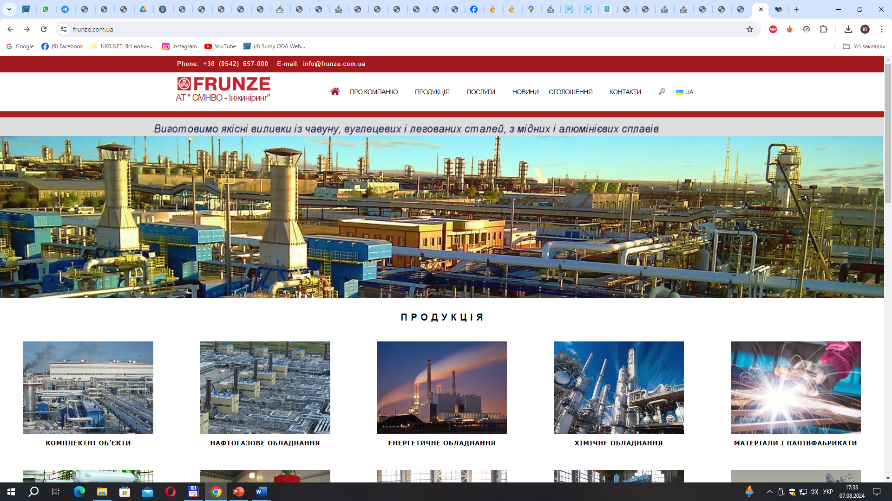


COOPERATION PRIORITIES: INDUSTRY
Сумський машинобудівний кластер енергетичного обладнання
Cluster-based activities:
Business
Science
Import substitution
Modernization
Exports
Human resources
R&D
Technologies
Prospects for cooperation:
CLUSTER
Establishment of innovation hubs to support startups
Government
Implementation of cooperation agreements
Strategy
Infrastructure
Support
Development of high-tech sectors, including IT

Slide 5







AGRICULTURE
STRUCTURE OF AGRICULTURAL PRODUCTION
Agricultural land
PROMISING DEVELOPMENT AREA:
HEMP CULTIVATION
1.7 million ha
2nd
place
in Ukraine by cultivated area
Arable land
1.2 million ha
474
hectares, 16% of Ukraine’s total
183.5 thousand ha not cultivated
CROP PRODUCTION
MAIN PRODUCT CATEGORIES
Grain and leguminous crops:
Potatoes:
Oil crops:
54%
4%
37%
Rapeseed:
Soybeans:
Sunflower:
4%
13%
20%

Slide 6

















COOPERATION PRIORITIES: AGRICULTURE
Prospects for implementing joint projects:
392
enterprises in the sector
USD 486 million
Cultivation of organic crops
export volume
Development of innovative methods for processing agricultural products
Establishment of an agricultural logistics center
Development of niche agricultural production

Slide 7
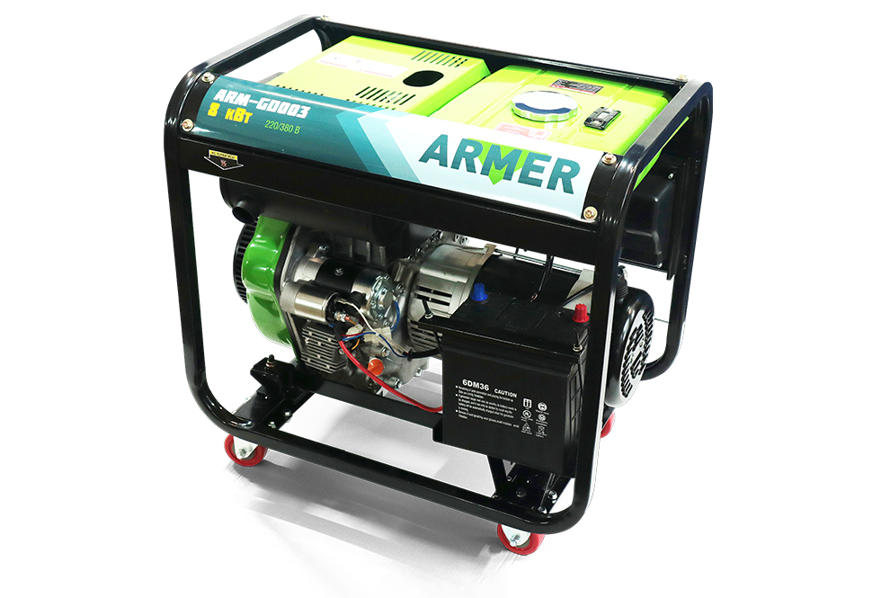
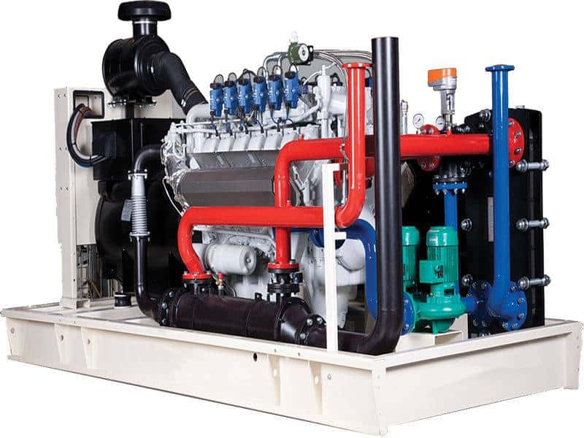
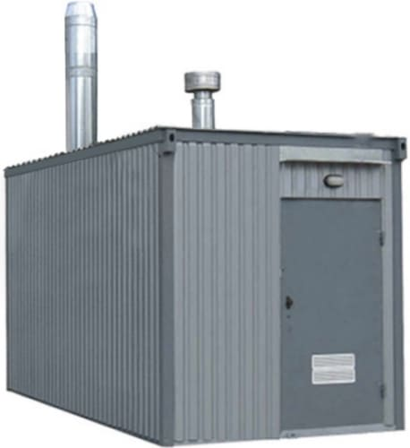

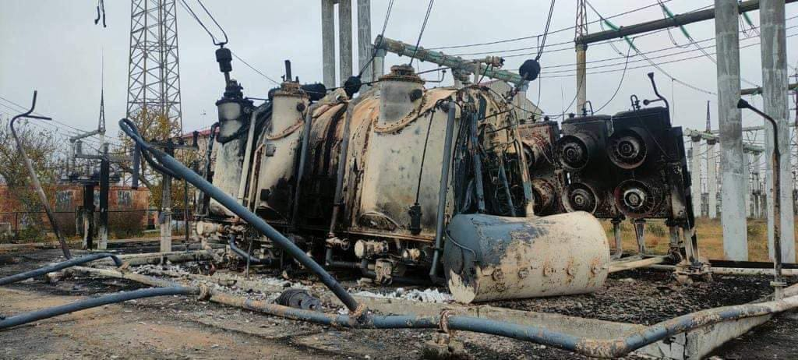
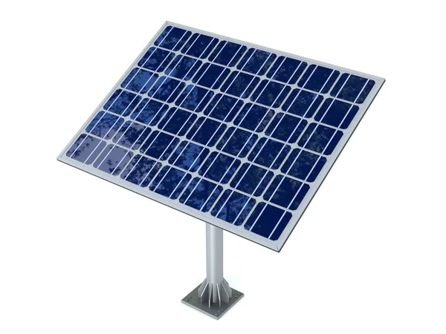
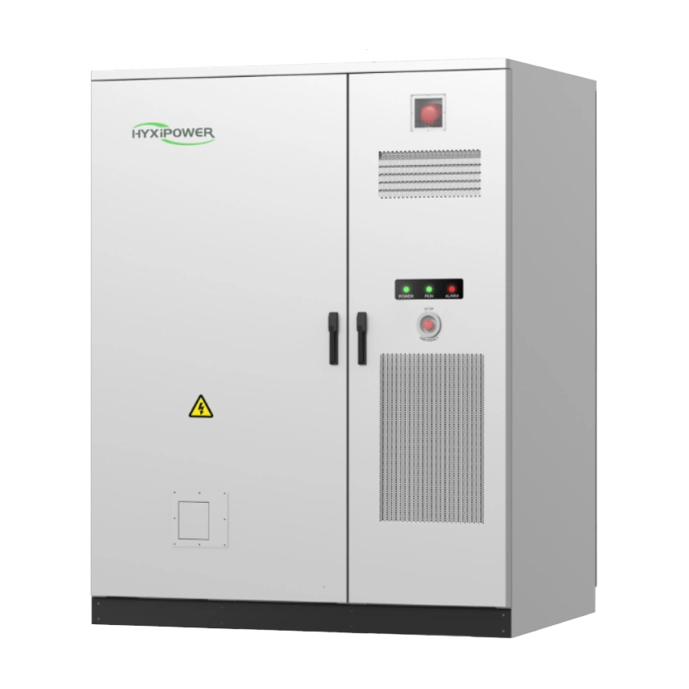





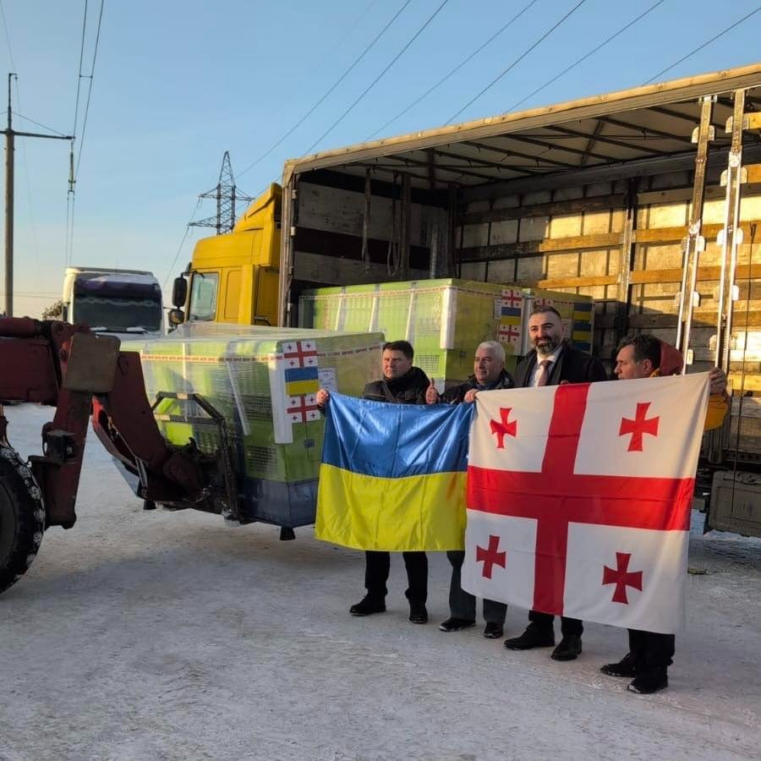
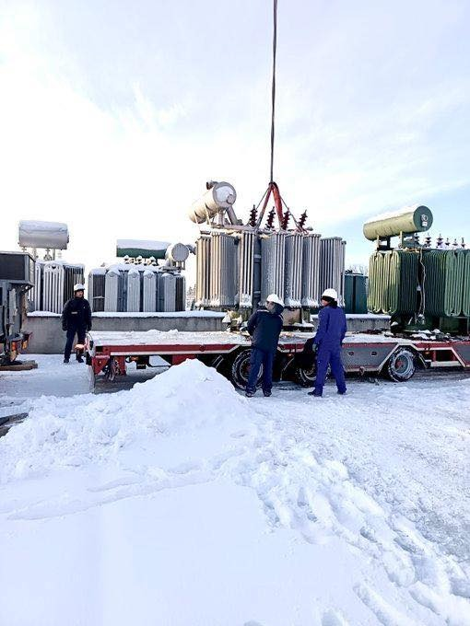
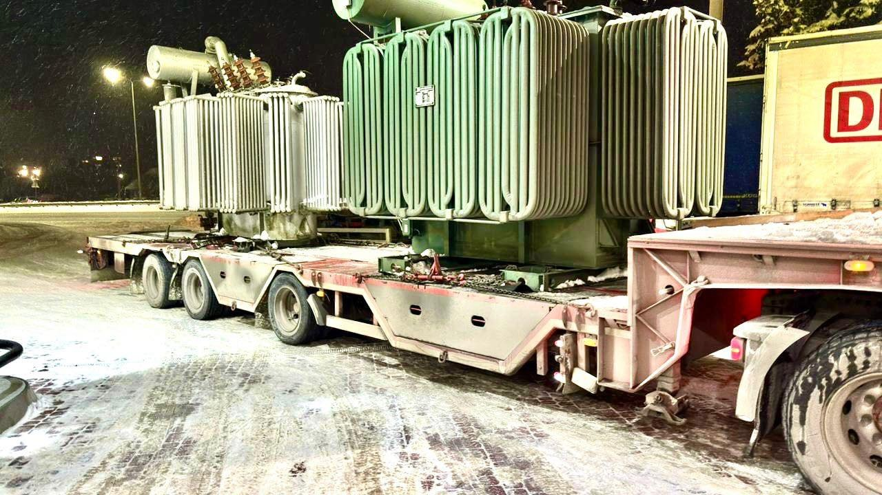
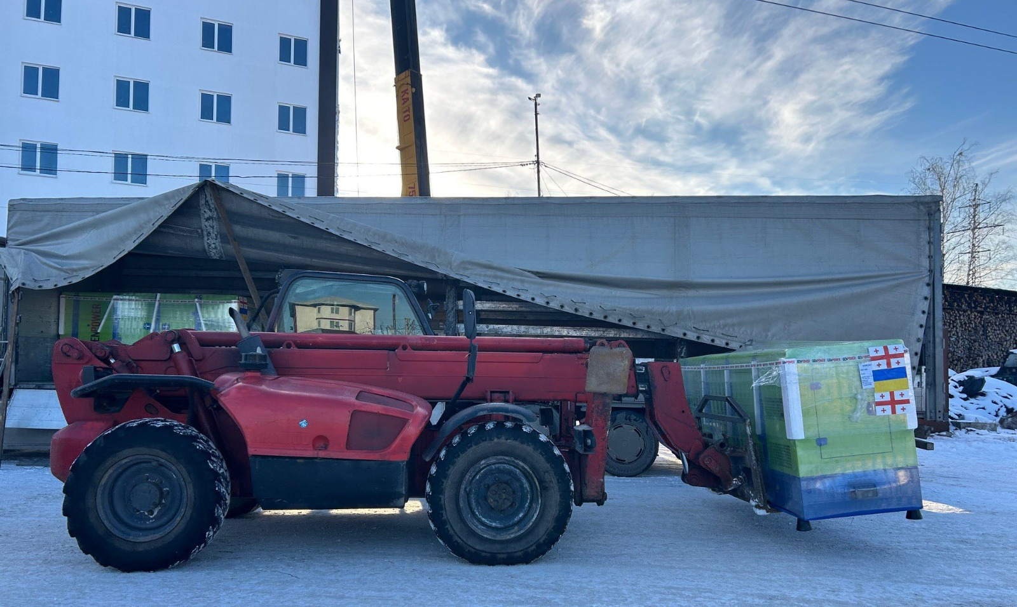
ENERGY SECTOR OF THE SUMY REGION
DAMAGED
INTERNATIONAL SUPPORT IN 2025:
DELIVERED IN JANUARY 2026:
over 2,000 power supply facilities
15 EcoFlow battery
stations
223 generators
23 CHP / 70.35 MW
30 MBH/ 19.1 MW
29 generators
41 solar power plants / 1.171 MW
49 energy storage systems / 0.435 MW
RESTORED
approximately 1,800 power supply facilities, some of which were damaged multiple times after restoration

Slide 8

COOPERATION PRIORITIES: ENERGY
Top 5 advantages of Sumy region:
1
Strong oil and gas complex in the region
2
Development of distributed generation, combining traditional and renewable energy sources
3
Potential for solar and wind power plant installations
4
Opportunities for hydroelectric development
5
Potential for bioenergy development due to abundant agricultural residues (straw, corn stalks, sunflower husks)
ENERGY POTENTIAL
Solar energy facilities |  | 1535
Hydropower facilities |  | 4

Slide 9

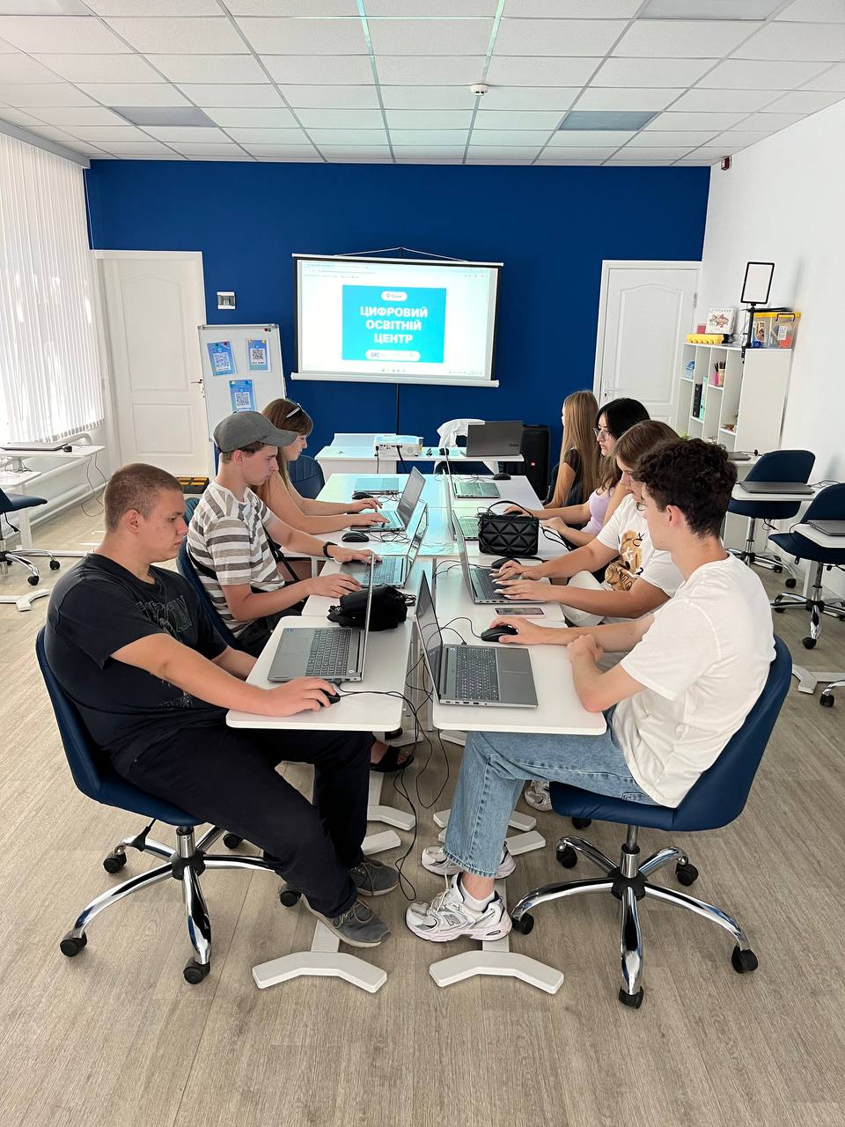
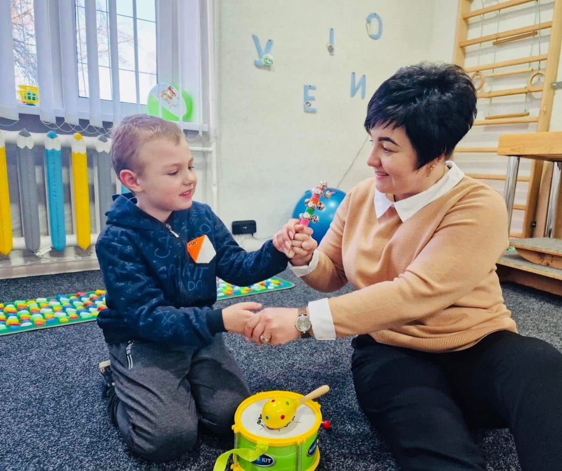
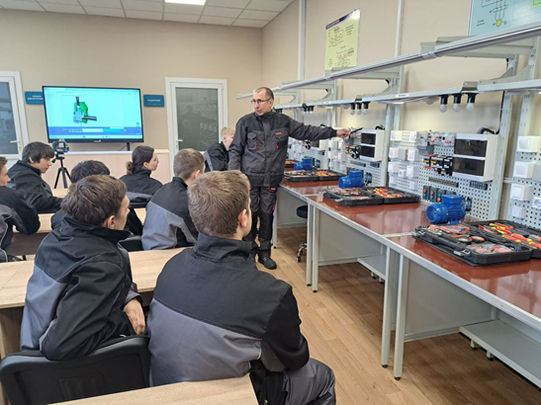
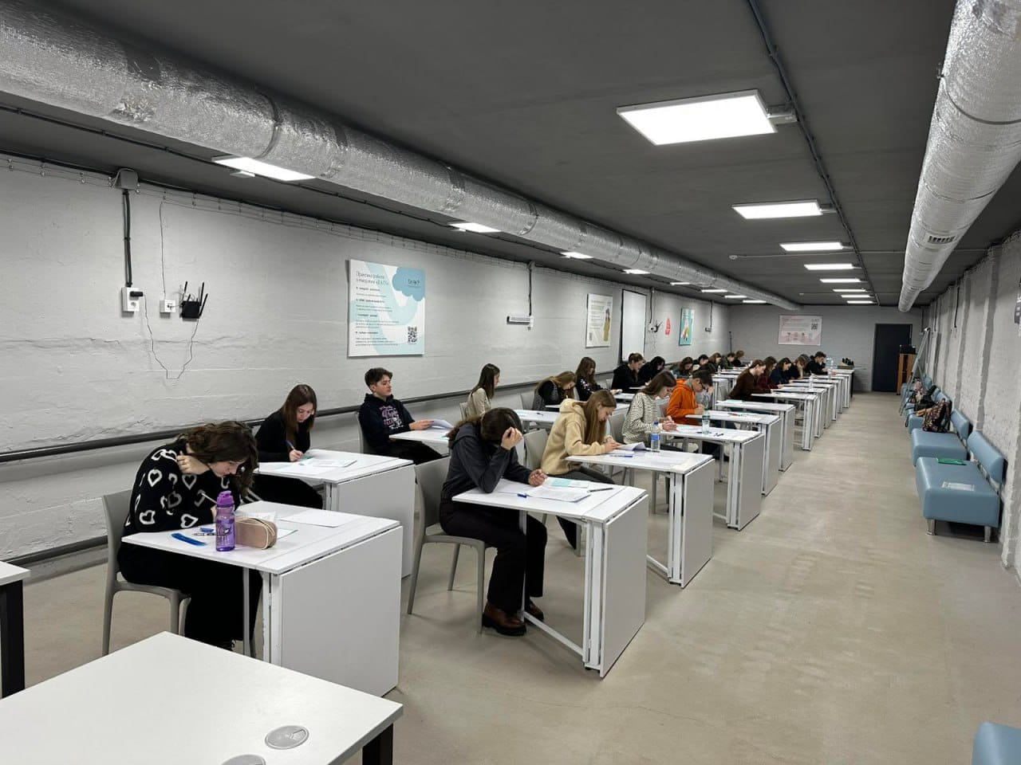
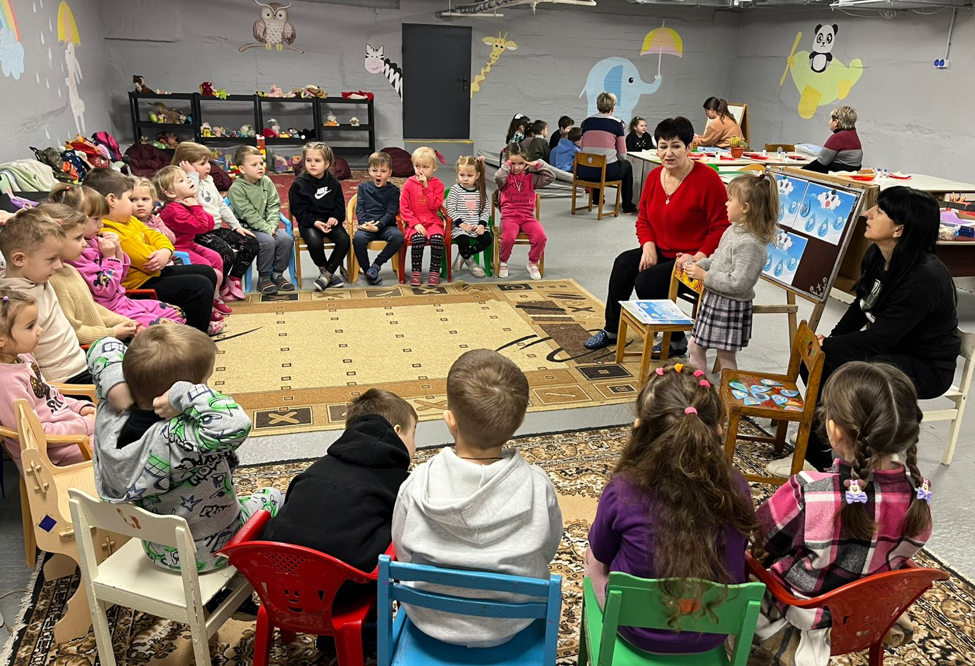
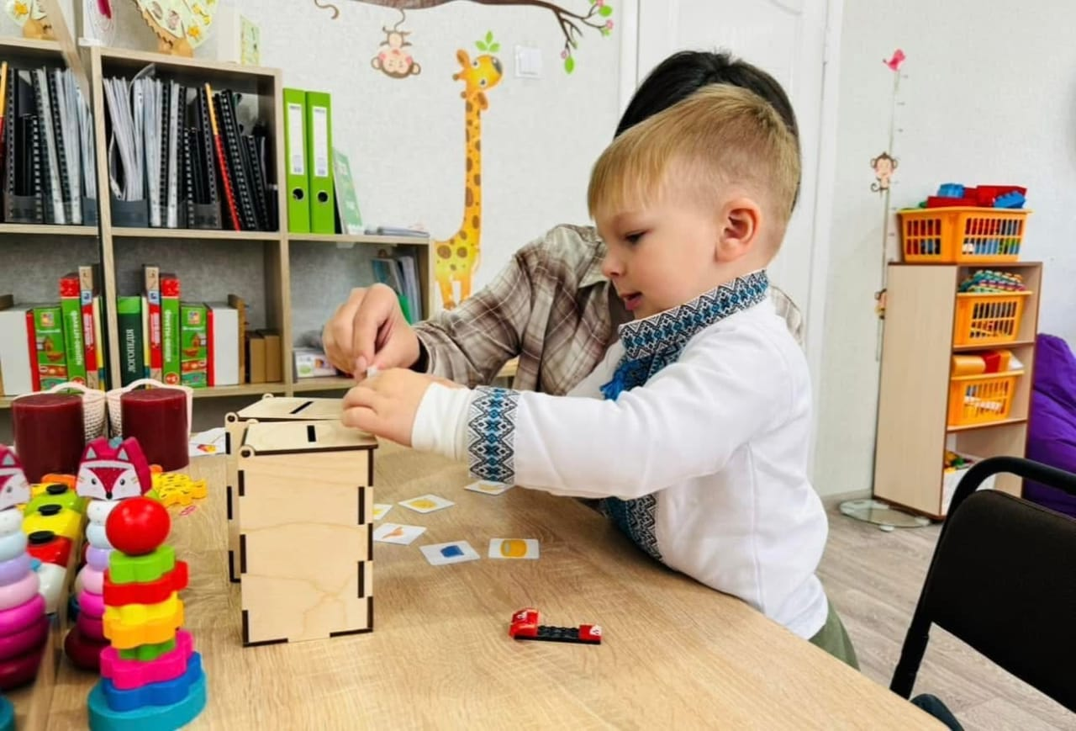
НЕЗЛАМНА ОСВІТА
Educational network of Sumy region
628
educational institutions
139 187
learners
6
higher education institutions
23
institutions of professional pre-higher education
24
vocational education institutions
PRESCHOOL EDUCATION- 204
GENERAL SECONDARY EDUCATION- 291
EXTRACURRICULAR EDUCATION - 80
Form of Education
INCLUSION
SUPPORT
OLYMPIADS
institutions
learners
6200
20
inclusive resource centers
91
educational centers for compensating learning losses and providing psychosocial support
students participating in the olympiad and tournament movement
Full-time learning
58
5 039
Distance learning
141
21 252
Hybrid learning
429
112 896
19
training and practical centers for vocational professions

Slide 10
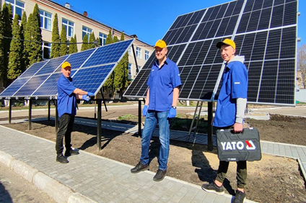
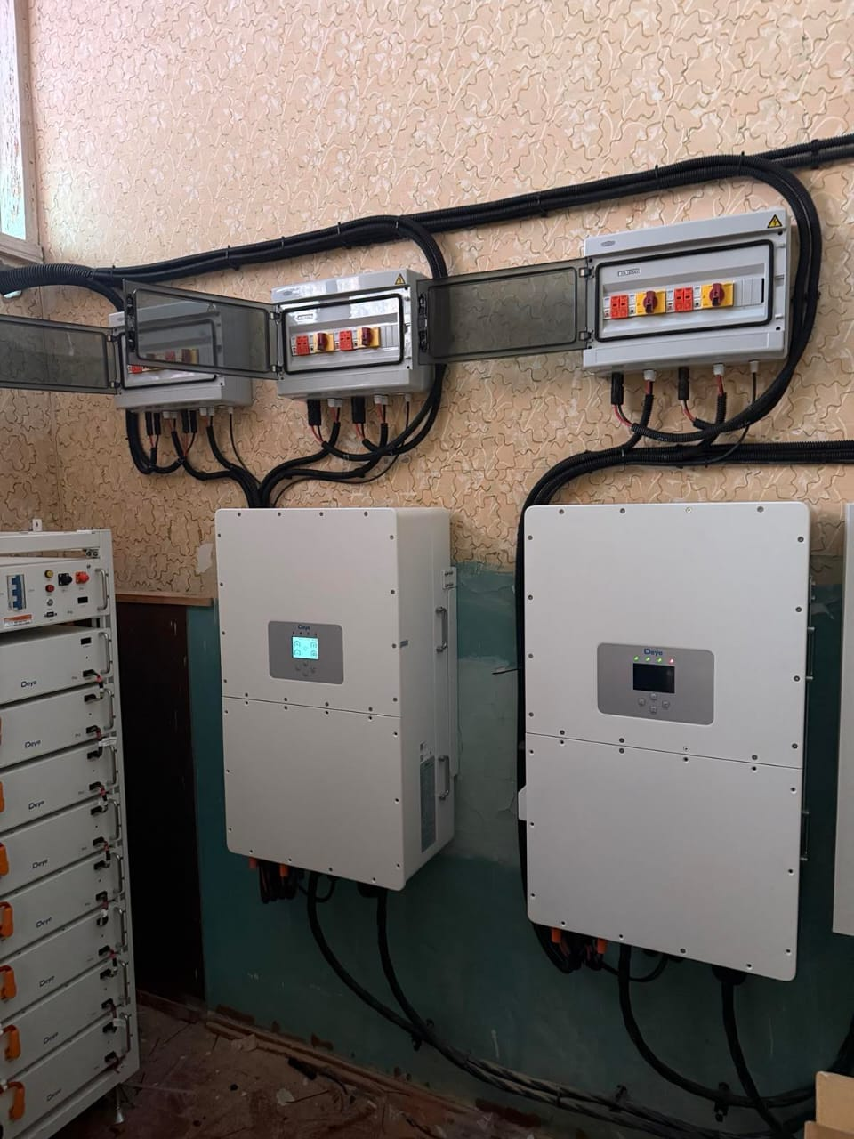
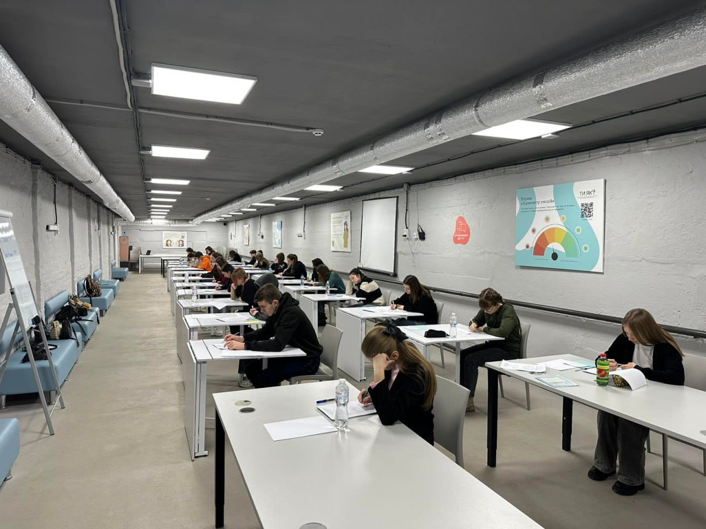
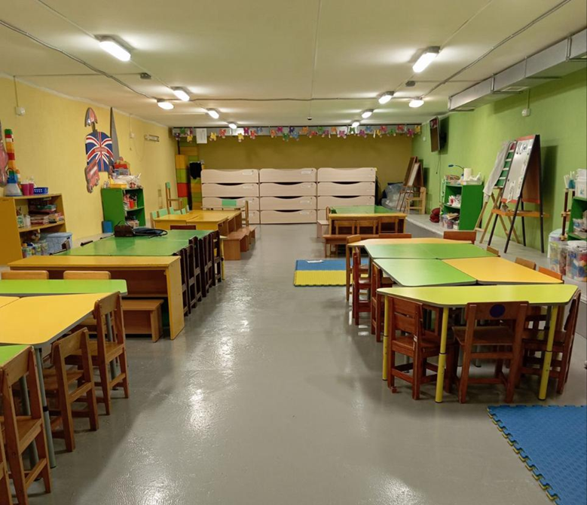
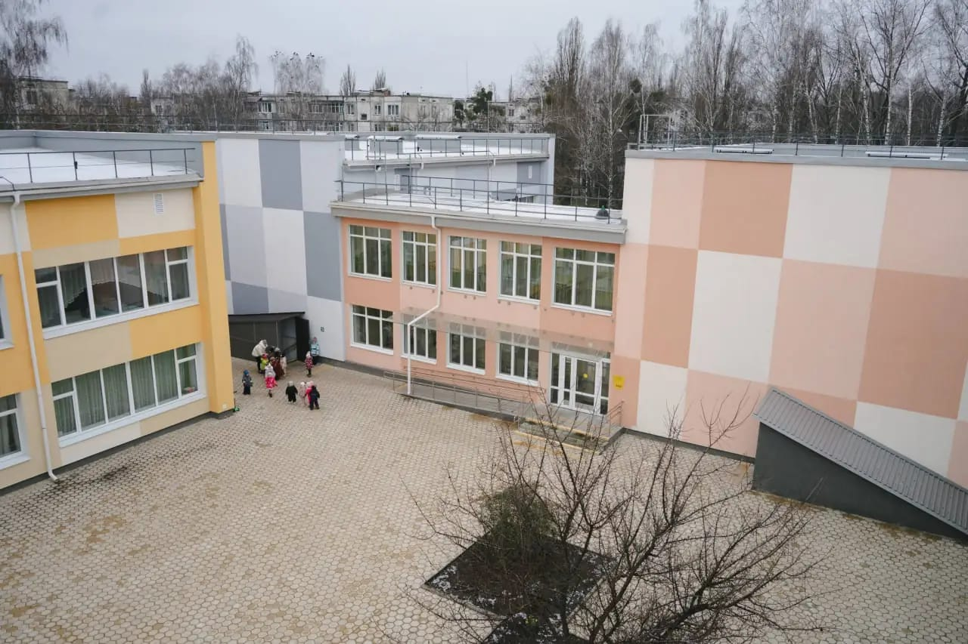
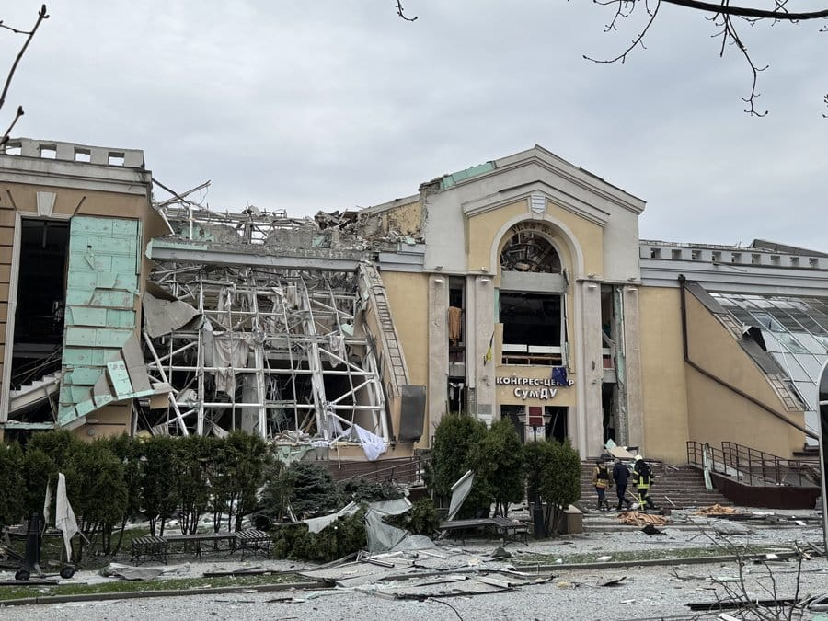
EDUCATION RESILIENCE
Safe and continuous educational process
15
433
solar power plants
educational institutions with shelters
energy independence of educational institutions
safe learning environment
100
8
14
restored educational institutions
underground schools
international memorandums
return to the educational process
learning even during threats
support and partnership

Slide 11




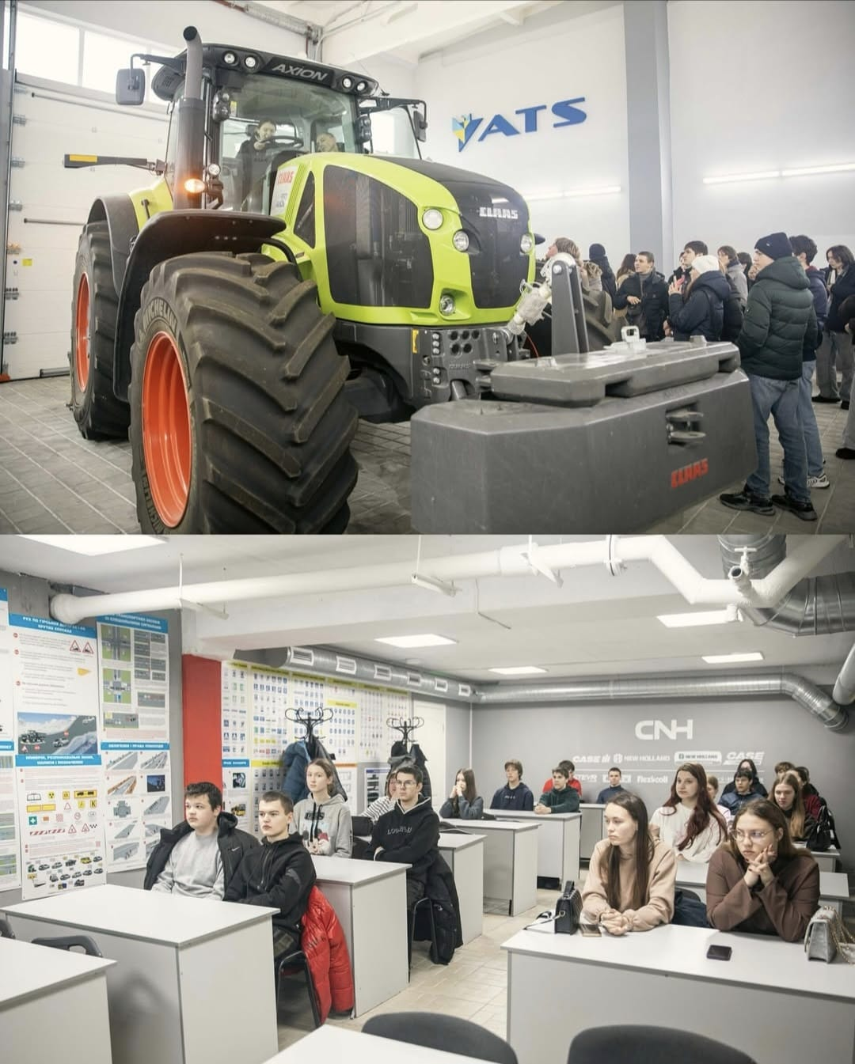
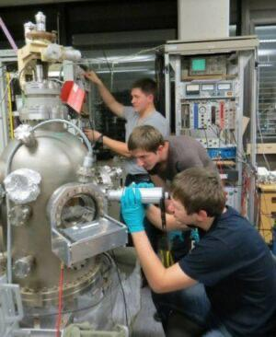
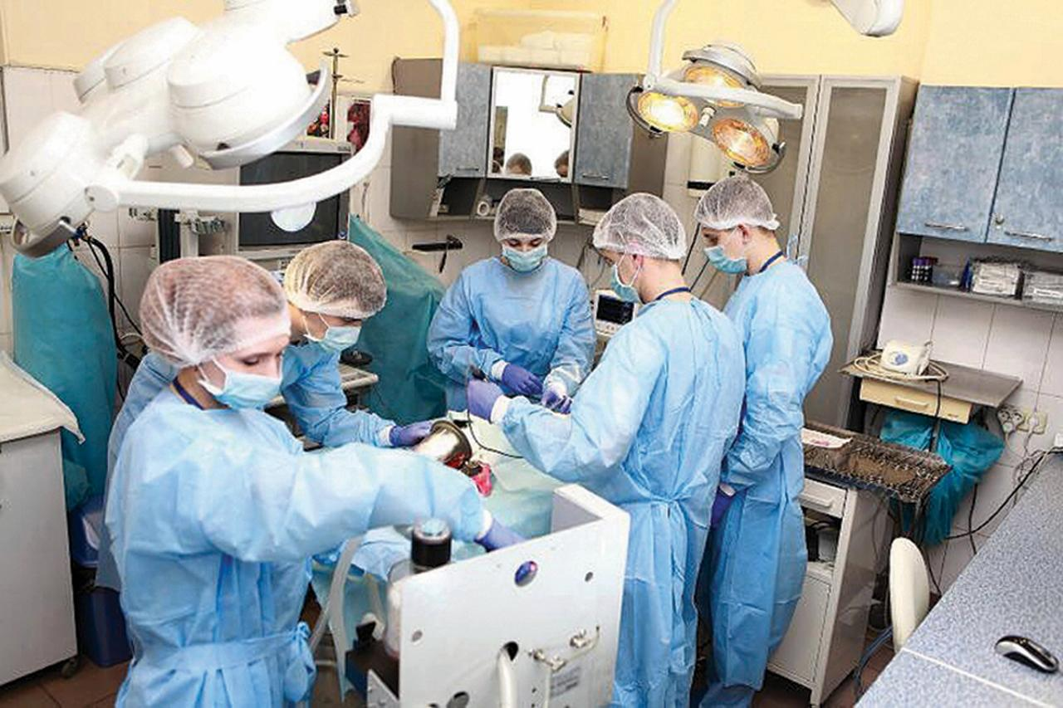


HIGHER EDUCATION — GROWTH THROUGH CHALLENGES
6
19 609
1 700
Fields of study at universities:
higher education institutions
students
academic and teaching staff
Security and defense
Business, administration, and law
Engineering, manufacturing, and construction
Information technology
Culture, arts, and humanities
Education
Healthcare and social welfare
Natural sciences, mathematics, and statistics
Agriculture, forestry, fisheries, and veterinary medicine
Social sciences, journalism, information, and international relations
Transportation and services
INTERNATIONAL RECOGNITION
1st place among higher education institutions in Ukraine
2nd place among agricultural higher education institutions in Ukraine
Prospects for cooperation:
Establishing partnerships between educational institutions, student and faculty exchanges
Joint research initiatives, experience sharing, and preparation of grant applications to attract funding

Slide 12
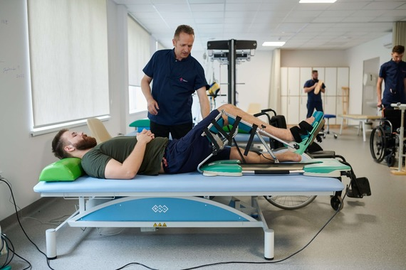
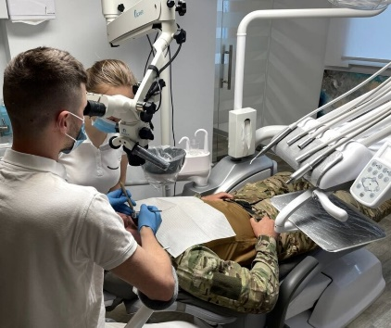
UNBREAKABLE HEALTHCARE
Healthcare network of Sumy region
87
healthcare facilities
Doctors – 3 274 осіб
Outpatient rehabilitation
Mid-level medical personnel– 7 128 осіб
15 | institutions signed an agreement with the NHSU
9 528 | patients treated in total in 2025
2 527 | including military personnel
Dental prosthetics and dental treatment for military personnel
2,098 services under Package 66 totaling
UAH 244.9 million
19,948 services under Package 67 totaling
UAH 16.9 million
Outpatient rehabilitation
Assessing Activities of Daily Living (ADLs)
5
17 | institutions signed an agreement with the NHSU
10 800 | patients treated in total in 2025
707 | including military personnel
mental health centers opened at cluster and supercluster healthcare facilities
10 institutions
76 expert teams
235 doctors involved
34 providers
Mobile Palliative Care Teams

Slide 13
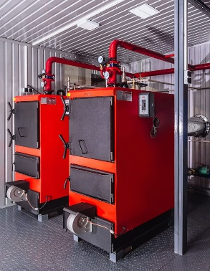



HEALTHCARE RESILIENCE
Efficient and continuous provision of medical services during wartime
83 institutions
1-6 months
117
Fuel supply for vehicles
equipped with autonomous heating
heating points in healthcare facilities
1-6 months
Supply of medicines
242
autonomous power sources in inpatient facilities
26
16 institutions
Water wells available
invincibility points
9 institutions
capable of using solar energy
5 days to 3 months
2
doctors
provided with official housing
Fuel reserves for generators
10 communities
financial support and material incentives for staff

Slide 14


Municipal Non-Profit Enterprise of the Sumy Regional Council “Sumy Regional Center for Emergency Medical Care and Disaster Medicine”
Structure of the Emergency Medical Service (EMS)
(operational units):
Key Performance Indicators:
Innovations
5 stations
13 substations
24 permanent team bases
calls to the emergency line «103» – 162 731
responses – 126 526 – 77,8%
of which critical – 2 556 – 2%
emergency – 103 526 – 81,8%
non-emergency – 20 444 –16,2%
Electronic warfare (EW) systems installed in vehicles
Use of advanced 3D manikin Laerdal SimMan 3G Plus
Mechanical cardiopulmonary resuscitation device “EASY PULSE”
Use of ultrasound diagnostics during patient transport
Operations in the “gray zone”
5-km zone:
calls – 1066
responses – 654
of which critical:– 15
emergency – 543
non-emergency – 96
20-km zone:
calls – 13002
responses – 9235
of which critical:– 196
emergency – 7556
non-emergency – 1483
In 2025, the following was received:
11 units of specialized ambulance vehicles.
With the support of the WHO, 5 armored all-wheel-drive vehicles were received.

Slide 15







COOPERATION PRIORITIES: HEALTHCARE AND REHABILITATION
PROJECTS DEVELOPED
Rehabilitation Center Project “Sumy”
CREATION OF A MODERN REHABILITATION CENTER FOR MILITARY PERSONNEL, VETERANS, AND THEIR FAMILIES
Veteran Pro Sumy
CREATION OF A UNIQUE SPACE FOR VETERANS AND THEIR FAMILIES – A PLACE WHERE THEY CAN RECEIVE PSYCHOLOGICAL SUPPORT, UNDERGO REHABILITATION, AND REINTEGRATE INTO SOCIETY
Hydrotherapy Complex
SAFEMED — Capsule Hospital
CREATION OF A MODERN HYDROTHERAPY REHABILITATION COMPLEX BASED AT TROSTIANETS CITY HOSPITAL
THE CAPSULE HOSPITAL IN SHOSTKA IS AN INNOVATIVE SOLUTION TO ENHANCE THE RESILIENCE OF THE HEALTHCARE SYSTEM
Rehabilitation Department at Konotop Hospital
ENSURING APPROPRIATE CONDITIONS FOR THE PROVISION OF HIGH-QUALITY REHABILITATION SERVICES AT KONOTOP CENTRAL DISTRICT HOSPITAL

Slide 16





CULTURAL RESILIENCE
18980
visitors
178
guided tour hours
22
exhibitions
The museum’s collection comprises over 17,000 exhibits. The museum building is an architectural monument.
In 2024, with the support of the French Republic in Ukraine (UAH 1.1 million), an innovative wall-drying system was installed at the N. Onatskyi Sumy Regional Art Museum.
In 2025, with the support of the French Institute in Ukraine (UAH 1.99 million), emergency roof repair works were carried out.
Sumy is home to marble statues by French sculptor Aristide Croisy, “Golgotha” and “Angel with Child,” which are monuments of national importance (the originals are located in Sumy, in the central cemetery).

Slide 17





DIGNITY. OPPORTUNITIES. REALIZATION. VETERANS ARE PART OF A STRONG SUMY REGION
7
veteran centers
99
specialists supporting war veterans and demobilized personnel
48072
7121
veterans
family members of fallen defenders
A veteran center is a tool for implementing veteran policy.
A veteran center provides a set of standardized services that a veteran or a member of their family can access in one place.
12 rehabilitation departments
psychological support: individual and group sessions using various psychotherapeutic methods to restore mental well-being
понад 5000 наданих послуг фахівцями із супроводу ветеранам війни та членам сімей загиблих Захисників
12 реабілітаційних відділень
over 5,000 services provided by specialists supporting war veterans and family members of fallen defenders
MENTAL HEALTH — THE KEY MEANS OF VETERAN RECOVERY

Slide 18






ADAPTIVE SPORTS – AN EFFECTIVE MEANS OF RECOVERY
23
29
gyms,
providing veteran sports services
veteran sports competitions
VETERANS FROM THE SUMY REGION HAVE ACHIEVED SUCCESS AT THE INVICTUS GAMES

Slide 19






CHALLENGES OF WAR
Railway infrastructure is constantly under attack by the aggressor country. Due to the security situation, passenger transportation volumes are decreasing.
Municipal transport is also being damaged, leading to reduced passenger services.
RECOVERY DESPITE MILITARY AGGRESSION

Slide 20




FORMATION OF NATIONAL RESISTANCE
The main goal of the Center is to prepare society for sustained resistance against the aggressor, develop patriotic and defensive awareness, and provide knowledge and practical skills to protect oneself, one's family, and one's country.
Organizational structure of the Center
Material, Technical, and Training Base of the Center:
administrative staff
interactive shooting
range
tourniquets, bandages, mannequins
7
instructors
classrooms
airsoft devices, body armor, helmets
10
7
combat veterans, including 5 instructors;
5
people certified by military training institutions

Slide 21




PREPARATION FOR NATIONAL RESISTANCE
in a frontline region
fields of knowledge
National Resistance
International Humanitarian Law
Psychological training
First aid in combat conditions
Leadership and activity planning
Information security and countering the enemy
Topography and land navigation
Engineering training and mine safety
Survival
Communications and information transmission
Weapons of mass destruction
Marksmanship training
Tactical training
Military technologies and unmanned systems
The target population for training includes
individuals who are unable to undergo initial and basic military training due to age,
health status, or other reasons,
as well as reserved employees.
ІНКЛЮЗІЯ
20
1 день полігон (тактика -стрільби)
7 days of training
883
individuals trained in 2025
a shortened training program is used
(48 hours in duration)

Slide 22




TRAINING OF FPV DRONE OPERATORS
aimed at strengthening the region’s air defense
Course objective
90 hours
to provide trainees with comprehensive knowledge and practical skills necessary for the effective use of FPV drones in combat conditions
89 members of the VFTC
total duration of the specialized course
completed training and received certificates as FPV drone operators for copter and aircraft types
Technical, tactical, and safety aspects of FPV drone operation
Methods of countering enemy unmanned aerial vehicles

Slide 23


SUMY REGION OPEN FOR COOPERATION
Sumy Regional State Administration – Regional Military Administration
+38 0542 782 777
mail@sm.gov.ua
gue@sm.gov.ua
https://sm.gov.ua/

