Slide 1
An Update from the EIB with a Focus on Ukraine
Kristina Mikulova
Head of Regional Hub for Eastern Europe
EIB Global Directorate

Slide 2
Content
EIB in Ukraine
EIB in the Water Sector
EIB, EU’s Climate Bank
EIB’s Activity in the Ukrainian Water Sector

Slide 3
EIB President Nadia Calviño visited Kyiv in February 2025
1. EIB in Ukraine

Slide 4
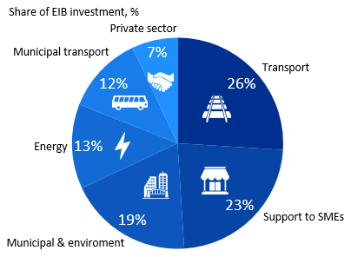
1. EIB’s Activity in Ukraine
1.1 General
The EIB has worked with Ukraine since 2007 in over 60 projects.
Most of the EIB’s activities in Ukraine have been carried out with EU budgetary guarantees under the External Lending Mandate, as well as technical assistance and investment grants from the EU budget or other sources.
Together with EBRD and the World Bank, EIB is one of the top-3 largest investors in Ukraine with signed projects of more than EUR 8.7bn.
Areas of EIB activity

Slide 5
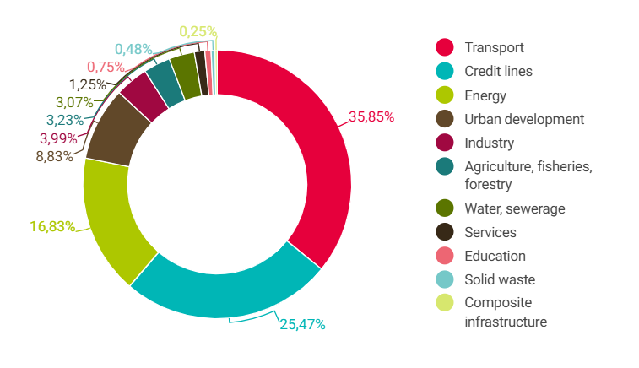
1. EIB’s Activity in Ukraine
1.1 General (cont.)
EIB activity in Ukraine by sector (since start of operations)

Slide 6
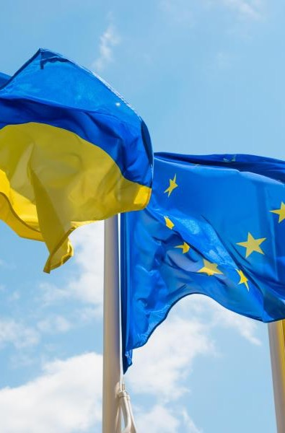
1. EIB’s Activity in Ukraine
€2.2
billion
1.2 Response to the War in Ukraine
€668
million
to meet most urgent financial needs of Ukraine fully disbursed within a month from the start of the war.
€650
million
to the Ukrainian road agency (Ukravtodor) and the Ukrainian railway (Ukrzaliznytsia) companies for the urgent repair of the road and rail transport infrastructure sector.
€350
million
€50
million
to the Ministry for Communities, Territories and Infrastructure Development to cover heating needs, restore municipal facilities to working order, and perform the thermal modernisation of residential and public buildings.
to Ukraine’s transmission system operator Ukrenergo to strengthen its financial resilience and help it to maintain energy supplies for industry and households.

Slide 7
1. EIB’s Activity in Ukraine
1.3 EU for Ukraine (EU4U) Initiative

Slide 8
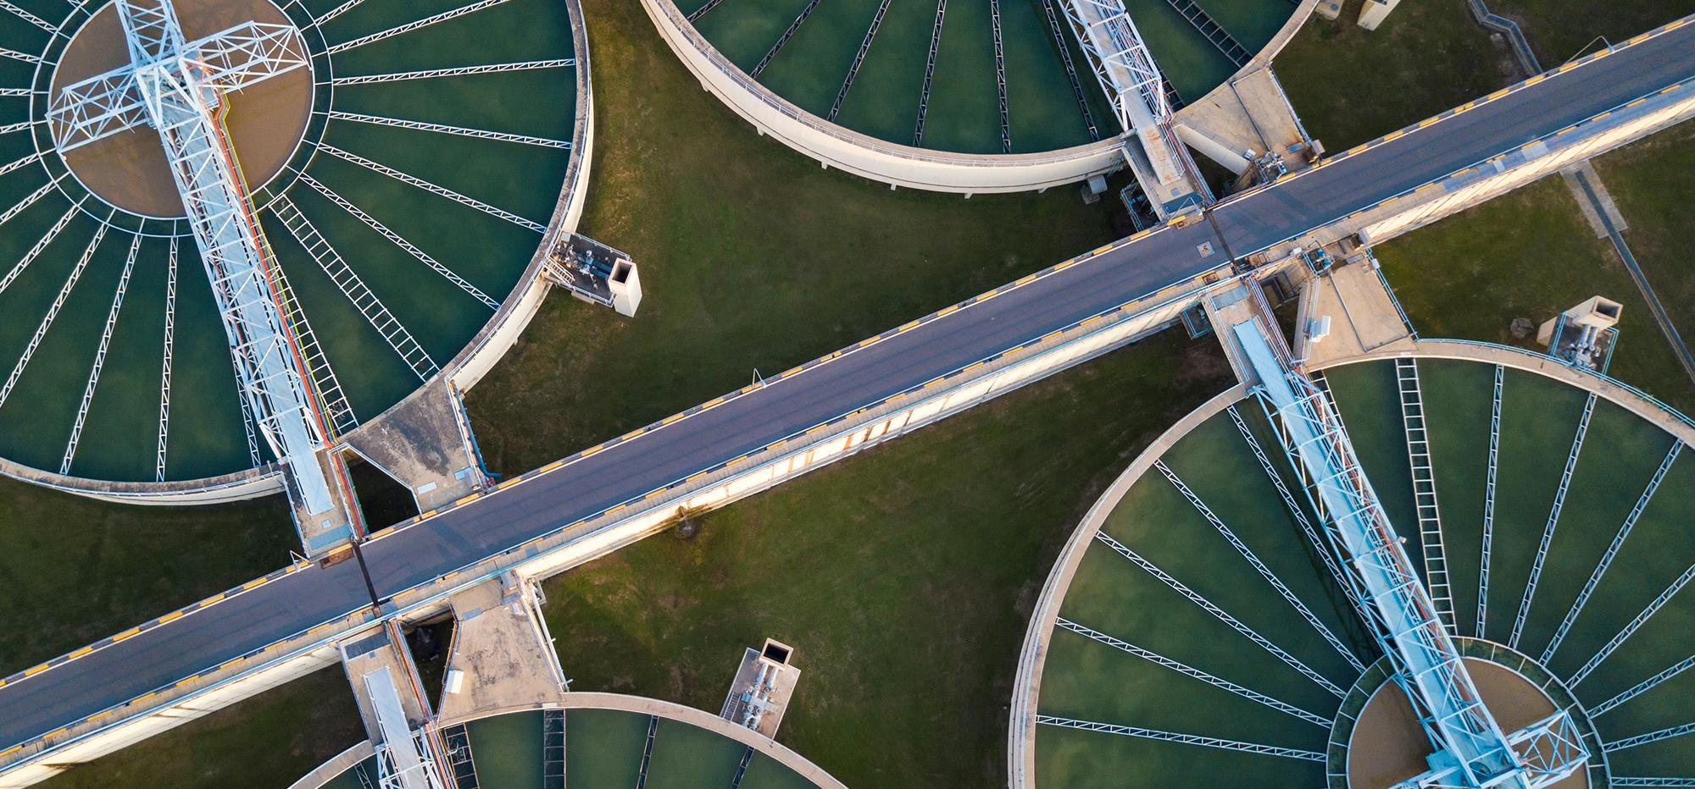
2. EIB in the Water Sector

Slide 9
2. EIB in the Water Sector
2.1 General
EIB is one of the largest sources of loan financing to the water sector worldwide: on average EUR 3 Bn per year,
Total loan amount of EUR 30 Bn over the past 10 years, 80% of which for projects inside EU,
Over the past 10 years, 400 major projects have been financed, 70% of which located within the EU,
EIB lending covers the whole water cycle (water resources, water supply, sanitation, flood protection).
EIB is active in the water sector in Ukraine.

Slide 10
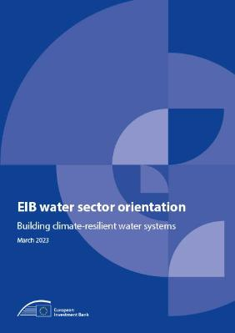
2. EIB in the Water Sector
2.2 EIB’s Water Sector Orientation (2023)
River basin approach (IWRM)
Sector development
Adaptation to climate change
Water efficiency
Development of new water supply
Wastewater and sanitation services
Research and Innovation
Maximise Added Value

Slide 11
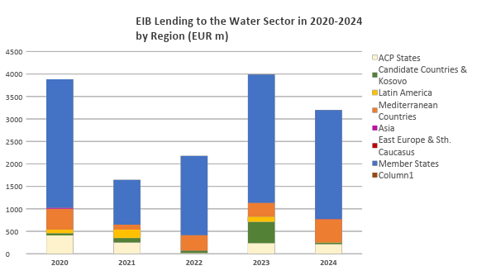
2. EIB in the Water Sector
2.3 Lending Data
Portfolio under active implementation (monitoring): EUR 22 bn

Slide 12
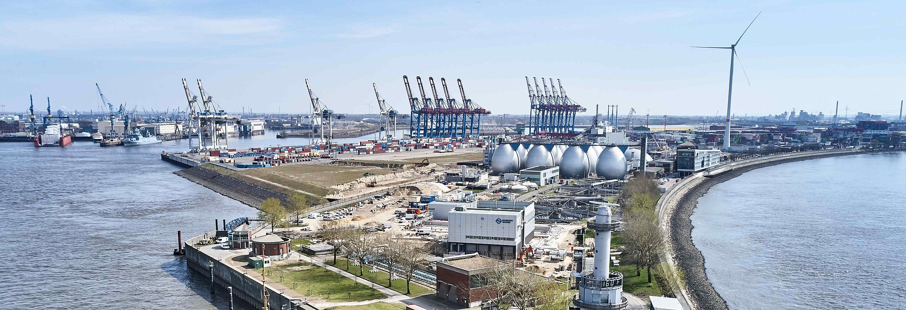
© HAMBURGWASSER
WWTP Hamburg (Germany), net energy generating since 2011
3. EIB, EU’s Climate Bank

Slide 13
3. EIB, EU’s Climate Bank
3.1 EIB’s Commitments to Climate Action and Environmental Sustainability (CAES)
“The EIB will increase its level of support to climate action and environmental sustainability to exceed 50% of its overall lending activity by 2025.” (EIB Group Climate Bank Roadmap 2020-2025)
“The EIB supports its countries of operation in delivering on their biodiversity goals” (Environment Framework 2022). Inside EU, it supports EU’s Biodiversity strategy for 2030 as part of the EU Green Deal.
We assess the climate action (CA) contribution of all our projects (adaptation and/or mitigation)
We determine the environmental sustainability (ES) of all our projects based on the EU Taxonomy.
CAES Score
Results:
Since 2021, climate action and environmental sustainability financing by the EIB has always been above 51% of total lending.
The weighted average CAES score of water projects has always been above 75% since 2021.

Slide 14
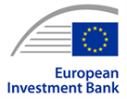
3. EIB, EU’s Climate Bank
3.2 EIB’s Policy Documents for Environment, Social and Climate
Environmental and Social Policy (Feb. 2022)
Environmental and Social Standards (Feb. 2022)
Climate Bank Roadmap (Nov. 2020)
Climate Adaptation Plan (Oct. 2021)
The PATH Framework (Oct. 2021)
Climate action: eligible sectors and eligibility criteria (May 2022)
The Environment Framework (Nov. 2022)
Climate Adaptation Investment Advisory Platform (ADAPT)
EIB’s Guidelines/Lending Policies/Orientations for different sectors:
•Energy
•Hydropower
•Transport
•Water

Slide 15
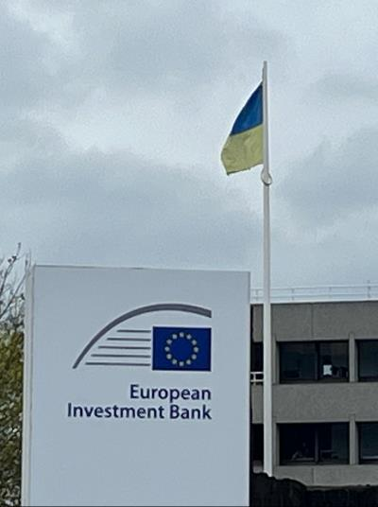
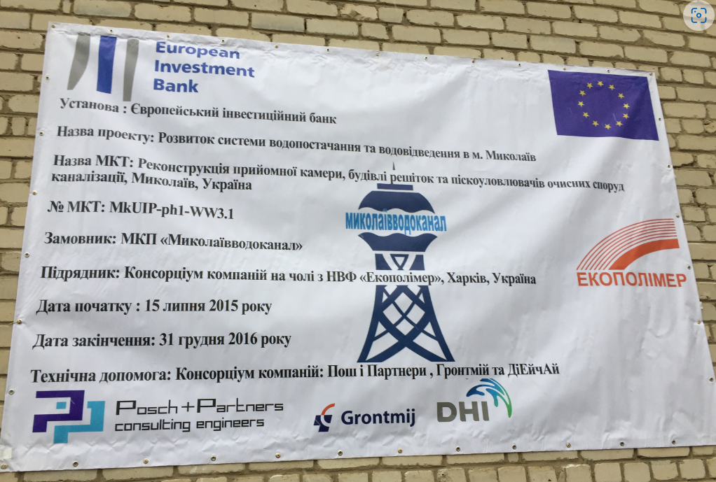
4. EIB’s Activity in the Ukrainian Water Sector

Slide 16
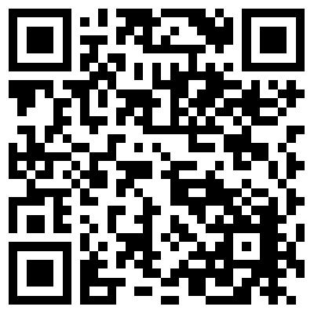
4. EIB’s Activity in the Ukrainian Water Sector
4.1 EIB’s New Framework Loan for the Water Sector in Ukraine
Loan amount: up to EUR 200 M
100% financing of the project cost
Signed on April 9, 2025: 1st Tranche of EUR 100m
Framework Loan
Eligible schemes: water and wastewater investments up to EUR 50 M
Allocations will be made further to a call for proposals organised by the Ministry of Communities and Territories Development

Slide 17
4. EIB’s Activity in the Ukrainian Water Sector
4.2 EIB’s Recovery Programmes in Ukraine – include Water Sector investments as well
Ukraine Early Recovery Programme: up to EUR 200 M 2014
Ukraine Recovery Programme: up to EUR 340 M 2020
Ukraine Recovery Programme III : up to EUR 100 M 2025

Slide 18
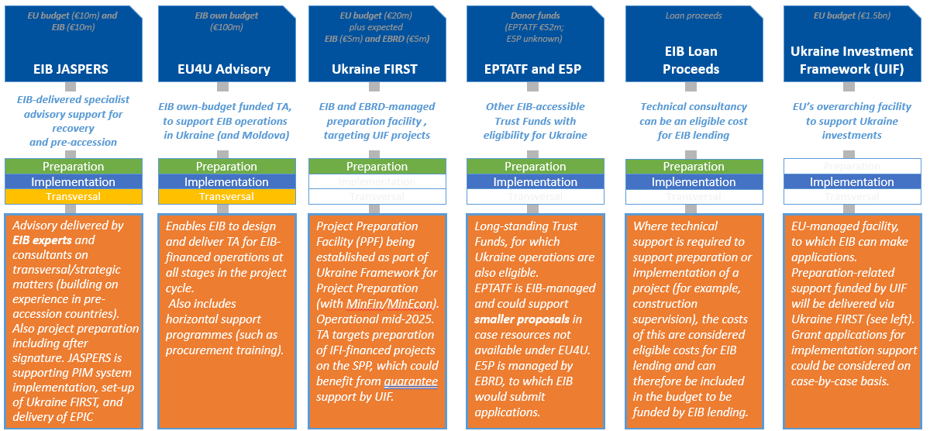
4. EIB’s Activity in the Ukrainian Water Sector
4.3 Overview of Technical Assistance mobilised by the EIB/EU in Ukraine

Slide 19
Thank you!
For more information please contact :
Kristina Mikulova (k.mikulova@eib.org)
Marco Beroš (m.beros@eib.org),
Violaine SILVESTRO VON KAMEKE (v.silvestro@eib.org)
EUROPEAN INVESTMENT BANK
http://www.eib.org/

