Slide 1
LLC "PACKING"
www.packing-ua.com

Slide 2
Packing company includes several production lines: stretch film, adhesive tape, cardboard sleeves. All these products can be made with flexographic printing in the form of a logo, contact and other information that is relevant at the present time.
In our production process, we use only the most advanced, automated and high-tech equipment for specialists with extensive experience in the field of packaging, which allows to achieve maximum productivity and high quality for production. We cooperate with the best manufacturers of raw materials, which allows us to create packaging solutions that provide maximum work efficiency for each client.
The production lines are equipped with modern software that helps support a non-stop technological process and guarantee a consistently high quality product, which is certified and controlled by the ISO 9001 system.
PACKING COMPANY HAS STARTED THE RELEASE OF A NEW TECHNOLOGICAL LINE FOR THE PRODUCTION OF FLEXOGRAPHIC PRINTING ON STRETCH FILM, ADHESIVE TAPE AND CARTON BOARDS.
As for us and manufacturers of polymer products and packaging materials in general, this is a step forward. With this print, we can shift product information, the manufacturer’s logo, and other information on the packaging. In this regard, such packaging becomes most effective for the development of the business of our customers. Most consumers for such products are food manufacturing companies, industrial goods, transport companies that value their status and apply stylish, colorful and original packaging.
This opportunity can be applied to all types of our products.

Slide 3
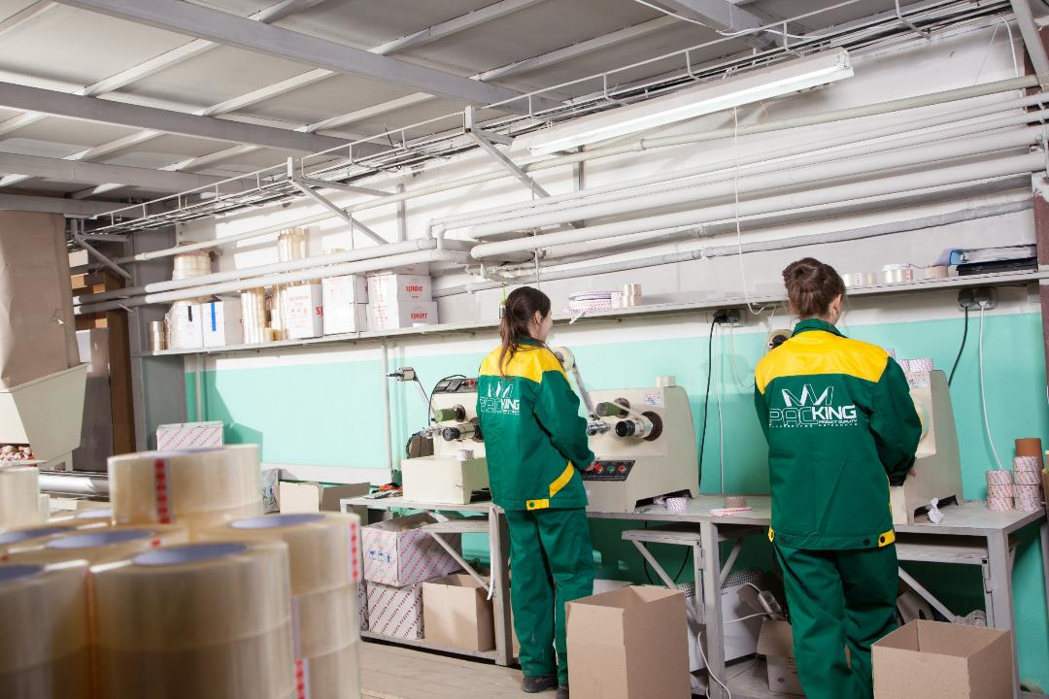

Slide 4
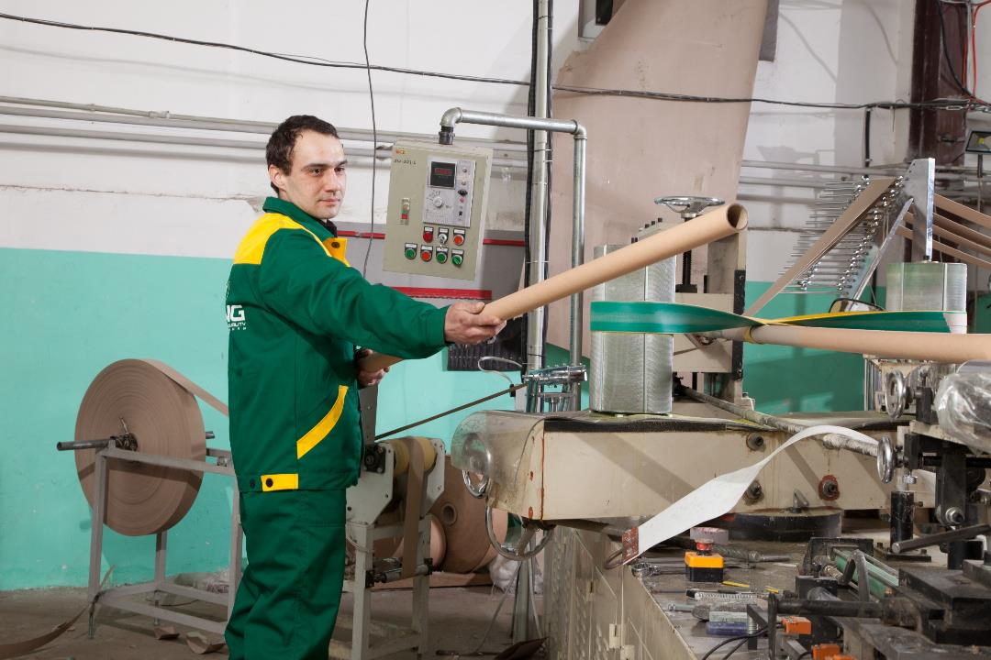

Slide 5
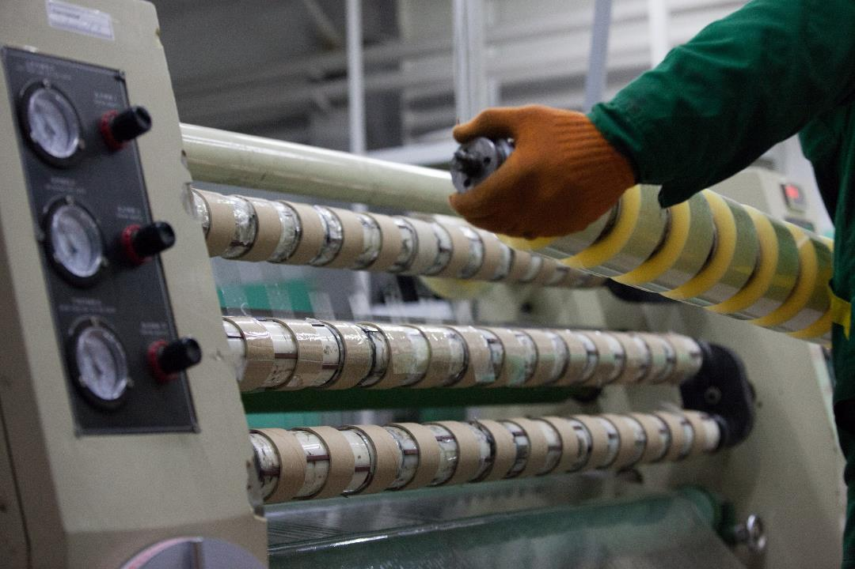

Slide 6
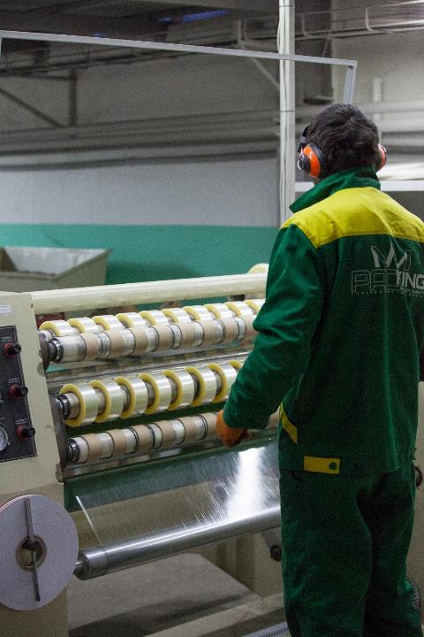

Slide 7
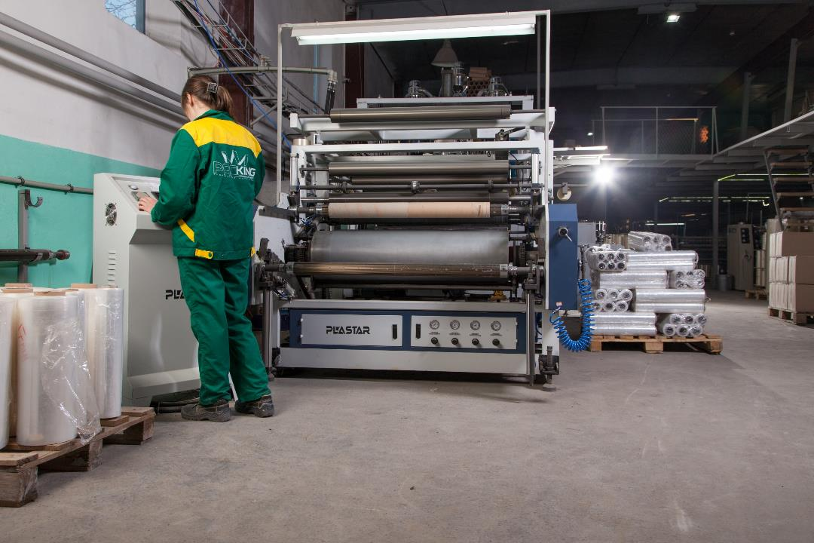

Slide 8
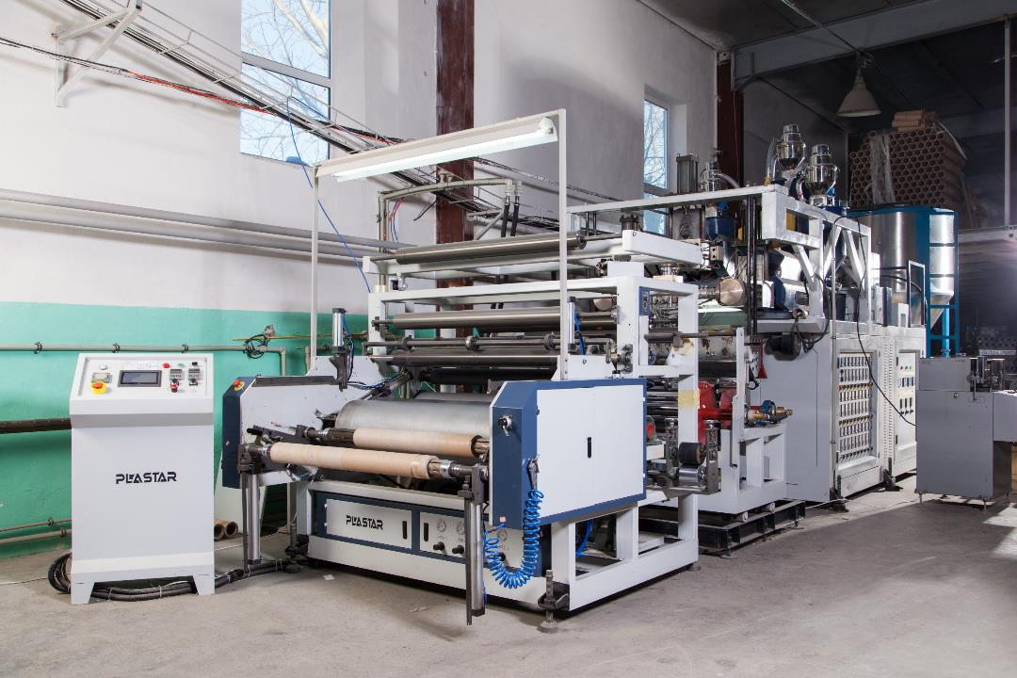

Slide 9
Our company offers a wide selection of adhesive tapes and adhesive tapes, among which you will find: packaging transparent tape, packaging colored tape, logo packing tape, stationery tape, double-sided acrylic tape, double-sided tape on a fabric basis, double-sided tape on a polypropylene basis, thin-sided tape, double-sided tape on a foam basis, masking tape, tape for windows, reinforced and aluminum tape, metallized tape, anti-slip tape, signal tape, special double-sided tape, all kinds of electrical tape, etc. You can buy multifunctional materials from us, which are widely used for packaging goods and as fasteners in the construction field.

Slide 10
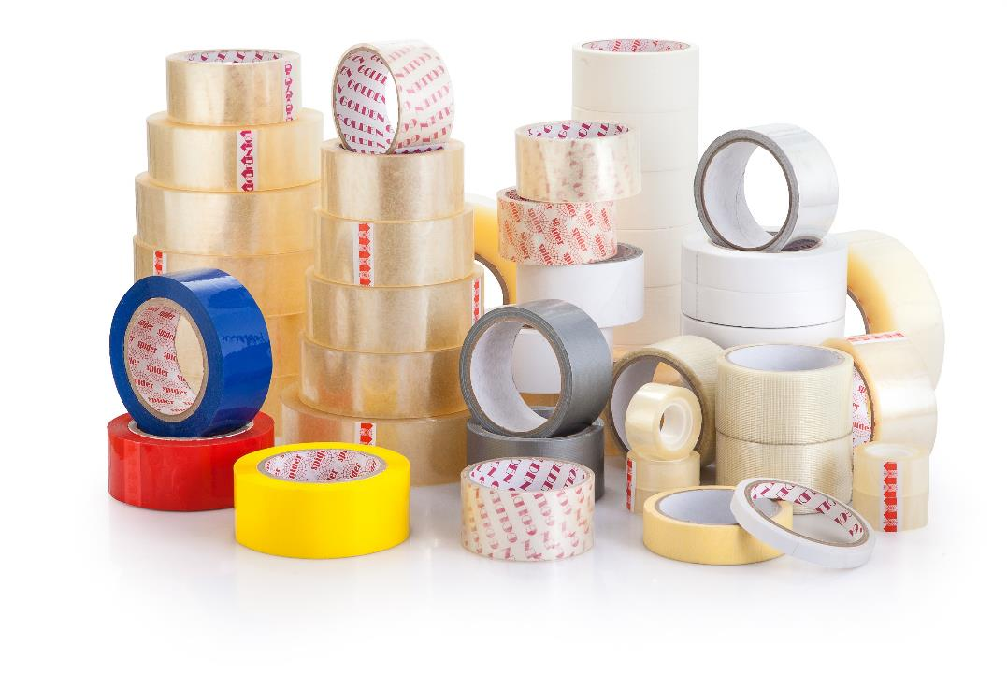

Slide 11
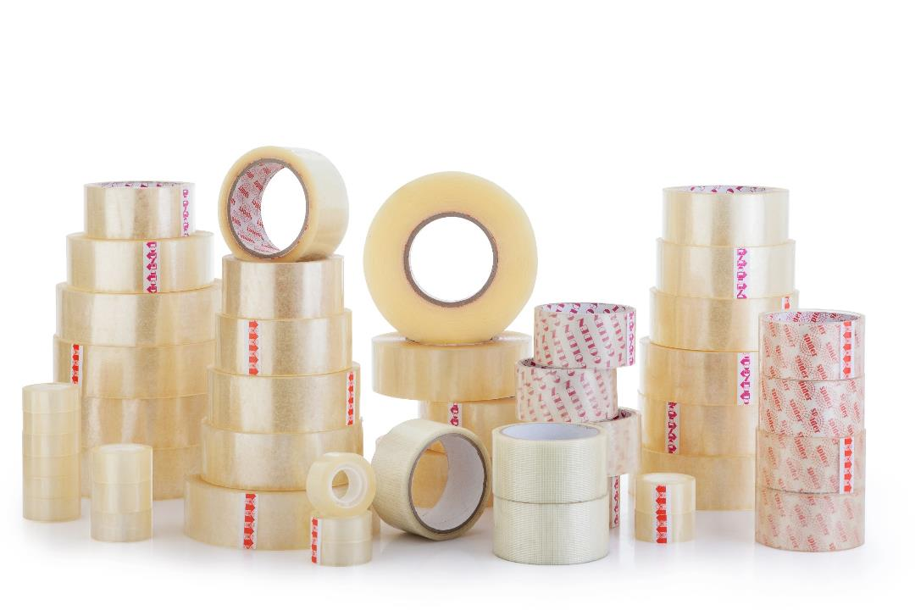

Slide 12
The jumbo roll of a stretch film (Jumbo roll / Jumbo Roll) is a raw material (blank) for the independent production of packaging stretch film of optimal width, thickness and winding. The final product made from jumbo rolls is manual or machine stretch packaging film. Rewinding jumbo rolls for your own purposes will allow you to get exactly the packaging stretch film that is most suitable for your production.
Stretch film is the best practical and versatile packaging material of the new generation with hefty advantages and low cost. Stretch film - is one of the most durable packaging materials, which is ideal for packaging and preserving goods during transportation, storage, environmental protection, and is also suitable for food packaging. Accordingly, it is divided into technical and food stretch. The use of technical stretch film is used in various fields production, distribution network, at home, during transportation, which helps to facilitate loading and unloading and save time on packaging goods, and high resistance to puncture, tear and shock explains the reason for its rapidly growing demand in the market. Not a single food industry production is also without the use of food stretch film, since it is very practical and effective in packaging food products. Today there is no industry where stretch film is not used.

Slide 13
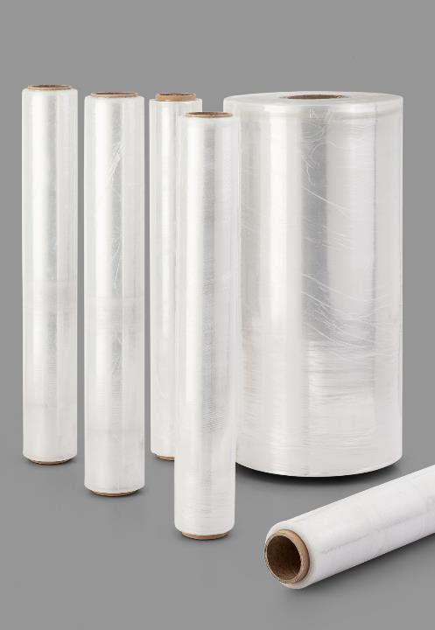

Slide 14
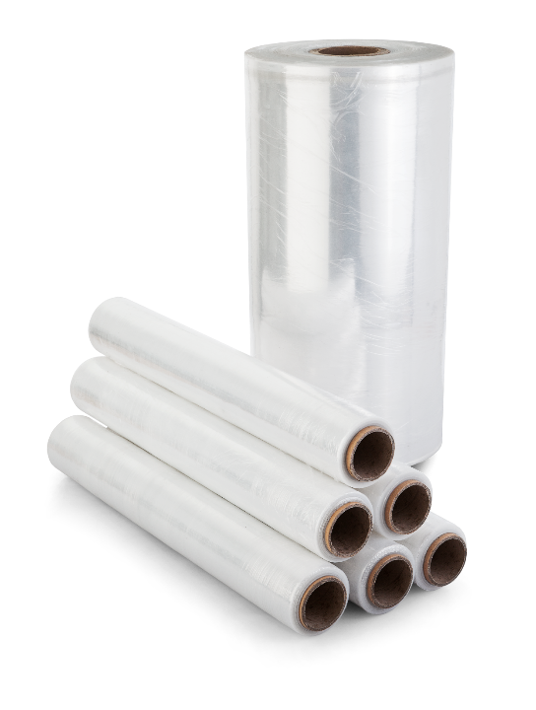

Slide 15
The company "Packing" is a leading manufacturer of cardboard sleeves (spools, bushings) - high quality products with competitive pricing. Our company cooperates with customers throughout Ukraine and neighboring countries. The latest automated production facilities and high-quality raw materials make it possible to produce a high-quality product with high and accurate physical characteristics in the shortest possible time from the momentзаказа. All products are certified, meet GOStam, TU and sanitary-epidemiological characteristics with the implemented ISO 9001 quality control system. You can wholesale a cardboard sleeve from us, at the same time you will receive competitive prices and favorable conditions for cooperation. For all questions, you can contact these contacts to obtain comprehensive information about the assortment of goods and their characteristics.
Cardboard sleeves are mainly used in various industries (textile, printing, food, chemical)
for winding roll materials, such as: stretch film, polyethylene film, all other types of films, scotch tape, cardboard rolls, toilet paper, paper towels, fax paper, foil, bags, bags, fabrics, threads, insulation, ruberoid, vapor barrier, linoleum and much more.
It is also used as a container for bulk materials, souvenir and gift products in the form of tubes.

Slide 16
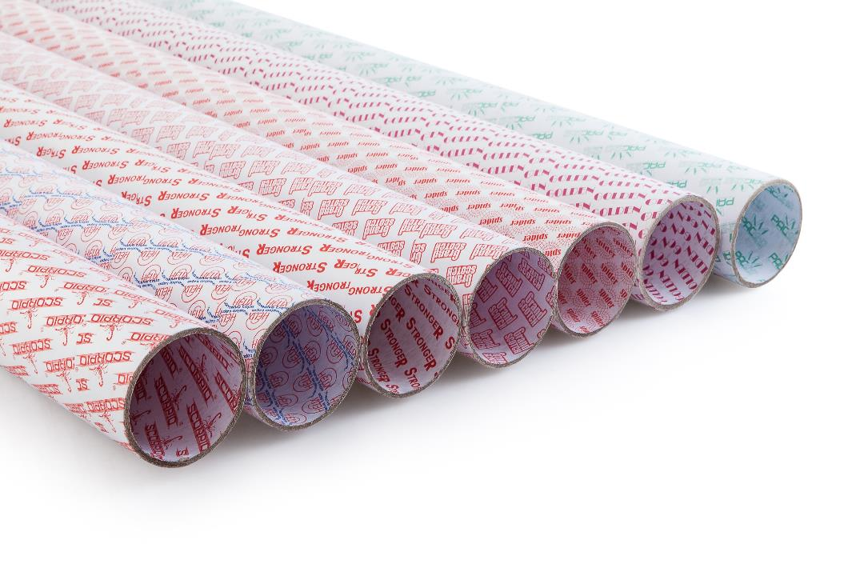

Slide 17
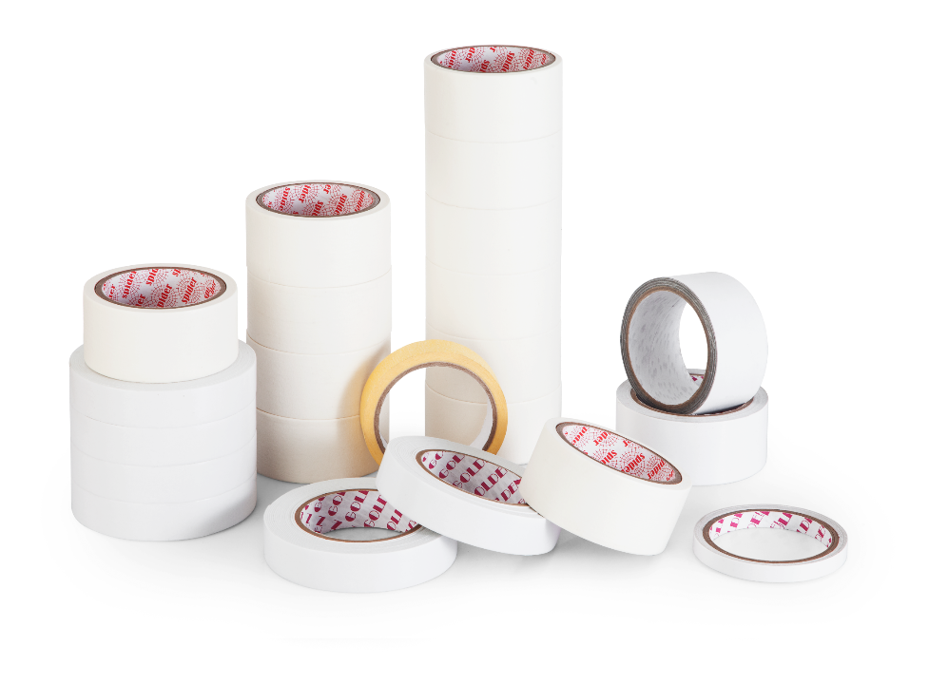

Slide 18
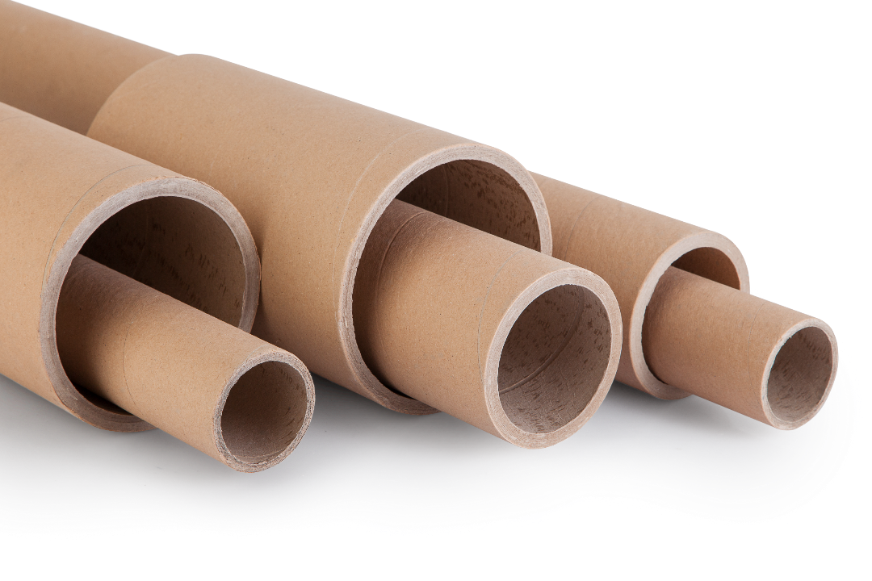

Slide 19
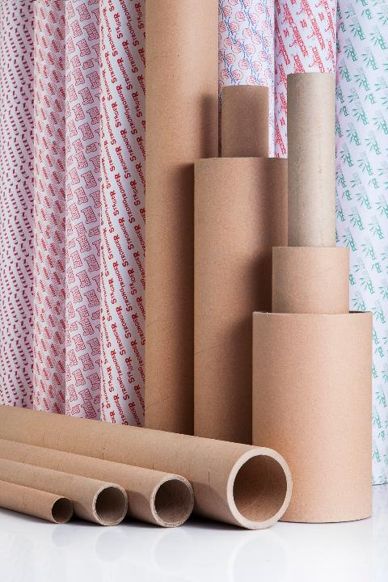

Slide 20
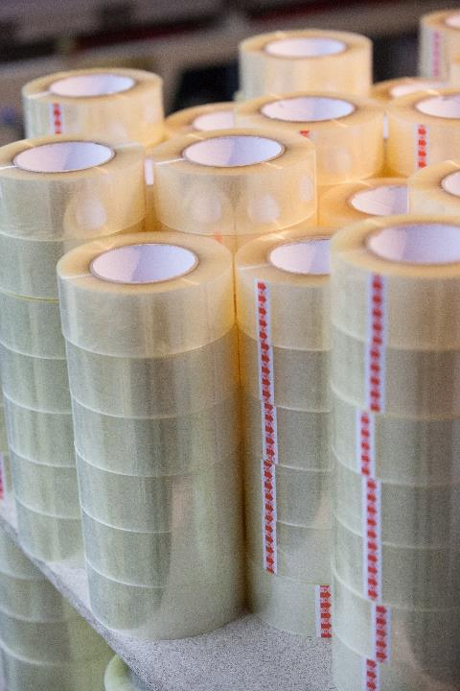

Slide 21
