Slide 1
Creative Box: Promoting the innovative approaches to building educational formats in youth work
IO1 – ”BUILDING OF STRATEGY FOR CREATIVITY DEVELOPMENT IN YOUTH WORK”
Developed by: NGO “Ukrainian Centre of the Future”
This project has been funded with support from the European Commission. Project Nº: 2021-1-PL01-KA220-YOU-000028673 This communication reflects the views only of the author, and the Commission cannot be held responsible for any use which may be made of the information contained therein.

Slide 2
Topic Description
In our challenging economic climate, young people need to develop the skills and understanding to pursue and develop innovative solutions in both their own lives and for the organisations they join and create as the community seeks new opportunities to meet the future.
Many of tomorrow’s jobs have yet to be created, and there is an ongoing skills mismatch between labour supply and demand. As well as training young people for specific professions, education systems must provide interdisciplinary knowledge to foster creative thinking. In addition, the idea of active, participating citizenship is now extended to children and young people.
Youth work sought to keep pace with changes in society and, accordingly, with circumstances, experiences, and expectations young. Thus, it must meet the mainstream requirement of creativity itself.

Slide 3
Analysis of educational experiments
One way to approach fundamental questions about learning, teaching, and education is from the perspective of complex dynamic systems theory. Over the past two decades, this theory has been increasingly promoted in the field of education as an approach to better understand learning and teaching processes (Jörg, Davis, & Nickmans, 2007; Koopmans & Stamovlasis, 2016; Steenbeek & van Geert, 2013; van Geert & Steenbeek, 2005).
The key difference between the complex dynamic systems approach and the transsystem approach is that the learning subject and the subject's environment shape each other.
A transsystem approach, including an approach to complex dynamic systems, concretizes this general principle, combining it with other characteristics of complex dynamic systems applied to the nature of learning processes that arise through socially embedded interactions.
In “Mechanisms of Emergence” R. Keith Sawyer, 2004, directly linked developmental psychology and creativity through the concept of emergence. Emergentism has its roots in philosophy and natural sciences.
PHILOSOPHY - Metaphysics: Emergence https://youtu.be/X_IuG3kJY_g

Slide 4
Analysis of educational experiments

Slide 5
Building a strategy
To create a holistic strategy, we suggest combining methods so that they positively influence team motivation and development.
The vectors of the reality of life:
the vertical plane, there is a movement from greater to less or vice versa, from the general to the exact, from the global to the exact senses, when the upper level must rest on the lower, the bigger part accommodates the minor one for further movement. James K. Kaufman and Ronald Baghetto's creativity method "4 C" ("The Four C").
Mini-c ("transformative learning” - "personally meaningful interpretation of experiences, actions and ideas"), little-c (everyday problem solving and creative expression), Pro-C (demonstrated by people who are professionally or professionally creative, but not necessarily outstanding) and Big-C (creativity is considered fundamentally, historically significant in the field). This model is designed to help accommodate models and theories of creativity that qualify as an important transformation as a higher appreciation of creativity.

Slide 6
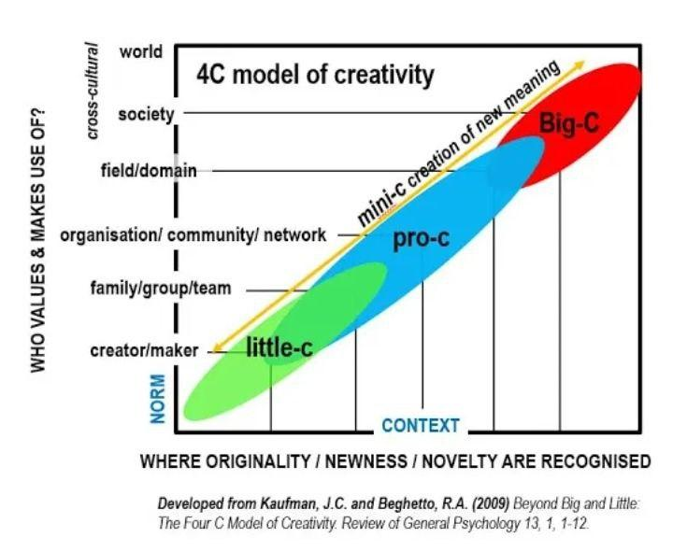
Building a strategy

Slide 7
Building a strategy
A horizontal vector: we investigate the parallel processes that are around in this series of solutions in the meaning that they exist next to each other at the same in the horizontal plane, and our task is to look around surfing with the help of our focus. Also, we focus on stages of a process, how exactly it occurs.
H. Altshuler, shows how universal principles of creativity form the basis of innovation. TRIZ identifies and codifies these principles and uses them to make the creative process more predictable.
The use of TRIZ is to study these recurring patterns of problem and solution, understand the contradictions present in the situation, and develop new methods of using scientific effects.

Slide 8
Building a strategy

Slide 9
Building a strategy
In the procedural vector, the main vector of finding a solution occurs in the process itself, such as the method of placing a story from pieces on the board, creating improvisational stories, and role-playing improvisation. In the process of creating history, the non-standard, paradoxical, something that is difficult to notice in the usual flow, mode of life, is manifested, emerges.

Slide 10
Building a strategy
Most methods anticipate a couple of motion vectors of finding a solution, but the main emphasis remains on the one only, while the form of creativity is what is found at the intersection of all three vectors, when a three-dimensional space is created for all three vectors to be taken into account. The solution at their intersection is the most complete and reveals all vectors.
So, if you take the role-playing method, the process itself can be further enriched by highlighting the background of the story, more details, who else is present in this process, which expands the horizontal view. In the same way, what is happening inside this hero, in fact, any figure, character, and what controls him when he does this, why, what is there in this that is hidden from the first glance, that adds a vertical look to what's going on. By gradually adding and layering planes, the space for creating a solution is enriched and such a solution emerges, which will consider various aspects the most.

Slide 11
Building a strategy
Solving the task itself has 3 major stages, creative acts:
the actual state and setting how it looks like and appears as it is: this can be done by using three vectors to cover the entire plane as much as possible.
directly a creative act, processing this material, where you can combine several methods as a form for experimentation, combination.
objectification of the creative act, when we formalise the solutions that appear and experiment with the very embodiment in practice in systematic coordinated actions. Moreover, when our created solution meets reality in the future, it can be slightly modified, transformed, considering those variables which we did not take into account before or that appeared, which also gives flexibility and the ability to respond to any unforeseen changes more easily and more efficiently. In today's world, this is one of the priority areas of development.

Slide 12
Building a strategy

Slide 13
The best practices of educational experiments and development of innovative solutions for learner`s organisations
For the practical application of the provided theoretical material in the creation of projects, we recommend taking the step-by-step algorithm as a basis.
Determine what exactly you want to create in your project and why this is important, the sense and meaning of that. These questions refer to the vertical vector. Try to find methods that will help you formulate this point more precisely. This point forms the mission, meaning and goals. For you to be motivated to do this project, it is important to find a personal need (value) of what you will do.
Who will it benefit? What exactly? Defining your target audience is a matter of horizontal vector. It is important to pay attention to the needs of those for whom you are doing this project. Analyse what already exists and what needs it satisfies. What new things do you want to bring to meet the needs of society? Define methods for this.
How will you do that? Procedural vector. This is the biggest space for creativity. This is an experiment. Depending on the task at hand, you can use different methods.

Slide 14
Building a strategy
The stage of grounding your creativity. It is an opportunity to see the risks and ways to avoid failure and disappointment. This is testing and approbation of your ideas for reality. Find among the methods that will help you in this. In the best way.
The stage of improvement after approval and consideration of possible risks.
When you decide that the project is ready for implementation, think about what you need for it.
Try using the same formula:
What?
Why?
For whom? (With whom?)
How?
Try to find some creative solution to solve this problem. If something is a problem, turn it into a task. If you have reached this point, then you already have enough practice to find a way to solve this problem.

Slide 15
Building a strategy
Each project partner chooses the most interesting projects and analyses them according to the algorithm:
an idea.
implementation (Where? How? What creative techniques were used? What made it possible?)
who found it useful and interesting? How well does it meet the needs of the target audience?
what are the risks? - loss of relevance due to changes in the needs of the target audience, technical support, funding, availability and needs of the team, the need to change and develop the project.
project capabilities: What does it create? What kind of product (useful information, connections between people, an environment for collaboration and co-creation).
prospects for further application in other conditions - Where? When? Why? For whom? For which types of activities?

Slide 16
References
Kupers, E. et al. (2018) Children’s Creativity: A Theoretical Framework and Systematic Review. SAGE. Available at: https://journals.sagepub.com/doi/full/10.3102/0034654318815707
Reicherts, M. (2015) Unleashing young people’s creativity and innovation European good practice projects. Luxembourg: Publications Office of the European Union.
Rosalie, J. (2018). The Untapped Potential of Transsystemic Thinking. McGill University - Faculty of Law. Yvon Blais
Sebba, J. et al. (2009) Youth-Led Innovation: Enhancing the Skills and Capacity of the Next Generation of Innovators. (2019) National Endowment for Science, Technology and the Arts (NESTA)

Slide 17
Creative Box: Promoting the innovative approaches to building educational formats in youth work
Thank you!
Contact us:
NGO “Ukrainian Centre of the Future”
Contact: Iryna Zubets
Email: irina.zubets@gmail.com
This project has been funded with support from the European Commission. Project Nº: 2021-1-PL01-KA220-YOU-000028673 This communication reflects the views only of the author, and the Commission cannot be held responsible for any use which may be made of the information contained therein.

