Slide 1
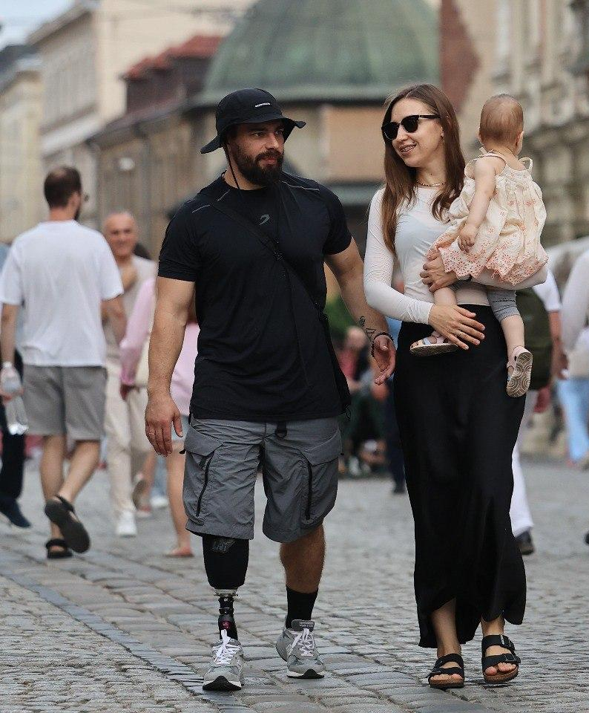


LVIV
Innovating Resilience in Wartime
Notes:
Innovating Resilience in Wartime

Slide 2
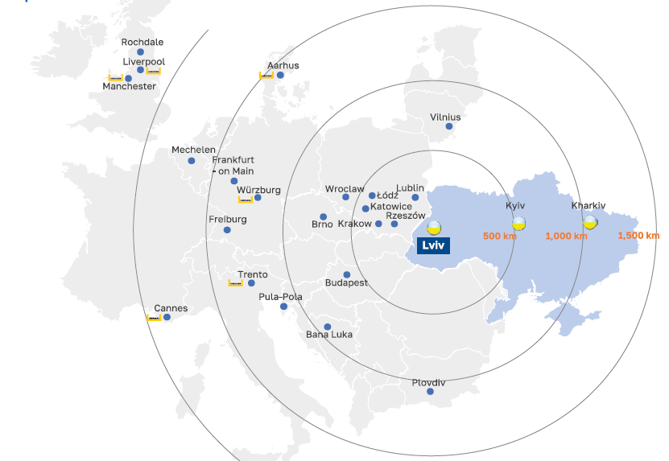
Berlin
Ukrainian
gateway to EU:
Warsaw
Munich
60 km
to the border

Slide 3
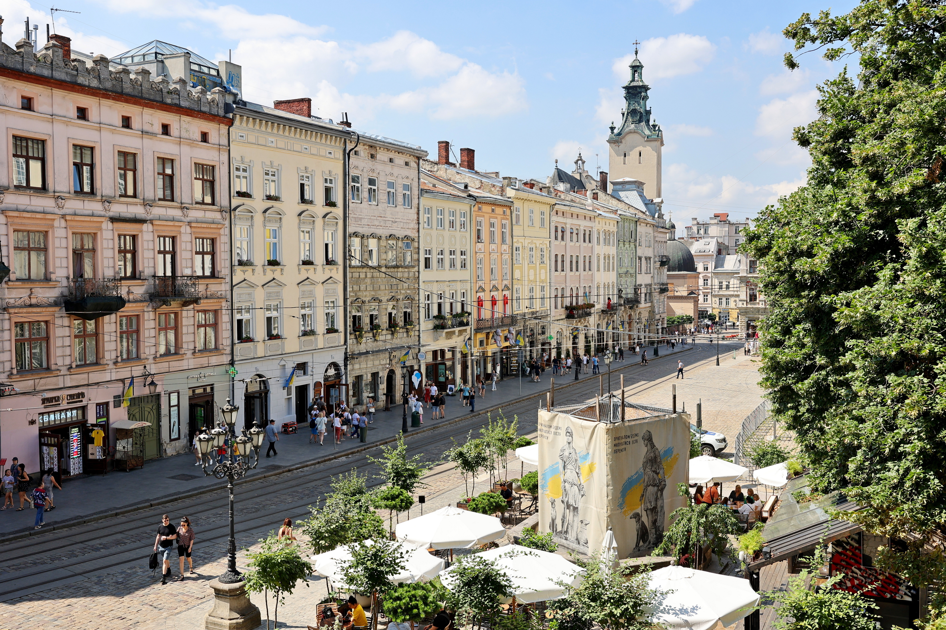


1 MILION OF POPULATION

Slide 4

103 THOUSAND STUDENTS

Slide 5
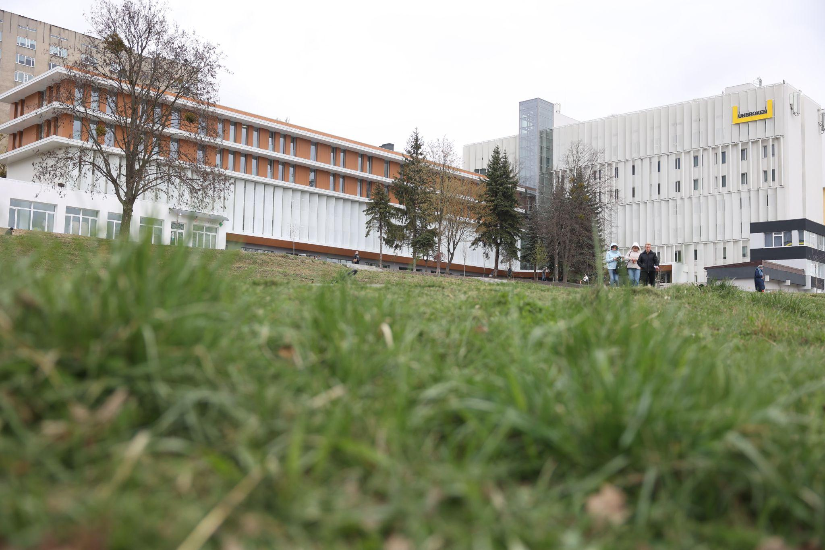
Lviv - country's main
rehabilitation and medical hub

Slide 6
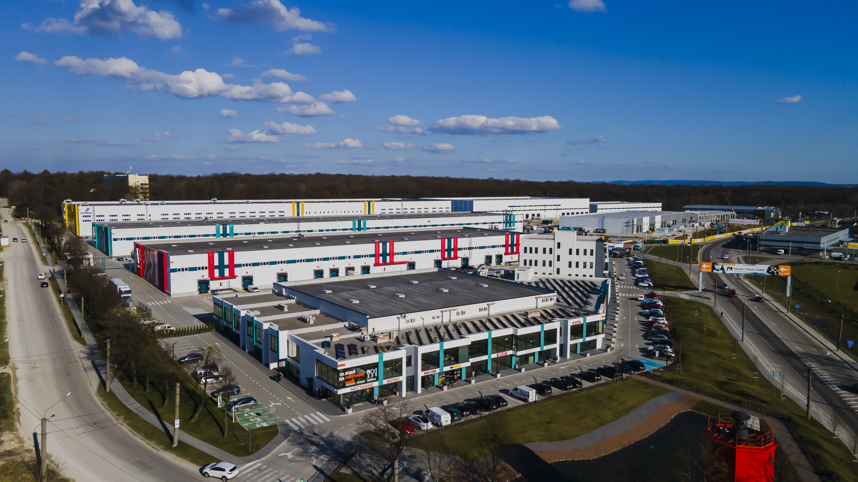
Lviv - new economic center of Ukraine

Slide 7
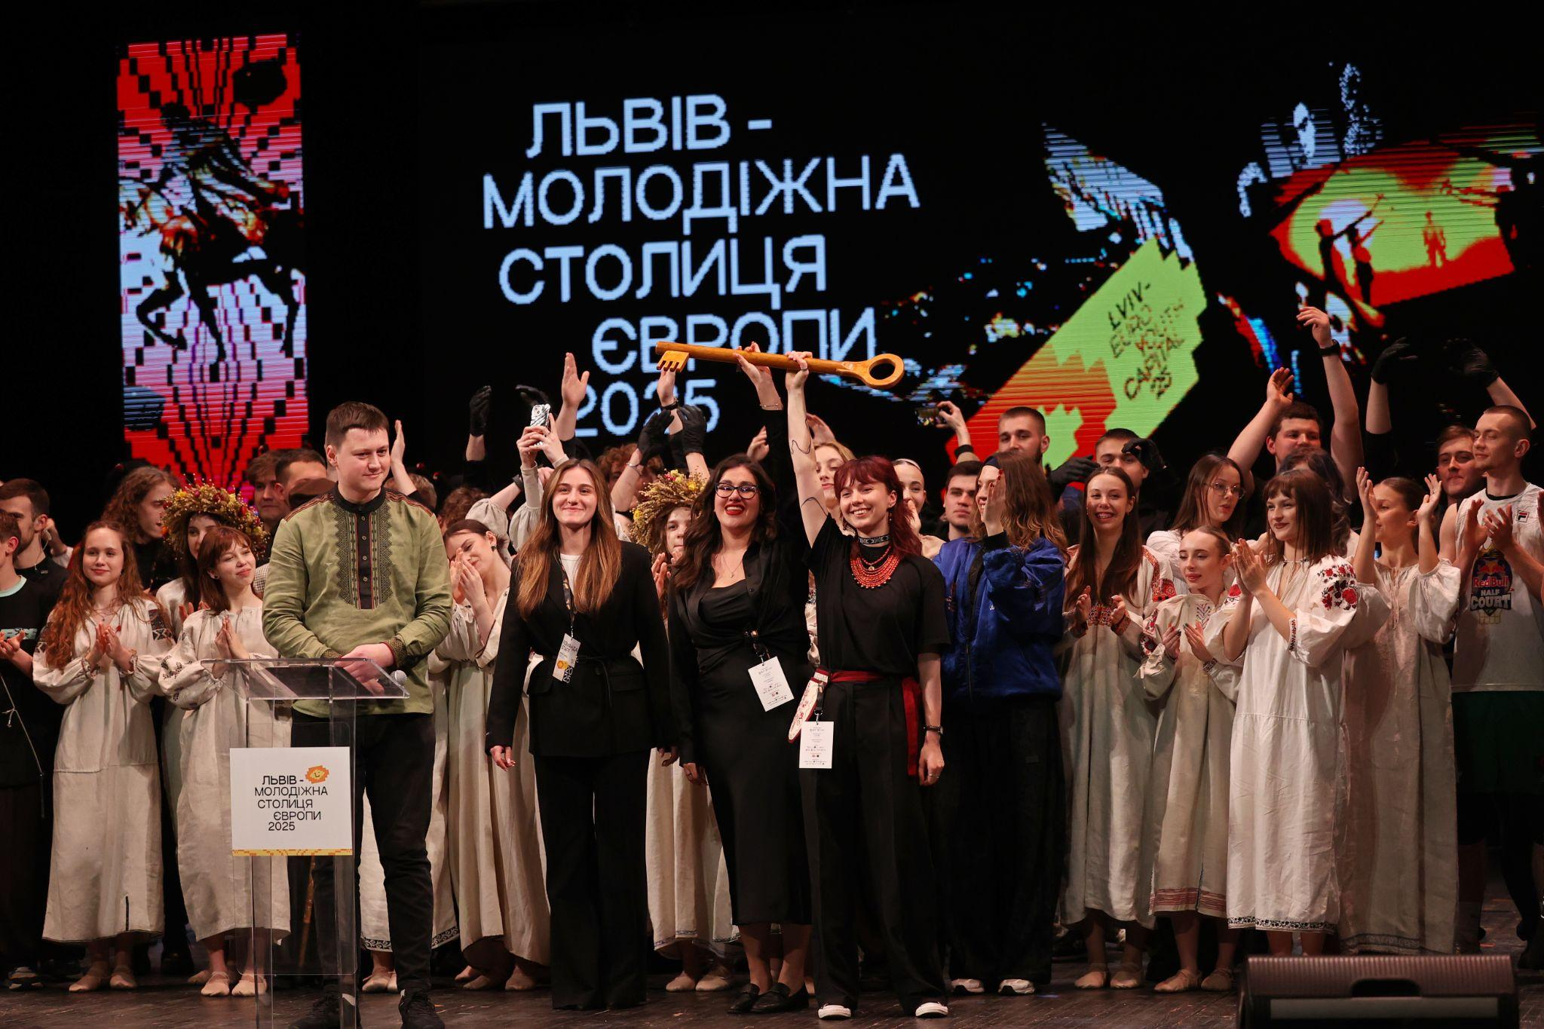
LVIV - EUROPEAN YOUTH CAPITAL 2025

Slide 8
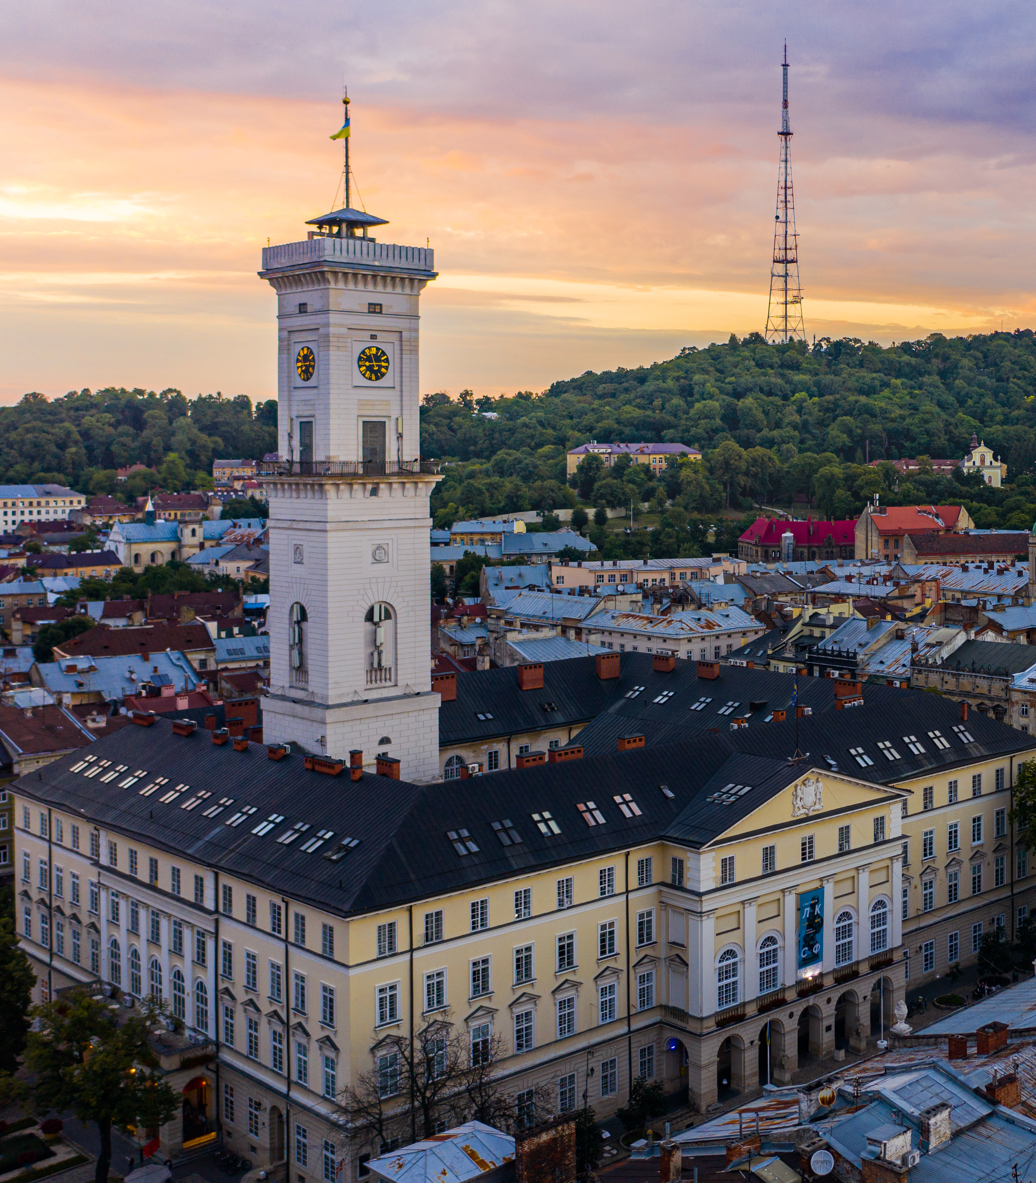
PROJECTS
Notes:
Innovating Resilience in Wartime

Slide 9
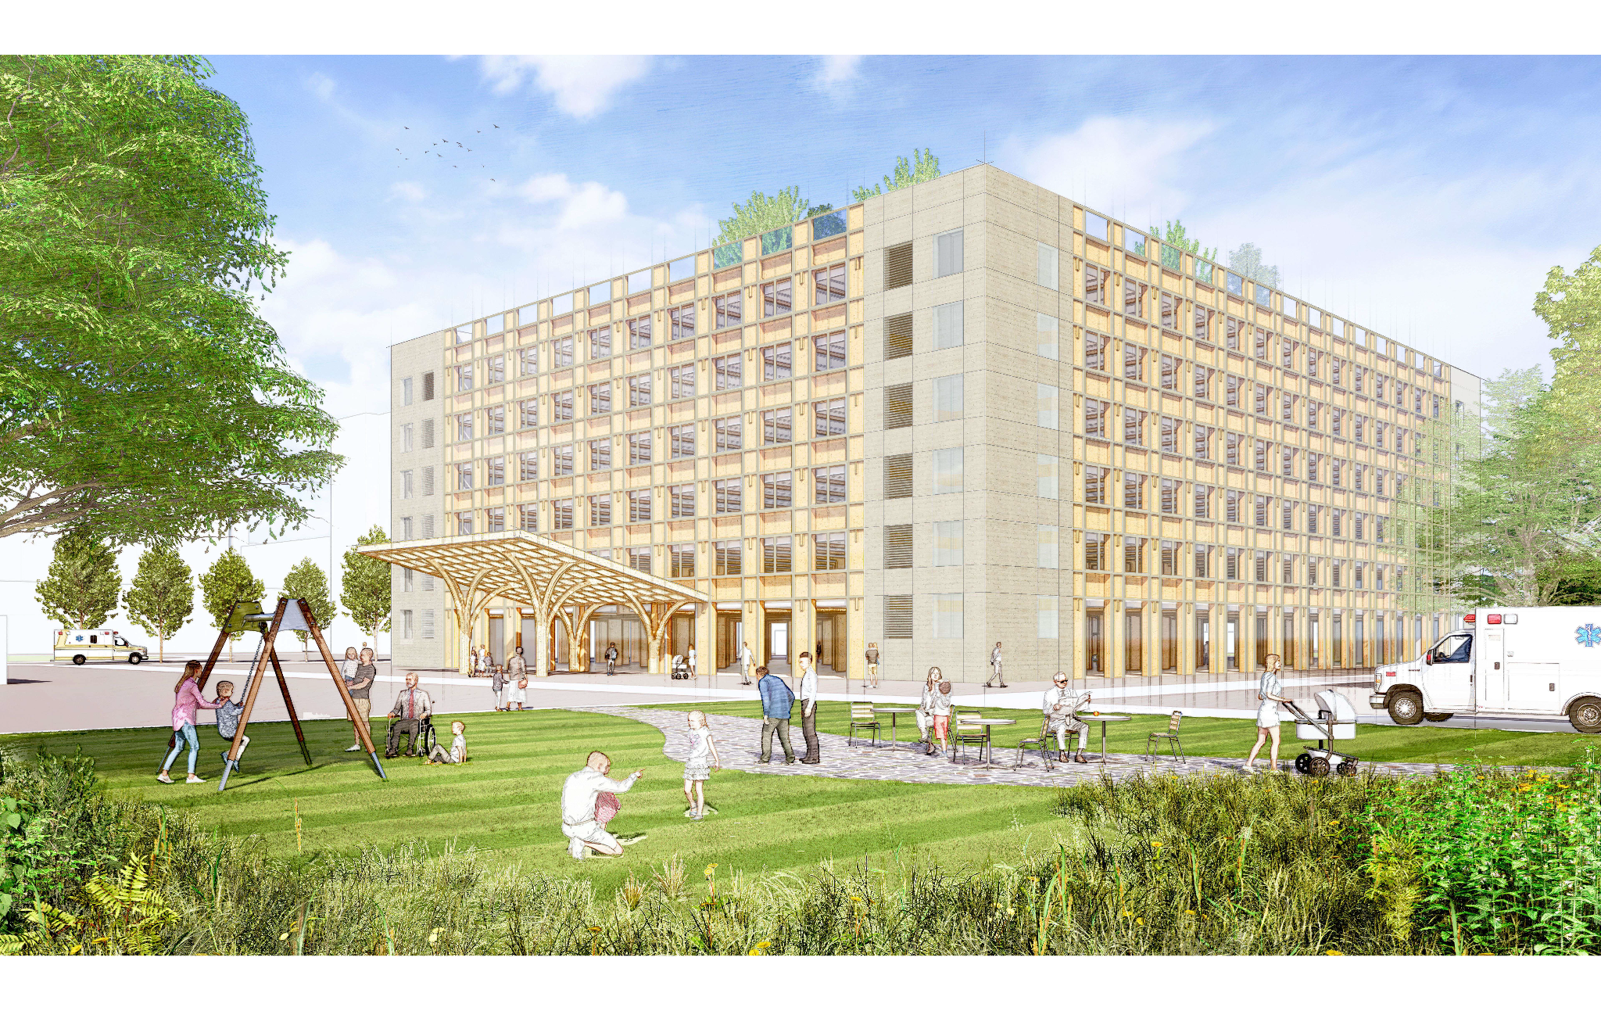
PROJECT 1: NEW UNBROKEN SURGICAL HOSPITAL CONSTRUCTION IN LVIV

Slide 10
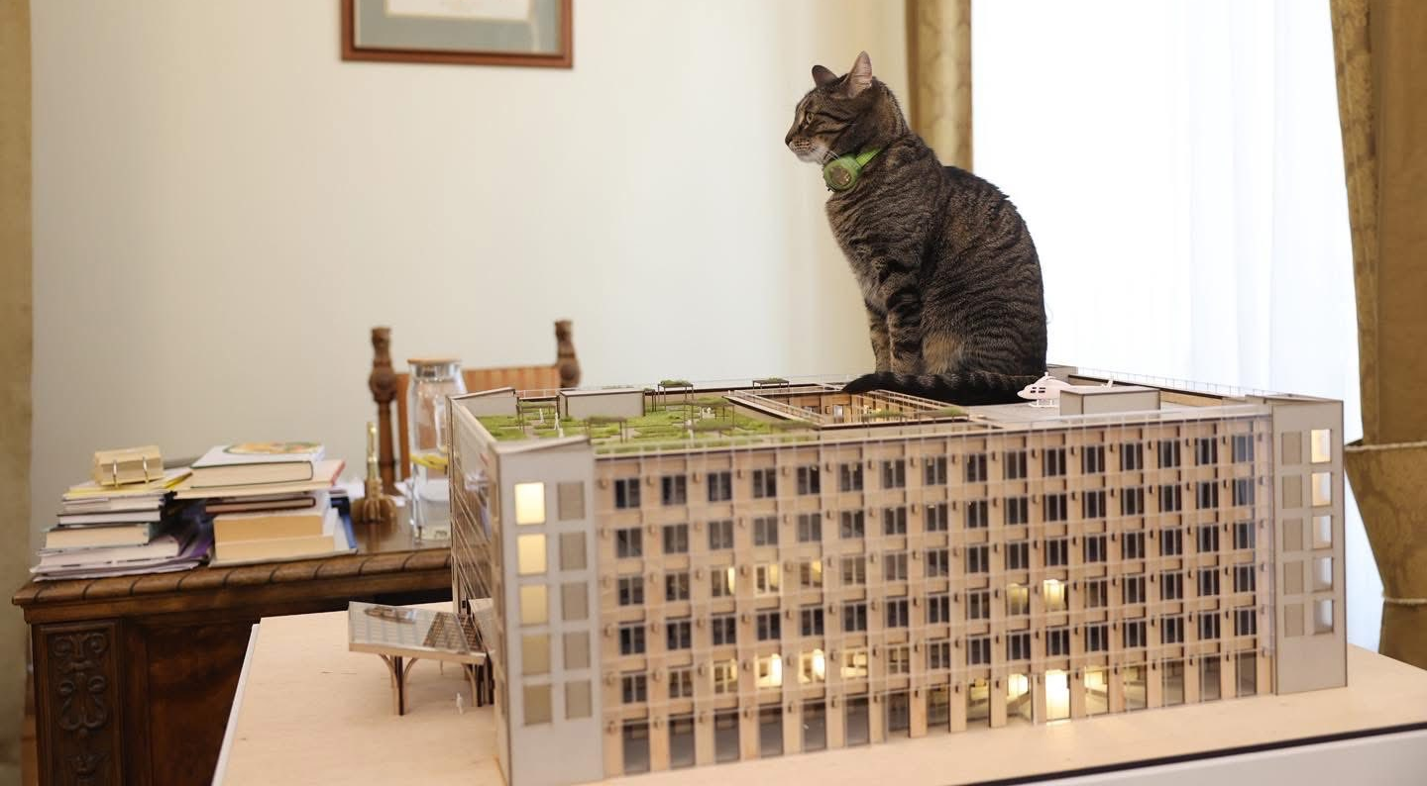
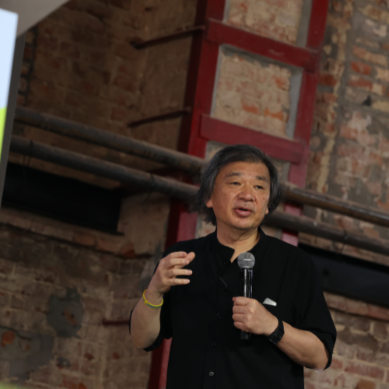
World-famous architect SHIGERU BAN
will design and build a new surgery center
Notes:
Innovating Resilience in Wartime

Slide 11
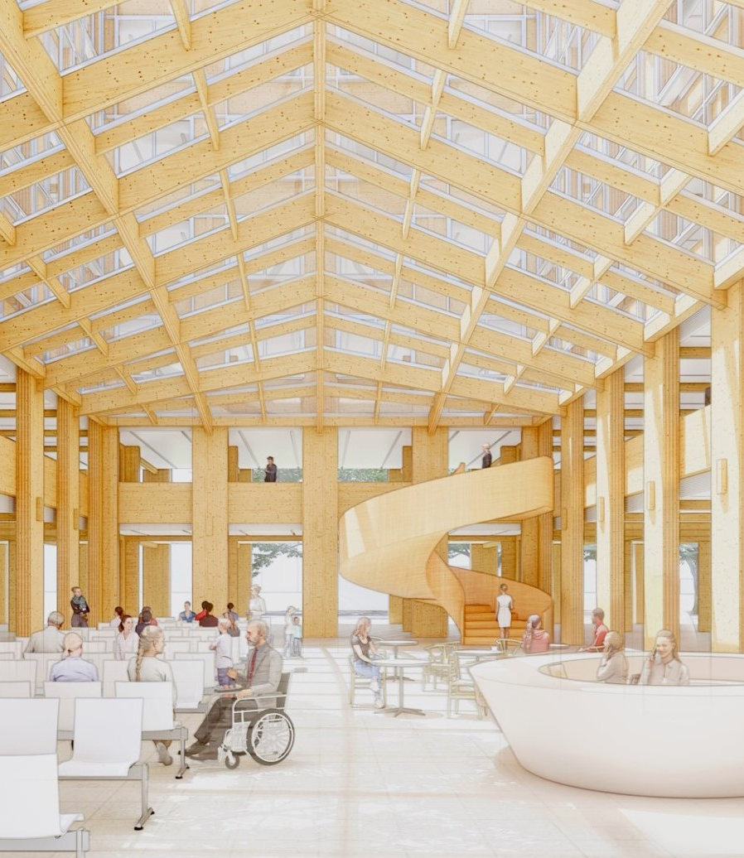

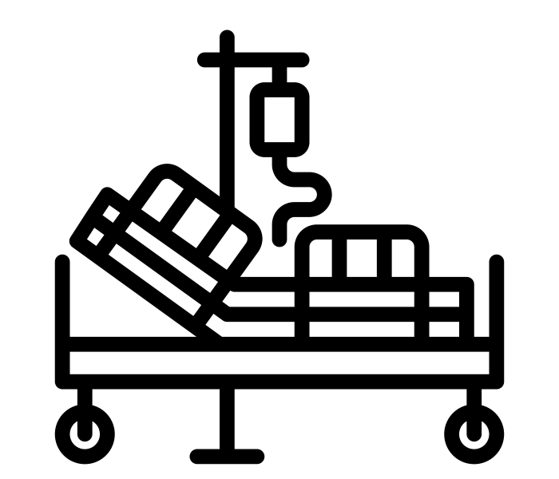

PROJECT 1: NEW UNBROKEN SURGICAL HOSPITAL CONSTRUCTION IN LVIV
Project goal:
To strengthen the UNBROKEN rehabilitation ecosystem because of growing demand for emergency surgery related to war injuries.
Building characteristics:
7 flors
31 500 м²
Total area
220 beds
In the Center
Materials:
wood and concrete
Medical services:
oncology
organ transplantation
intensive care
cardiac surgery
rehabilitation
Estimated cost: 94 Mln Euro

Slide 12
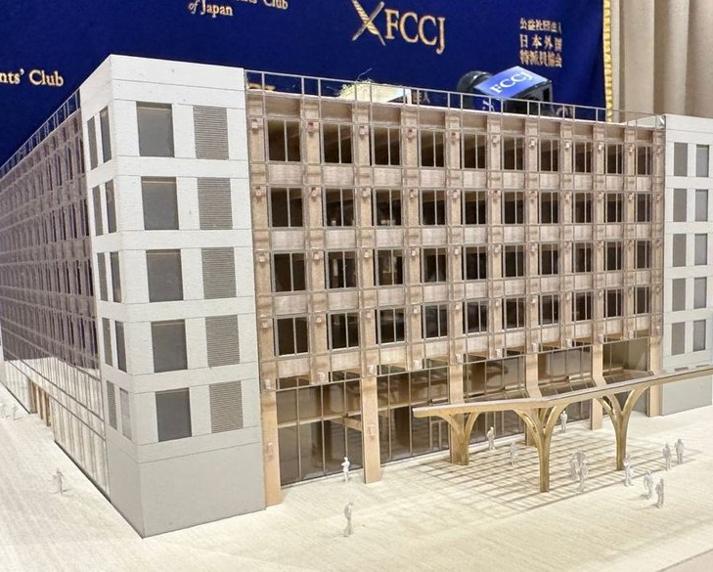
PROJECT 1: NEW UNBROKEN SURGICAL HOSPITAL CONSTRUCTION IN LVIV
Investment model
Public-private partnership mechanism with the involvement of a private partner.
The private partner must provide Financing - Construction, Equipment and Maintenance.
Public Partner - Lviv City Council, will attract grant funding to cover part of the capital costs and operate the Surgery Hospital.
Financial model
50% – donor grant funds attracted by the Public Partner (Lviv City Council).
50% – private partner funding.
Private partner returns funds from the public partner for operational readiness (availability payments) within 15–20 years after the facility is put into operation.

Slide 13





PROJECT 1: NEW UNBROKEN SURGICAL HOSPITAL CONSTRUCTION IN LVIV
Our partners:
Where are we now?
Project design - almost completed
Feasibility study – in progress
PPP tender – IQ of 2026
What are we looking for?
Partners and donors
Medical equipment or funding
Private partner for PPP project

Slide 14
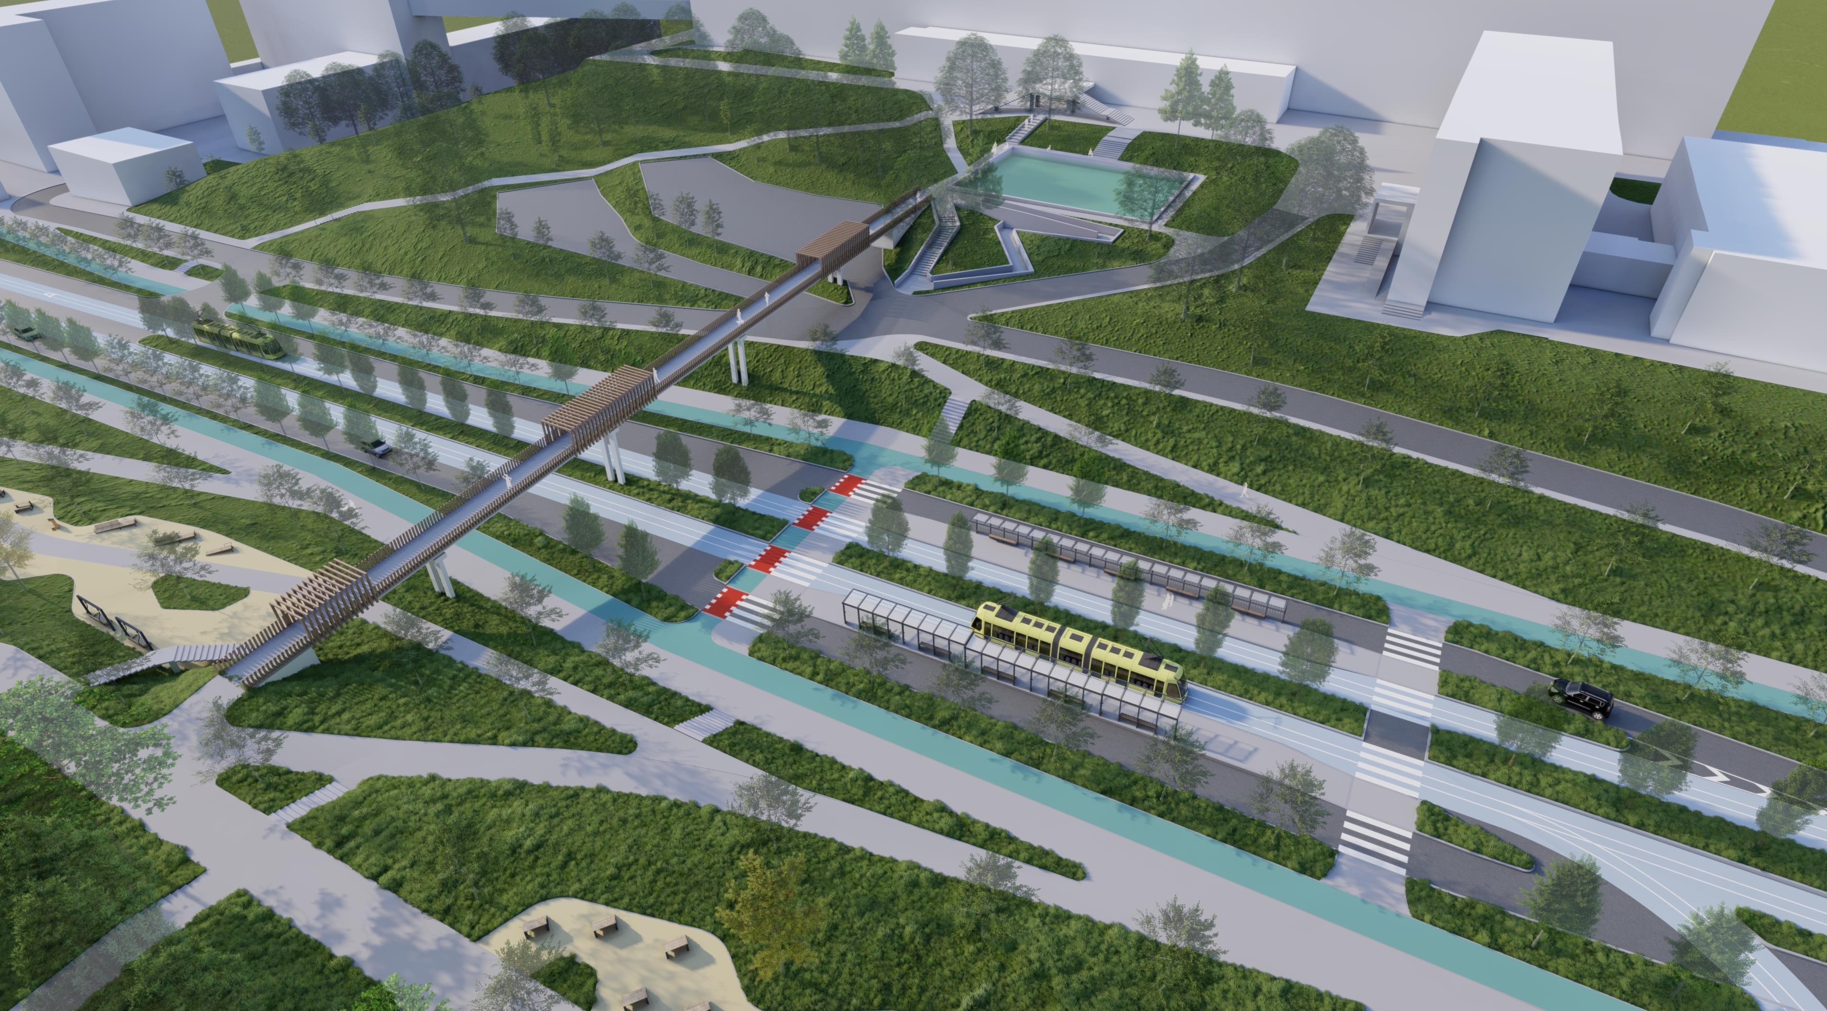
PROJECT 2: Construction of a tram line
to the Unbroken rehabilitation ecosystem in Lviv

Slide 15
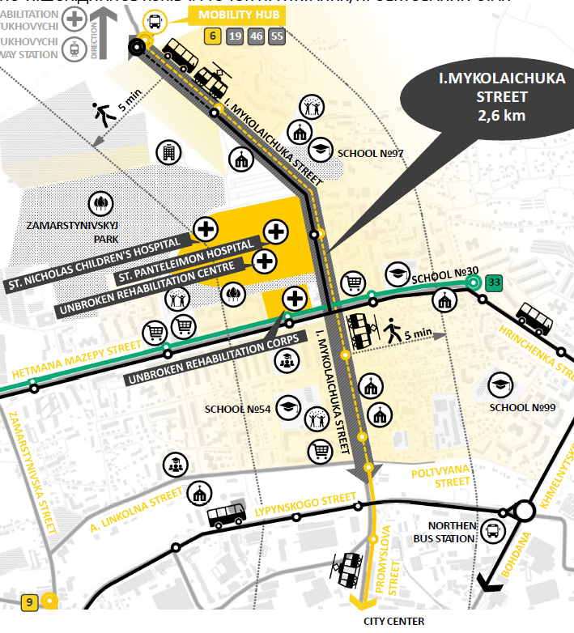
Project goal:
improving transport accessibility to the Unbroken Rehabilitation ecosystem and north city district.
Project include:
improving transport accessibility to the Unbroken Rehabilitation ecosystem
reconstruction of the Mykolaychuka street.
construction of a tram line,
separate lanes for public transport and emergency services,
bicycle infrastructure.
Estimated cost: 64 Mln Euro

Slide 16
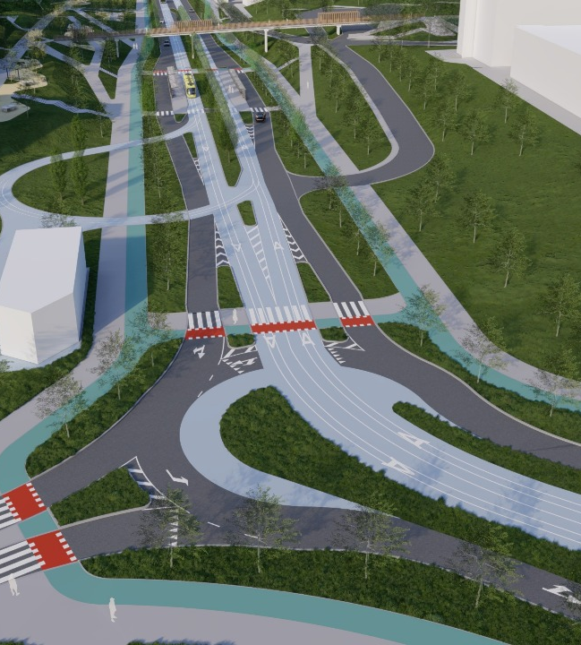

PROJECT 2: Construction of a tram line
to the Unbroken ecosystem
Our partners:
Where are we now?
Preparation for the construction tender for the first stage
Negotiation of cooperation terms with AFD for the 2nd and 3rd stages
What are we looking for?
Partners and donors for next stages
Funding
technical consultant and construction contractor

Slide 17
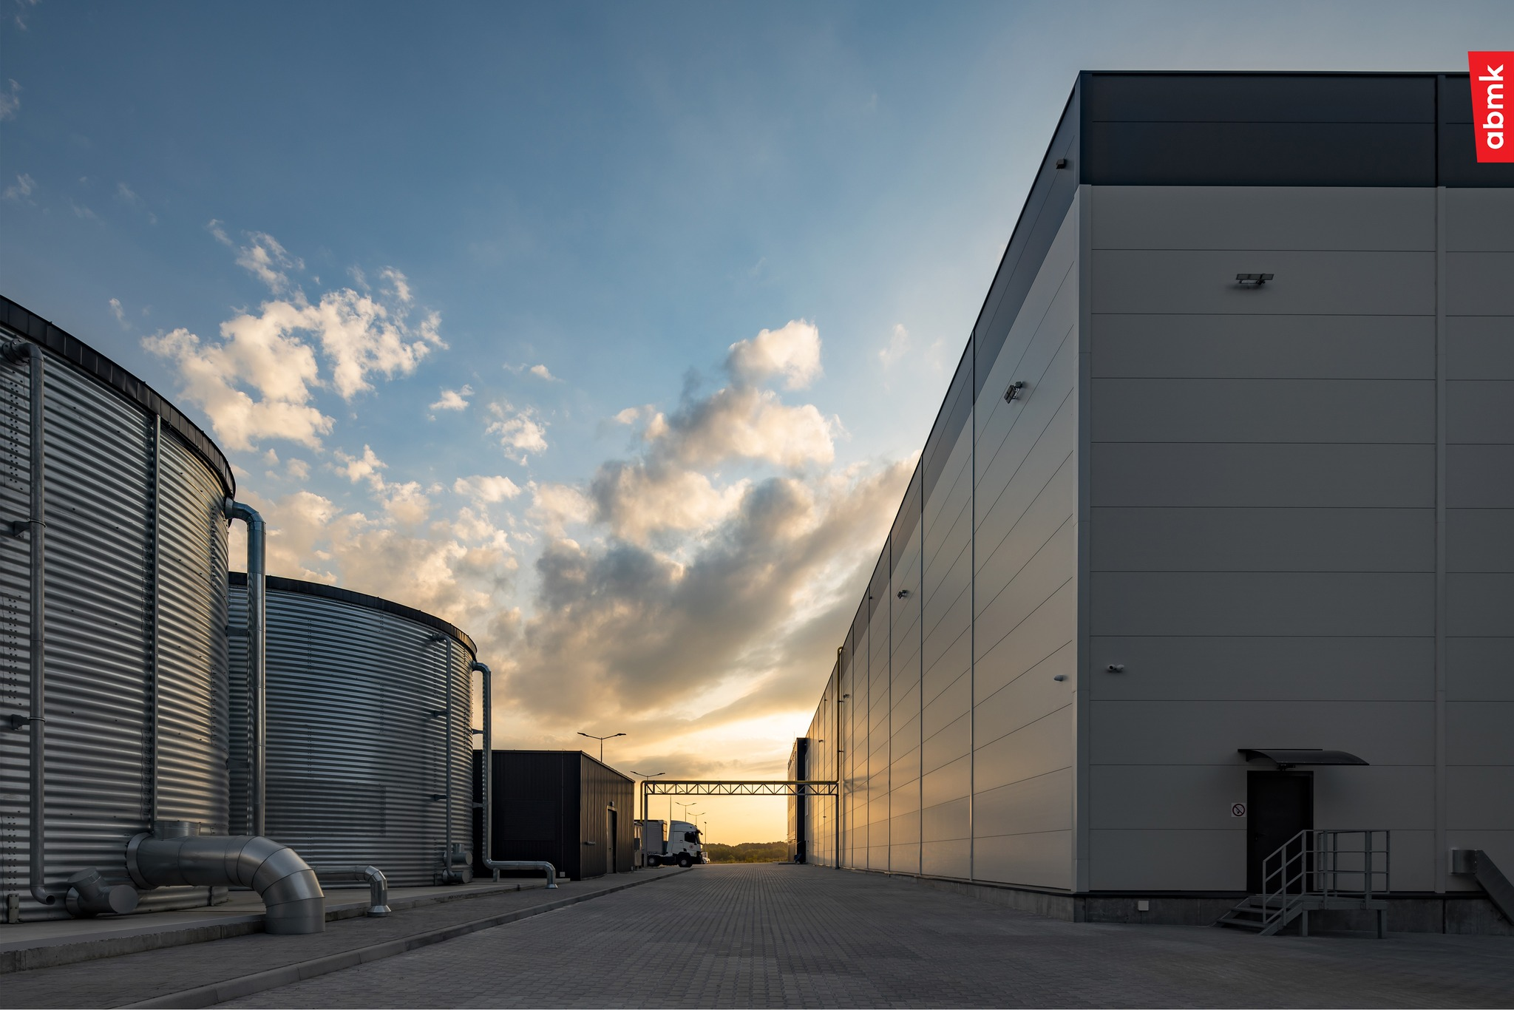
PROJECT 3: NEW INDUSTRIAL ZONE IN LVIV

Slide 18
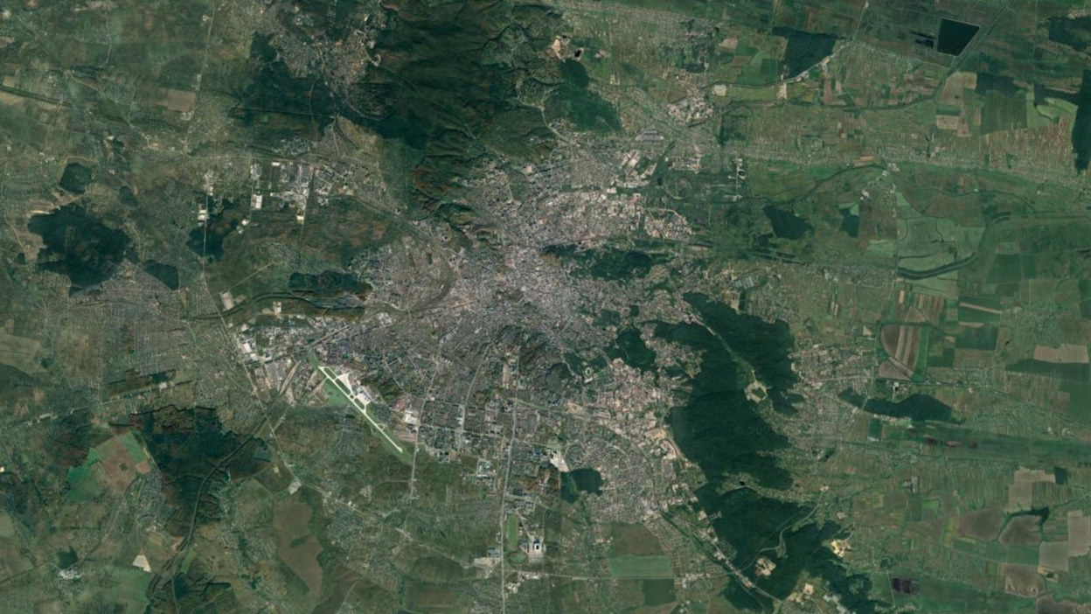
New Industrial zone
Area - 120 ha
Poland
KYIV
Railway
station
City center
Airport
LVIV
Ring road
Ring road

Slide 19
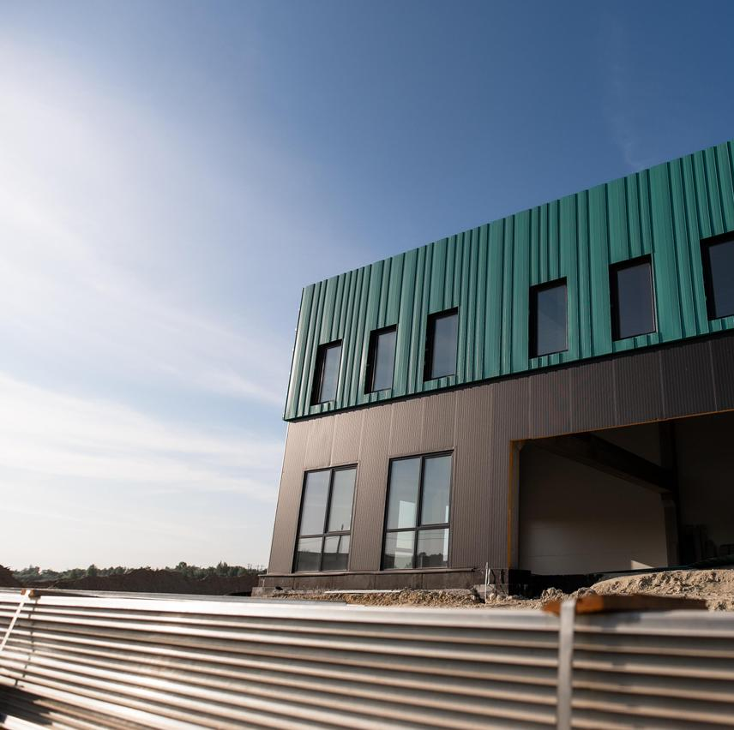
NEW INDUSTRIAL ZONE IN LVIV
Project goal:
creation and development of a new industrial zone in Lviv, for the implementation of private investment industrial projects.
Area - 120 ha
Investment model
creation of new industrial parks
implementation of investment projects with significant investments
purchase of land plots for ownership and lease

Slide 20
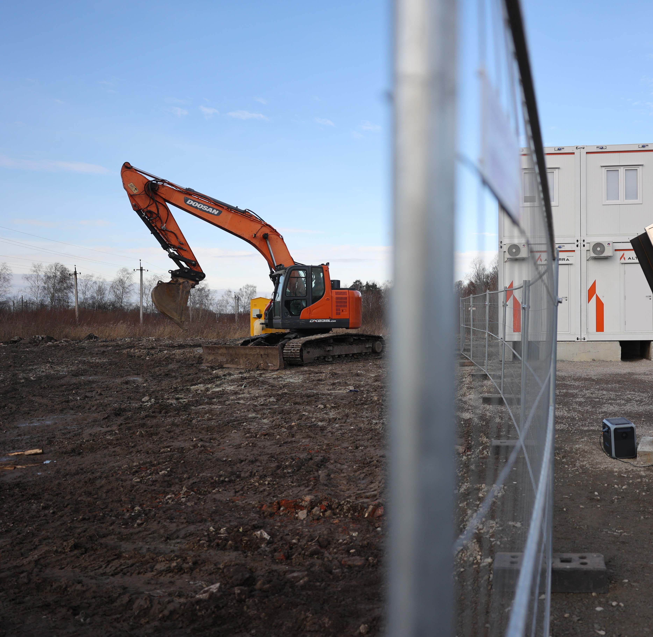

NEW INDUSTRIAL ZONE IN LVIV
Our partners:
Where are we now?
Master plan of the territory - in progress
Memorandum of cooperation with the first investor - was signed
What are we looking for?
Private investors
Industrial projects

Slide 21
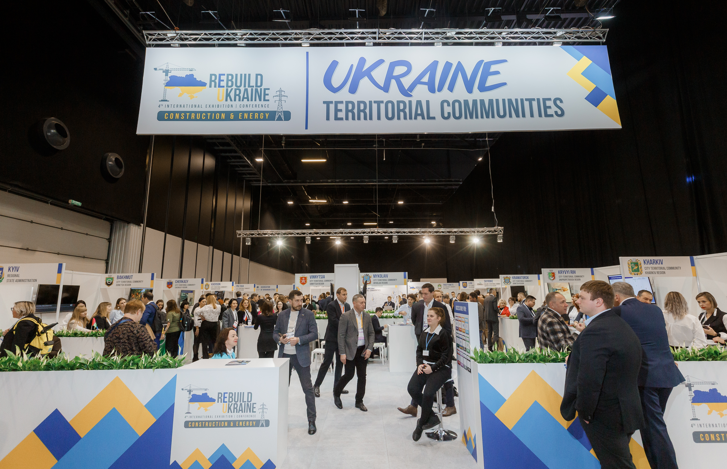
You are welcome you
to visit the Lviv stand!

Slide 22
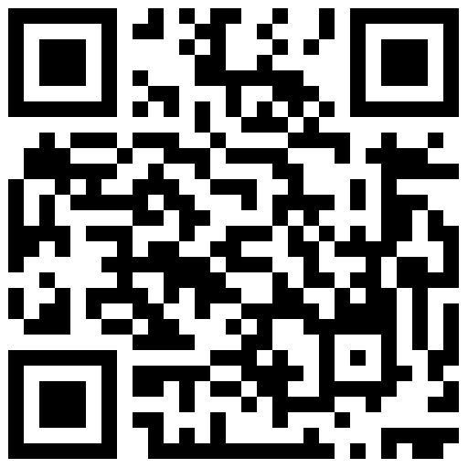
Contact us:
Andrii PAVLIV,
Head of Investment and Projects Office of Lviv City Council
E-mail: invest@lvivcity.gov.ua
Phone: +38032-254-6006
investinlviv.com
Notes:
Innovating Resilience in Wartime

