Slide 1


Reconstruction and development of healthcare facilities in the Trostyanets community

Slide 2
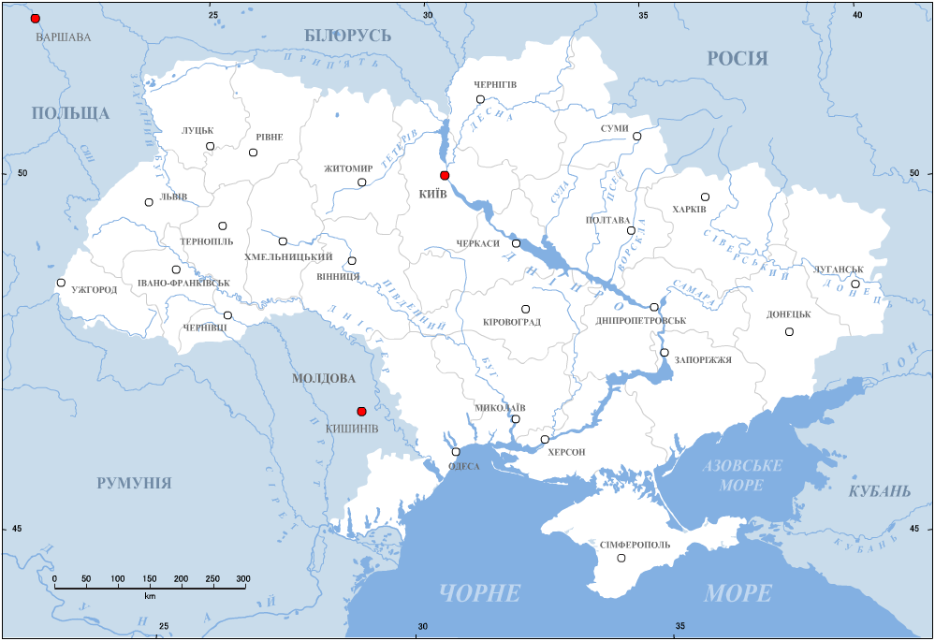
The location of Trostyanets
1200 km
Trostyanets
35 km
364 km
120 km
110 km
551 km
702 km

Slide 3
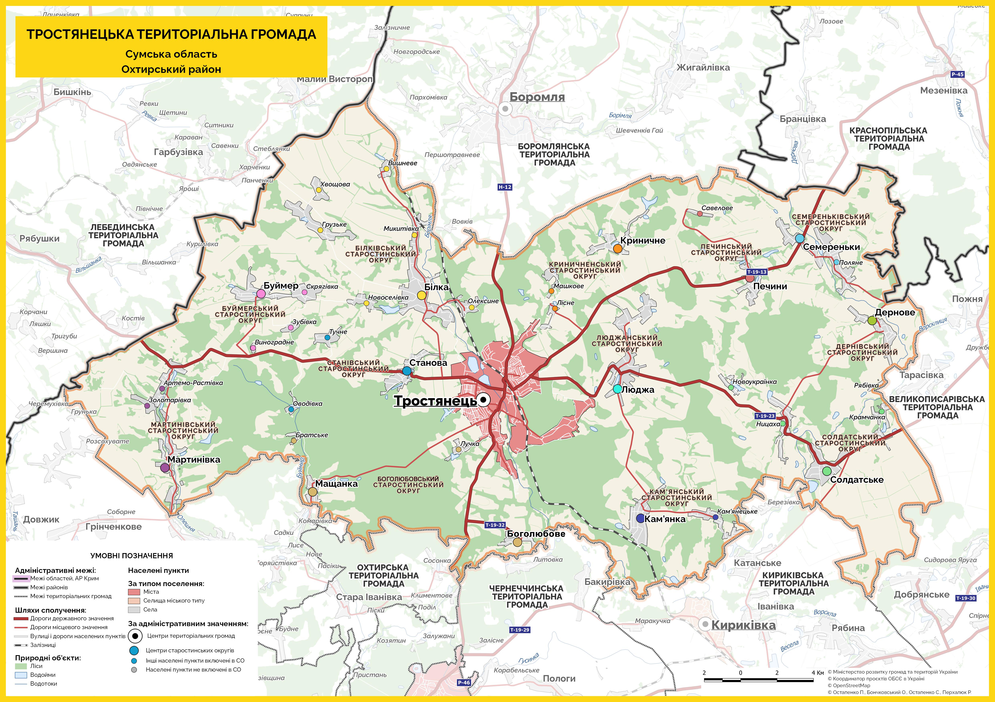
Overview of the
Trostyanets Community
Trostyanets city territorial community:
38 settlements
12 village districts
Trostyanets – administrative center
Population – 26,942 people
Total area of the community – 78,865.85 hectares
The following routes pass through the community:
Highway: Sumy – Poltava – Oleksandriya (Hlukhiv – Kharkiv) – N12
Railway line: Kyiv – Sumy – Kharkiv

Slide 4
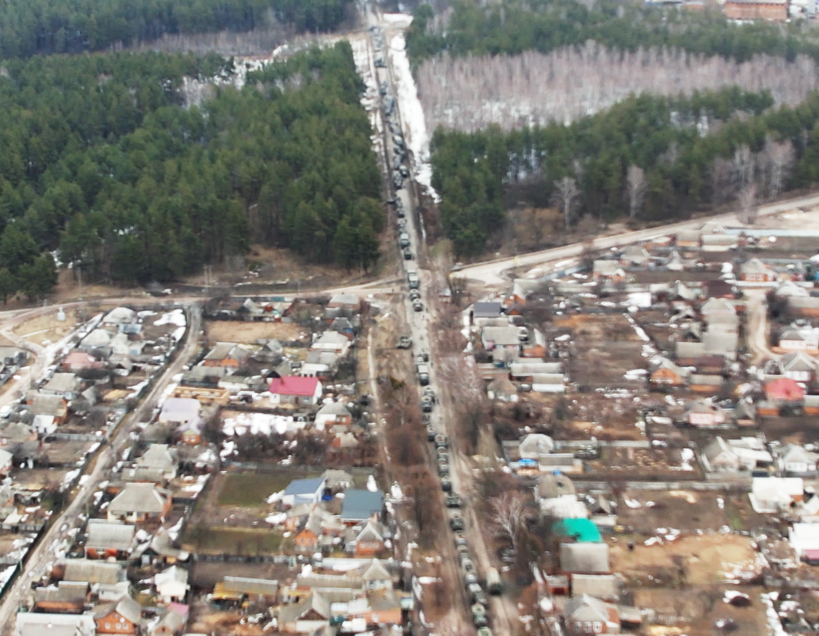
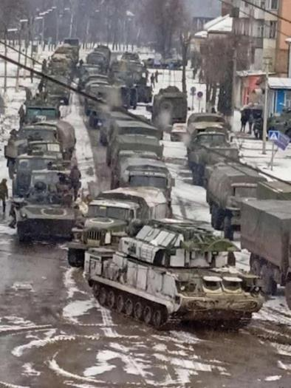
Occupation of the Trostyanets community
February 24, 2022 – March 26, 2022

Slide 5
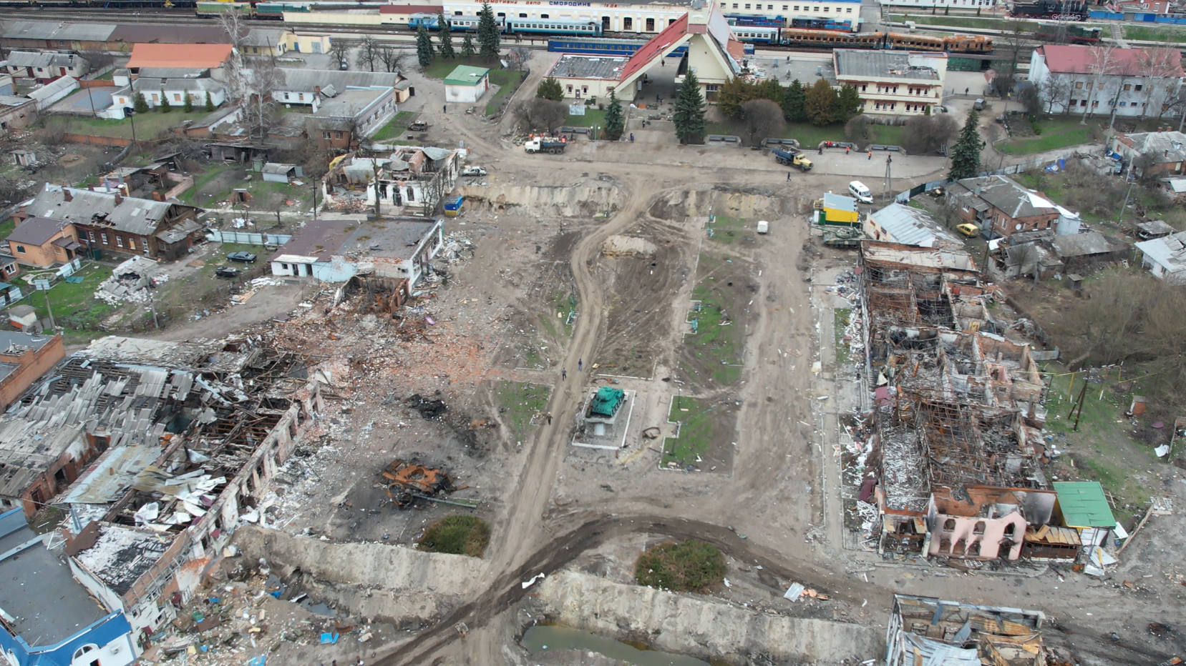
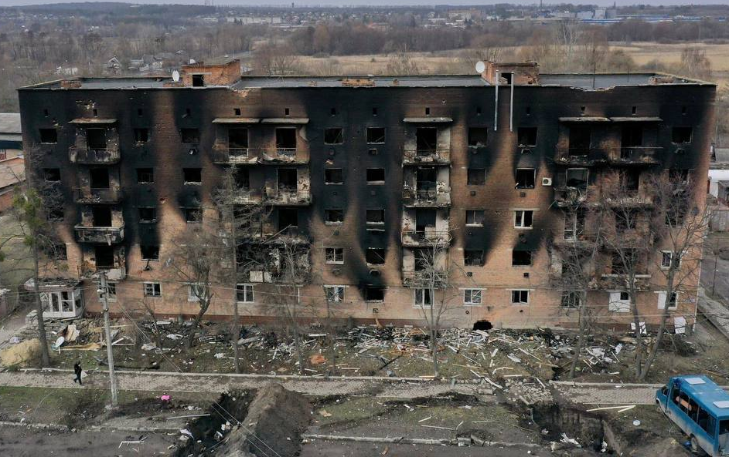
Destruction of Facilities and Damaged
Community Infrastructure

Slide 6
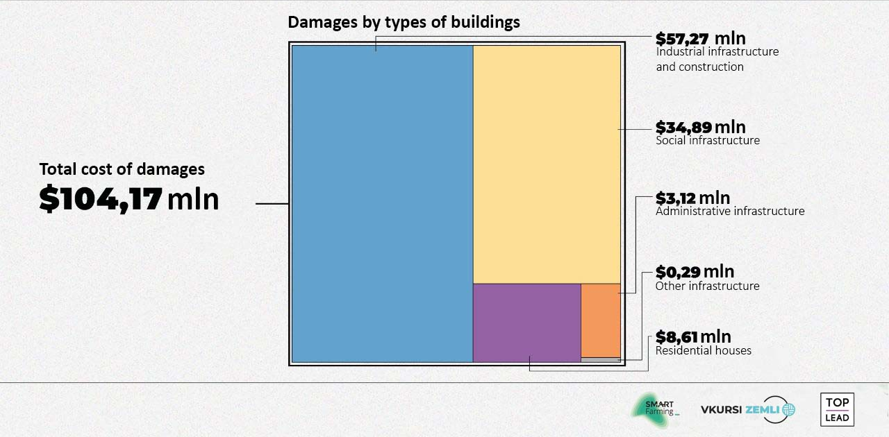
Incurred Losses

Slide 7
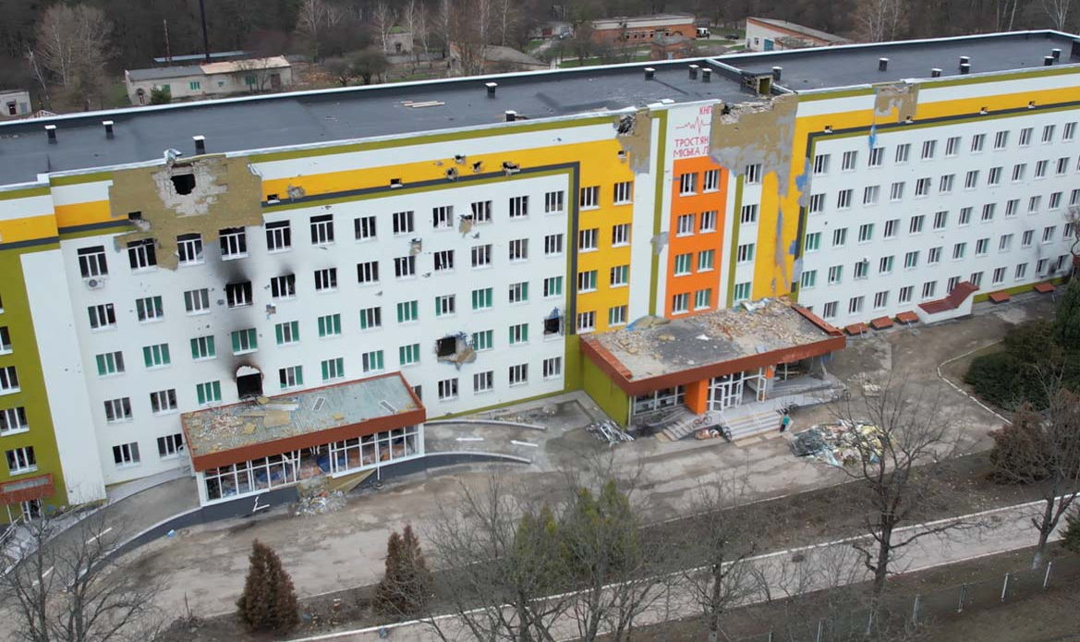
Trostyanets city hospital
Total building area: 12,000 sq. m.
Medical staff: 200 persons
Total capacity:
250 beds
Severe damage caused by Russian tank shelling in March 2022 and as a result of a missile strike in April 2024

Slide 8
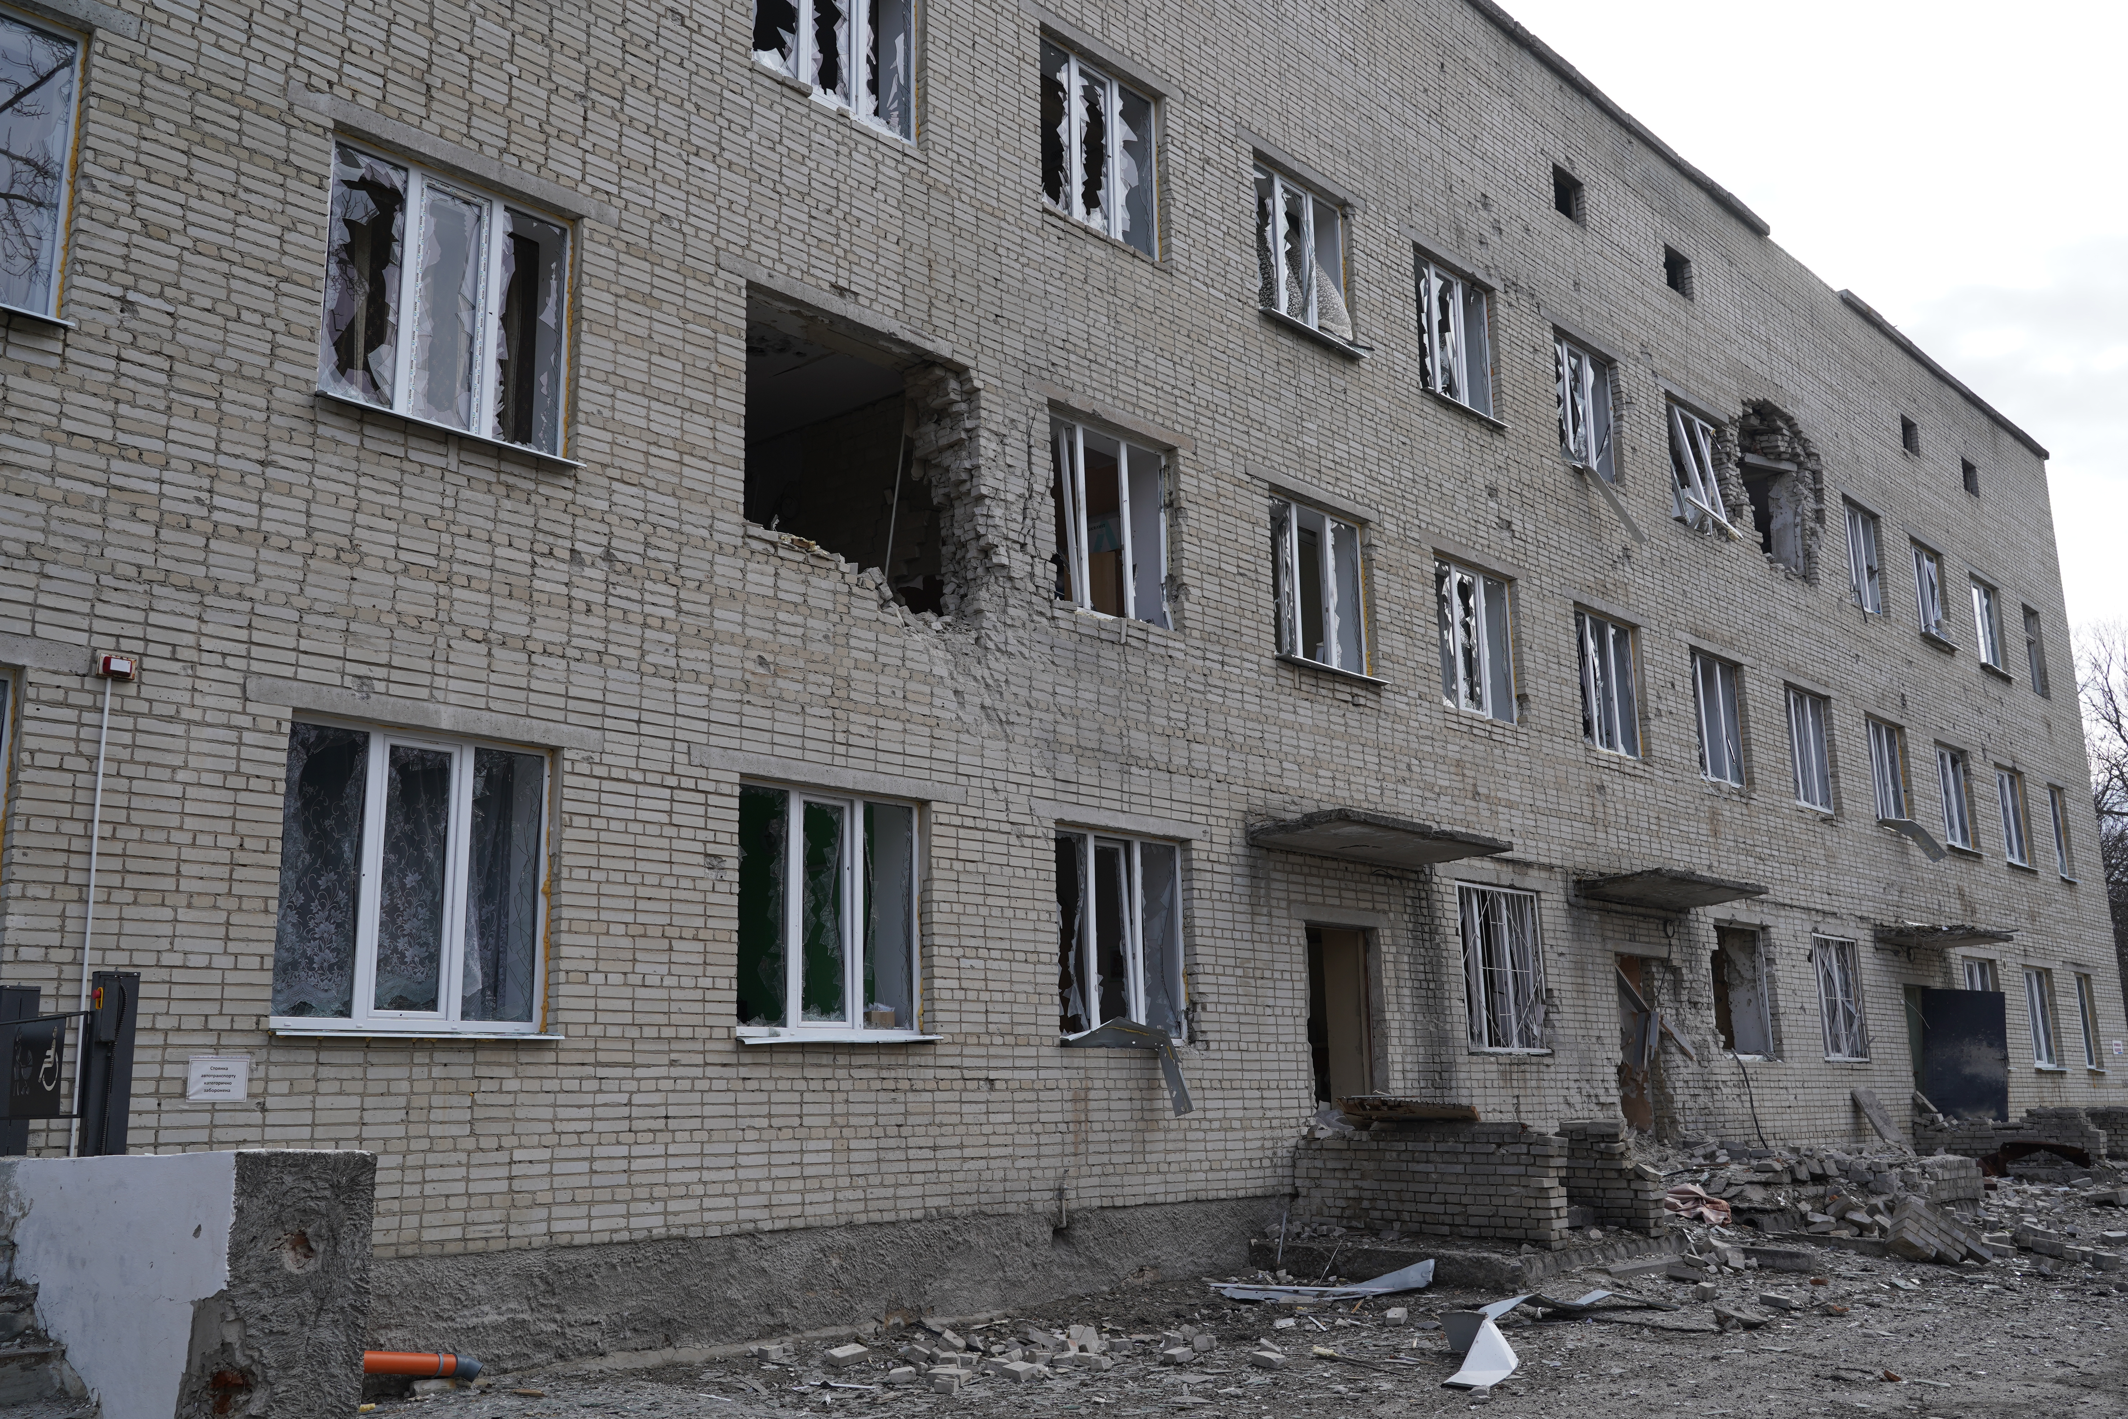
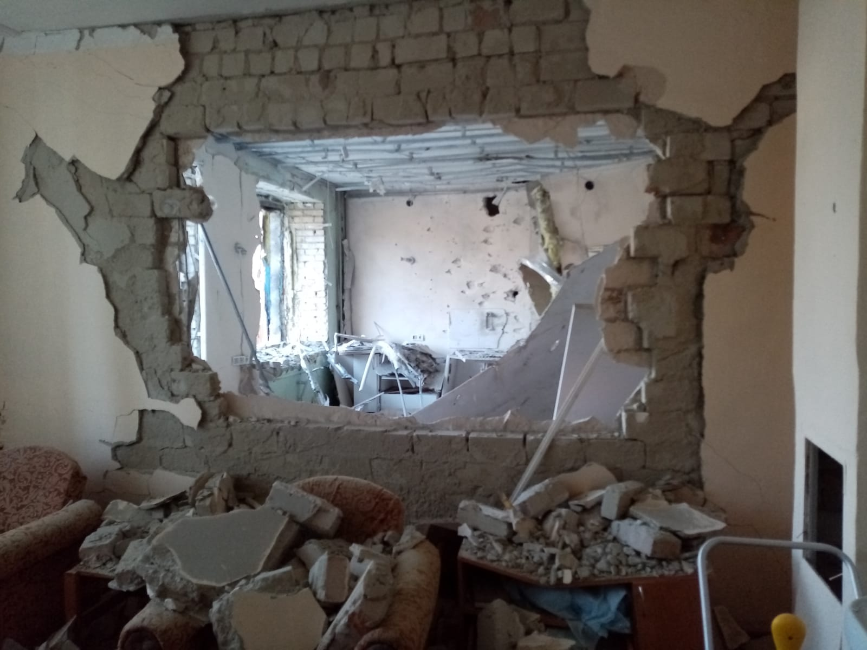
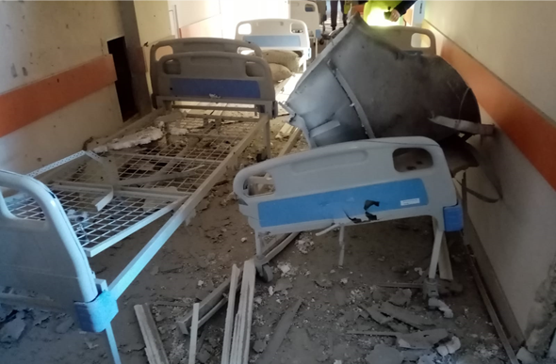
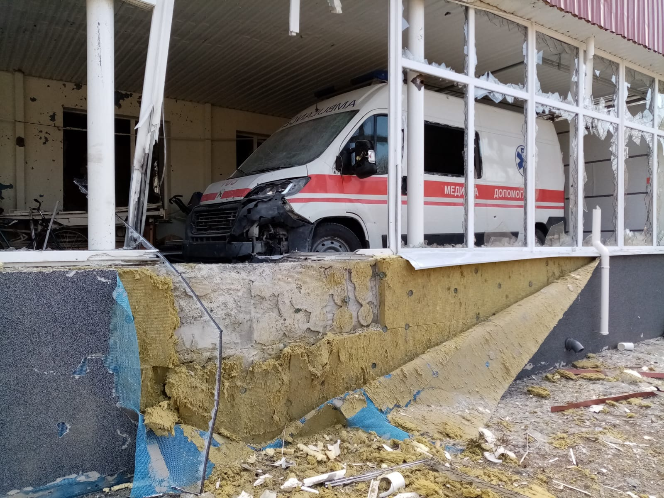
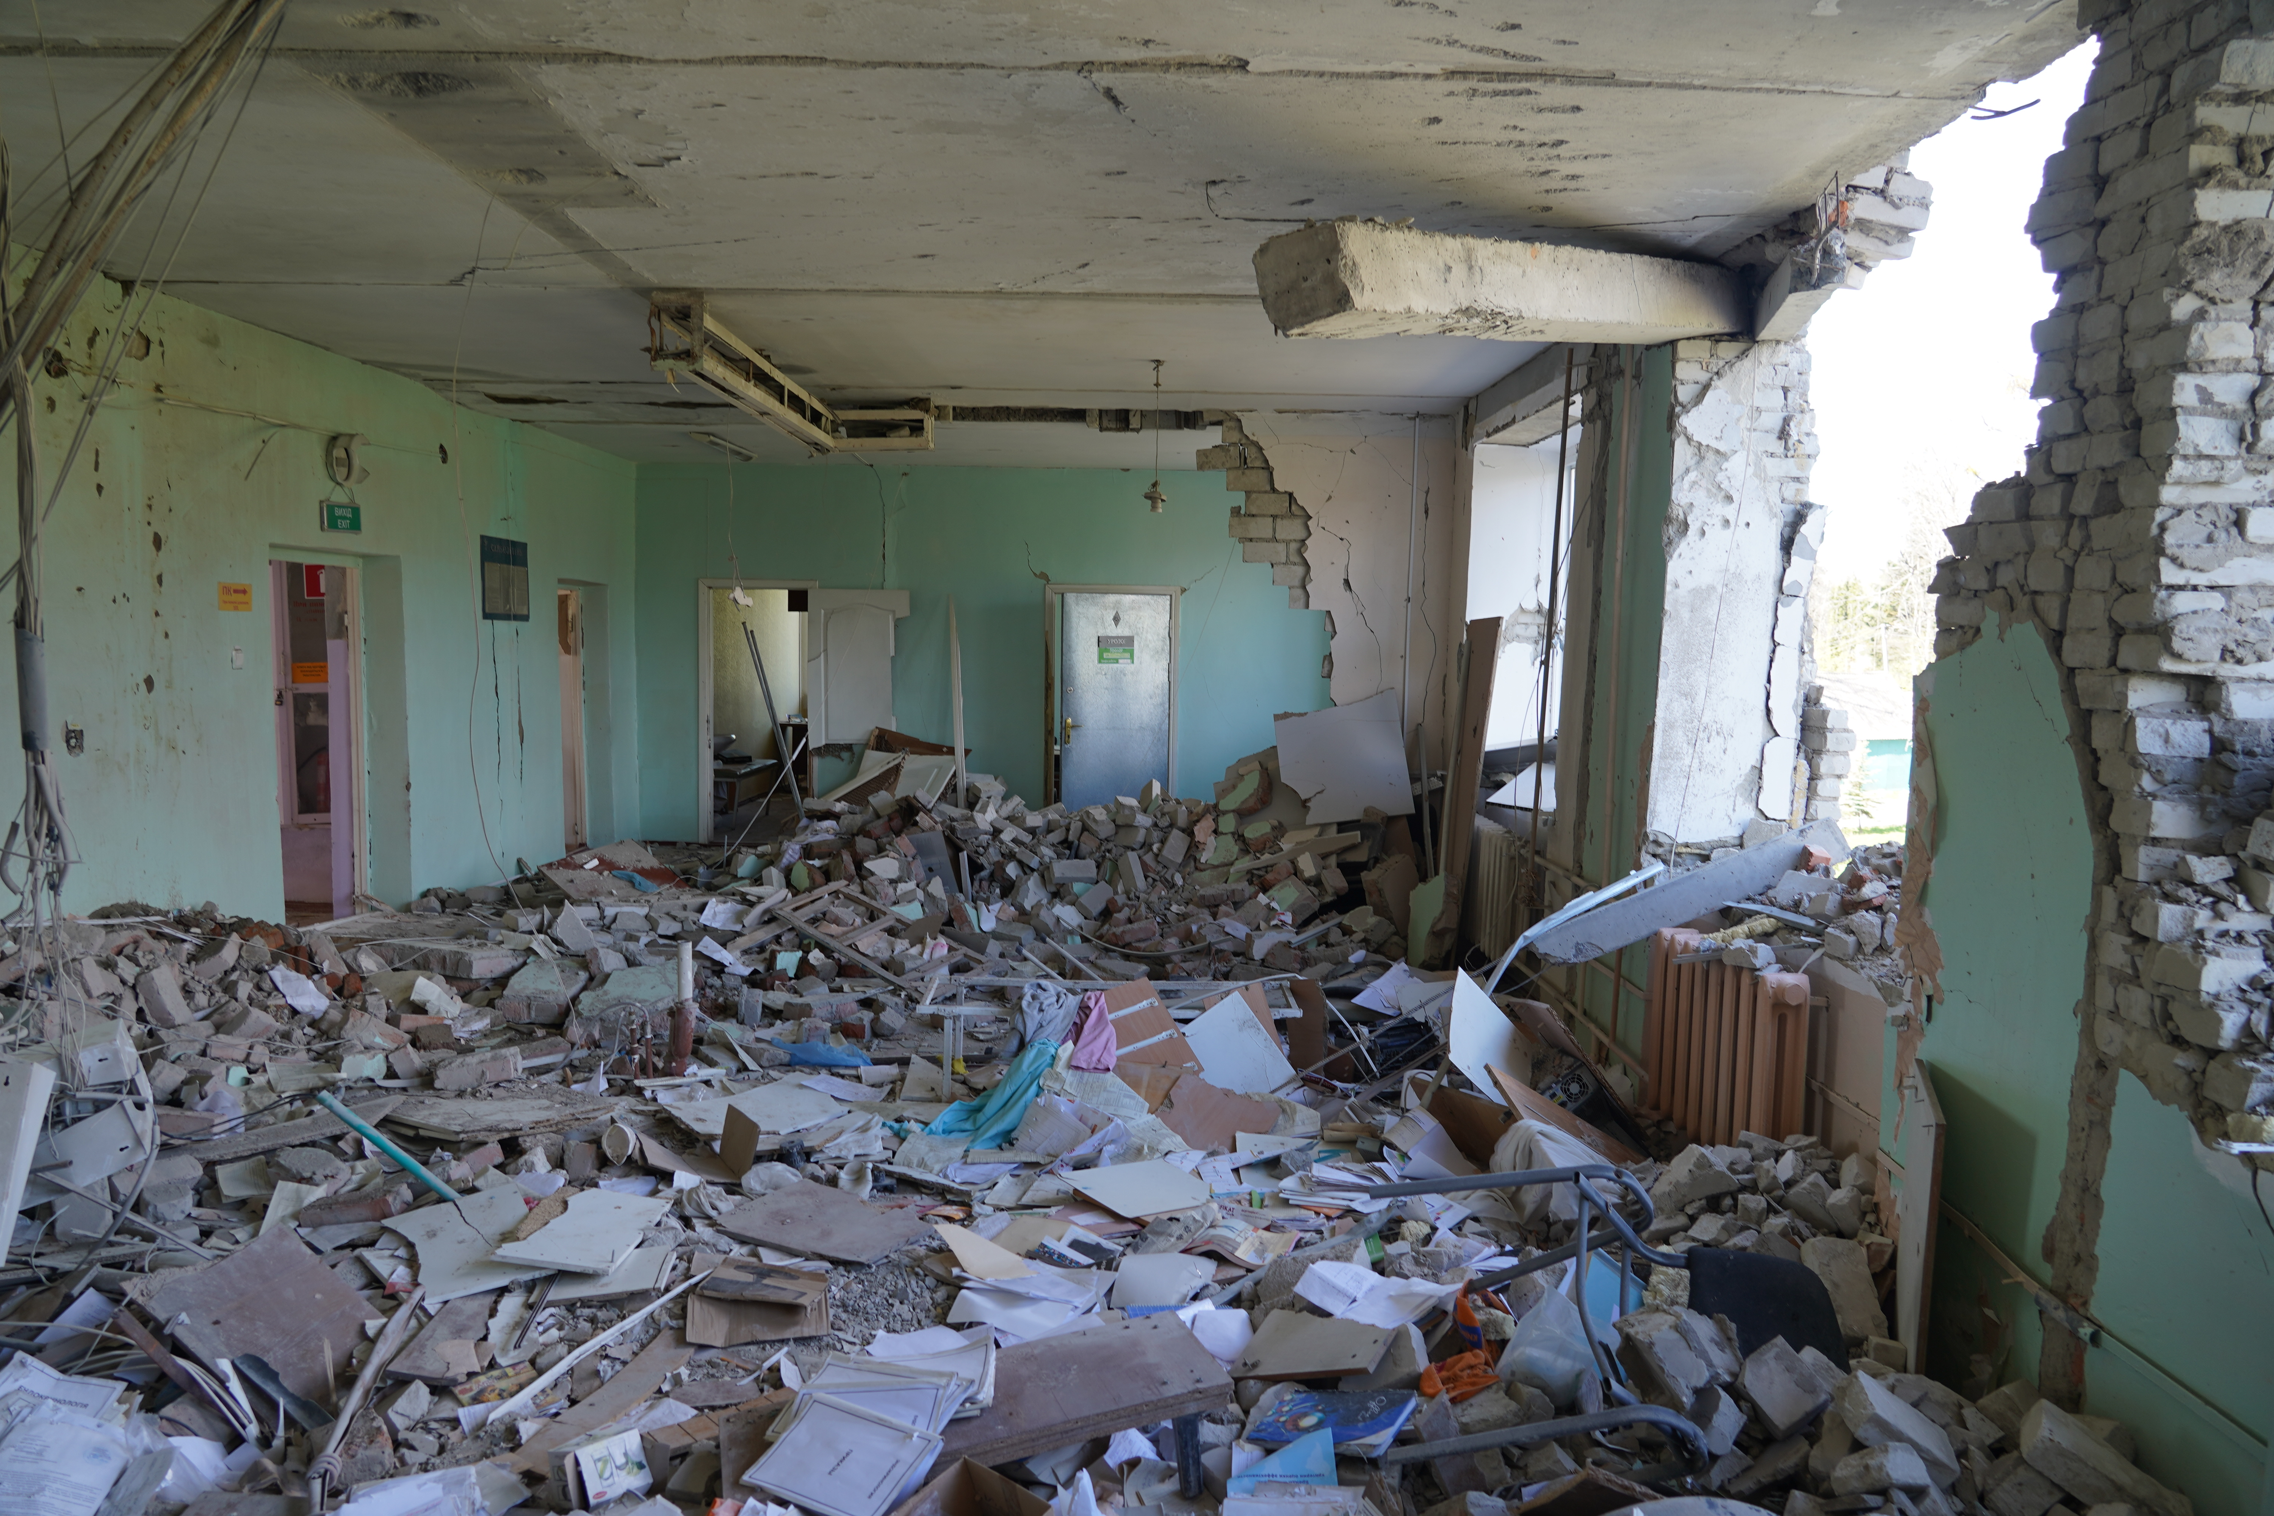
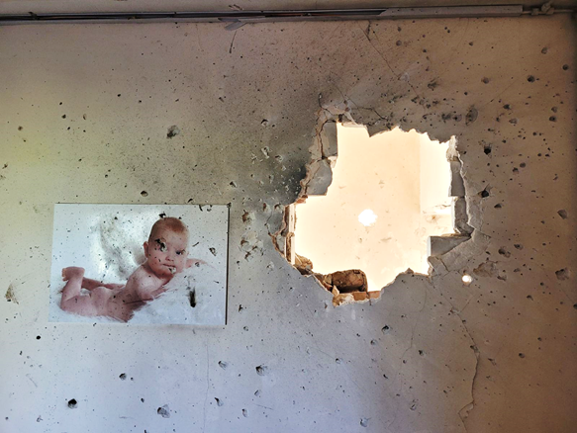
Destruction of the city hospital

Slide 9
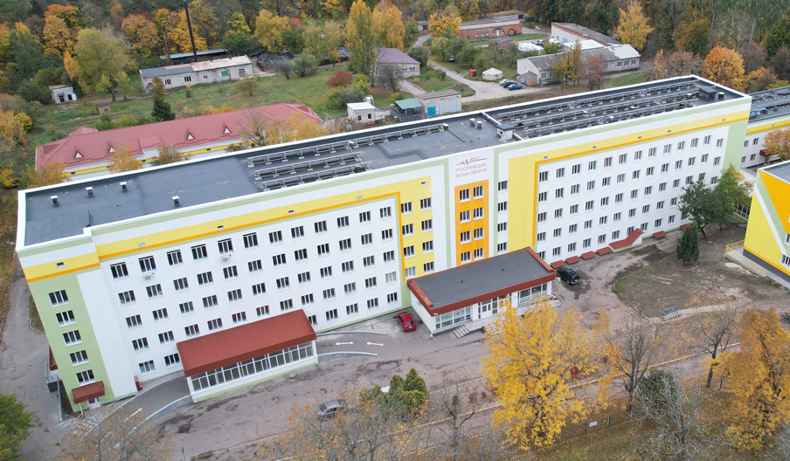
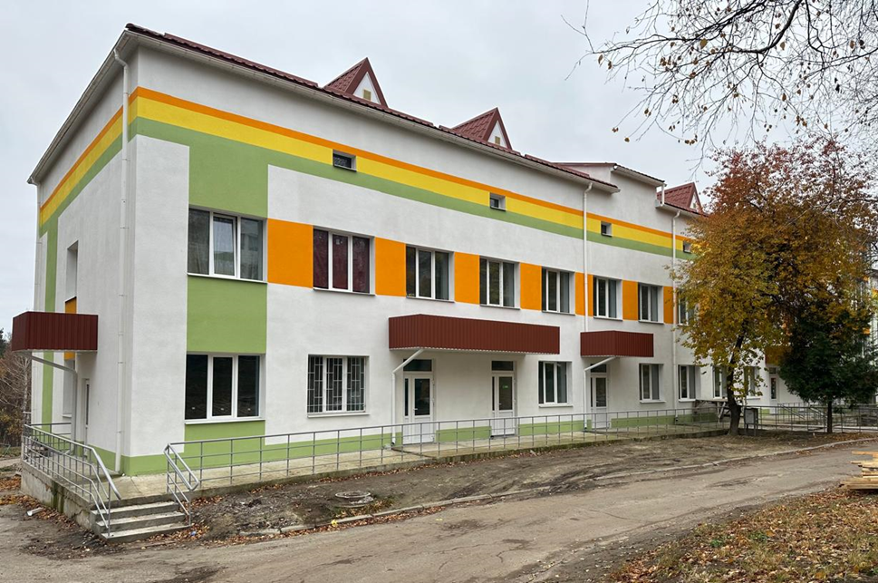
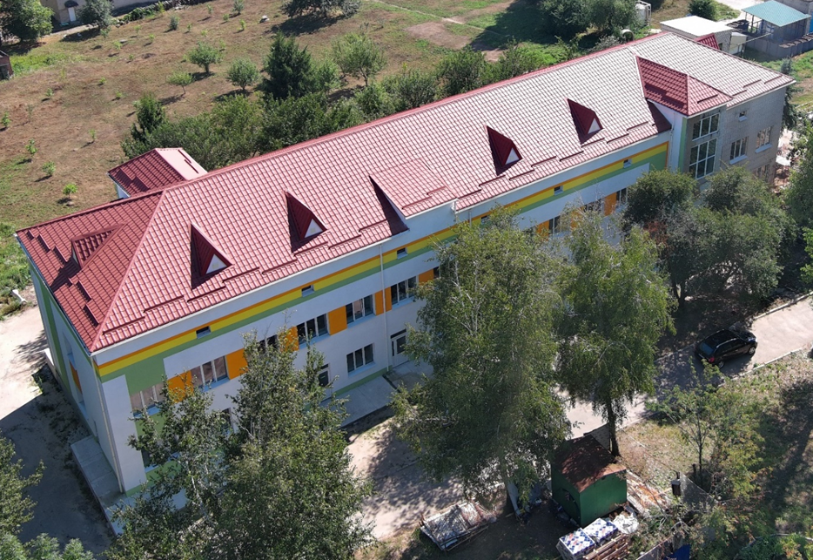
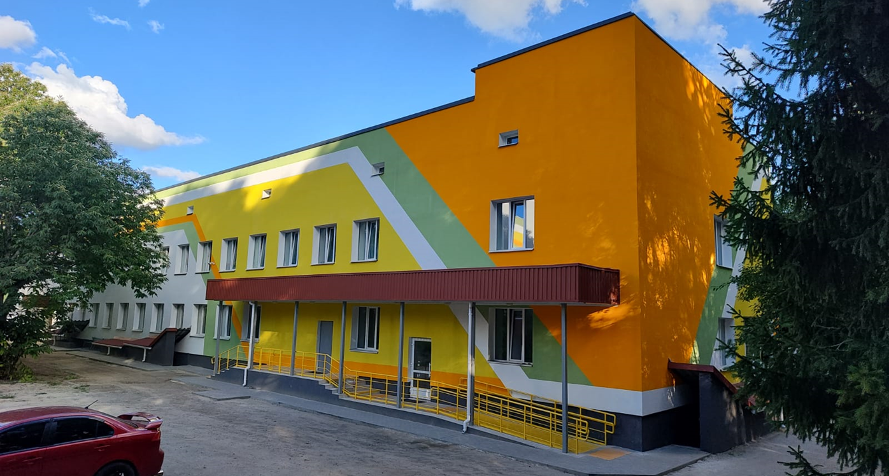
Restoration of the city hospital

Slide 10
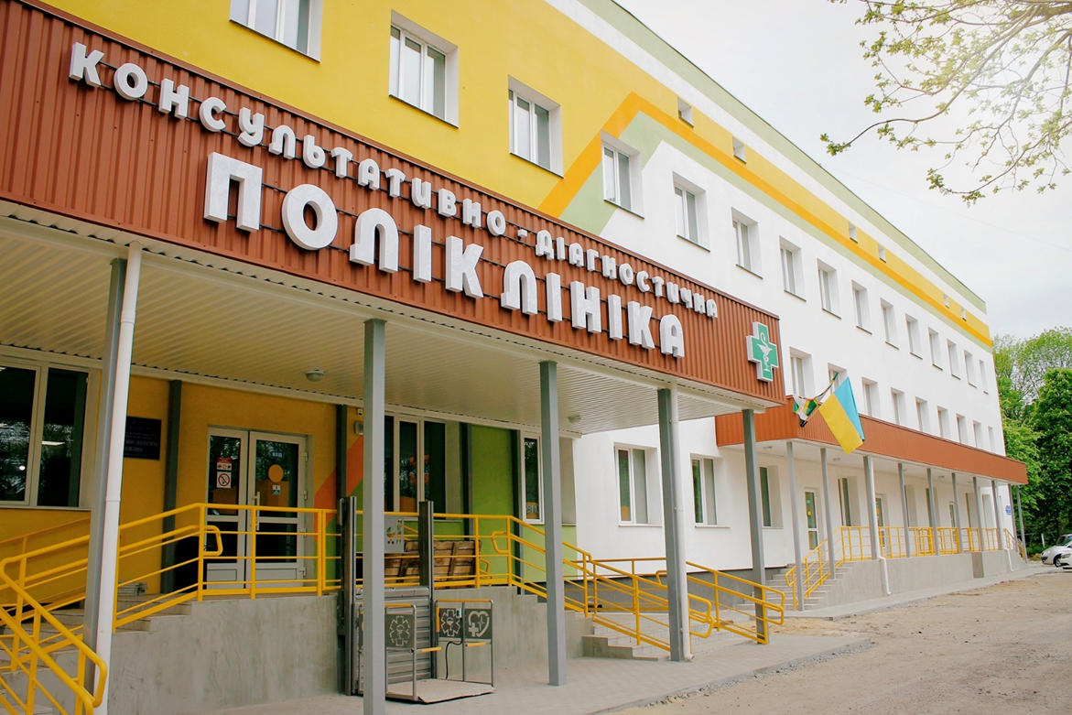
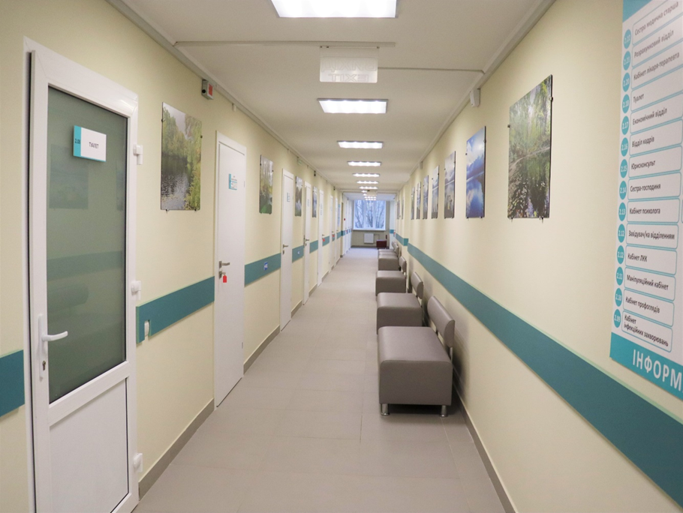
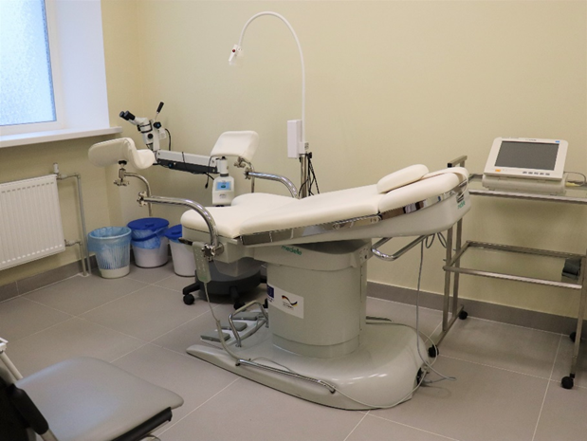
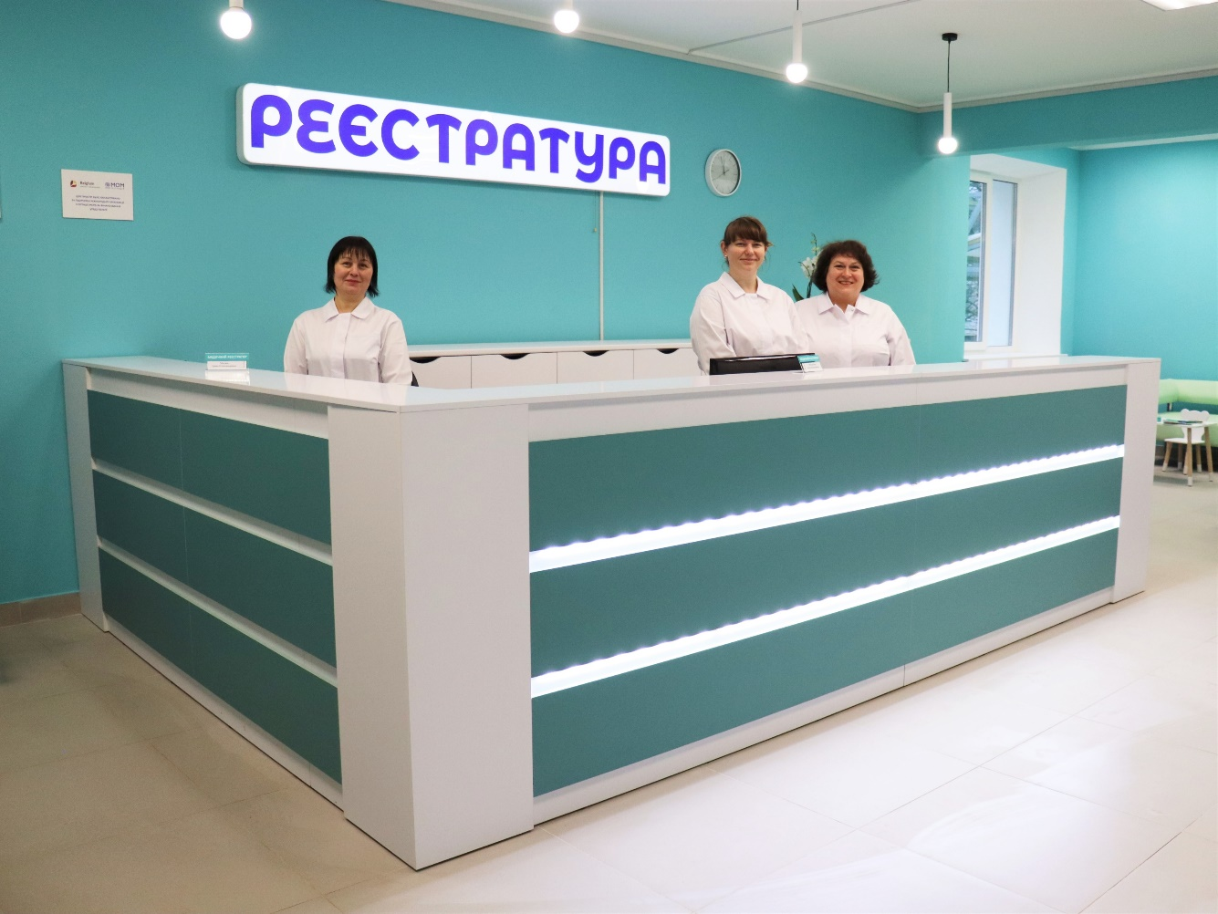
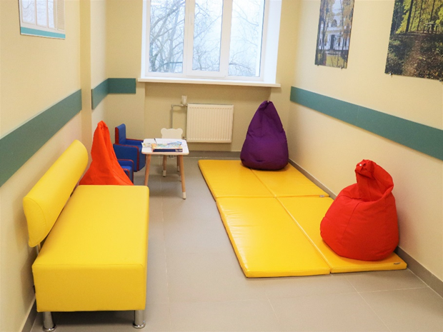
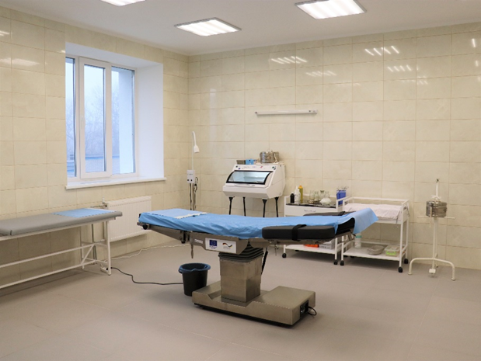
Restoration of the city hospital

Slide 11
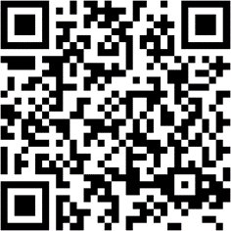

Reconstruction of the building for the “Trostyanets Primary Health Care Center”
Construction area: 2,012.4 sq. m.
Cost: UAH 140.0 million.

Slide 12
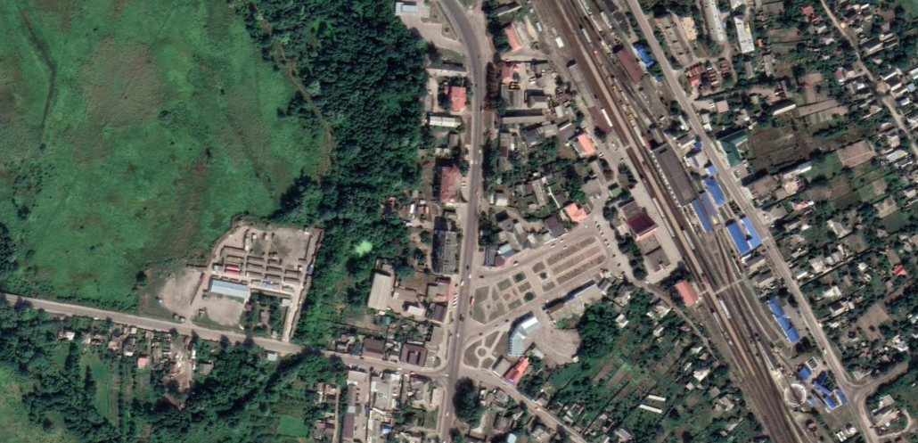
Reconstruction of the building for the “Trostyanets Primary Health Care Center”
National highway
N-12 Sumy-Poltava
Location of the facility
Railway station
Apartment building being renovated as part of an experimental project
Railway station square

Slide 13
Reconstruction of the building for the “Trostyanets Primary Health Care Center”
Project goal – to improve the conditions for providing primary medical care by reconstructing a non-residential three-story building using a modern approach to energy efficiency of public buildings, safety, accessibility, and high-quality healthcare services.

Slide 14
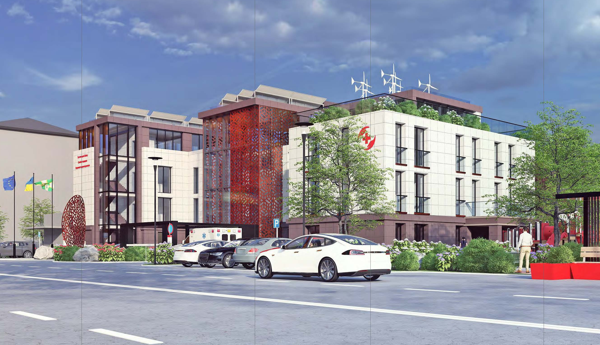
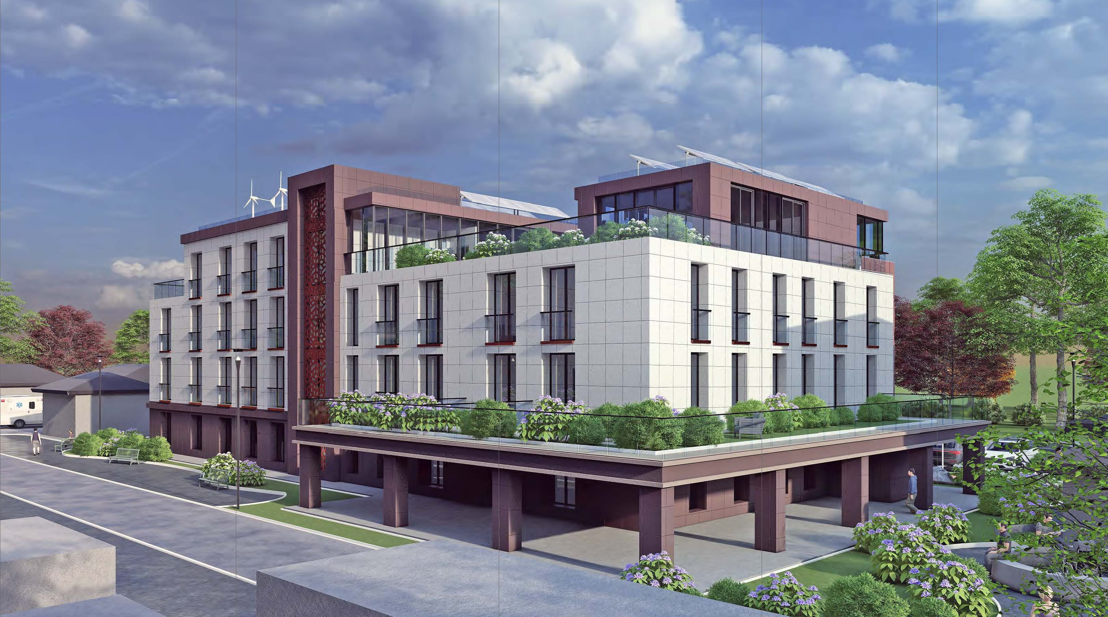
Reconstruction of the building for the “Trostyanets Primary Health Care Center”
Thermal modernization of facades and renovation of exterior finishes.
Construction of a fourth floor with a terrace.
Installation of an elevator to ensure accessibility for people with limited mobility on all floors.
Renovation of interior layout.
VRF heating and cooling system, ventilation with heat recovery, and a 41 kW solar power plant.
Complete replacement of engineering networks.
Construction of a new dual-purpose shelter for 120 people.
Landscaping of the surrounding area.

Slide 15
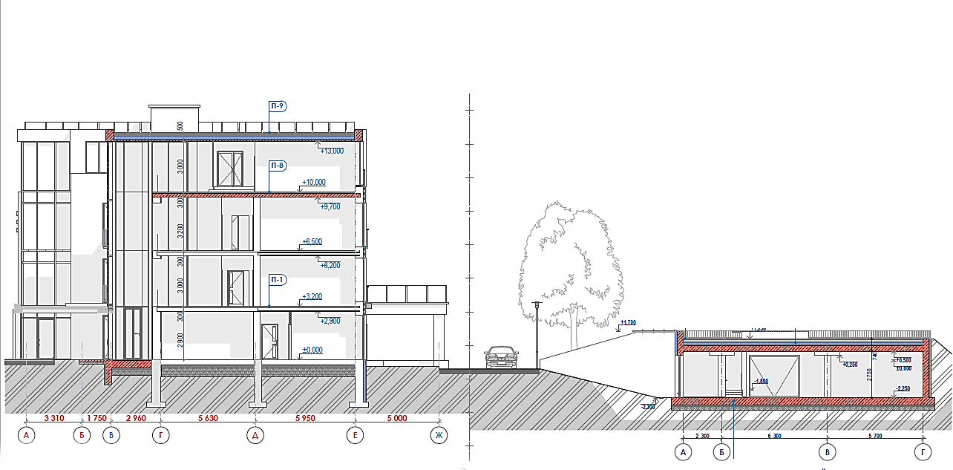
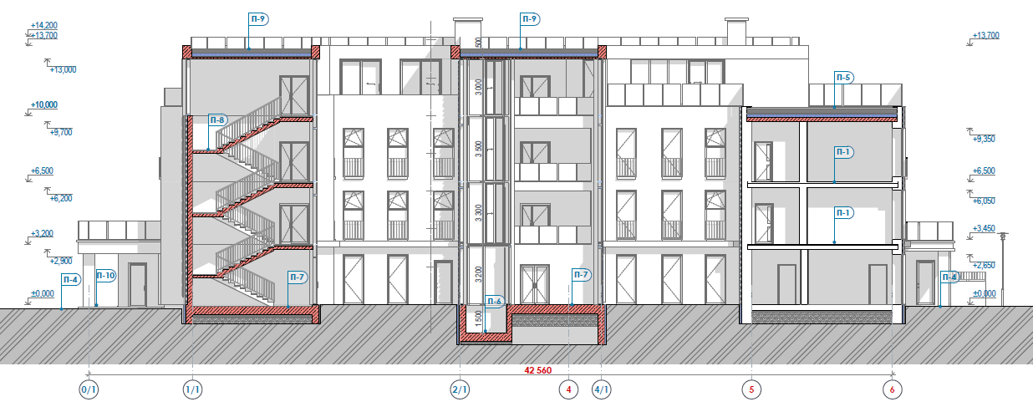
Reconstruction of the building for the “Trostyanets Primary Health Care Center”
Extension floor with conference room
SHELTER for 120 people
Elevator for access by people with limited mobility

Slide 16
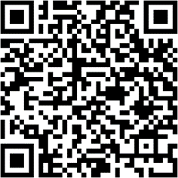

Creation of a Multifunctional Rehabilitation and Hydrotherapy Complex
Construction area: 1,838 sq. m.
Cost: 198.9 million UAH

Slide 17
Creation of a Multifunctional Rehabilitation and Hydrotherapy Complex
Site for the construction of a new residential neighborhood
The territory of Trostyanets City Hospital
Location of the facility
Arboretum “Neskuchne”

Slide 18
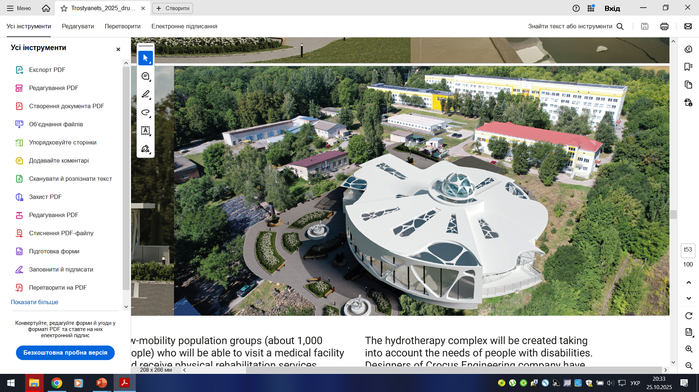
Creation of a Multifunctional Rehabilitation and Hydrotherapy Complex
Project goal – restoration of the physical and mental health of individuals affected by the armed aggression of the Russian Federation through the creation and uninterrupted operation of a rehabilitation department based at the Trostyanets City Hospital.

Slide 19
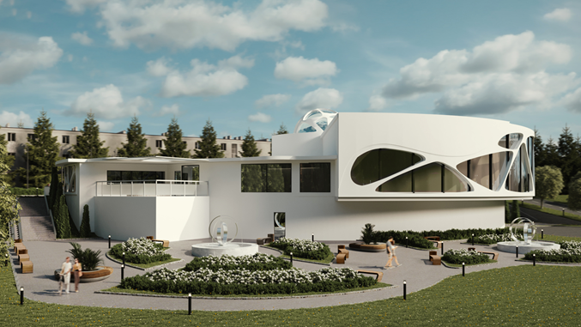
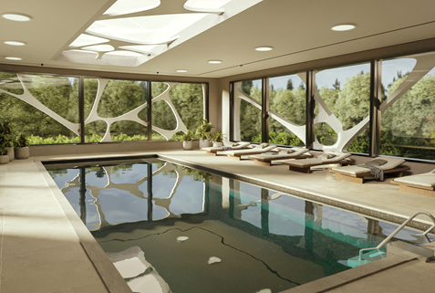
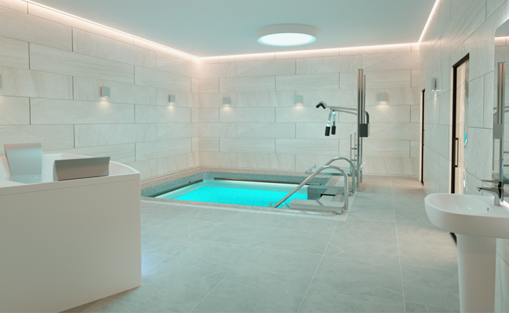
Creation of a Multifunctional Rehabilitation and Hydrotherapy Complex
Capacity – up to 3,000 people per year (up to 15,000 procedures)
Full barrier-free access for people with limited mobility
Creation of 20 new jobs
Energy-efficient building – VRF heating and cooling system, ventilation with heat recovery
Zoning – therapeutic and rehabilitation area (1st floor) and wellness and recovery area (2nd floor).
Functional zones – 10 (massage rooms, physiotherapy, aromatherapy, SPA area, pools, relaxation zones, technical rooms, changing rooms, and restrooms).
Hydromassage baths, aquatic rehabilitation trainers, massage tables, equipment for pools and SPA procedures.

Slide 20
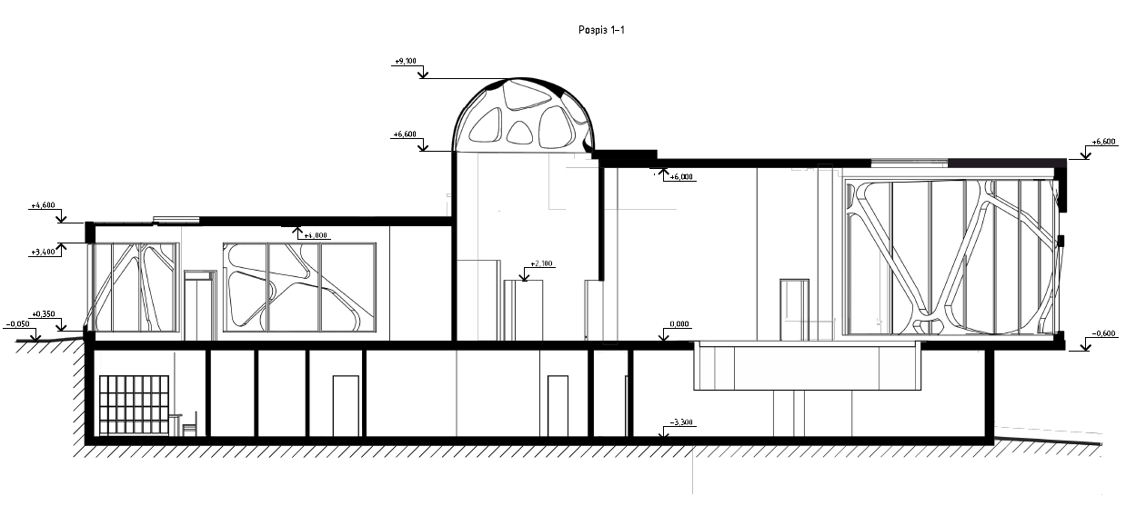
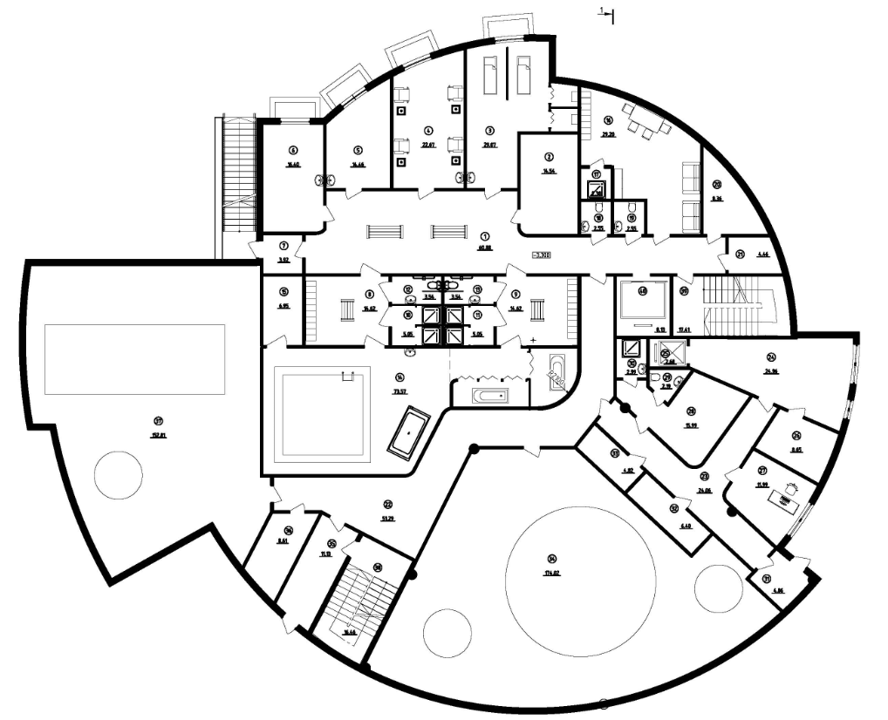
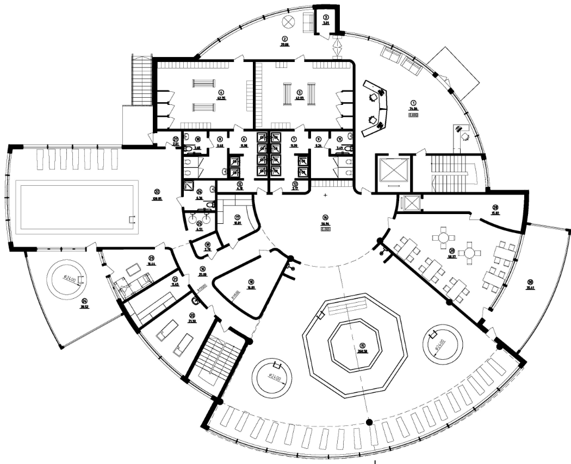
Creation of a Multifunctional Rehabilitation and Hydrotherapy Complex
First floor
Second floor
2
Manual therapy room
Massage room
Treatment room
Traction room
Salt room
Swimming pool
Hydromassage pool
3
1
6
6
4
5
3
7
7

Slide 21
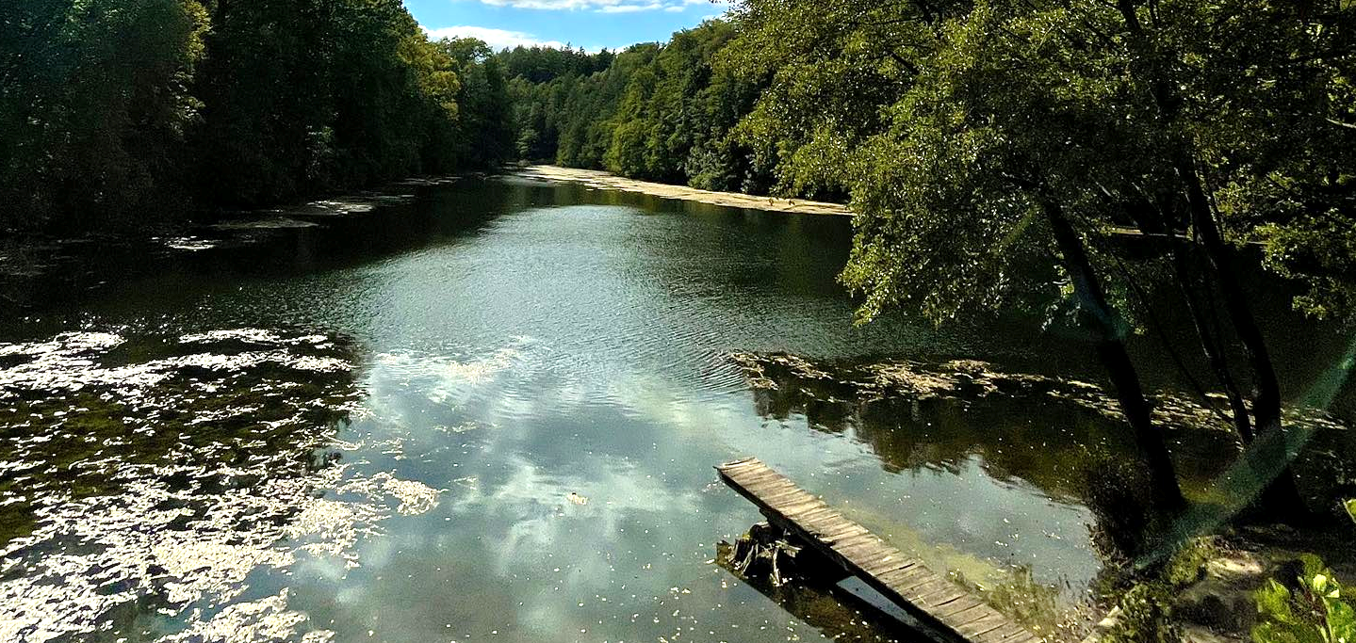
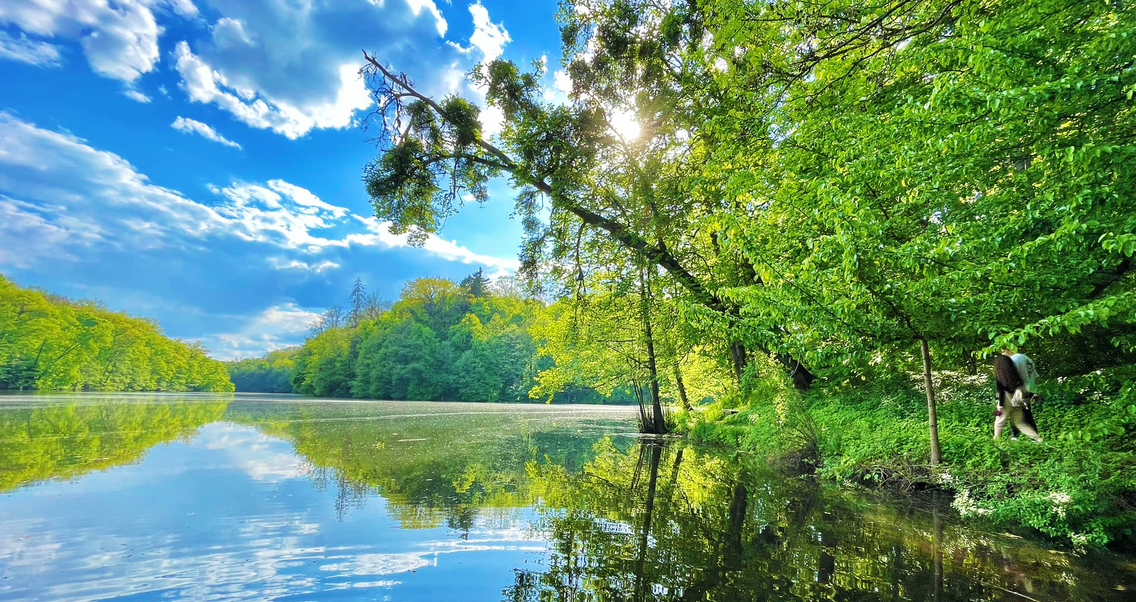
The future residential district “Steel Dream” and the “Neskuchne” Dendrological Park are located nearby

Slide 22
Trostyanets Community needs your support and assistance for its recovery and development
Trostyanets City Council,
Ukraine, Sumy Region, Trostyanets, 6 Myru Street
https://trostyanets-miskrada.gov.ua
Email: mail@trostyanets-miskarada.gov.ua
https://facebook.com/TrostyanetsTownCouncil/
Mayor Yuriy Bova, tel.: +380997900372

