Slide 1
Recycling Damage into Green Recovery

Slide 2
WHO? Recover Ukraine is a Not-for-Profit International Humanitarian Fund that works in partnership with communities, companies and authorities in Ukraine
We design and implement practical solutions for the demolition of the damaged infrastructure with subsequent recycling of the debris into reconstruction works
Our mission is to develop and implement programmes that contribute to the revival and restoration of Ukraine
Our partnerships mean we can share funds with wide spectrum of organisations to achieve our mission
Together with our partners, we are changing the fate of Ukraine and building the future

Slide 3
Partners:
Legal partner:
Technical Advisers:
Contractor Partners:
Aggregates:
Plant & Machinery:
Demining:

Slide 4
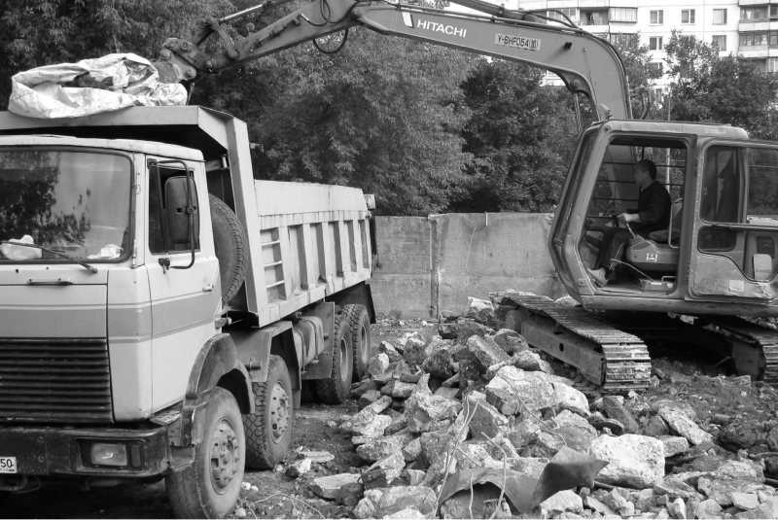
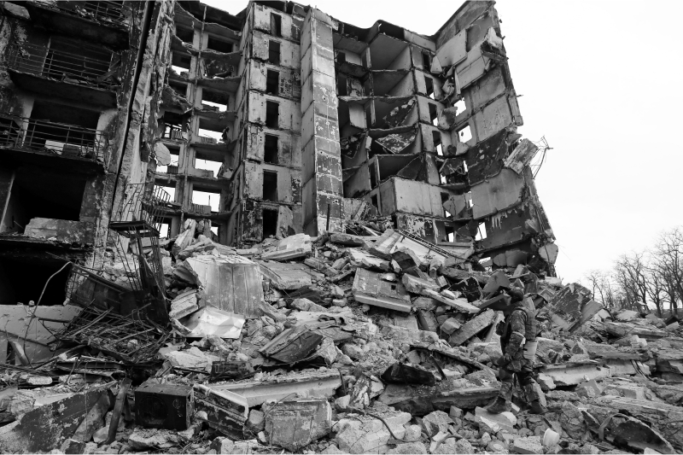
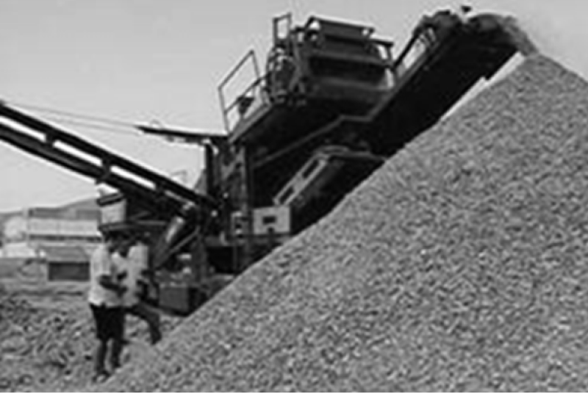
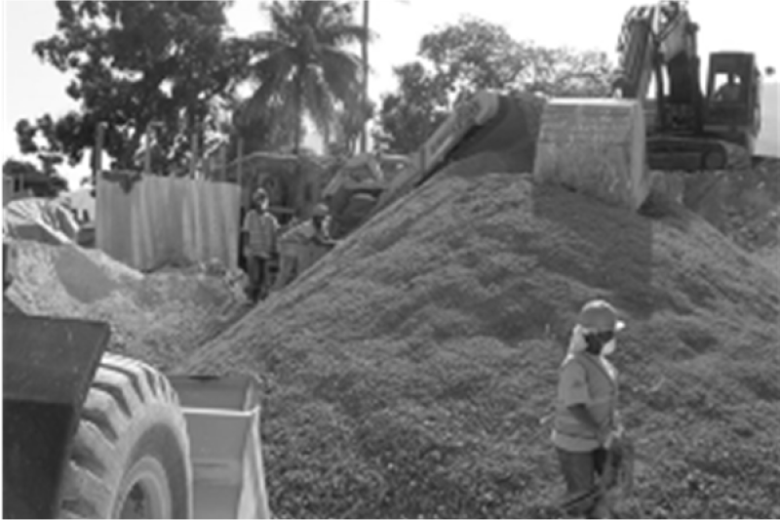
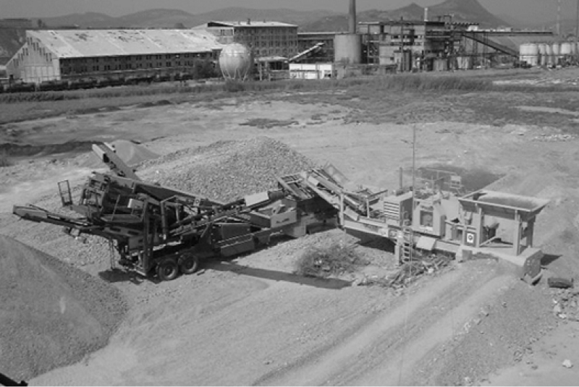
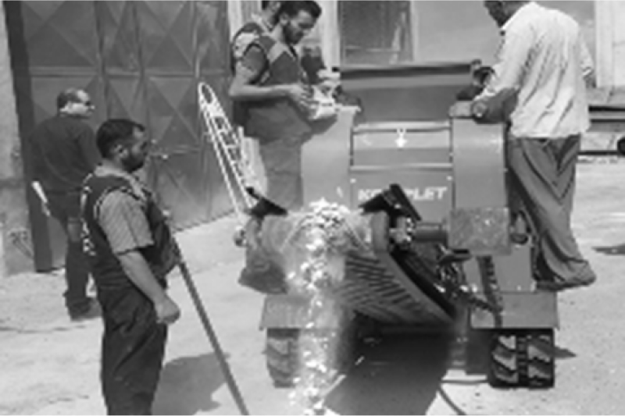
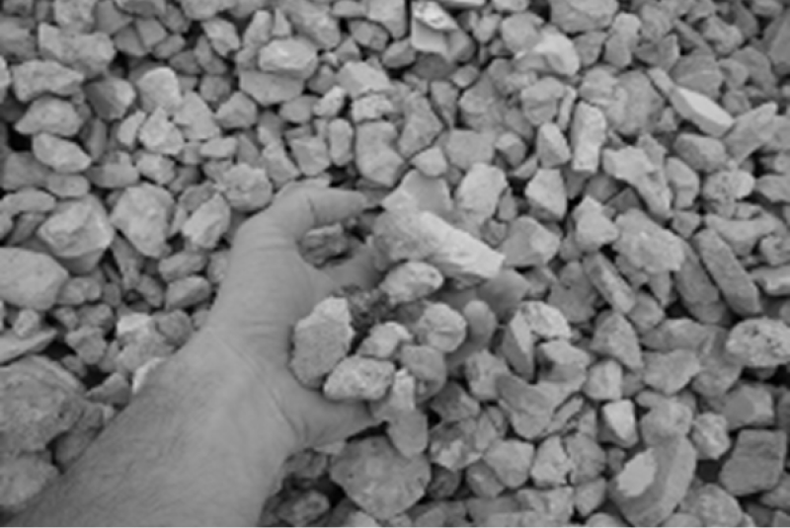
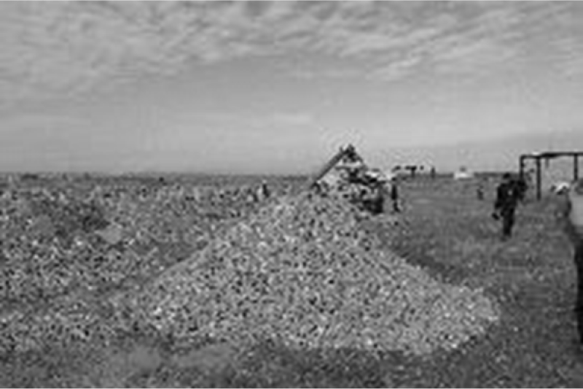
Partner Experience: Post-conflict & disaster programmes in Americas, Europe, Balkans and Asia
Debris Removal in Ukraine
Demolition in Ukraine
Recycling debris in Bosnia
Recycling debris in Haiti
Recycling debris in Kosovo into a road construction material
Recycling debris in Syria
Recycling debris in Lebanon
Recycling debris in Iraq

Slide 5
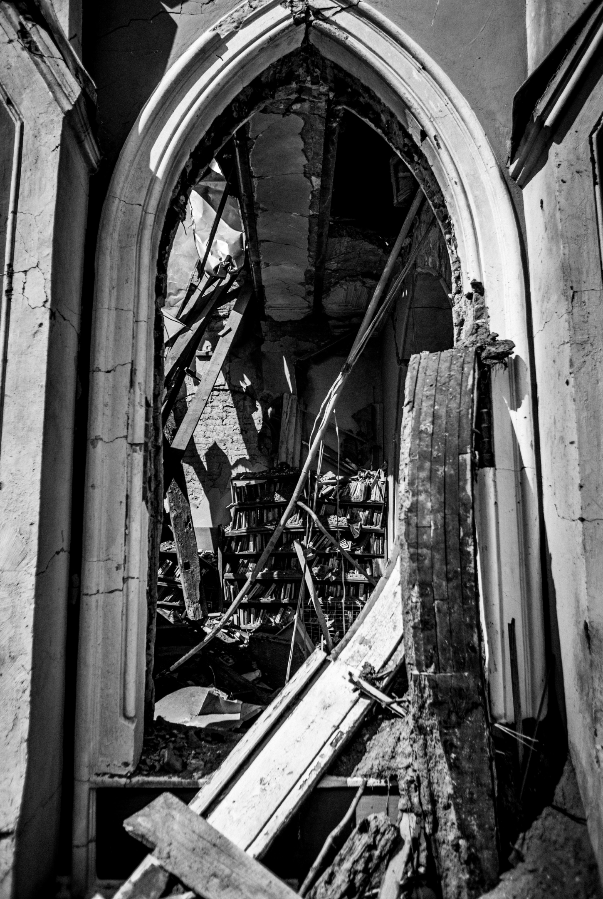
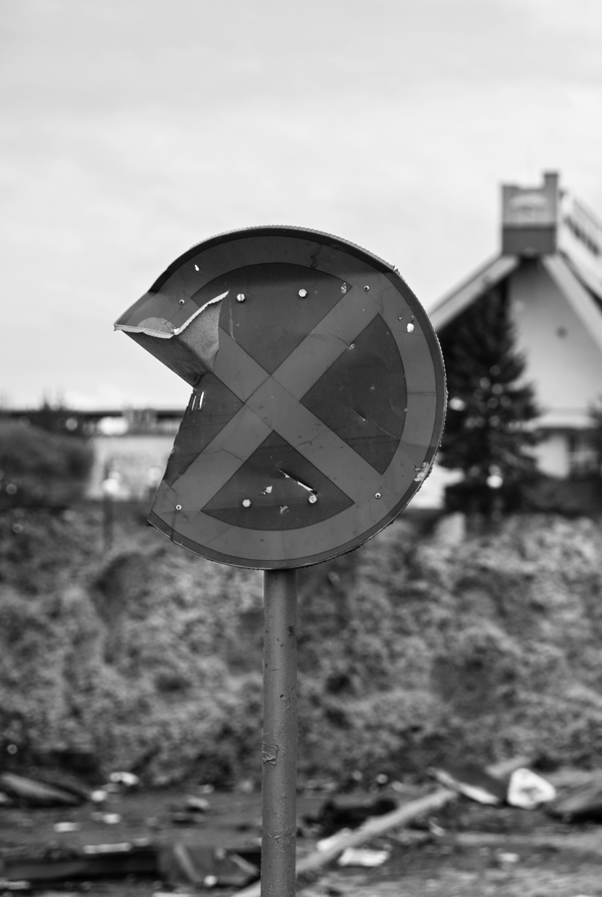
Why?
Extensive damage throughout Ukraine in all sectors:
Residentials
Energy
Industrial
Commercial
Agricultural
First step is always Safe and Timely clearance of damaged sites to enable recovery

Slide 6
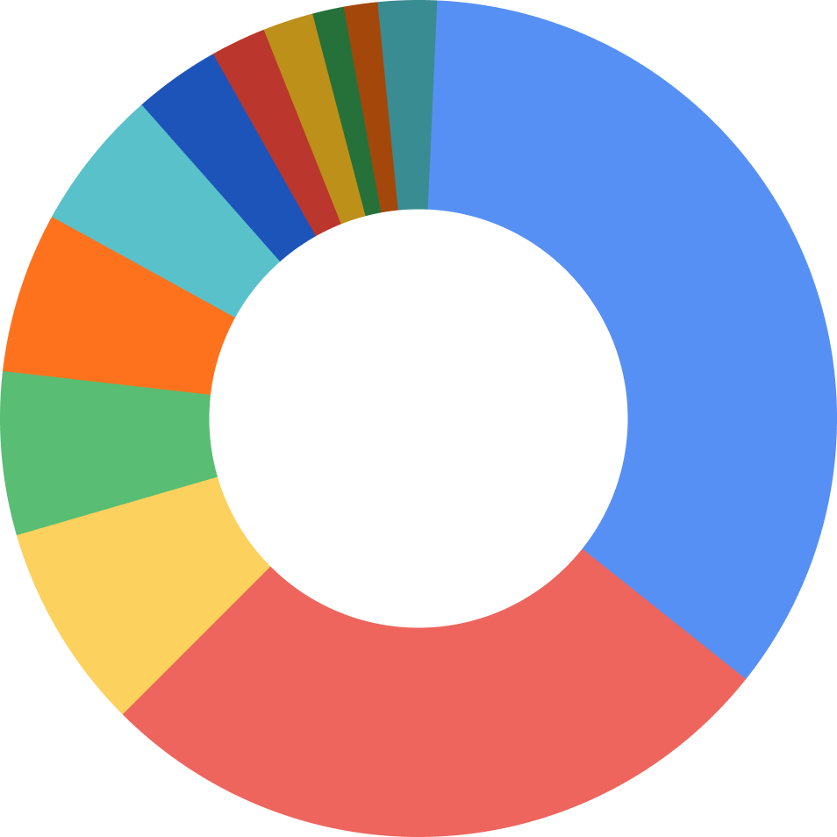
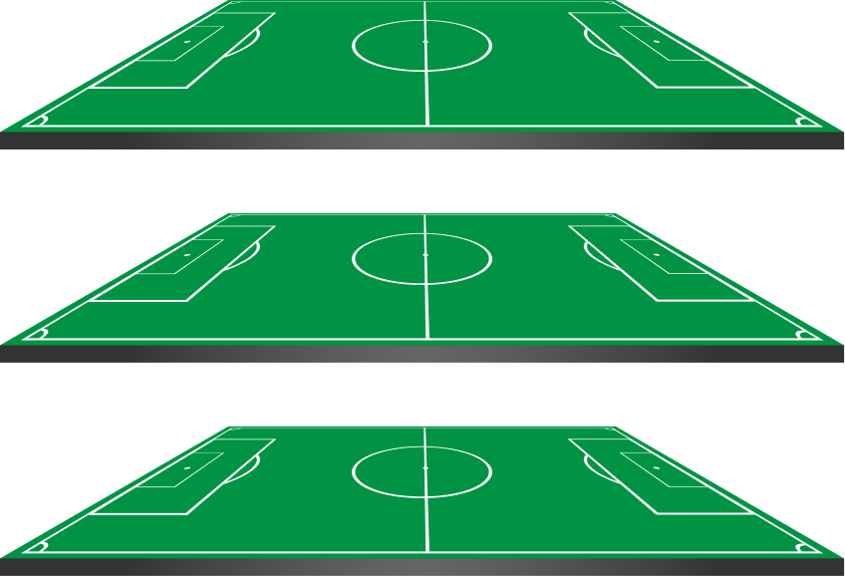
Why?
Current estimates for debris in Ukraine:
Direct damages by type of property, $ bn
18,000,000t of debris
2.6
1.8
2.2
2.7
3.1
Housing
If placed 5m height the land required is
Infrastructure
4.5
Assets of enterprises
8.1
2,250,000m2 or 225 hectares
53.6
Education
8.7
Agriculture & land resources
143.8
Energy
8.9
Forestry
11.3
Transport
Trade
36.2
Culture, sport, tourism
Healthcare
Other
x362 football fields
Source: Kyiv School of Economics

Slide 7
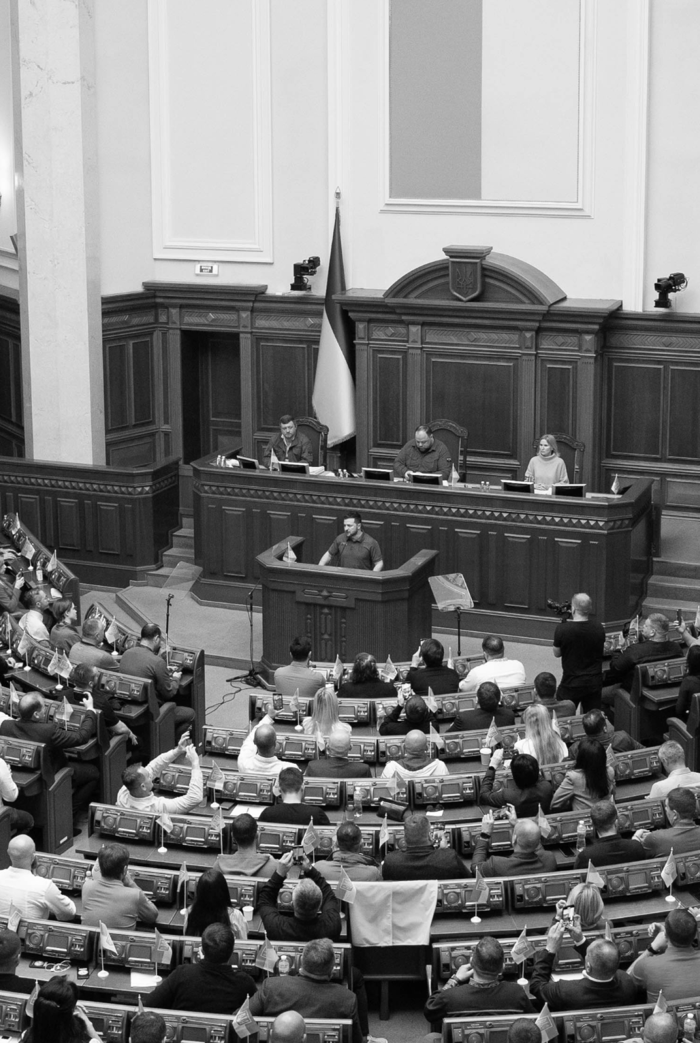
Waste Regulations:
In 2022, the Ukrainian government approved the “Procedure for Waste Management Generated by Damage (Destruction) of Buildings and Structures as a Result of Hostilities
Direction towards implementation of Association Agreement between Ukraine and the EU
Regulates waste management
Requirements for its reuse, recycling and recovery

Slide 8
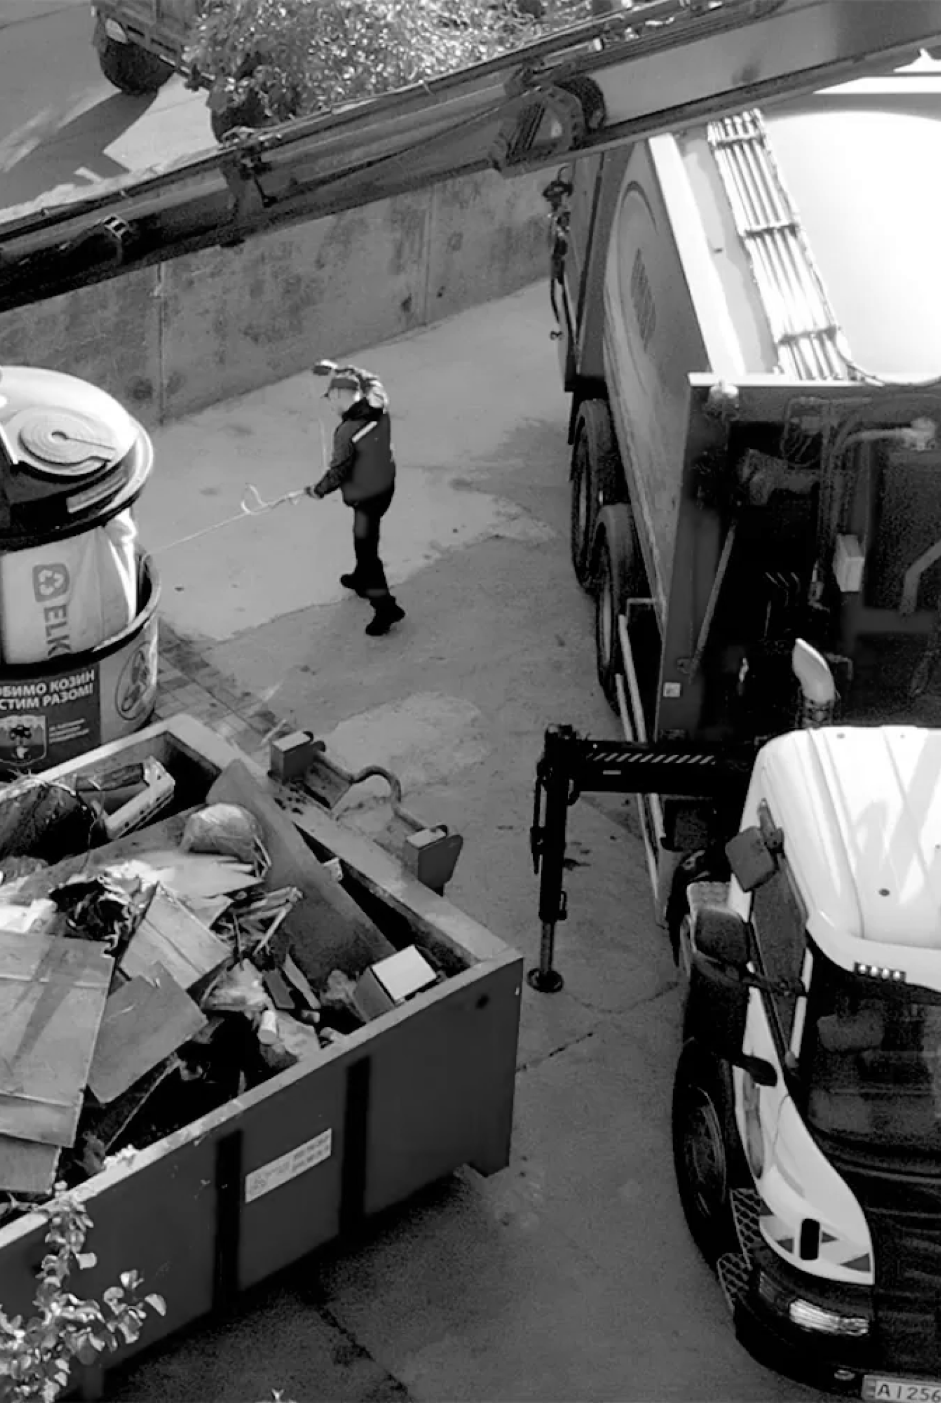
How?
We achieve our mission by:
Safe demolition of damaged buildings and infrastructure
Manage asbestos, hazardous wastes and unexploded ordnance waste management
Recycle the debris into new (re)construction materials
Rebuild with the recycled debris
Main focus on Jobs, Recycling and Community Engagement

Slide 9
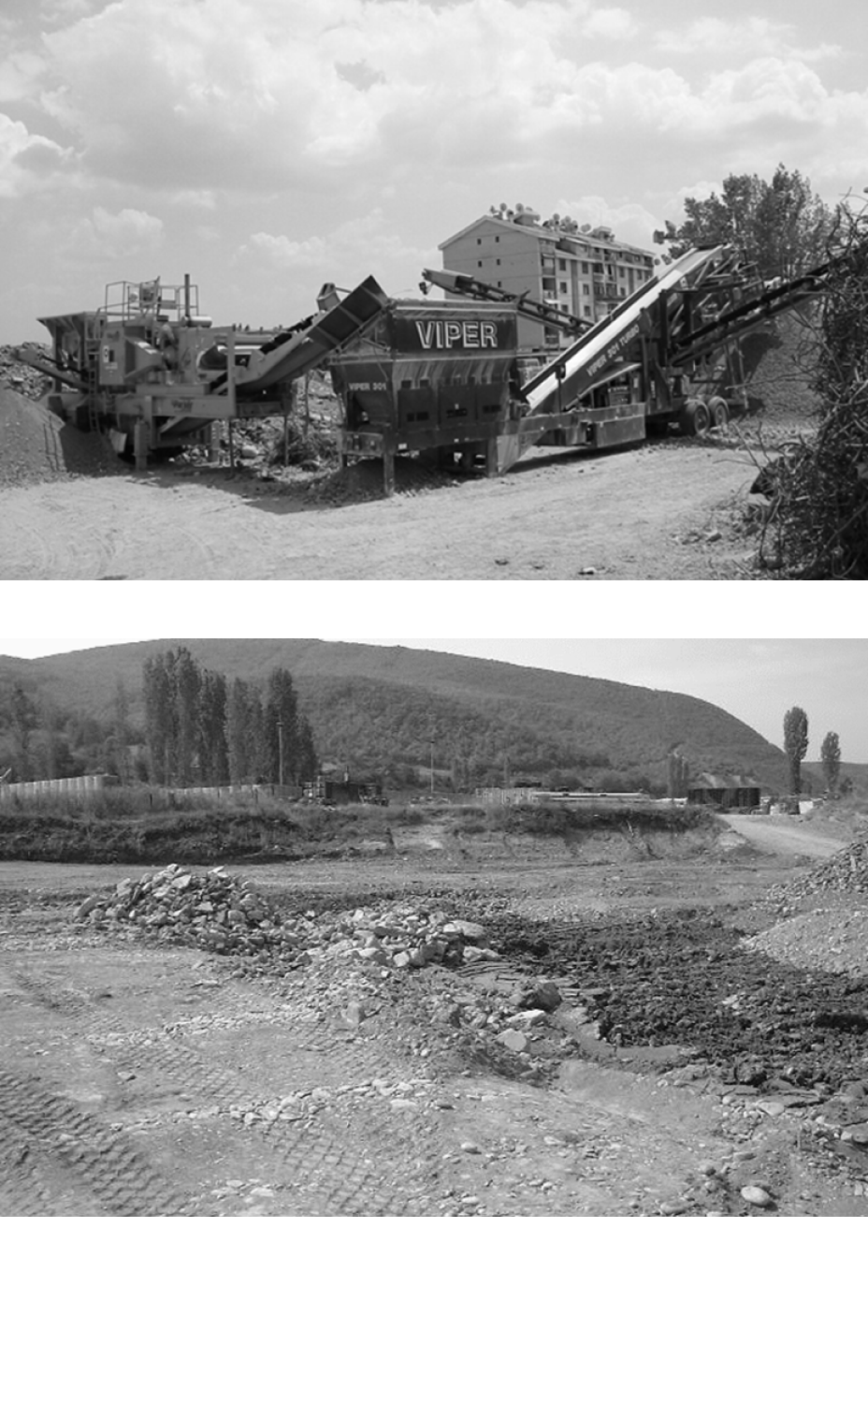
How?
Our recycled debris materials:
Meet Technical Specifications for use as an engineering fill and as road-base
According to documented Quality Protocol specific for recycled debris
Provide lower carbon footprint for reconstruction compared to quarried materials
Foundation for circular economy in the construction industry
Recycling debris in Kosovo for use as engineering fill at NATO camps

Slide 10
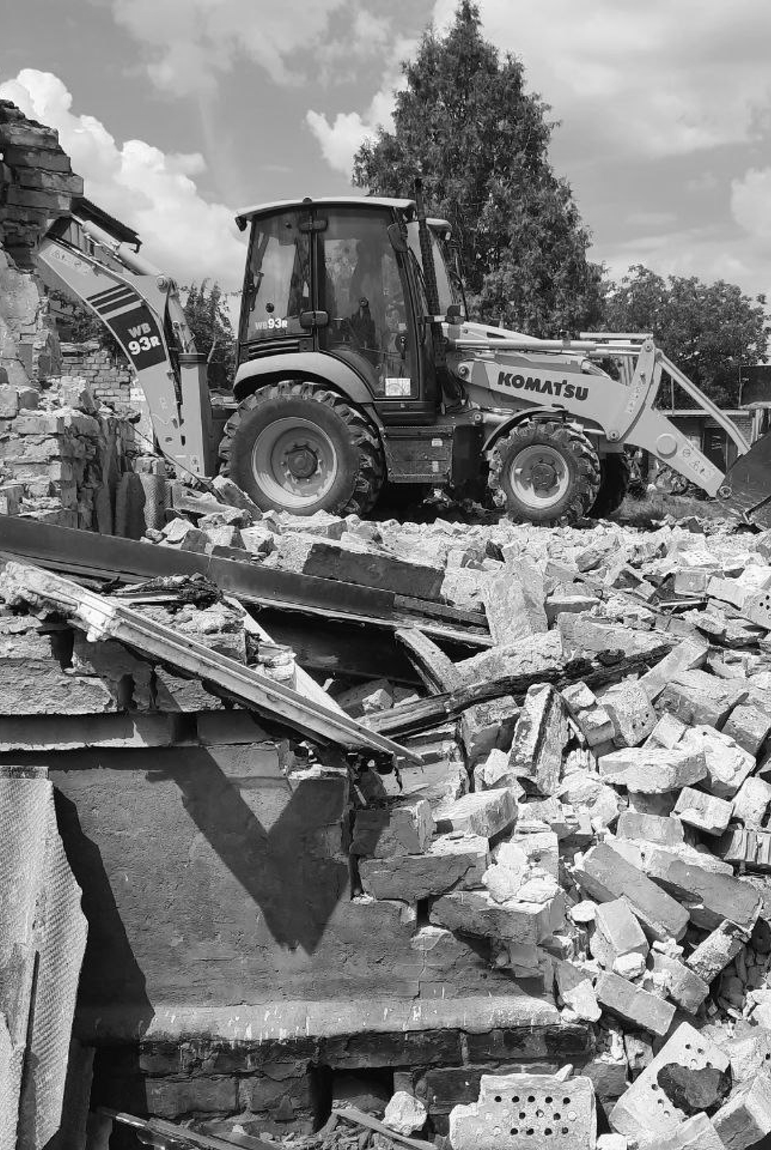
Results?
Our results are:
More jobs from recycling than typical disposal
Safe sites for homeowners to return to for rebuilding
Reduce use of quarries by recycling the debris
Less debris needing disposal thus less land for disposal
Vision: To have a financially self-sustaining debris recycling operation that is funded by the revenue from sale of recycled debris

Slide 11
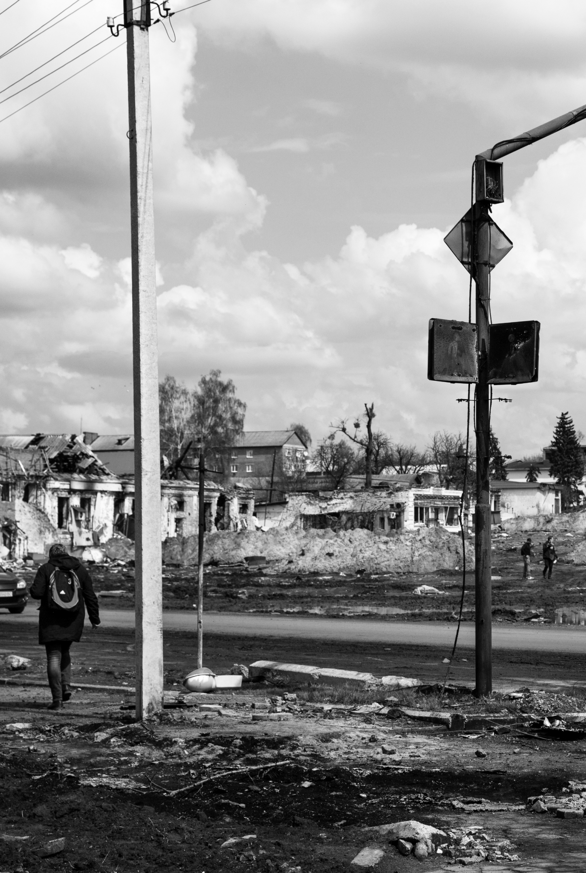
What do we need?
Recover Ukraine needs:
Seed Funding support to implement our programmes in Ukraine
Plant and equipment to realise our mission and achieve the results
Integration with reconstruction programmes to provide quality recycled debris materials

Slide 12
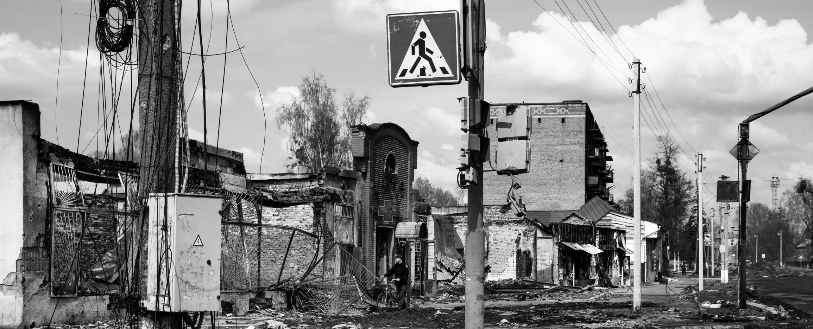
Thank you for your time, ready to answer any questions
Email: info@recoverua.com Website: https://recoverua.com
Registered Address: Wybzeże Ojca Sw. Jana Pawla II, 20 37-700, Pzemysł, Polska

