Slide 1
MHT4-20kW Master-Slave Paralleling Solution
www.solinteg.com
2023.5.9 V1.0

Slide 2
Solution Introduction
Master-Slave Control Parallel System
The hybrid inverter has become a new trend that has gained popularity in recent years as a result of the rising energy problem and electricity rates. But due to its short emergence, the power range hasn't been enlarged to cover all kinds of scenarios, so in some cases, a parallel system is required to expand the system application diversity.
In a storage system with multiple Integ MHT hybrid inverters (≤10pcs), a parallel solution is required to manage and control all inverters’ operation modes, energy supply and use. Solinteg Hybrid inverter supports up to 10pcs parallel with master-slave control, which saves time and money on the installation and provides higher stability. In the parallel system, all batteries connected to different inverters are always kept at the same SOC level no matter how diversified the loads are connected with each inverter.
Parallel Solution

Slide 3
Notice Before Use
Master-Slave Control Parallel System
Only a smart meter and a group of CTs are required for a parallel system.
Inverters in the parallel system should be the same model, and battery as well.
On-grid inverter cannot be involved in a paralleled hybrid system.
Battery cannot be connected in parallel, one battery rack connects to one inverter.
A slave inverter in a parallel system that loses CAN bus communication won't affect the whole system's operation, just the inverter that lost communication will stop working. However, if a master inverter in a parallel system loses contact with the Smart Meter, the entire system will fail.
In the parallel system, each battery connected in the system can reach a fully charged status or discharge to a specific SOC value almost at the same time.
In the parallel system, the settings of the master inverter will automatically sync to all slave inverters which means you just need to set the parameter of the system once.

Slide 4
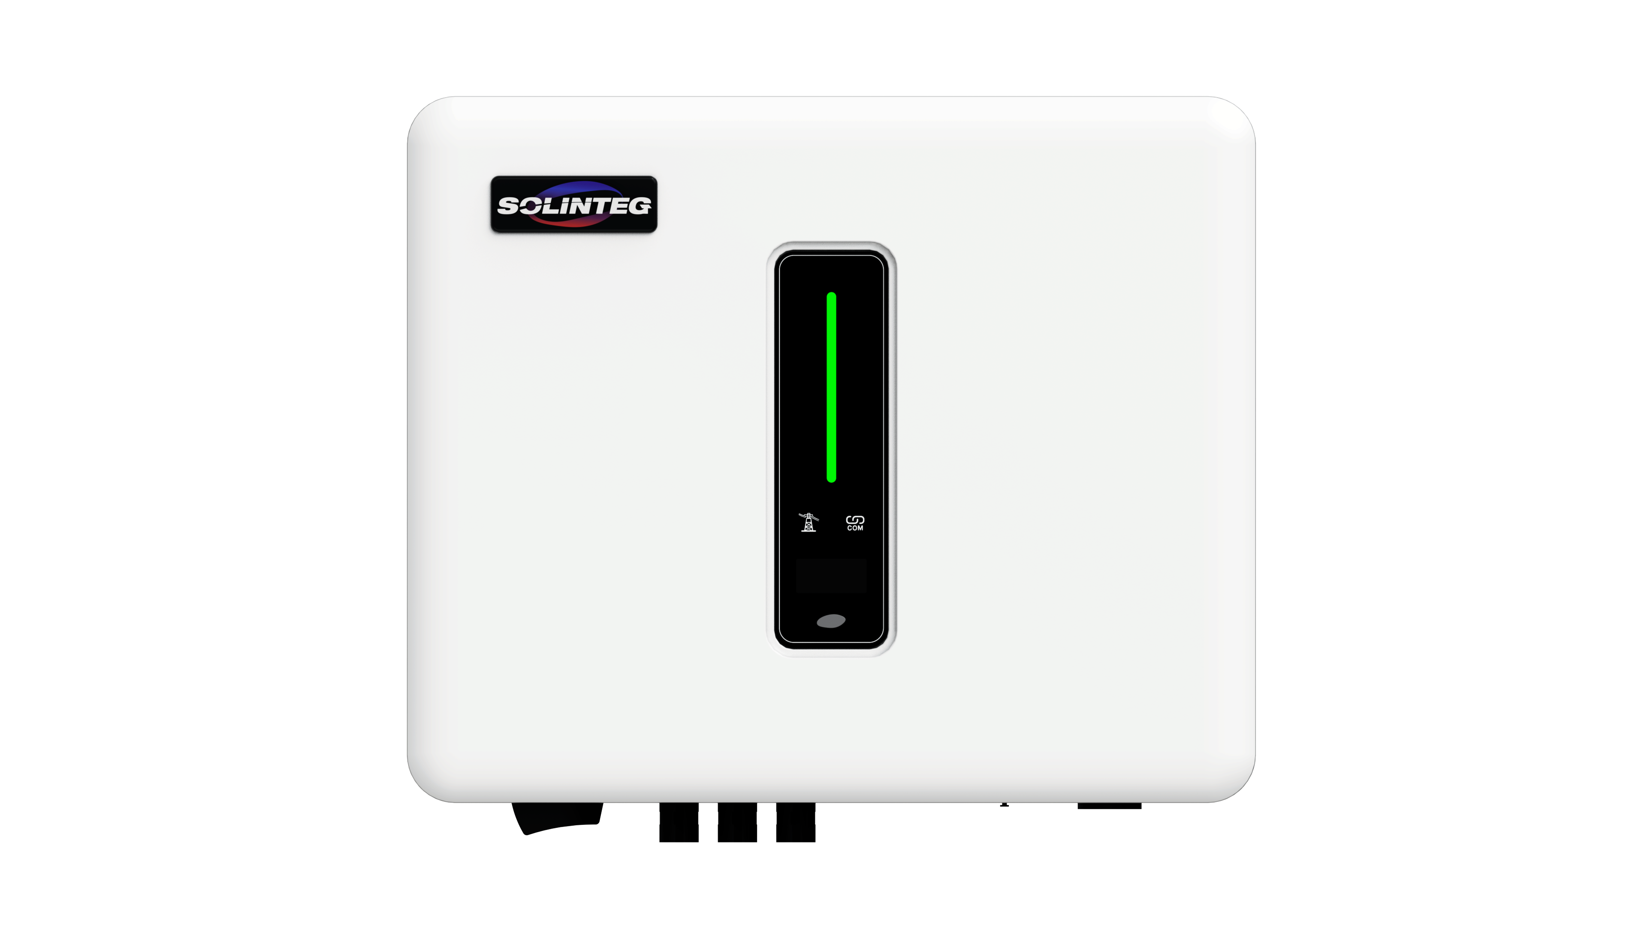
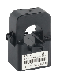
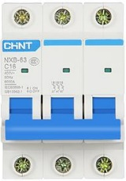
Parallel System-Whole System Wiring Diagram
Master Inverter
Slave Inverter N
PV
PV
CT*3
MAX. 10pcs
On-grid
Back-up
On-grid
Back-up
Grid
Battery
CAN
Battery
CAN
CAN
Meter
RS485
Back-up Load
Back-up Load
1Phase Load
Normal 3Phase Load

Slide 5
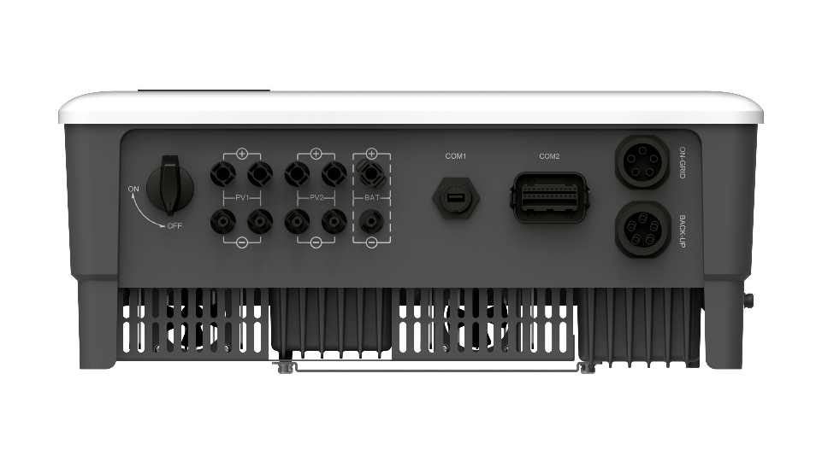
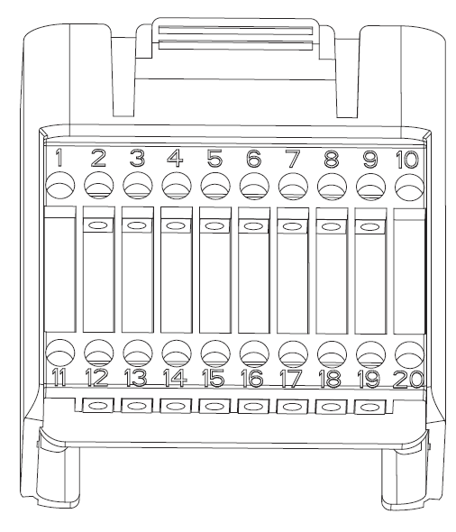
Parallel System-CAN Communication Illustration
Master Inverter
Slave Inverter 1
Slave Inverter N
…
CAN
CAN
…

Slide 6
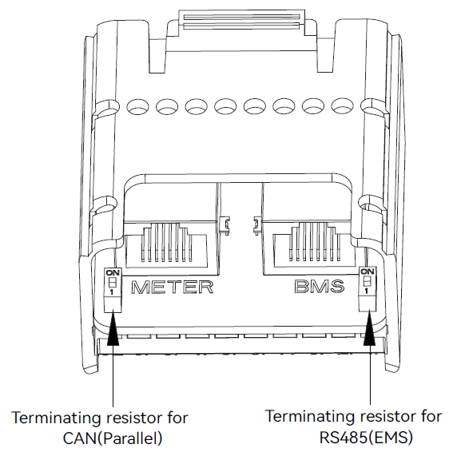
Parallel System-CAN Communication Wiring
Master Inverter
Slave Inverter 1
Slave Inverter N
…
CAN
CAN
Turn the CAN terminating resistors of the Master and the last slave inverter to ON position.
ON
ON

Slide 7
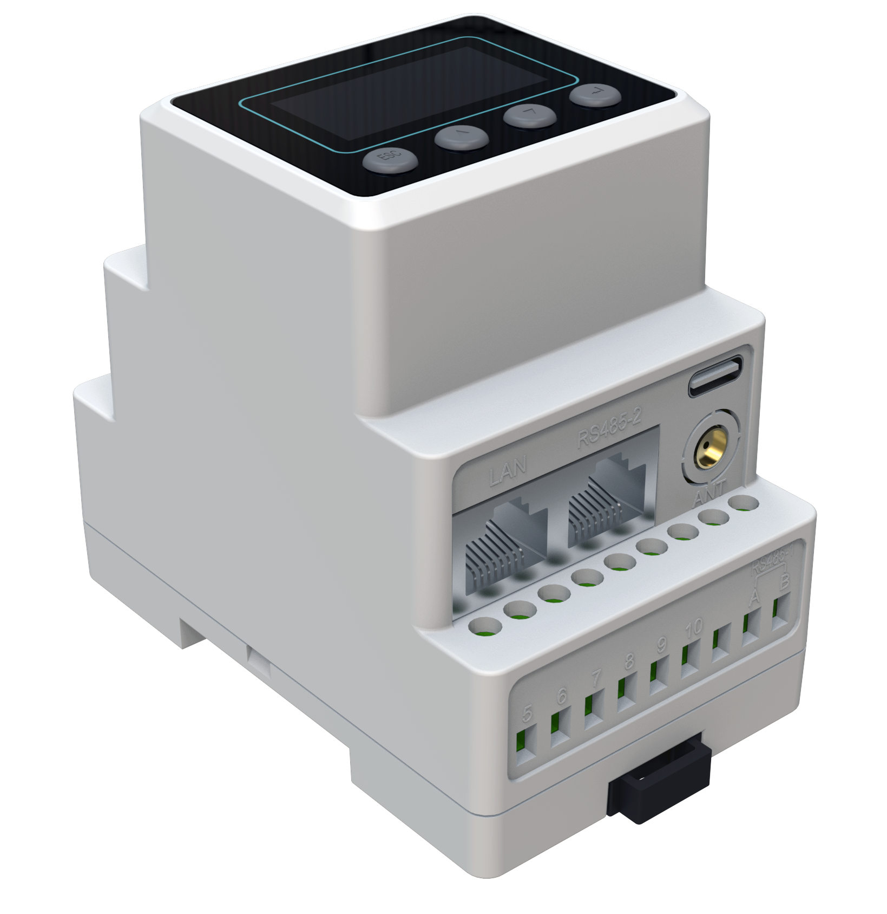
Parallel System-Smart Meter Connection
Master Inverter
Slave Inverter 1
Slave Inverter N
…
CAN
CAN
One parallel system only needs one smart meter and it’s connected to the Master inverter.
RS485-2
RS485

Slide 8
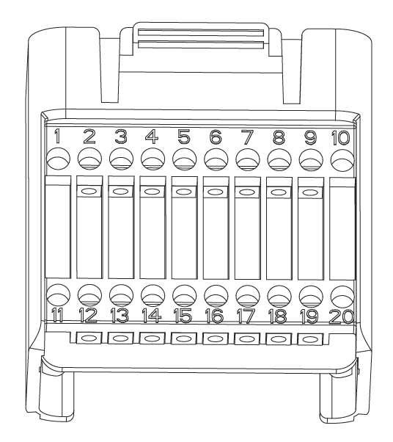
Parallel System-RCR Connection
In Germany and some European countries, an inverter connected to the grid must be able to receive the grid dispatch instructions to feed the power to the grid as required, which we called the RCR function. The communications ports for the RCR device to connect are shown below;
Master Inverter
Only the master device needs to be connected.
Only integrated with active power adjusting function.

Slide 9
Parallel System-RCR Connection
When K1 is turned on, the maximum allowed feed-in power is 100% of the total rated power of the inverter.
When K2 is turned on, the maximum allowed feed-in power is 60% of the total rated power of the inverter.
When K3 is turned on, the maximum allowed feed-in power is 30% of the total rated power of the inverter.
When K4 is turned on, feed-in power is not allowed.
The RCR function must be enabled on the inverter screen or the App. If the Ripple Control Receiver is not connected or the RCR function is not enabled, the inverter will fail to output.
DI
4+
DI
4-
DI
3+
DI
3-
DI
2+
DI
2-
DI
1+
DI
1-
K4
K3
K2
K1
Only the master inverter needs to connect to the Ripple Control Receiver in a parallel system.
Ripple Control Receiver
Active Power Dry Contact Connection Diagram
Notes:
In Germany and some European countries, an inverter connected to the grid must be able to obey the grid dispatch instructions to feed the power to the grid as required, which we called the RCR function. The interface of this function is as follows;

Slide 10
Parallel System-Operation Procedures
Install the parallel system according to the system wiring diagram, especially the CAN communication between each inverter.
Each inverter has to equip with a WiFi/LAN dongle.
Batteries need to connect to each inverter separately.
Power on all the inverters (Don’t turn on the backup loads before the parallel system commissioning is completed.)
If there is a power grid connection, connect the inverter to the power grid.
If there is no power grid, switch on the battery and PV.
Configure the WIFI network for the whole system.
Create a power plant in the SOLINTEG monitoring platform and add all inverters in the plant.
Set the inverter connected to the smart meter as the Master via the monitoring platform (or the screen) and set other inverters as Slave by the same mean, turn on the terminal resistor of the Master and last Slave inverter.
Confirm that all inverters are online in the monitoring platform.
Set the necessary parameters of the master inverter via APP or screen, such as safety code, export limit, RRCR, etc.
All inverters are connected to the power grid, batteries and PV to make sure that the system can run normally.
When the parallel system runs properly, turn on the loads connected to the backup side.
Notes:
全部图片待替换

Slide 11
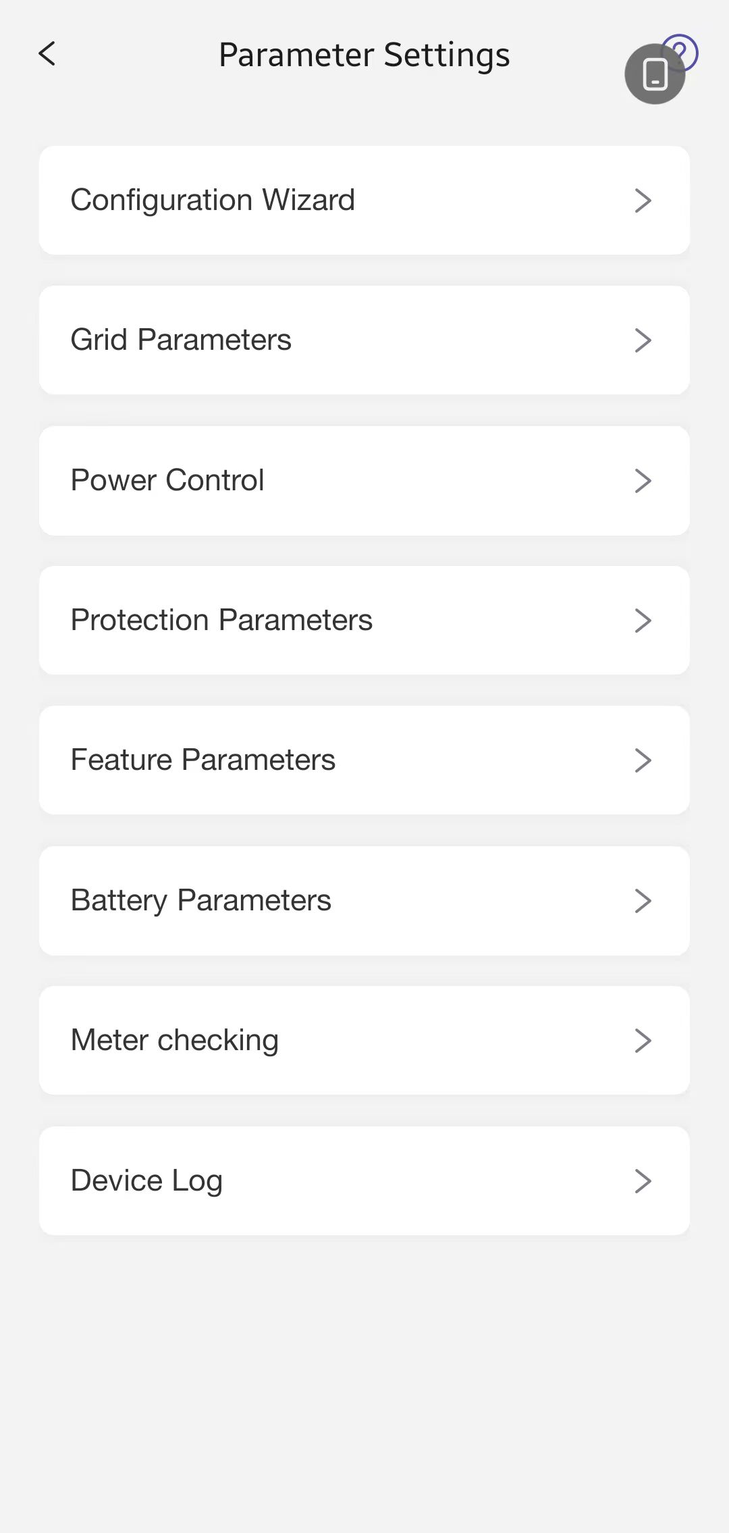
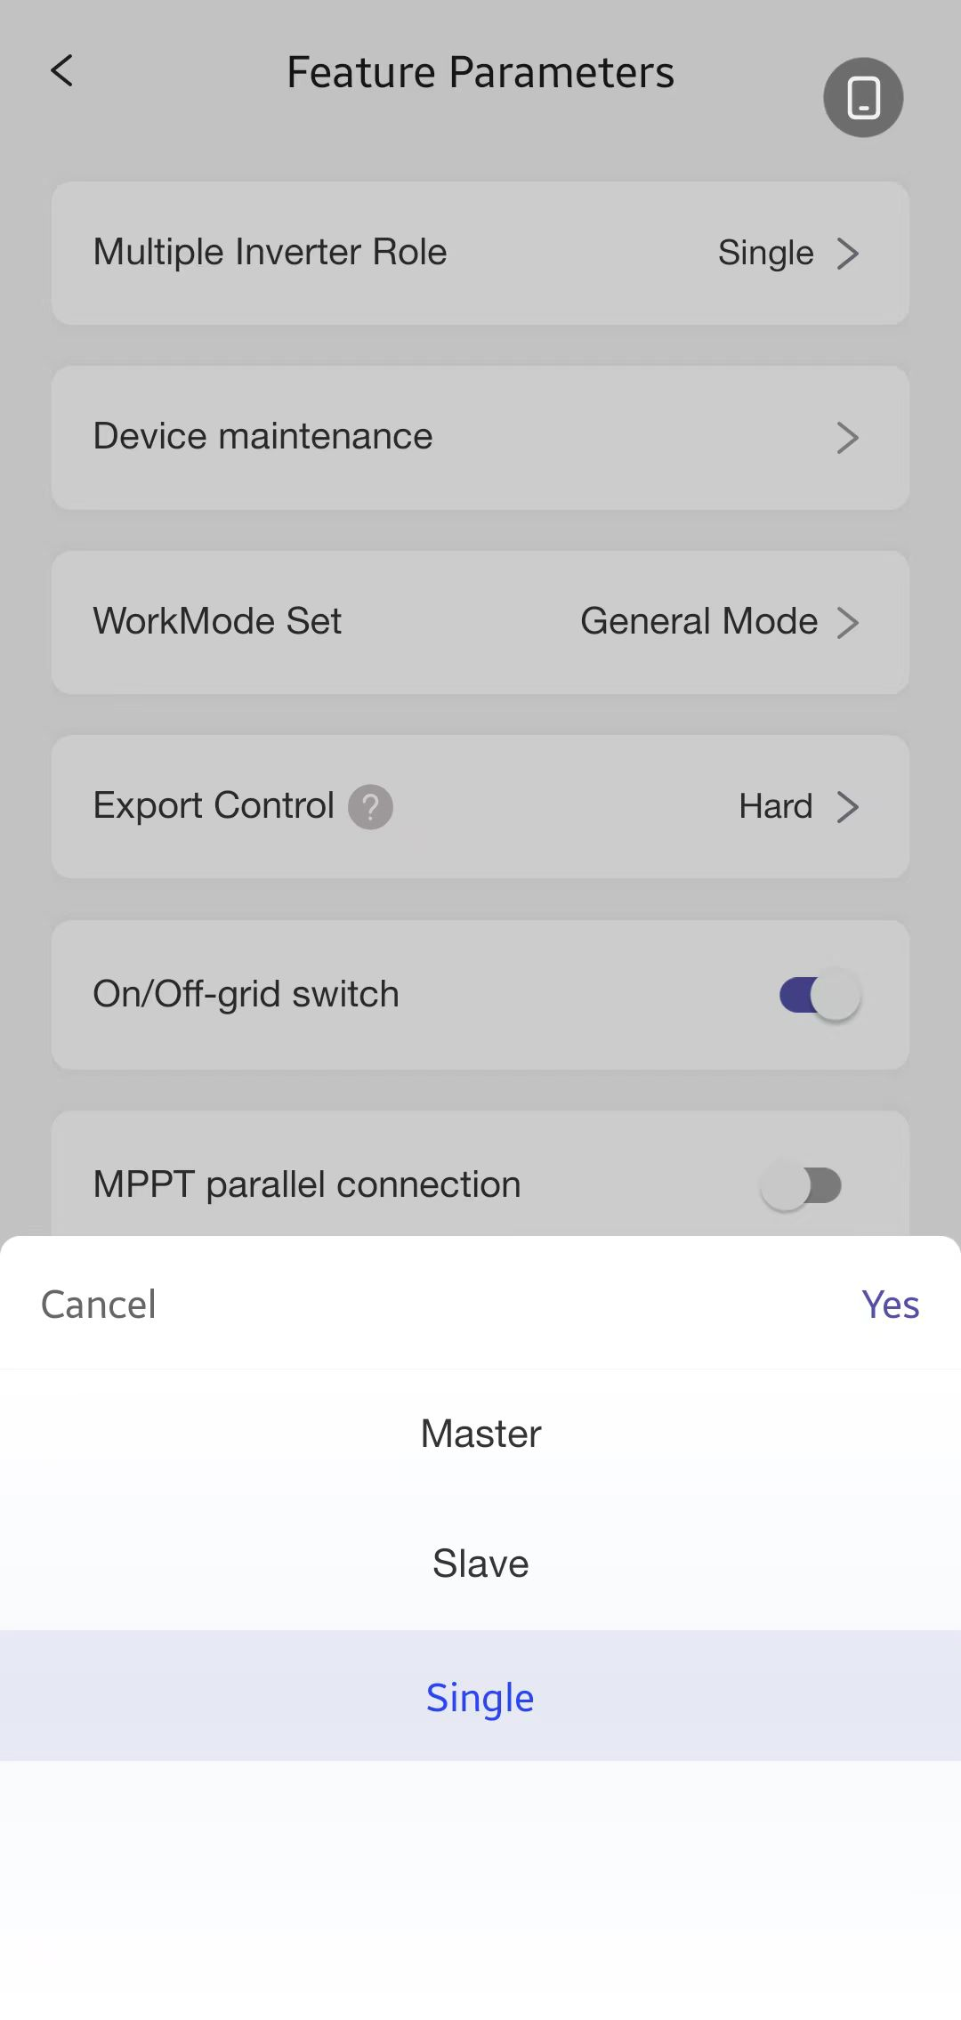
Parallel System-Inverter Role Setting
Inverter Screen Settings
Inverter App Settings
Advanced
Settings
<Advanced>
Multi-INV Role
Master
1s
InPut Password
1000
Wait
Verify Fail
Wait
Incorrect
<Advanced>
Multi-INV Role
Slave
Correct
Verify OK
1s
…
1s
1s
<Advanced>
Multi-INV Role
Slave
<Advanced>
Multi-INV Role
Slave
<Advanced>
Multi-INV Role
Master
1s
1s

Slide 12
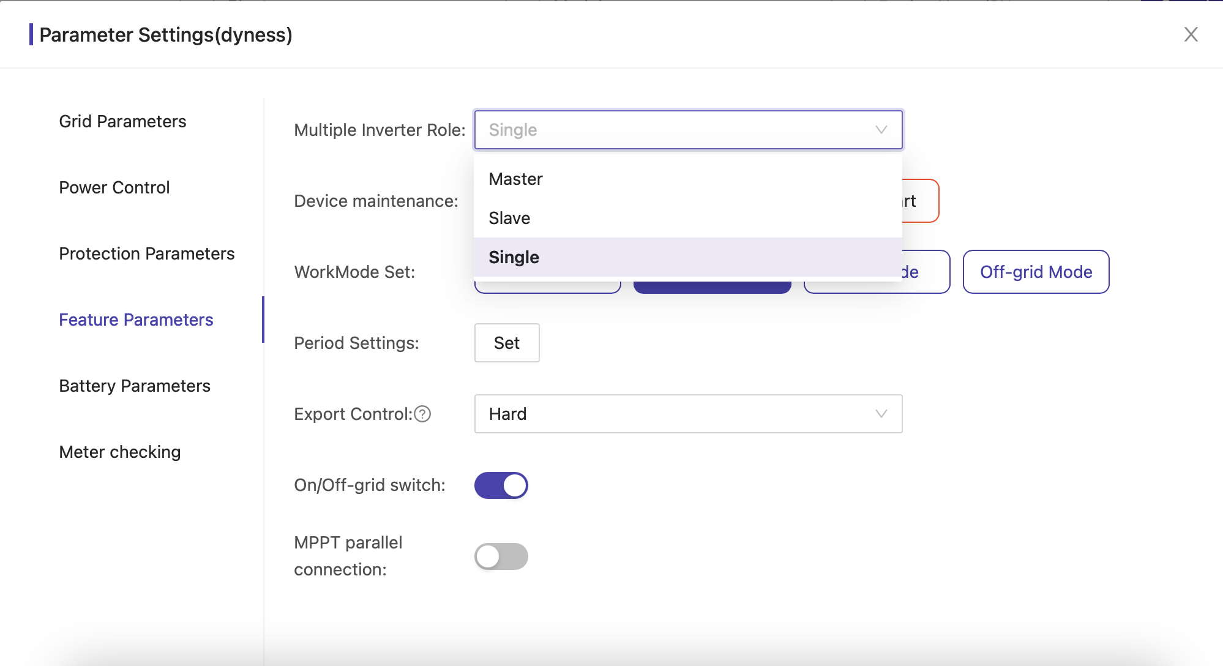
Parallel System-Inverter Role Setting
Wattsonic Cloud Setting
Web Portal Settings
Set each inverter’s role in a parallel system in the Web portal. Click [Management], [Device Management],[ ], [Feature Parameters], [Multiple Inverter Role] to set or change the inverter role.

Slide 13
Parallel System-Create A Parallel Plant in Solinteg Monitoring
Wattsonic Cloud Setting
Login Solinteg cloud @ https://www.solinteg-cloud.com and click [Plant Management]—[Add Plant].

Slide 14
Parallel System-Create A Parallel Plant in Solinteg Monitoring
Wattsonic Cloud Setting
Fill in the required fields which are marked with * in Installation Info and Location menu.

Slide 15
Parallel System-Create A Parallel Plant in Solinteg Monitoring
Wattsonic Cloud Setting
Once one device information from the paralleling system is filled in, the others in this parallel system will automatically pop up. Click [Batch] to add all the inverters. (Please remember to set the inverter’s role as Master or Slave via the inverter screen or SolintegSet APP).
Note: The inverter connected with Smart Meter must be set as Master inverter.

Slide 16
Parallel System-Create A Parallel Plant in Solinteg Monitoring
Wattsonic Cloud Setting
Input the electricity price and select currency according to the local policy. Click the [Complete] button, and a notice of creating plant successfully will pop up.

Slide 17
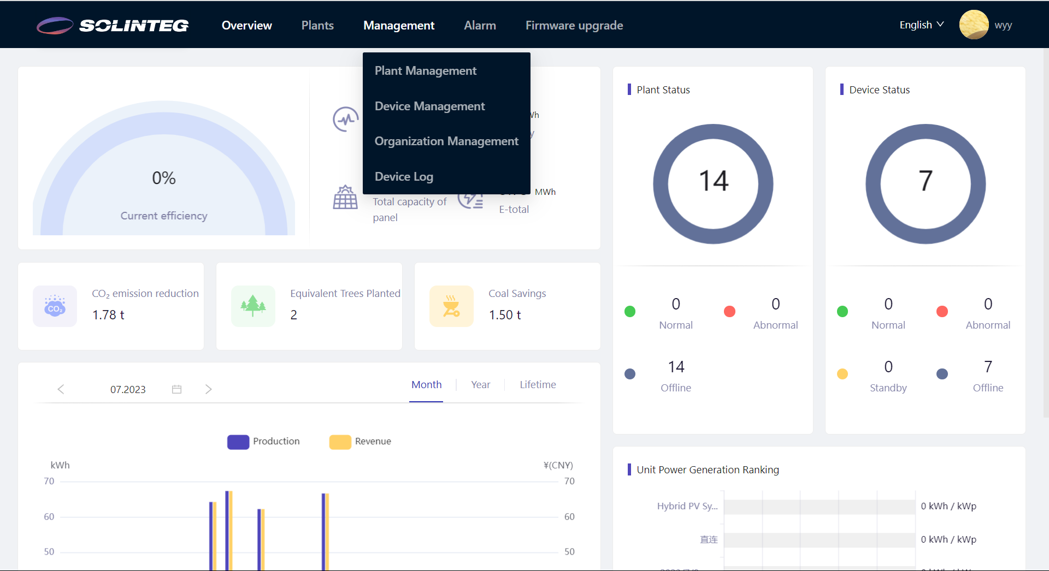
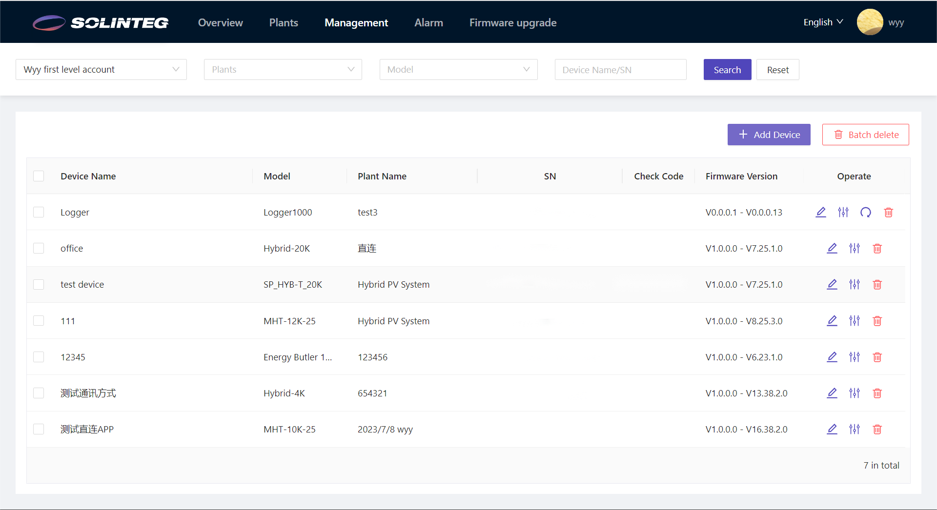
Parallel System-Add Device to An Existing Plant
Wattsonic Cloud Setting
Login Solinteg cloud , enter [Device Management] menu, and then click [Add Device].

Slide 18
Parallel System-Add Device to An Existing Plant
Wattsonic Cloud Setting
Once one device information from the paralleling system is filled in, the others in this parallel system will automatically pop up. Click [Batch] to add all the inverters. (Please remember to set the inverter’s role as Master or Slave via the inverter screen or SolintegSet APP).
Note: The inverter connected with Smart Meter must be set as Master inverter.

Slide 19
THANK YOU
www.solinteg.com

