Slide 1
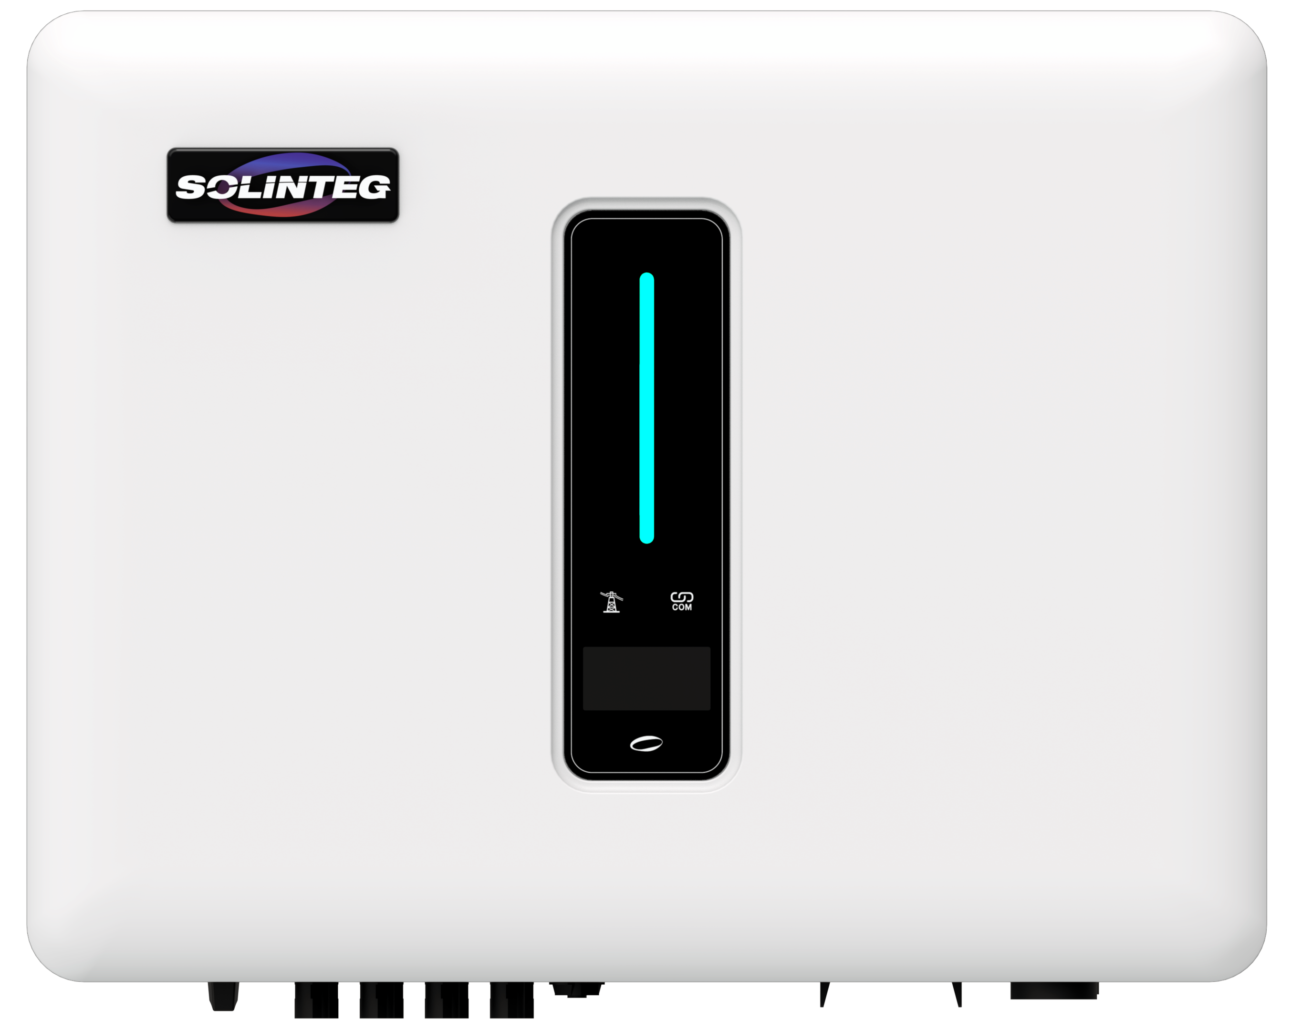
10kW
How Solinteg Unbalanced Output benefits your life?
L1: 0kW
L2: 0kW
L3: 0kW
1kW
3kW
6kW
Use Your Power More Efficiently
www.solinteg.com
academy@solinteg.com
How Solinteg Unbalanced Output benefits your life?

Slide 2
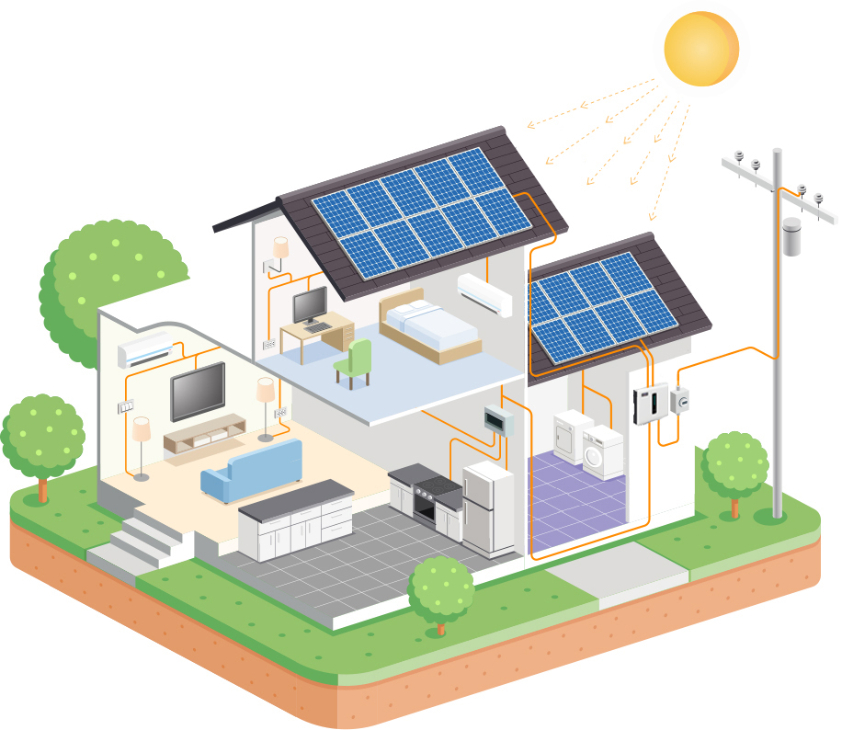
Brief Introduction
What is unbalanced output？
Save Your Every Watt
PV Power
6kW
Three-phase hybrid inverter with an unbalanced output application is a type of inverter used in three-phase electrical systems. It is designed to provide a stable power supply to loads that have uneven power demands across the three phases. With an unbalanced output function, the inverter output power on each phase depends on the load consumption of each individual phase.
Connect to L2
AC：2kW
No unbalanced output :
each phase must output balanced;
Limited unbalanced output:
It can't output 100% power in an unbalanced situation;
100% unbalanced output:
It can output 100% power in an unbalanced situation;
110% unbalanced output:
It can output 110% power in an unbalanced situation;
Connect to L1
Fridge：1.8kW
Connect to L3
Dryer：2.2kW
Loads
Side
L1: 1.8kW
L1: 0kW
Grid
Side
L2: 2kW
L2: 0kW
L3: 2.2kW
L3: 0kW
Solinteg 6kW Inverter
www.solinteg.com
academy@solinteg.com
How Solinteg Unbalanced Output benefits your life?
02

Slide 3
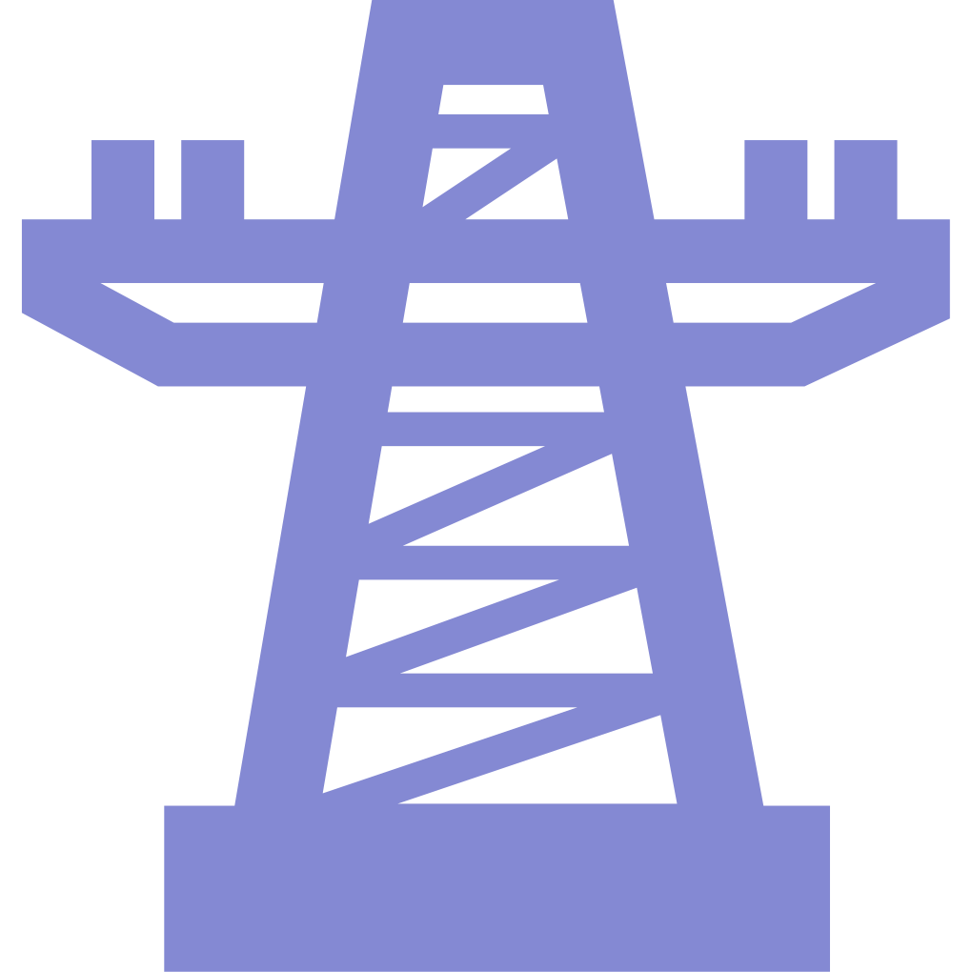
How does unbalanced output benefit your power system?
Which one is your electricity using scenario?
Save Your Bill at All Conditions
For different solar system users all over the world, they may face different regulations or situations:
Power Export Limitation
For different countries, the power export limitation may be different. Some are partly limited and some are fully limited. An inverter without unbalanced output may face huge power waste when the export is limited.
Export Limited
Different Bill Mode
No Battery
Grid Billing Mode
Some nations charge for power across the total of all three phases, whereas others charge for each phase individually. Unbalanced output can save customers more money in locations billed on a single phase.
With or Without Battery
Some inverters support unbalanced output while the battery is connected but we support the unbalanced output no matter battery is connected or not.
www.solinteg.com
academy@solinteg.com
How Solinteg Unbalanced Output benefits your life?
03

Slide 4
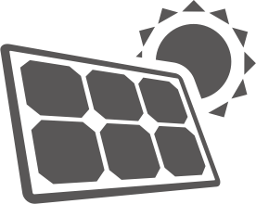
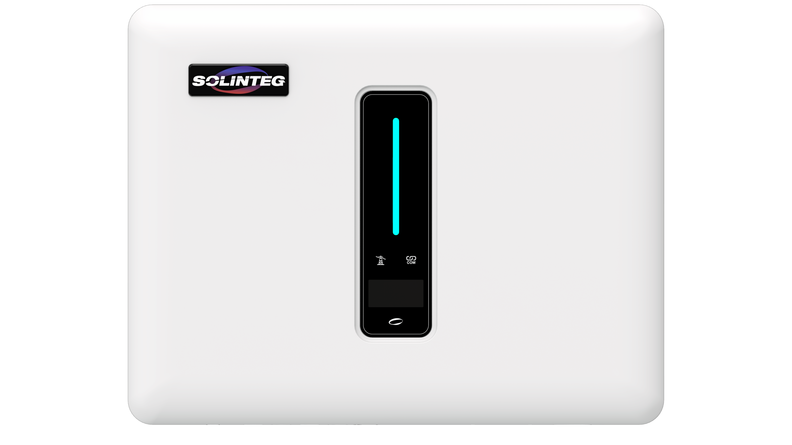
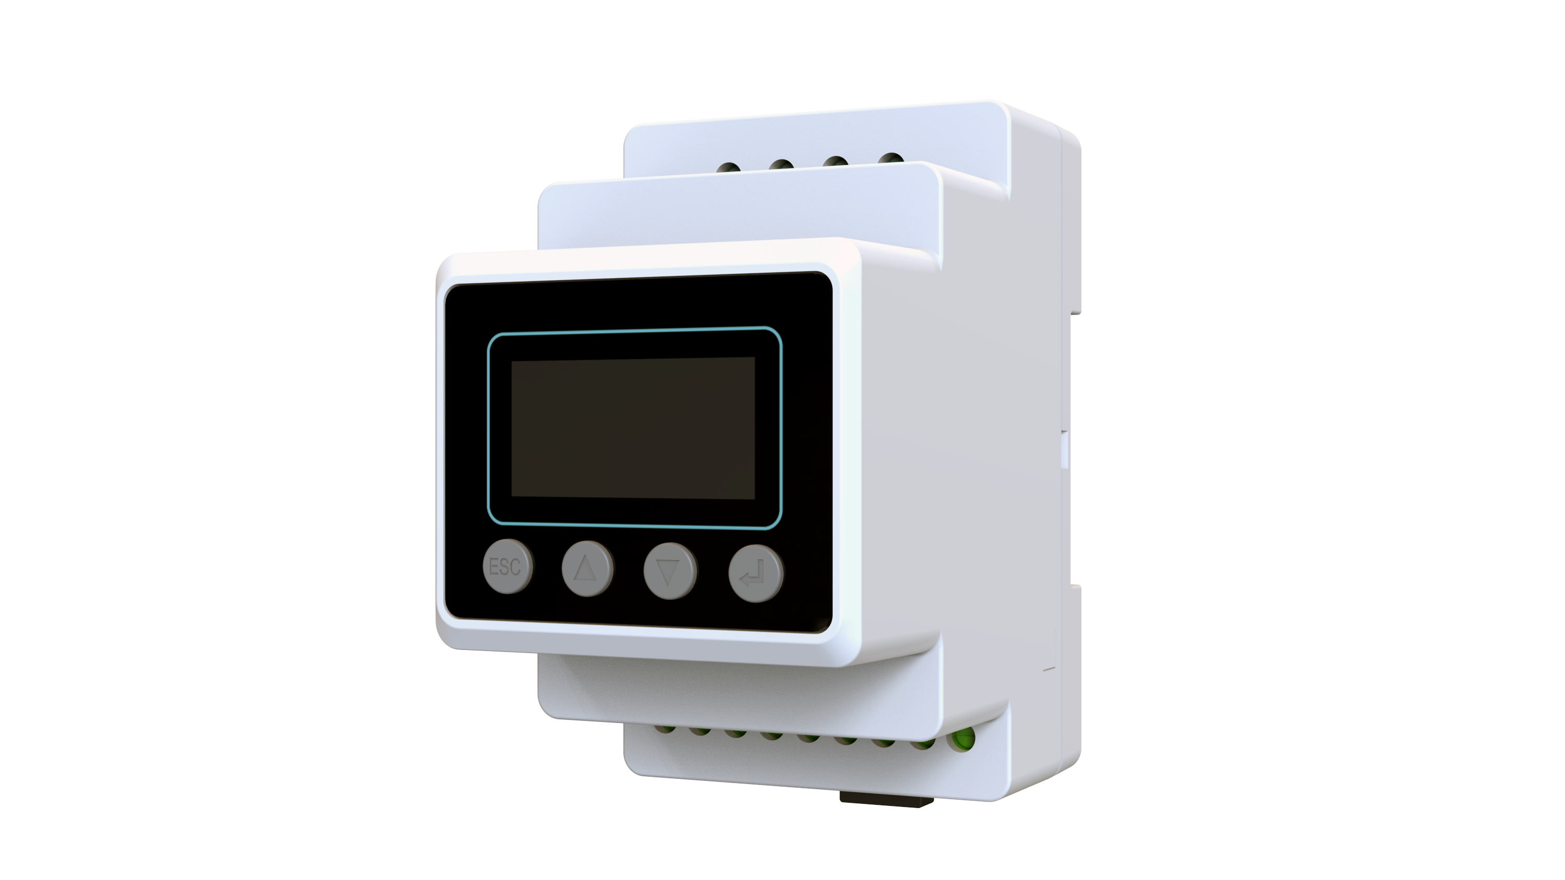
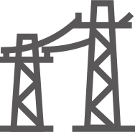
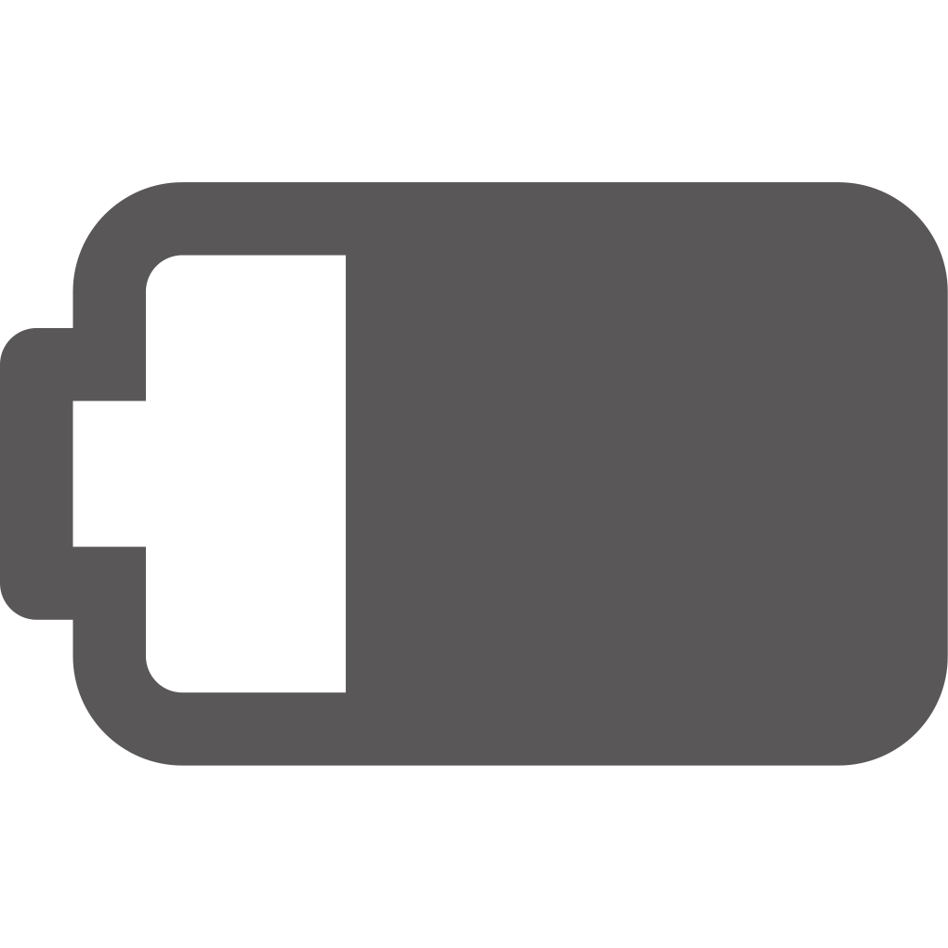
SCENARIO 1
Billed in Single Phase
Power Export Limit On
With Battery Connected
VS
110% UNBALANCED
100% BALANCED
PV
PV
6kW
6kW
6kW
0.5kW
0kW
L1
3.5kW
0.5kW
0kW
L1
1.3kW
0kW
L2
0.5kW
0.8kW
L2
2kW
2.2kW
0kW
L3
2kW
0.5kW
1.7kW
L3
Meter
Grid
Meter
Grid
Solinteg
6kW
Battery
Other Brand
6kW
2.2kW
1.3kW
0.5kW
2.2kW
1.3kW
0.5kW
Loads
Loads
Battery
100% energy independence
1095USD more electricity bill a year
71% more PV generation
Over 40% PV power wasted
Note：
1. Compared when both systems will work stable for 4h a day.
2. For both scenarios, the battery charging and discharging power limitation is 2kW.
3. Electricity price: for purchasing 0.3USD/kWh, for selling 0.1USD/kWh.
www.solinteg.com
academy@solinteg.com
How Solinteg Unbalanced Output benefits your life?
04

Slide 5
SCENARIO 2
Billed in Single Phase
Power Export Limit On
Without Battery Connected
VS
110% UNBALANCED
100% BALANCED
PV
PV
6kW
6kW
4kW
0.5kW
0kW
L1
1.5kW
0.5kW
0kW
L1
1.3kW
0kW
L2
0.5kW
0.8kW
L2
2.2kW
0kW
L3
0.5kW
1.7kW
L3
Meter
Grid
Meter
Grid
Solinteg
6kW
Other Brand
6kW
2.2kW
1.3kW
0.5kW
2.2kW
1.3kW
0.5kW
Loads
Loads
167% more PV power generation
1095USD more electricity bill a year
3650kWh grid power saved
Over 75% PV power wasted
Note：
1. Compared when both systems will work stable for 4h a day.
2. For both scenarios, the battery charging and discharging power limitation is 2kW.
3. Electricity price: for purchasing 0.3USD/kWh, for selling 0.1USD/kWh.
www.solinteg.com
academy@solinteg.com
How Solinteg Unbalanced Output benefits your life?
05

Slide 6
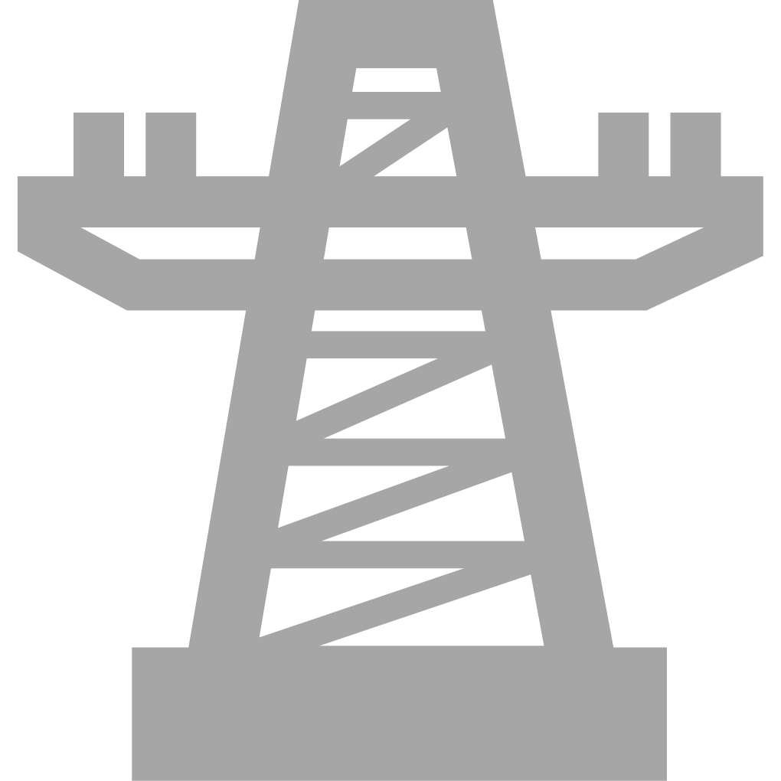
SCENARIO 3
Billed in Single Phase
Power Export Limit Off
With Battery Connected
VS
110% UNBALANCED
100% BALANCED
PV
PV
6kW
6kW
6kW
0.5kW
0kW
L1
6kW
2kW
1.5kW
L1
1.3kW
0kW
L2
2kW
0.7kW
L2
2kW
2.2kW
0kW
L3
0kW
2kW
0.2kW
L3
Meter
Grid
Meter
Grid
Solinteg
6kW
Battery
Other Brand
6kW
2.2kW
1.3kW
0.5kW
2.2kW
1.3kW
0.5kW
Loads
Loads
Battery
100% PV power utilization
Battery charging power wasted
642.4USD bill saved a year
3212kWh more grid power used a year
Note：
1. Compared when both systems will work stable for 4h a day.
2. For both scenarios, the battery charging and discharging power limitation is 2kW.
3. Electricity price: for purchasing 0.3USD/kWh, for selling 0.1USD/kWh.
www.solinteg.com
academy@solinteg.com
How Solinteg Unbalanced Output benefits your life?
06
Notes:
建议去掉1.1倍PV过载来计算，方便易懂

Slide 7
SCENARIO 4
Billed in Single Phase
Power Export Limit Off
Without Battery Connected
VS
110% UNBALANCED
100% BALANCED
PV
PV
6.6kW
6.6kW
6.6kW
2.2kW
1.7kW
L1
6kW
2kW
1.5kW
L1
2.2kW
0.9kW
L2
2kW
0.7kW
L2
2.2kW
0kW
L3
2kW
0.2kW
L3
Meter
Grid
Meter
Grid
Solinteg
6kW
Other Brand
6kW
2.2kW
1.3kW
0.5kW
2.2kW
1.3kW
0.5kW
Loads
Loads
10% more PV power generation
10% PV power wasted
60% more revenue
292kWh more grid power used
Note：
1. Compared when both systems will work stable for 4h a day.
2. For both scenarios, the battery charging and discharging power limitation is 2kW.
3. Electricity price: for purchasing 0.3USD/kWh, for selling 0.1USD/kWh.
www.solinteg.com
academy@solinteg.com
How Solinteg Unbalanced Output benefits your life?
07

Slide 8
SCENARIO 5
Billed in Total
Power Export Limit On
With Battery Connected
VS
110% UNBALANCED
100% BALANCED
PV
PV
6kW
6kW
6kW
0.5kW
0kW
L1
3.5kW
0.5kW
0kW
L1
1.3kW
0kW
L2
0.5kW
0.8kW
L2
2kW
2.2kW
0kW
L3
2kW
0.5kW
1.7kW
L3
Meter
Grid
Meter
Grid
0kW
In total
2.5kW
Import
Solinteg
6kW
Battery
Other Brand
6kW
2.2kW
1.3kW
0.5kW
2.2kW
1.3kW
0.5kW
Loads
Loads
Battery
100% energy independence
1095USD more electricity bill a year
71% more PV power generation
Over 40% PV power wasted
Note：
1. Compared when both systems will work stable for 4h a day.
2. For both scenarios, the battery charging and discharging power limitation is 2kW.
3. Electricity price: for purchasing 0.3USD/kWh, for selling 0.1USD/kWh.
www.solinteg.com
academy@solinteg.com
How Solinteg Unbalanced Output benefits your life?
08
Notes:
Billed in total 应该是白色吧？右图购电部分计算有问题

Slide 9
SCENARIO 6
Billed in Total
Power Export Limit On
Without Battery Connected
VS
110% UNBALANCED
100% BALANCED
PV
PV
6kW
6kW
4kW
0.5kW
0kW
L1
1.5kW
0.5kW
0kW
L1
1.3kW
0kW
L2
0.5kW
0.8kW
L2
2.2kW
0kW
L3
0.5kW
1.7kW
L3
Meter
Grid
Meter
Grid
0kW
In total
2.5kW
Import
Solinteg
6kW
Other Brand
6kW
2.2kW
1.3kW
0.5kW
2.2kW
1.3kW
0.5kW
Loads
Loads
167% more PV power generation
1095USD more electricity bill a year
3650kWh grid power saved
Over 75% PV power wasted
Note：
1. Compared when both systems will work stable for 4h a day.
2. For both scenarios, the battery charging and discharging power limitation is 2kW.
3. Electricity price: for purchasing 0.3USD/kWh, for selling 0.1USD/kWh.
www.solinteg.com
academy@solinteg.com
How Solinteg Unbalanced Output benefits your life?
09

Slide 10
SCENARIO 7
Billed in Total
Power Export Limit Off
With Battery Connected
VS
110% UNBALANCED
100% BALANCED
PV
PV
6kW
6kW
6kW
0.5kW
0kW
L1
6kW
2kW
1.5kW
L1
1.3kW
0kW
L2
2kW
0.7kW
L2
2kW
2.2kW
0kW
L3
0kW
2kW
0.2kW
L3
Meter
Grid
Meter
Grid
0kW
In total
2kW
Export
Solinteg
6kW
Battery
Other Brand
6kW
2.2kW
1.3kW
0.5kW
2.2kW
1.3kW
0.5kW
Loads
Loads
Battery
100% PV power utilization
Battery charging power wasted
2920kWh power saver a year
584USD more electircity bill a year
Note：
1. Compared when both systems will work stable for 4h a day.
2. For both scenarios, the battery charging and discharging power limitation is 2kW.
3. Electricity price: for purchasing 0.3USD/kWh, for selling 0.1USD/kWh.
www.solinteg.com
academy@solinteg.com
How Solinteg Unbalanced Output benefits your life?
10

Slide 11
SCENARIO 8
Billed in Total
Power Export Limit Off
Without Battery Connected
VS
110% UNBALANCED
100% BALANCED
PV
PV
6.6kW
6.6kW
6.6kW
2.2kW
1.7kW
L1
6kW
2kW
1.5kW
L1
2.2kW
0.9kW
L2
2kW
0.7kW
L2
2.2kW
0.6kW
L3
2kW
0.8kW
L3
Meter
`
Grid
Meter
Grid
2kW
Export
1.4kW
Export
Solinteg
6kW
Other Brand
6kW
2.8kW
1.3kW
0.5kW
2.8kW
1.3kW
0.5kW
Loads
Loads
10% more PV power generation
10% PV power wasted
43% more revenue
Less power revenue
Note：
1. Compared when both systems will work stable for 4h a day.
2. For both scenarios, the battery charging and discharging power limitation is 2kW.
3. Electricity price: for purchasing 0.3USD/kWh, for selling 0.1USD/kWh.
www.solinteg.com
academy@solinteg.com
How Solinteg Unbalanced Output benefits your life?
11

Slide 12
Advantages of 110% Unbalanced Output
Higher
Power Independence
More Power Generation
More Revenue
Faster Charging
Less Electricity Bills
www.solinteg.com
academy@solinteg.com
How Solinteg Unbalanced Output benefits your life?
12

Slide 13
10kW
L1: 0kW
L2: 0kW
END
Visit Solinteg website to find out more
L3: 0kW
1kW
3kW
6kW
Use Your Power More Efficiently
www.solinteg.com
academy@solinteg.com
How Solinteg Unbalanced Output benefits your life?
END

