Slide 1
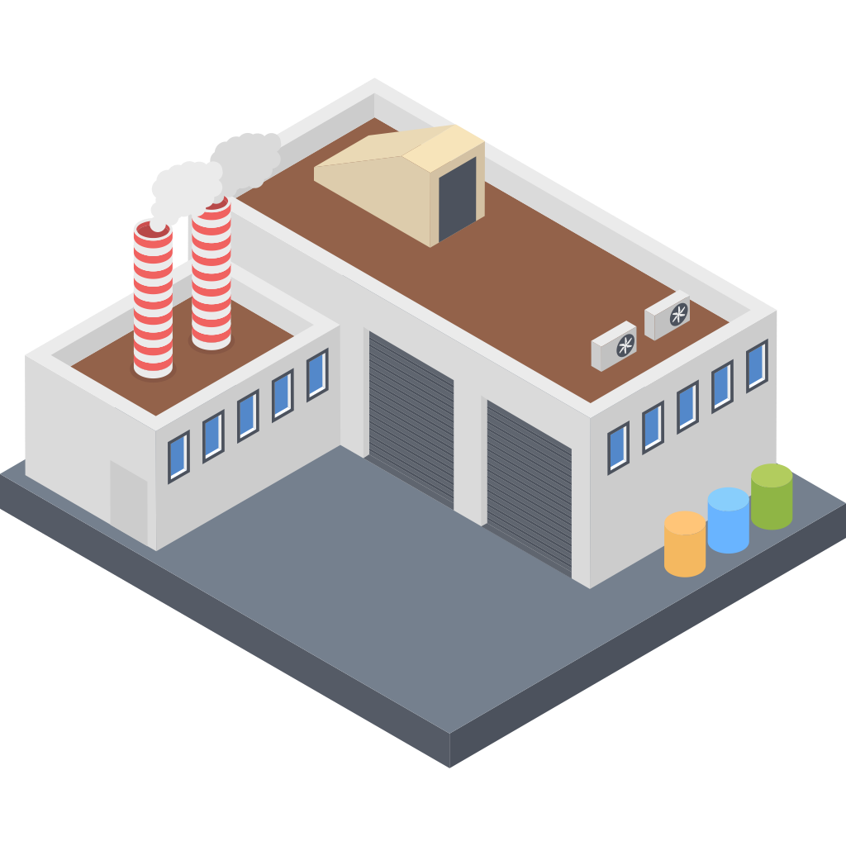
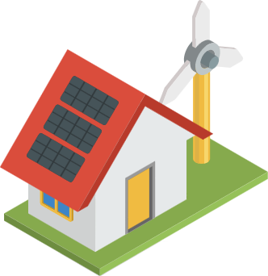
SOLINTEG C&I SOLUTION
Energy Storage System
www.solinteg.com
academy@solinteg.com
Solinteg C&I Solution

Slide 2
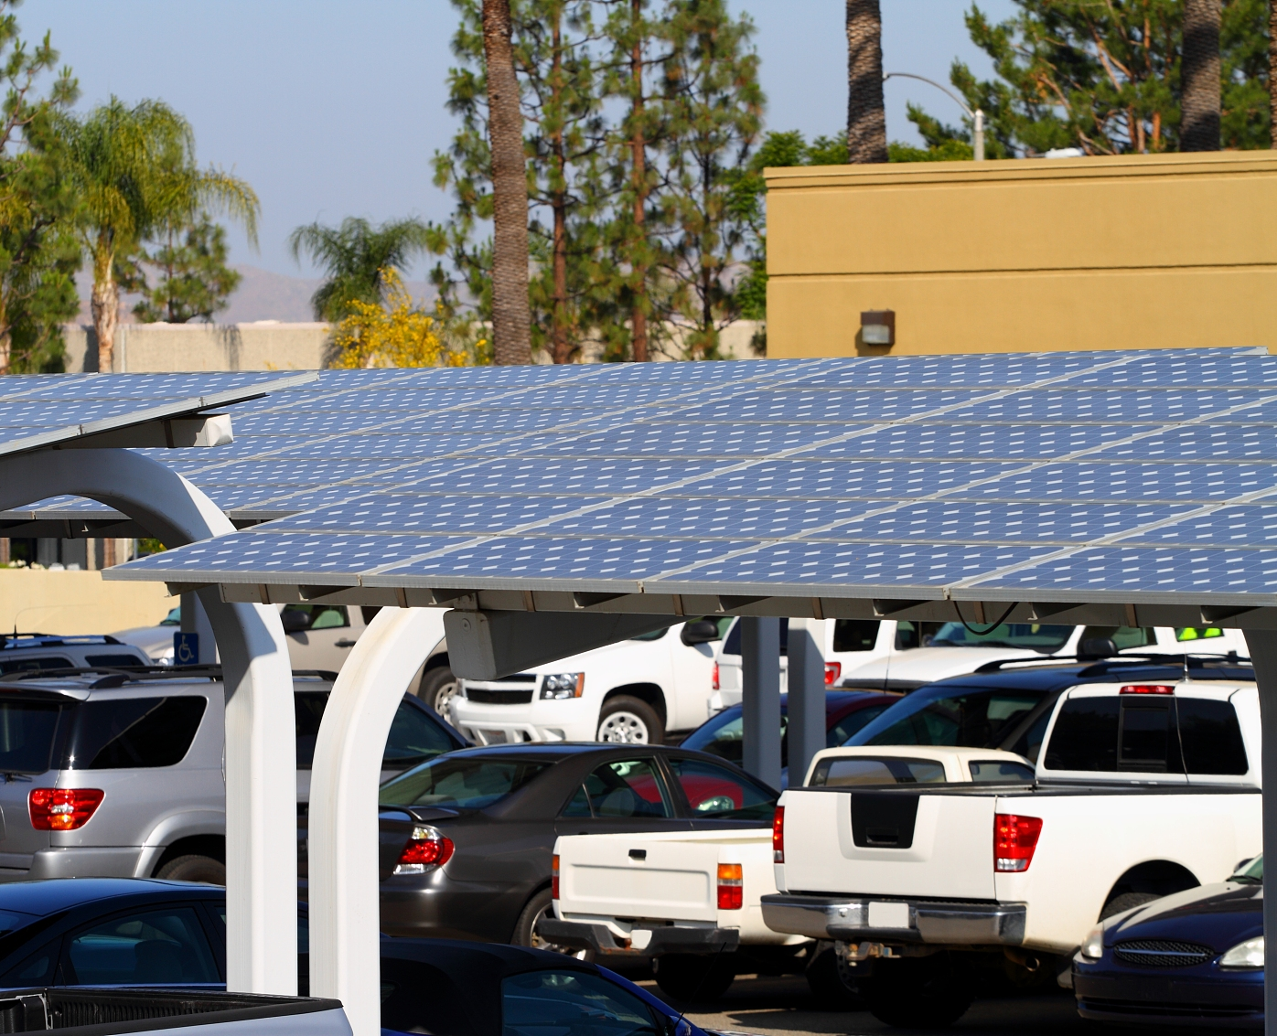
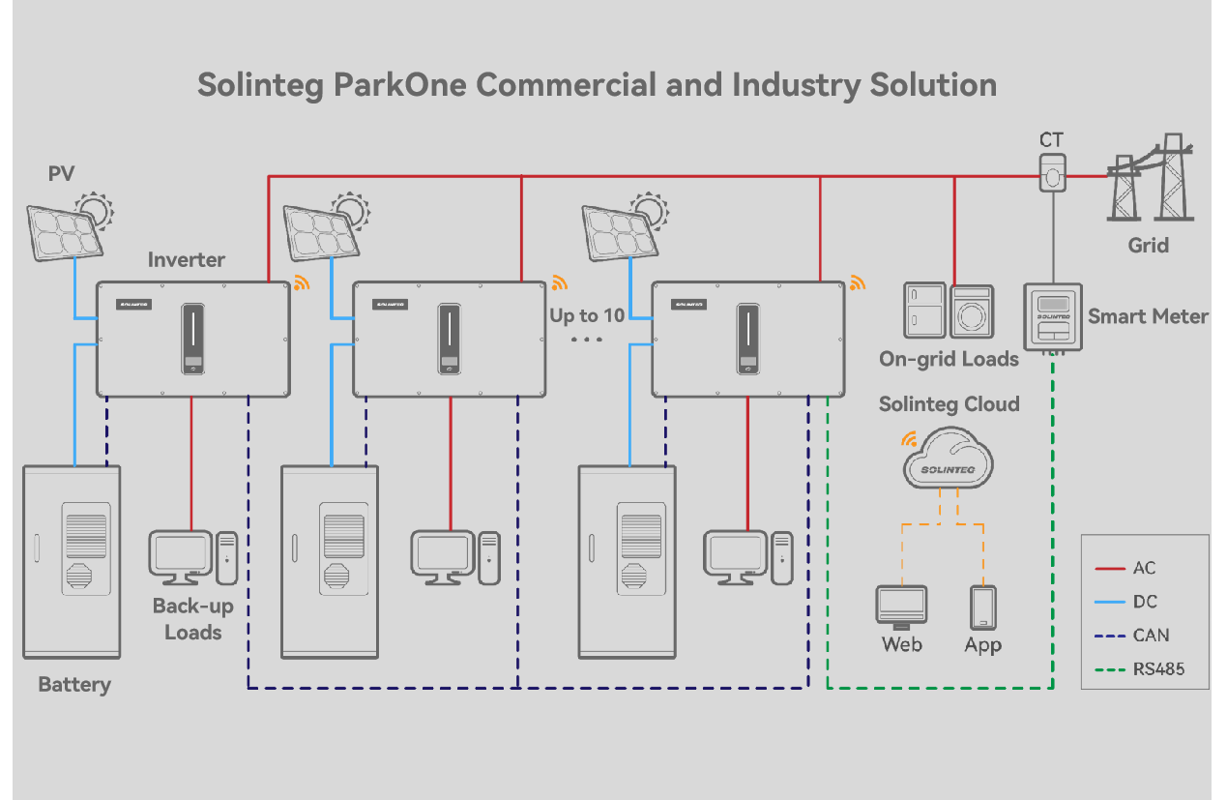
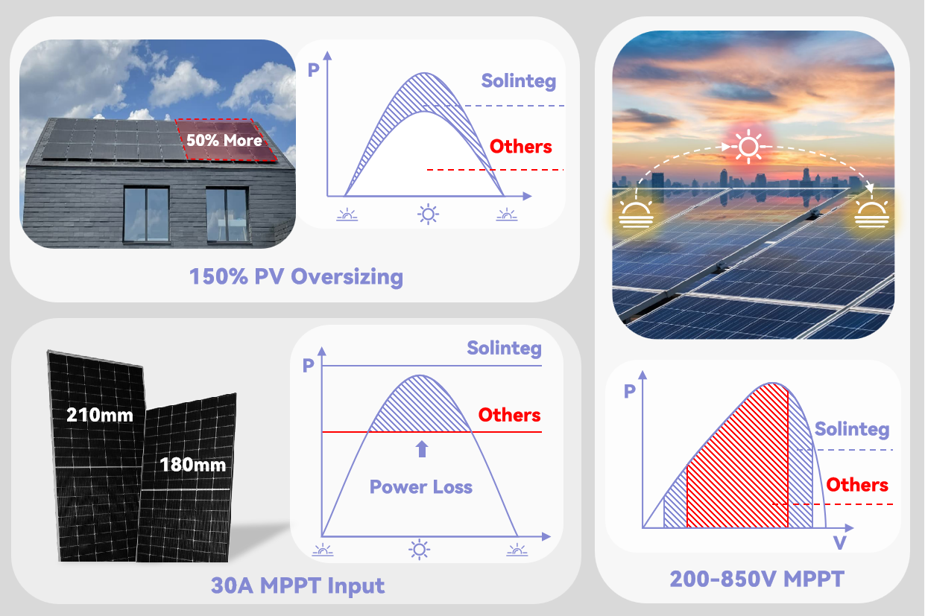
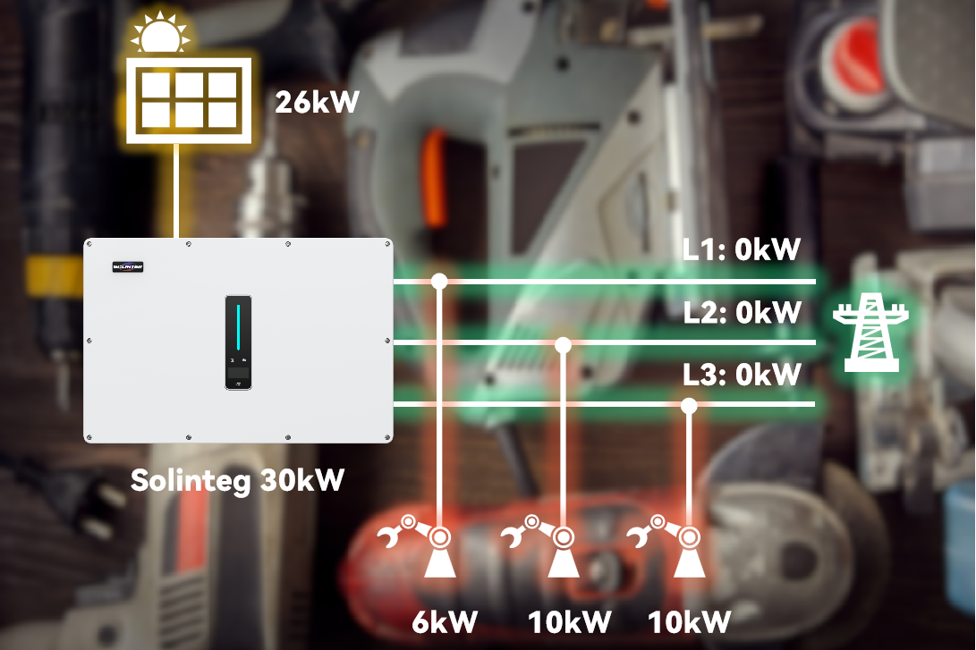
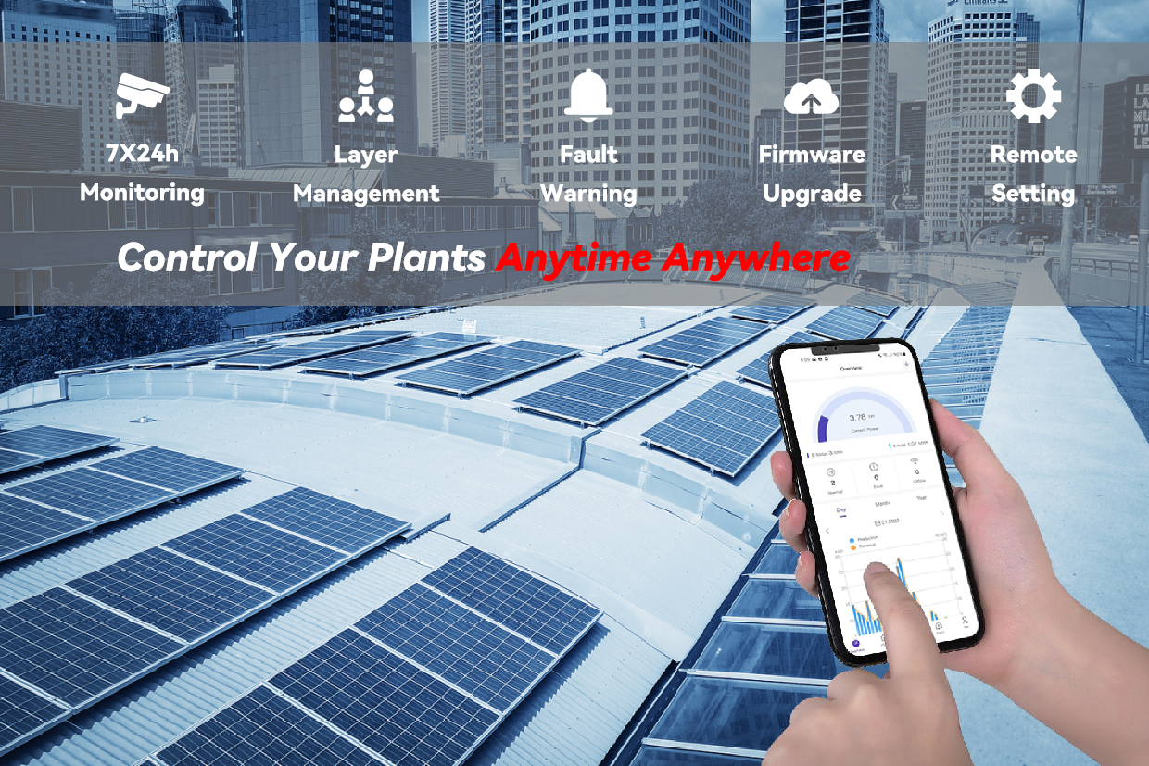
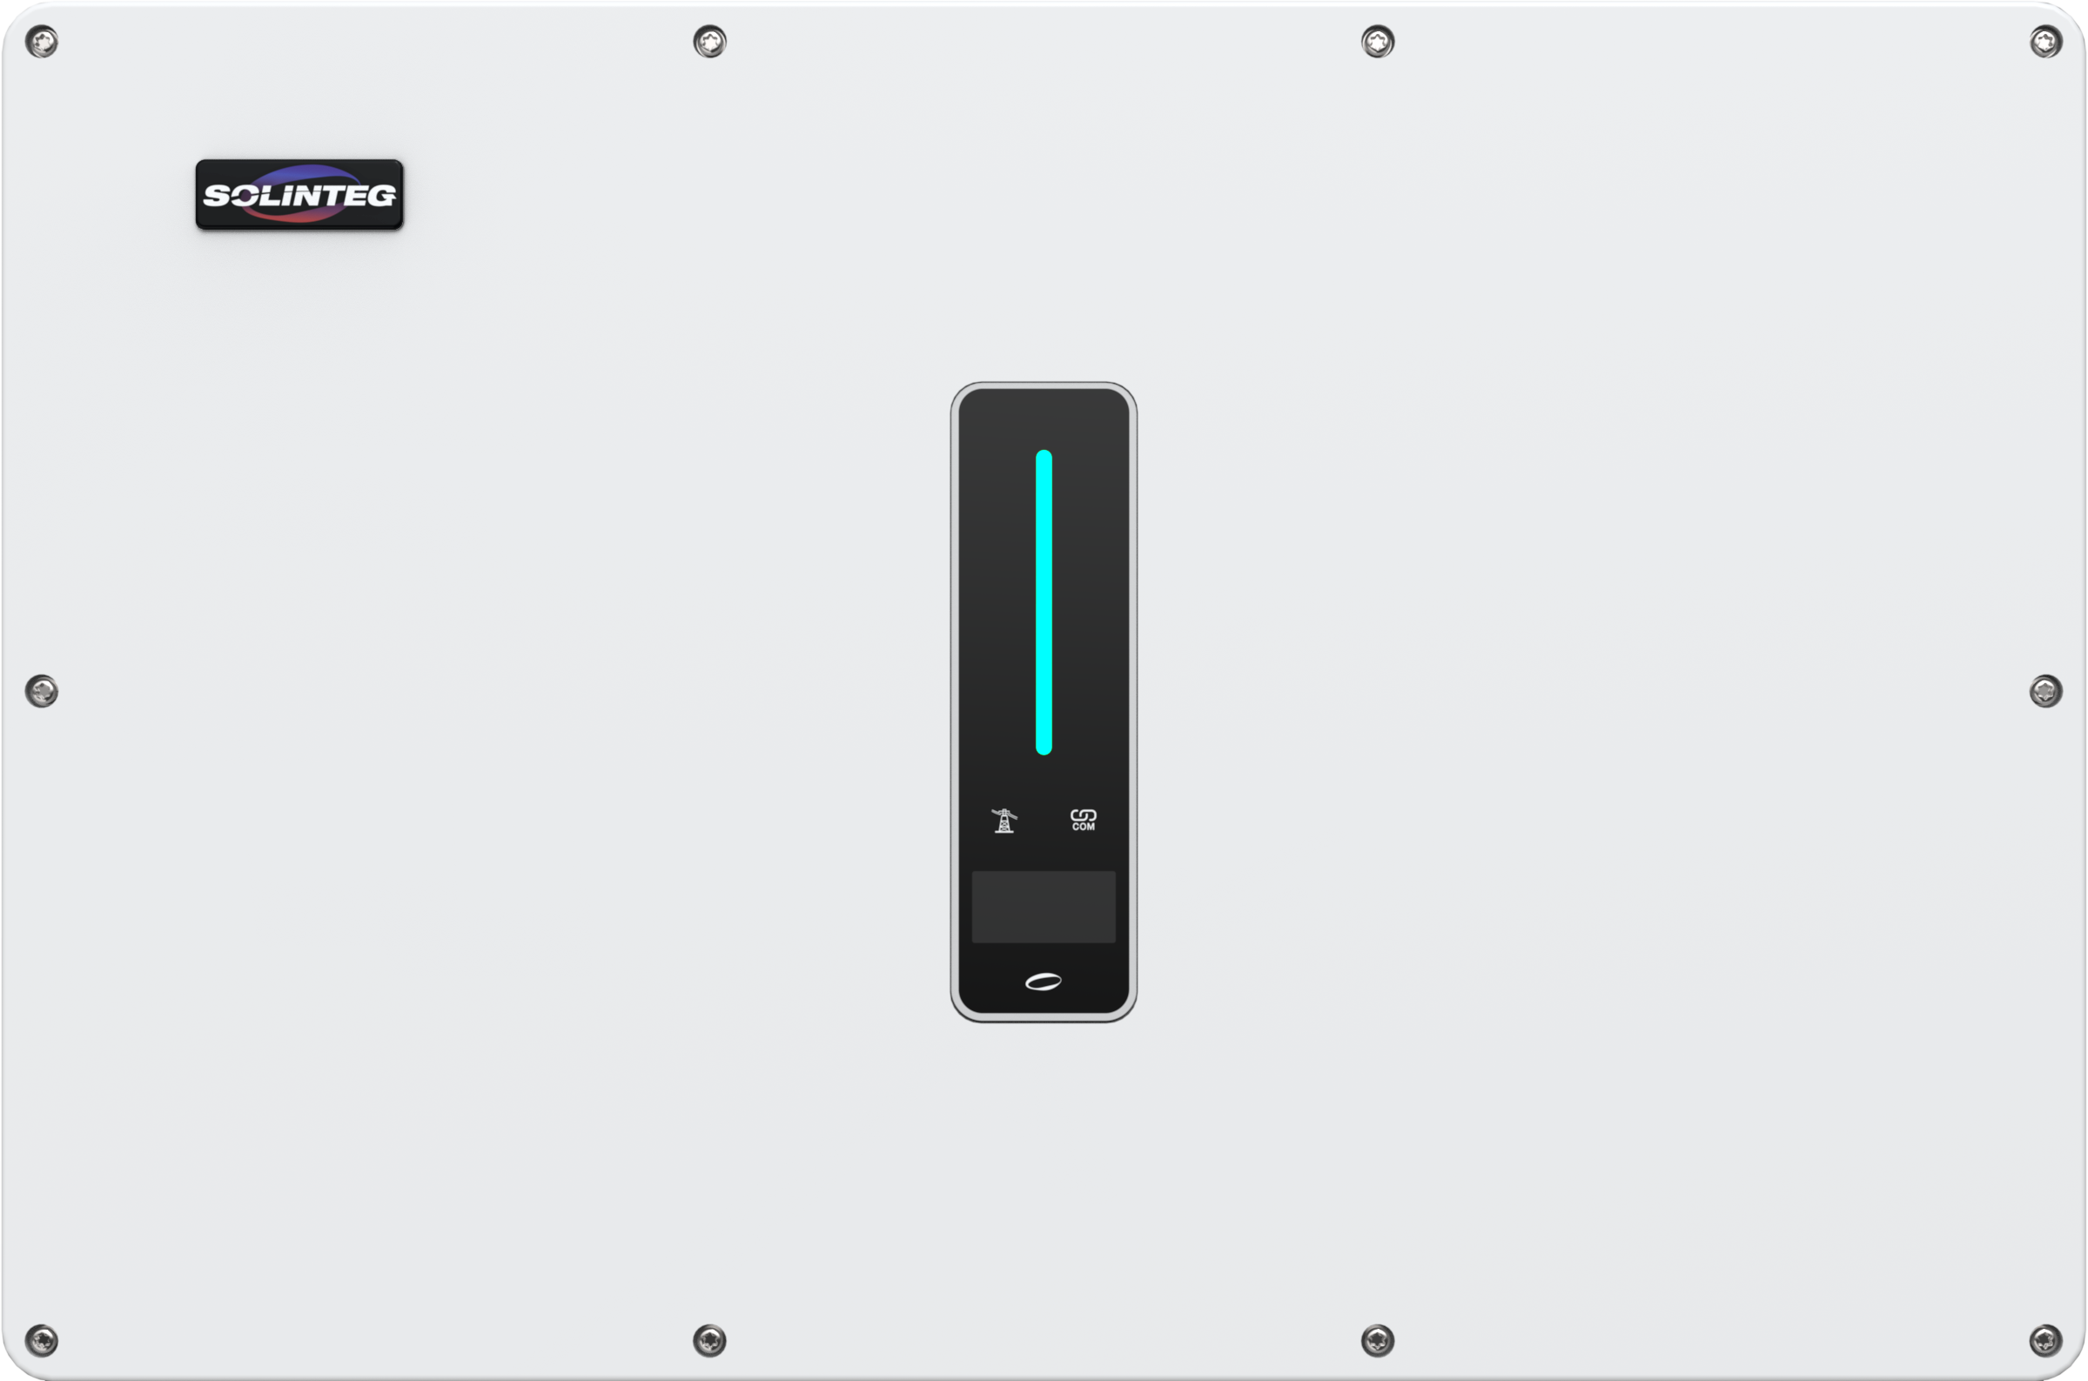
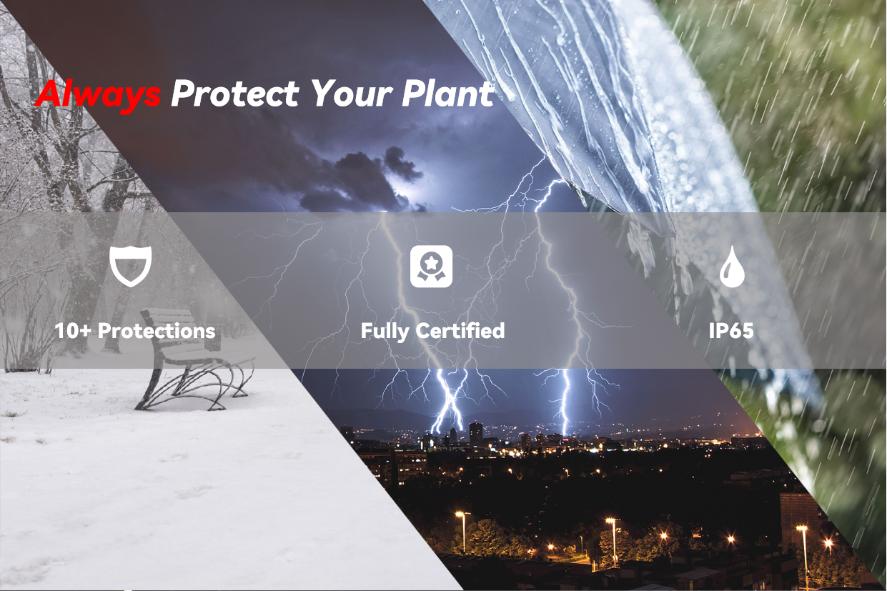
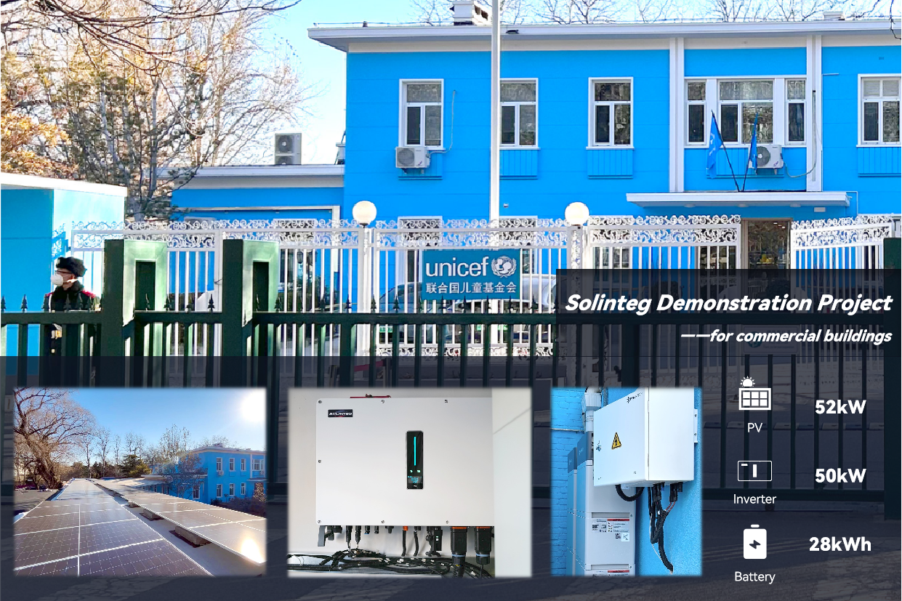
Solinteg C&I Solution
Part 1
Brief Introduction
Part 2
Efficient
Part 3
Functional
Part 4
Smart
CONTENTS
Part 5
Safe
Part 6
Applications
www.solinteg.com
academy@solinteg.com
Solinteg C&I Solution
02

Slide 3
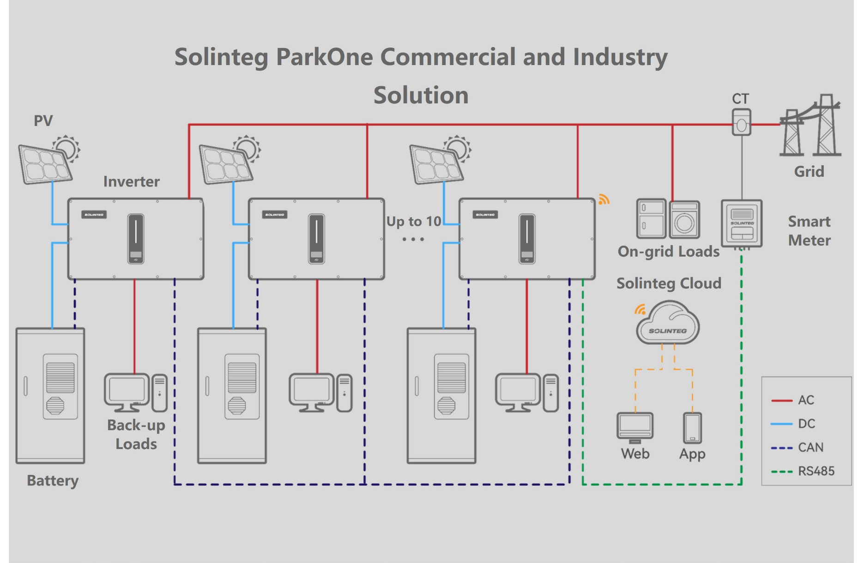
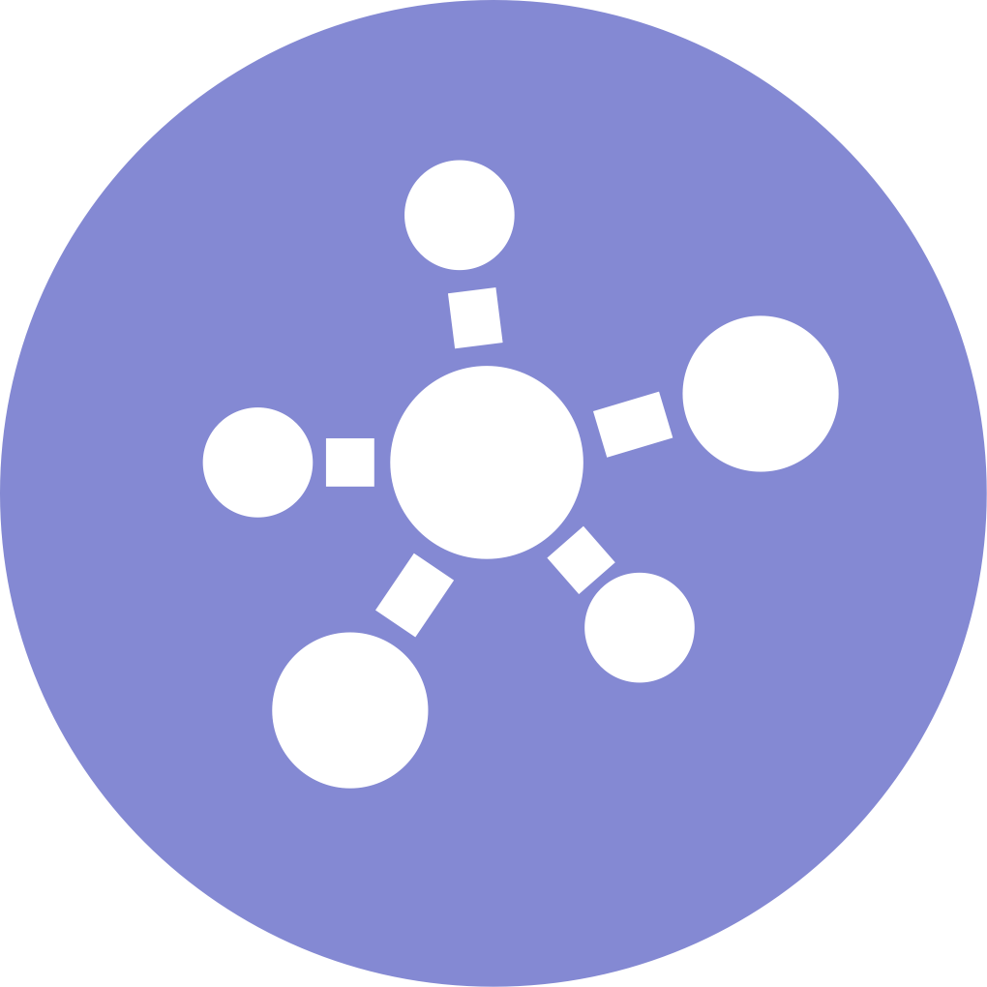
Brief Introduction
Solinteg provides an innovative decentralized smart energy solution-Parkone, which is designed for commercial and industry customers. Compared with traditional PV energy storage systems, Parkone simplifies device number and system complexity, reduces the costs of installation and maintenance. Users can monitor, maintain and control the whole system in the monitoring APP, which offers them a more convenient and efficient solution.
Efficient
Functional
Wide Power Range
High Efficency
30A MPPT input
Up to 10 units paralleling
Seamless switching
Unbalanced output
Multiple Control
DG Ready
Smart
Safe
Smart EMS
Intelligent Monitoring
Smart Grid
Emergency stop
10+ protections
IP 65
www.solinteg.com
academy@solinteg.com
Solinteg C&I Solution
03

Slide 4
Efficient
P
Solinteg
Input
50% More
Others
150% PV Oversizing
More power for loads and charge the battery at the same time, and more power in poor irradiation days
30A MPPT Input
Compatible with all kinds of big power PV panels, no power loss occurs
200-850V MPPT Voltage Range
Wider working voltage range for more possibility to track the max power point
Up to 4 MPPT
8 PV inputs and 4 MPPT make the PV connection more flexible
150% PV Oversizing
Solinteg
P
P
210mm
Others
Solinteg
182mm
Power Loss
Others
V
30A MPPT Input
200-850V MPPT
www.solinteg.com
academy@solinteg.com
Solinteg C&I Solution
04

Slide 5
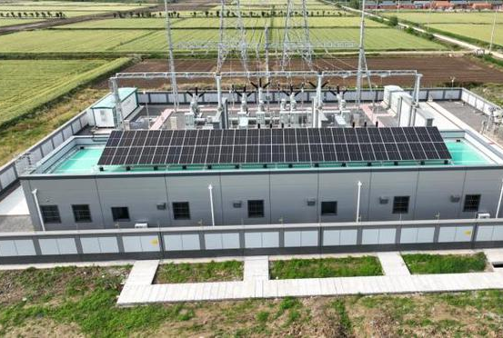
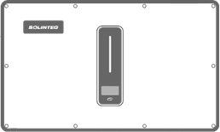
Efficient
25kW - 50kW
Output
Max. Efficiency
98.8%
Wide Power Range
25-50kW, suitable for different applications
High Efficiency
Max. efficiency up to 98.8%, more generation, and less power loss
100A Charging and Discharging
Shorter full charging time and bigger discharging power
110% AC Overloading
Bigger loads connection
Up to 10 Units Paralleling
Expand the system from 25kW to 500kW flexibly
50/40/36/30/25
Paralleling
Up to 10
100A
Charing & Discharing
110% AC Overloading
www.solinteg.com
academy@solinteg.com
Solinteg C&I Solution
05

Slide 6
FUNCTIONAL
Unbalanced Output
26kW
In a three-phase system, it is common that different power loads will be used at the same time on different phases, which will cause the power consumption of the whole three-phase grid to be unbalanced.
L1: 0kW
Imagine a scene ( as shown in the pic):
PV generation is 26kW. Where the power export is limited and there are three working loads of different phases, L1: 6kW; L2: 10kW; L3: 10kW.
L2: 0kW
L3: 0kW
What will happen when you are using a 30kW inverter without the unbalanced output function?
PV: 26kW to 18kW
L1：6kW
Other
30kW
Inverter
L1： 0kW
LOADS
L2：6kW
L2：-4kW
GRID
L3：6kW
L3：-4kW
Solinteg 30kW
Due to the lack of unbalanced output function, and to ensure there is no power exporting to the grid, the inverter each phase output will be limited to 6KW. Therefore, the total power of the inverter is forced to decrease from 26KW to 18kw, and L2 and L3 phases require additional power purchase from the grid to fill the power gap.
6kW
10kW
10kW
Solinteg inverters support 100% unbalanced output.
So in this case, each phase can be fully supplied by the inverter, which can save energy bills and increase load flexibility.
www.solinteg.com
academy@solinteg.com
Solinteg C&I Solution
06

Slide 7
FUNCTIONAL
Seamless Auto Switching
Auto Switching < 20ms
Uninterrupted power supply
Solinteg hybrid inverters can switch your system to off-grid mode when the power blackouts.
The whole switching process is managed automatically and can be activated within 20ms.
It keeps your important devices running, and reduces losses caused by power outages.
*: The system is capable of sustaining typical household demands without experiencing power outages; however, it is not designed to support life-sustaining medical equipment. It does not offer a guaranteed backup power supply in every situation.
www.solinteg.com
academy@solinteg.com
Solinteg C&I Solution
07

Slide 8
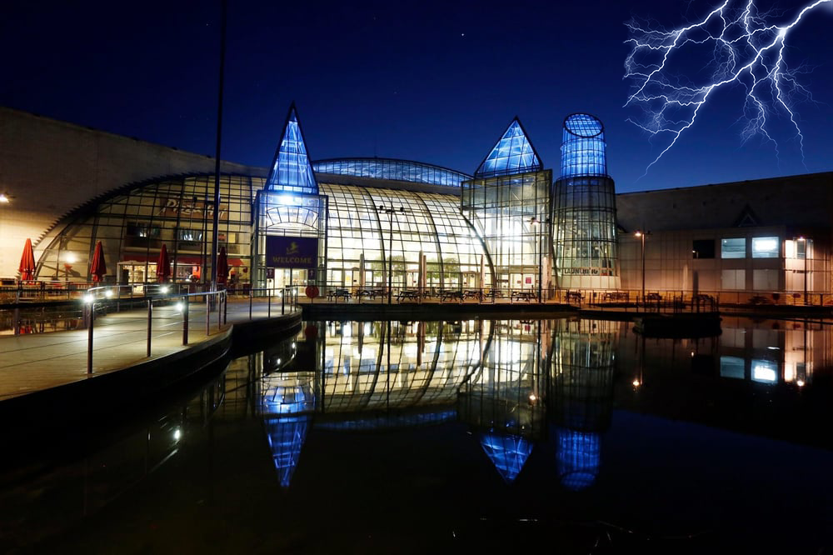
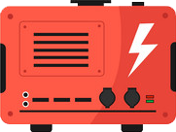
FUNCTIONAL
Keep The Power ALL The Time
Start the Diesel Generator Remotely
DG Ready
It is possible that we may encounter extreme situations where the grid blackouts, the battery reaches SOC protection value, and the solar panels don’t have higher generation due to bad weather.
Don’t worry! Solinteg hybrid inverters support the use of a diesel generator as an AC source to supply loads and charge batteries in this situation.
Solinteg hybrid inverter can control the diesel generator through a dry contact terminal, which can manually or intelligently start the diesel generator remotely to respond to emergencies.
DO
DG
www.solinteg.com
academy@solinteg.com
Solinteg C&I Solution
08

Slide 9
FUNCTIONAL
Control Your Devices Flexibly
Digital Output
0-10V/4-20mA Analog Quantity Output
Multiple Control-DO/AO
Auto Switching < 20ms
Uninterrupted power supply
Solinteg 25-50kW inverters offer multiple ways of control ways, which include three digital outputs and two analog outputs.
With these AO/DO contacts, you can remotely control the loads that are connected to our inverter on and off through our APP. For example, turn on or off the light at a certain time, preheating the room before you come to the house.
Also, we can connect a lot of heating storage devices through the DO & AO contacts such as heating pumps, towel heating racks, and boilers to efficiently use the power generated from the PV. For example, if there’s excess power in the daytime, you can use it to increase the temperature of heat pumps or boilers and enjoy a warm home when you come back.
DO
AO
EMS
www.solinteg.com
academy@solinteg.com
Solinteg C&I Solution
09

Slide 10
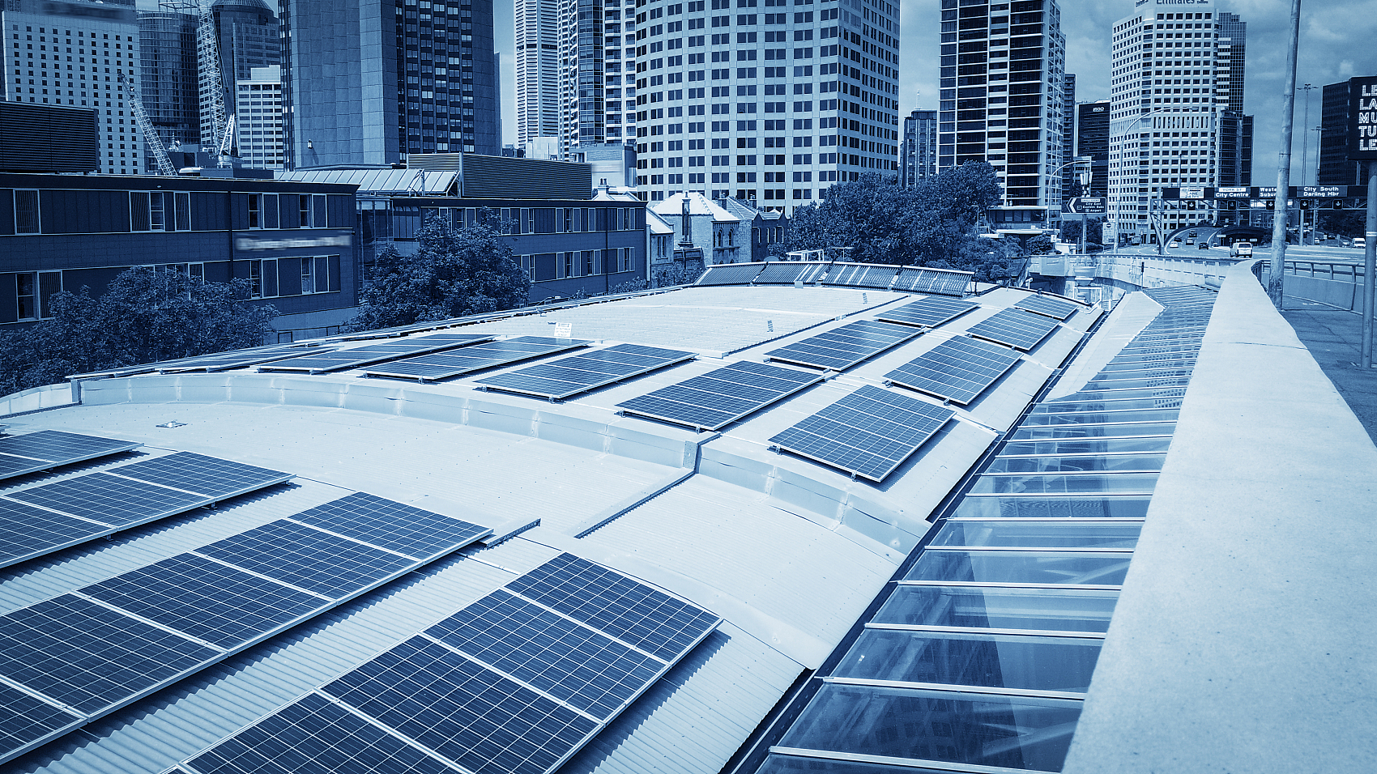
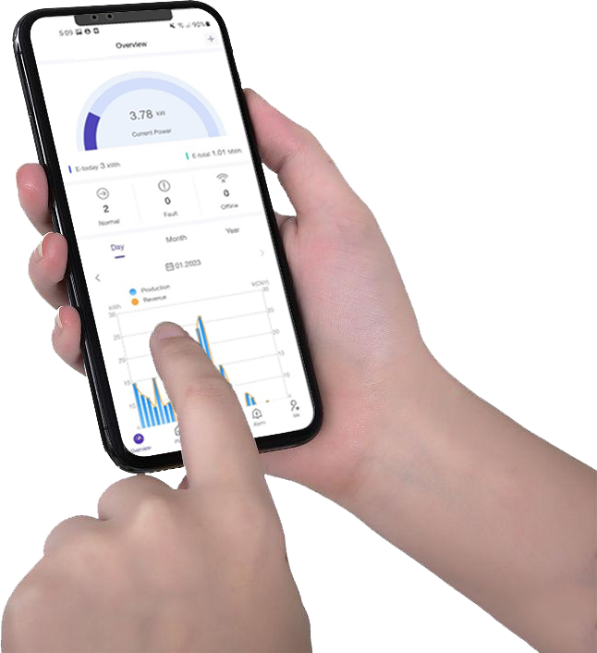
SMART
Intelligent Monitoring
7X24h
Monitoring
Layer Management
Fault
Warning
Firmware
Upgrade
Remote
Setting
Solinteg provides an intelligent and convenient remote control platform-- Solinteg Cloud.
You can easily manage and check your system and subordinate PV power station anytime and anywhere, including power generation status, battery status, load consumption information, etc. Also, multiple settings can be remotely configured through Solinteg Cloud and its portable version Solinteg App, such as turning on/off the inverter, firmware upgrading, parameters setting, operation mode setting, etc.
Our platform makes it possible for operators to monitor and control their system in a timely manner on PC and mobile phone.
Control Your Plants Anytime Anywhere
www.solinteg.com
academy@solinteg.com
Solinteg C&I Solution
10

Slide 11
SMART
··
Use Your Power Efficiently
Economic Mode
Peak Load Shifting
Export Limit
......
Smart EMS
Have you ever been troubled by the following PROBLEMS?
Significant peak-to-valley electricity price
Expensive electricity used in non-emergency time
Excess power exports to the power grid without any payback or even being punished.
…
Solinteg smart EMS can provide you with solutions in these scenarios.
You can manually control some high-consumption loads on and off on Solinteg Cloud. Or you can intelligently control these loads by preset working modes or time periods and limit the export power to use your power more efficiently.
www.solinteg.com
academy@solinteg.com
Solinteg C&I Solution
11

Slide 12
SMART
Smart Grid
There are different requirements for inverters in different regions. Some are related to safety, while others are related to the grid.
For example, RRCR in Germany. If the grid is overloaded, the utility company will send a command to the inverter through RRCR to ask the inverter to reduce its feed-in power to 0%, 30%, 60% of its rated power according to the command. If the grid is not overloaded, the inverter will be allowed to feed 100% of the power.
Solinteg has the integral solution to adapt to the different region’s requirements. Such as DRED, RRCR, N-PE check, and so on.
Adapt to Different Regions Friendly
DRED/ RRCR
N-PE Check
www.solinteg.com
academy@solinteg.com
Solinteg C&I Solution
12

Slide 13
SAFE
Multiple Protection
Always Protect Your Plant
Solinteg inverters have an elegant outlook design with IP65 class protection and over 10 kinds of safety protection, such as surge protection, DC reverse polarity protection, over-temperature protection and so on, which ensure our inverters perform stable and safely.
Complete protection and certifications make sure that our customers choose our products without worry.
10+ Protections
Fully Certified
IP65
www.solinteg.com
academy@solinteg.com
Solinteg C&I Solution
13

Slide 14
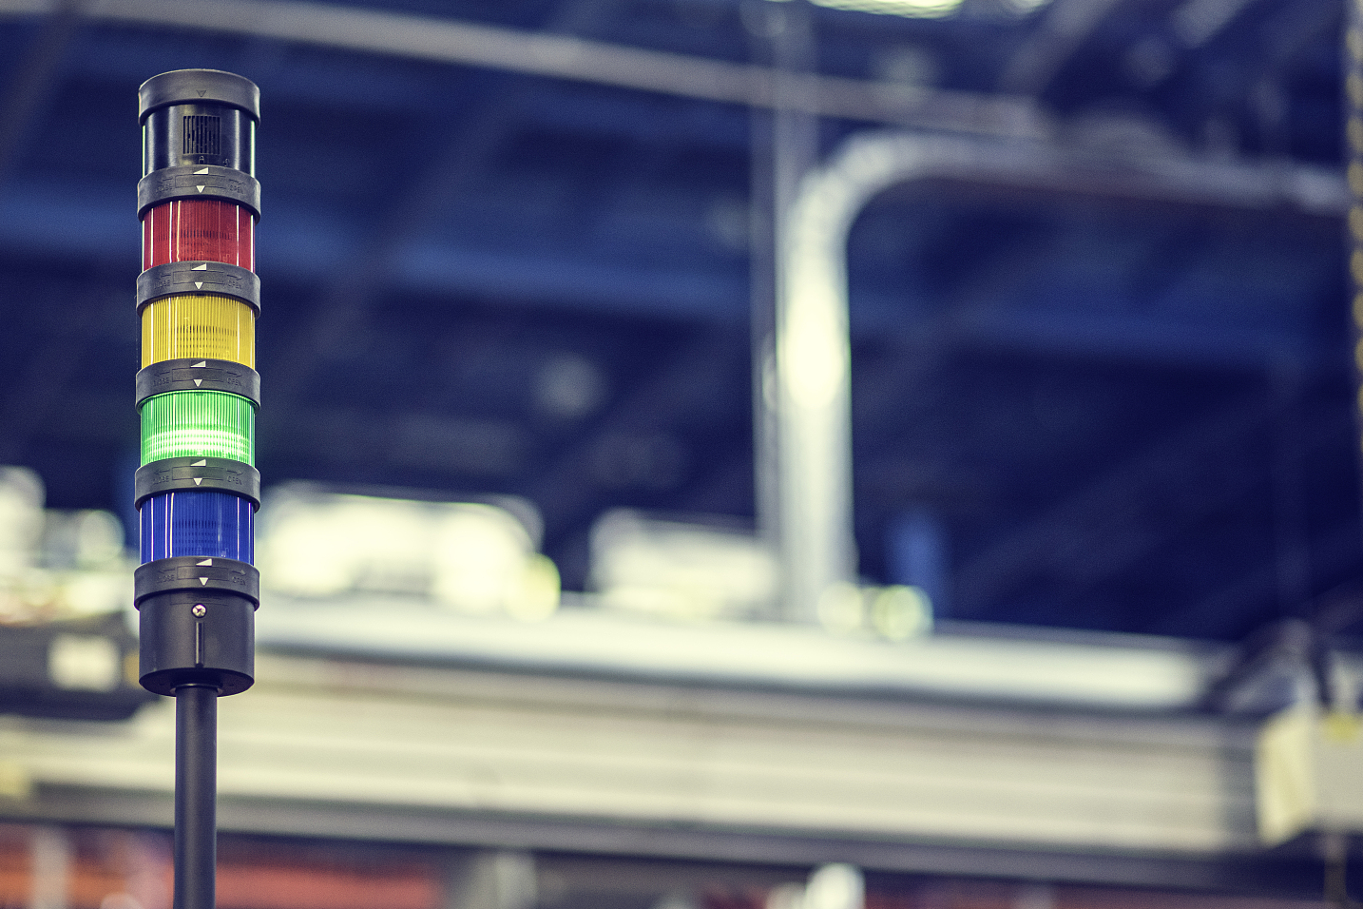
SAFE
Emergency Stop
When an accident occurs, it usually takes you several minutes to turn off the DC switch, battery switch, and AC switch.
Solinteg hybrid inverter comes to stand with an emergency stop function, which can cut off all outputs rapidly.
You can stop the inverter with a press when an accident occurs and avoid system damage being enlarged.
www.solinteg.com
academy@solinteg.com
Solinteg C&I Solution
14

Slide 15
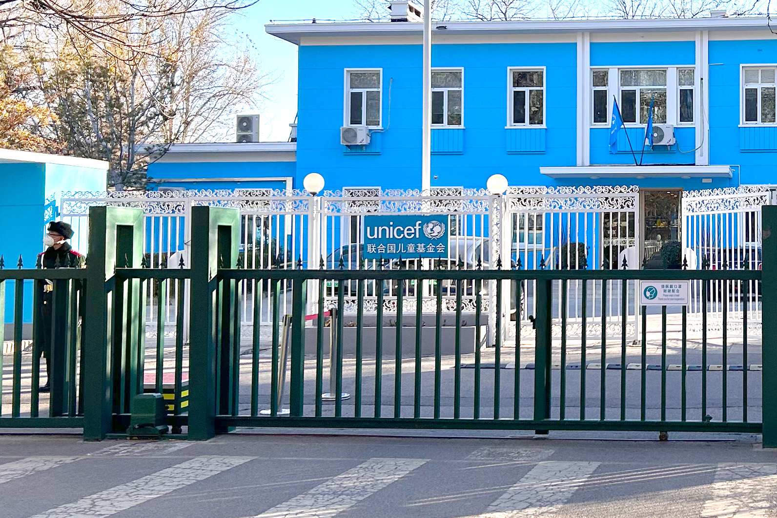
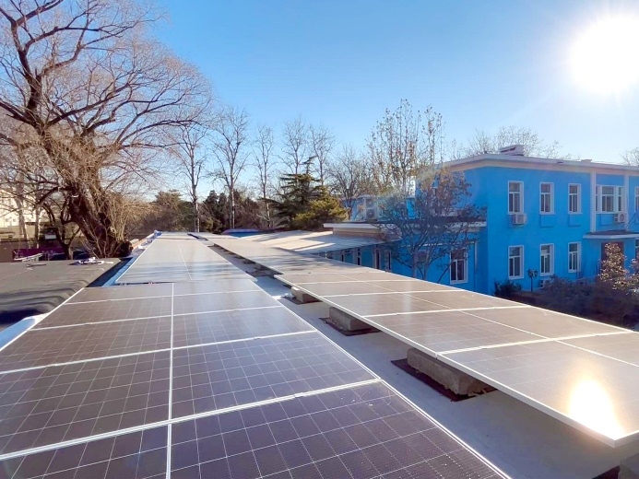
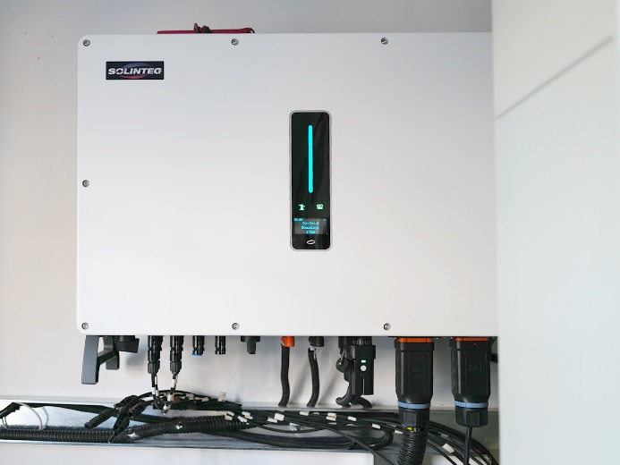
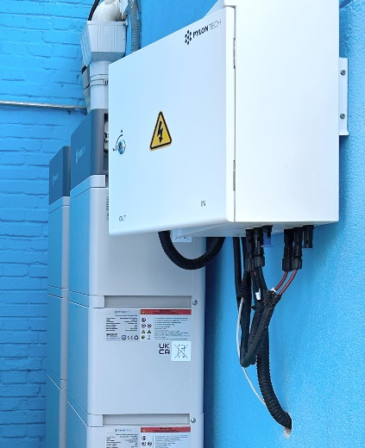
Applications
Commercial Buildings
For some commercial buildings, an energy storage system can help them build a self-running power system, which can not only reduce their electricity bills, but also help some remote buildings use power independently without a grid.
As power consumption can be supplied by PV generation at daylight time, small capacity batteries are enough to supply critical devices at night for many commercial scenarios.
As the project shown in the right picture, this is a small commercial energy system designed for UNICEF, which can generate about 160kWh of energy a day and save over 58.4MWh energy a year.
Solinteg Demonstration Project
——for commercial buildings
52kW
PV
50kW
Inverter
28kWh
Battery
www.solinteg.com
academy@solinteg.com
Solinteg C&I Solution
15

Slide 16
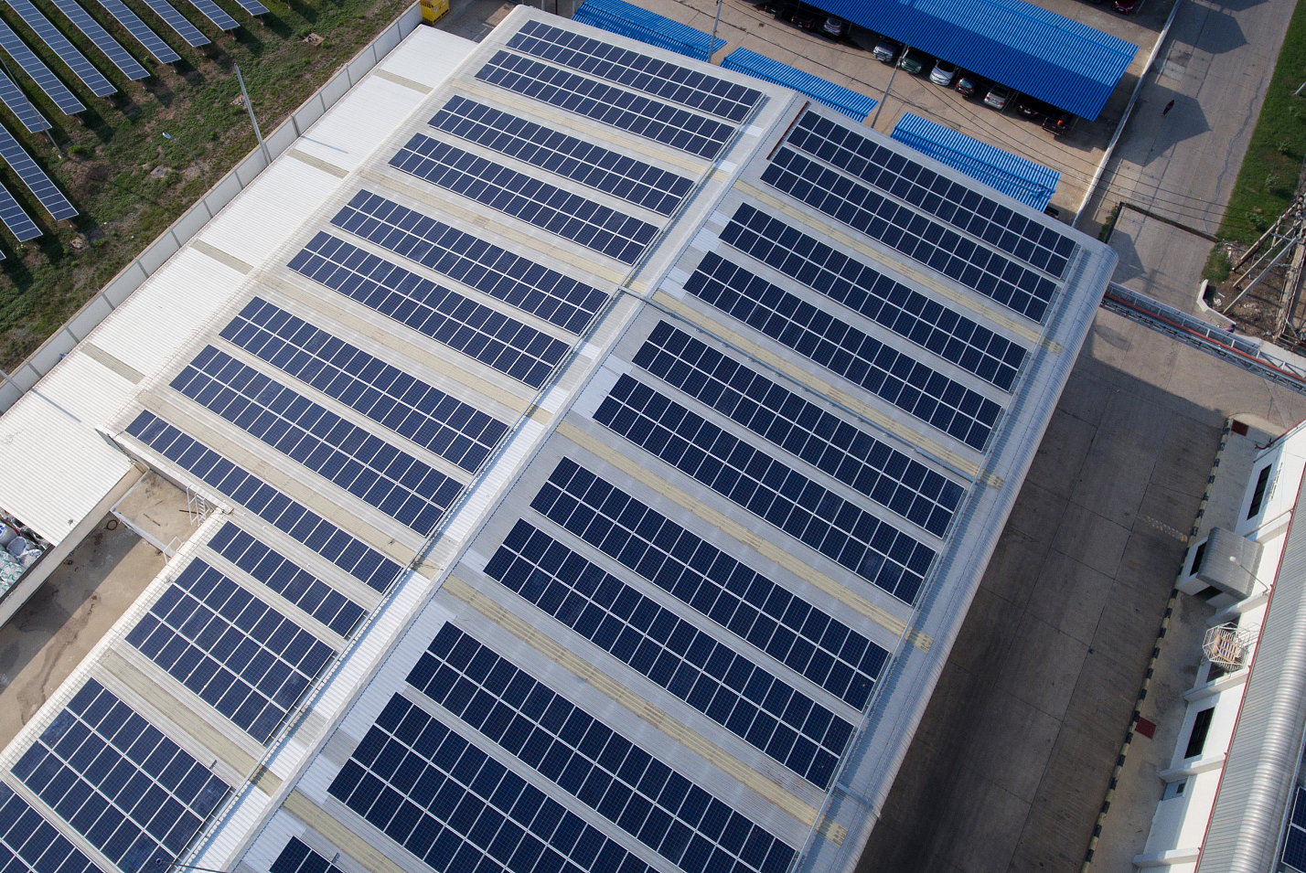
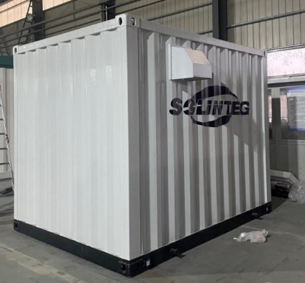
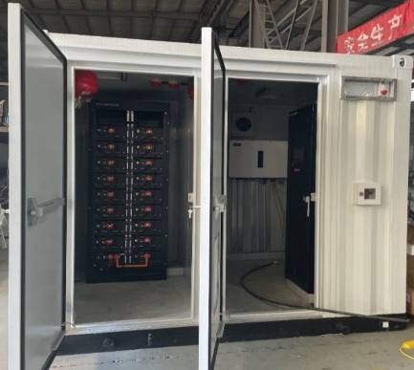
Applications
Industry
Many factories have large roofs without any shade. It’s a natural perfect place to install solar panels. When combining the big roof with an energy storage system, it can make many profits for the investor.
For the big capacity solar panels, we can build a parallel system with Solinteg inverters. With suitable batteries, the system can not only supply sufficient power for the factory 24 hours a day but also import the surplus power to the grid to make huge profits.
As the project shown in the left pictures, a parallel system with 6 units of 50kW Solinteg inverter can generate more than 333MWh a year for the investor.
Solinteg Demonstration Project
——for industry application
380kW
PV
50kW x 6 Units
Inverter
120kWh
Battery
www.solinteg.com
academy@solinteg.com
Solinteg C&I Solution
16

Slide 17
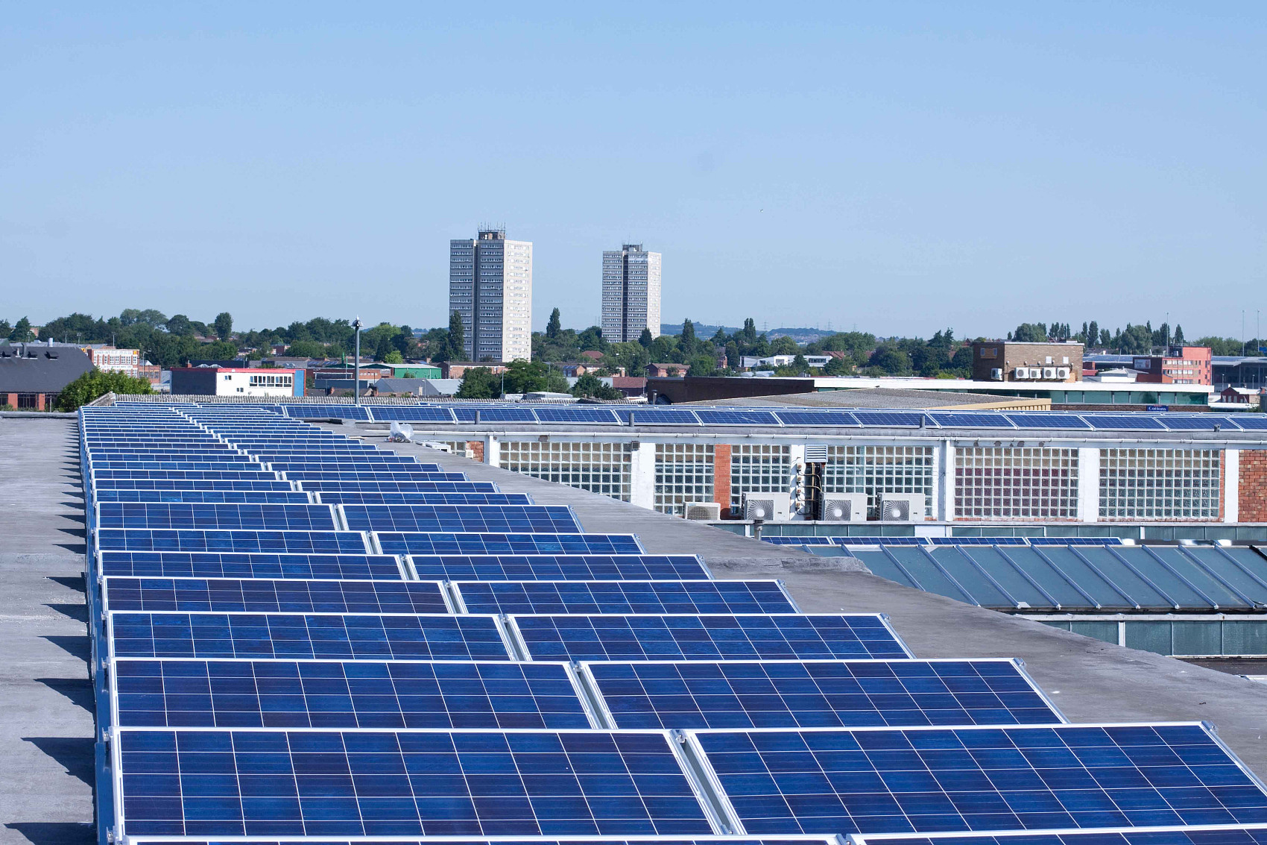
Applications
Solinteg Demonstration Project
——for large-scale application
Large Scale
UP to 5MW
PV
50-500kW Hybrid
To ensure the stability of the electrical grid and the availability of reserve power in case of an emergency. Some large-scale solar projects in China are required to include a certain percentage of energy storage. Typically, the whole system energy storage percentage is between 10 and 20%.
Solinteg hybrid inverter 25-50kW can be paralleled up to 500kW to include in a 5MW large-scale project with a requirement of coupling 10% energy storage.
Inverter
According to the demand
Battery
www.solinteg.com
academy@solinteg.com
Solinteg C&I Solution
17

Slide 18
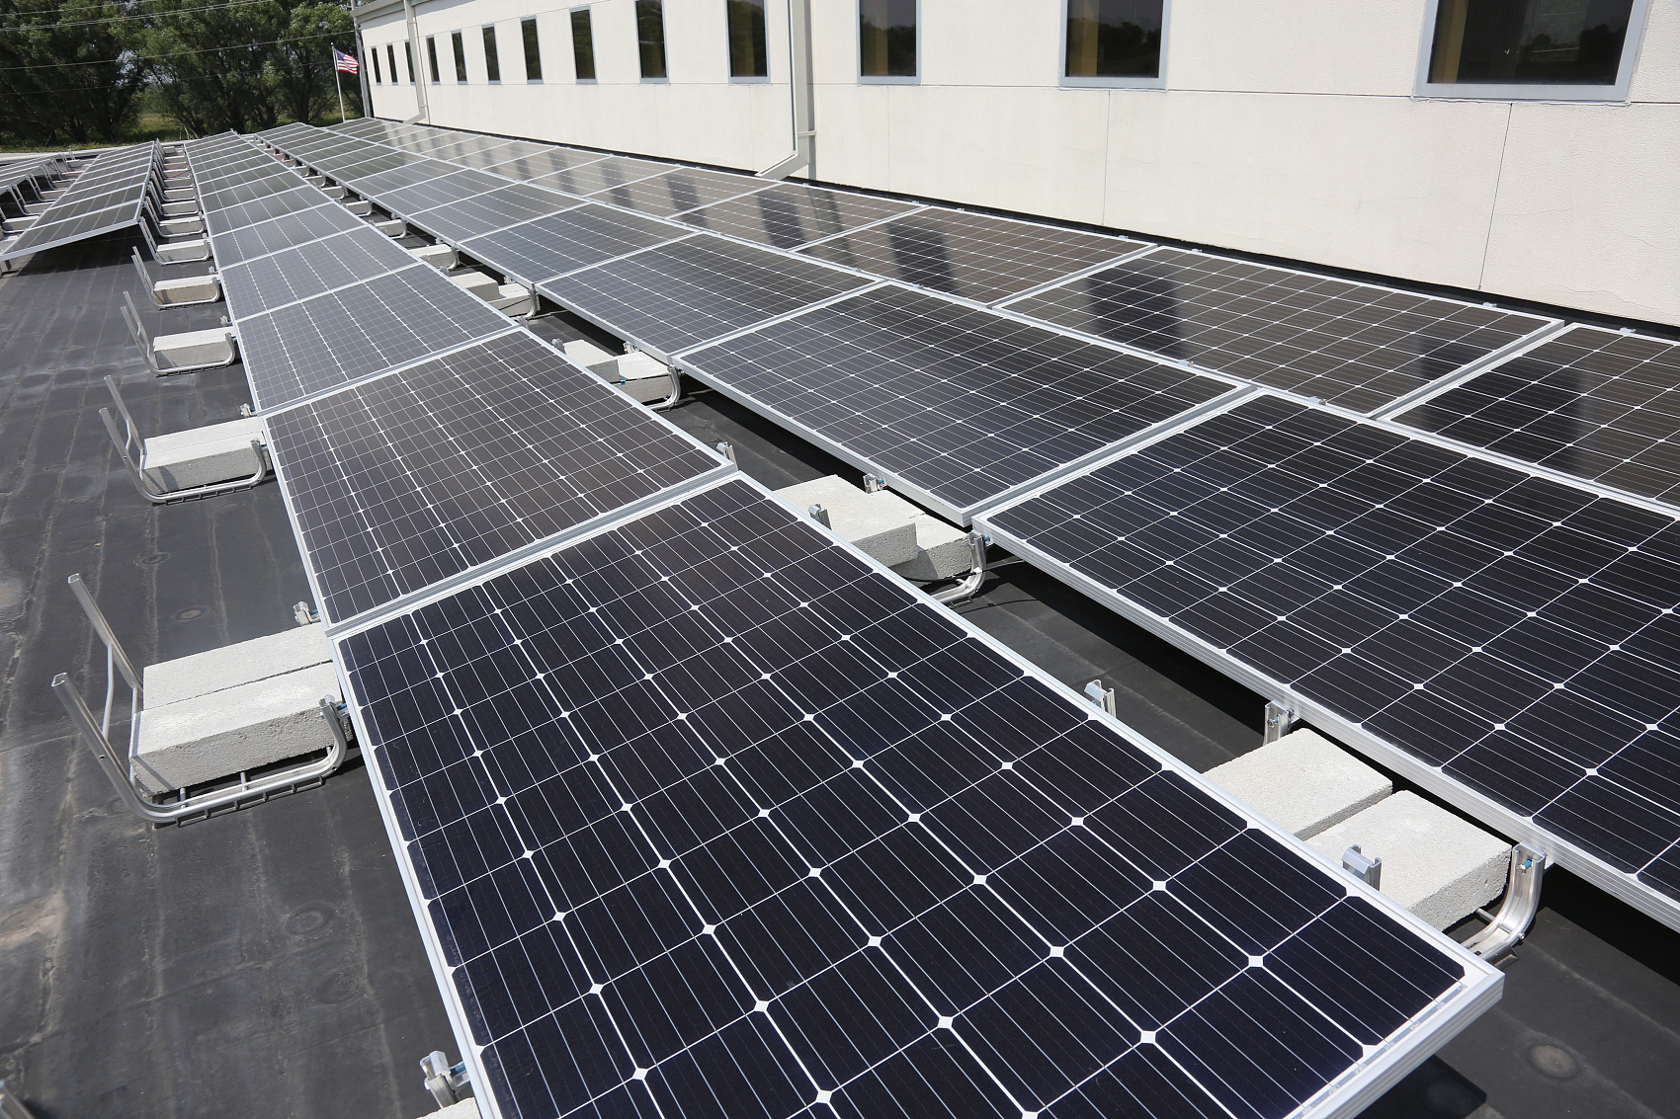
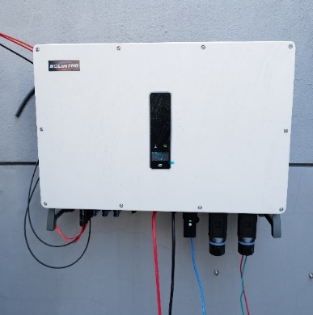
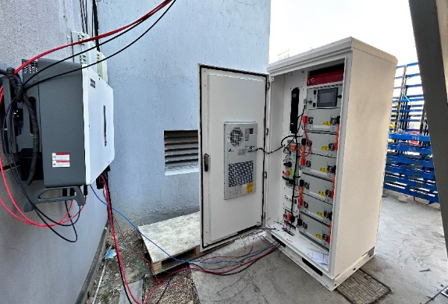
Applications
On-grid Revamping
There are many on-grid solar systems that were installed under the stimulation of the high subsidy and FIT. When the policy changes, there are no more profits for exporting the power into the grid. So, revamping their on-grid system to an energy storage system is a good choice.
Using Solinteg’s inverters and smart meters, with suitable batteries, they can revamp their system easily, and monitor the whole system in Solinteg Cloud.
Just like the system in the left picture, a 500kW on-grid system is transformed into an energy storage system by adding a Solinteg 50kW hybrid inverter and Pylontech 100kWh batteries..
Solinteg Demonstration Project
——for on-grid revamping
50kW
PV
50kW Hybrid
Inverter
100kWh
Battery
www.solinteg.com
academy@solinteg.com
Solinteg C&I Solution
18

Slide 19
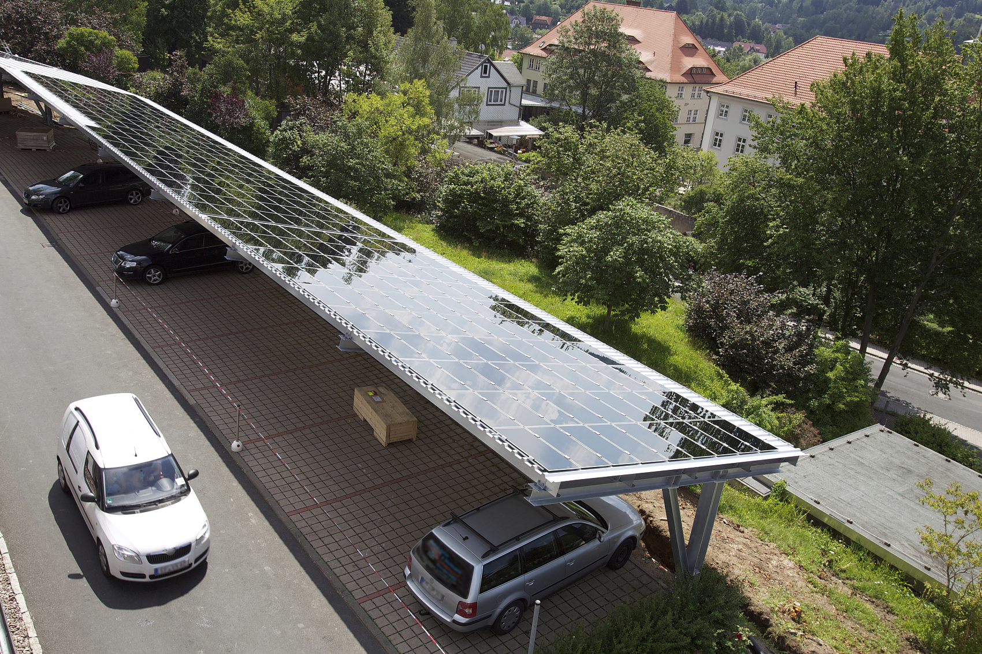
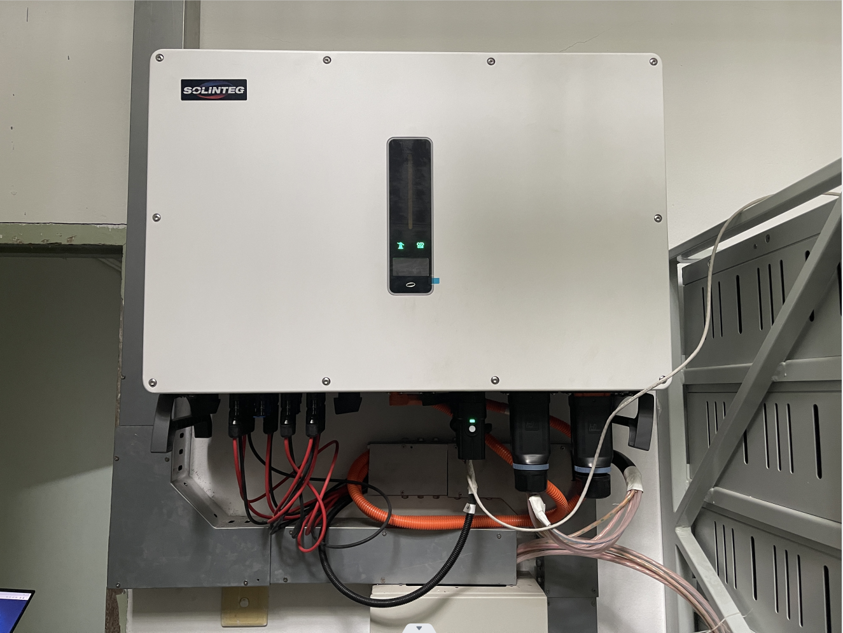
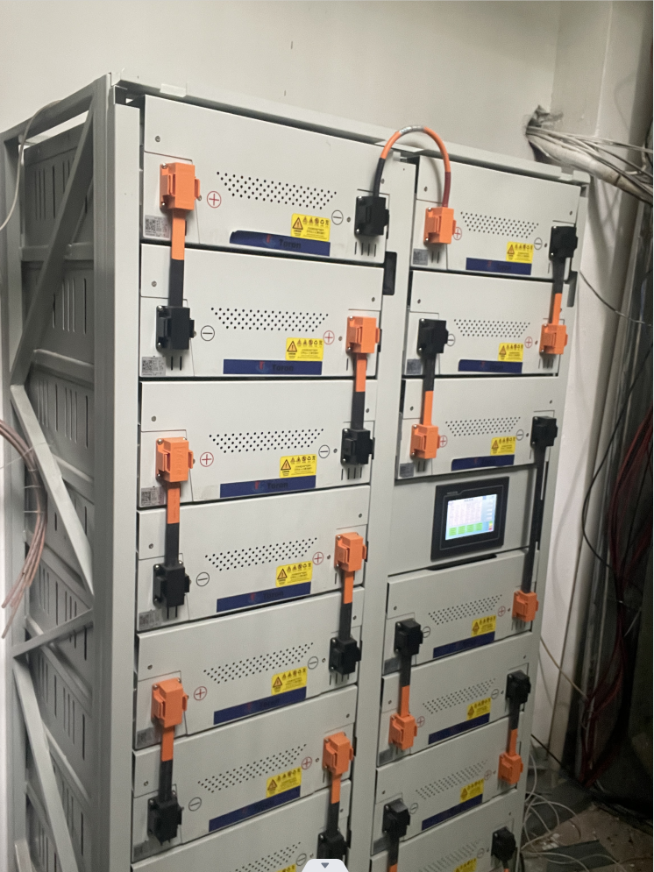
Applications
EV Charging Station
With the development of the electric vehicle industry, there will be more demands for EV charging stations. It is an ideal solution to combine the charging station with an energy storage system.
A storage system with sufficient batteries can run an EV charging station independently without a grid at daylight and evening.
The picture on the right shows an EV charging station which can generate about 700kWh in a good irradiation day. So, for a 50kWh battery EV, the station can charge over 20 cars’ battery from 20% to 90%.
Solinteg Demonstration Project
——for EV charing station
210kW
PV
50kW x 3 Units
Inverter
400kWh
Battery
www.solinteg.com
academy@solinteg.com
Solinteg C&I Solution
19

Slide 20
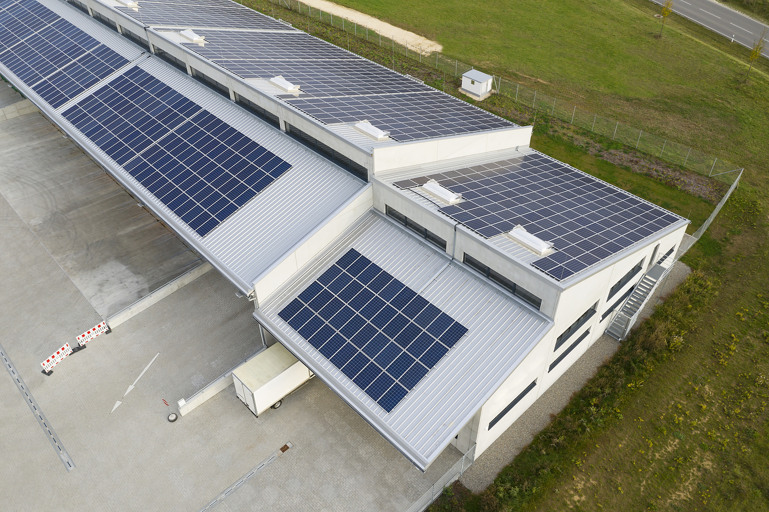
Applications
Investment & Return
How fast can the solar investment be returned?
Here we use a small commercial system built in a mall in Germany as a demonstration. They built an energy storage system with 260kW PV, 4 units 50kW inverter and 200kWh batteries. The total investment of this system is about 450,000 euros. We consider the generation time a day to be about 3-4 hours, so the total generation is about 260MWh a year. In this way, it could save about 78,000 euros on electricity a year. So, the return time is about 5.77 years. If there are any other subsidies, this time will be shorter, but if there’re loans, the return time will be longer.
Different areas have different electricity prices. So, the return time may be more or less different. But the huge return and the priceless effort of environmental protection never change.
Total Investment: 450,000 €
Total Generation: 260 MWh/Year
Return Time: 5.77 Years
260kW
PV
50kW x 4 Units
Inverter
200kWh
Battery
www.solinteg.com
academy@solinteg.com
Solinteg C&I Solution
20

Slide 21
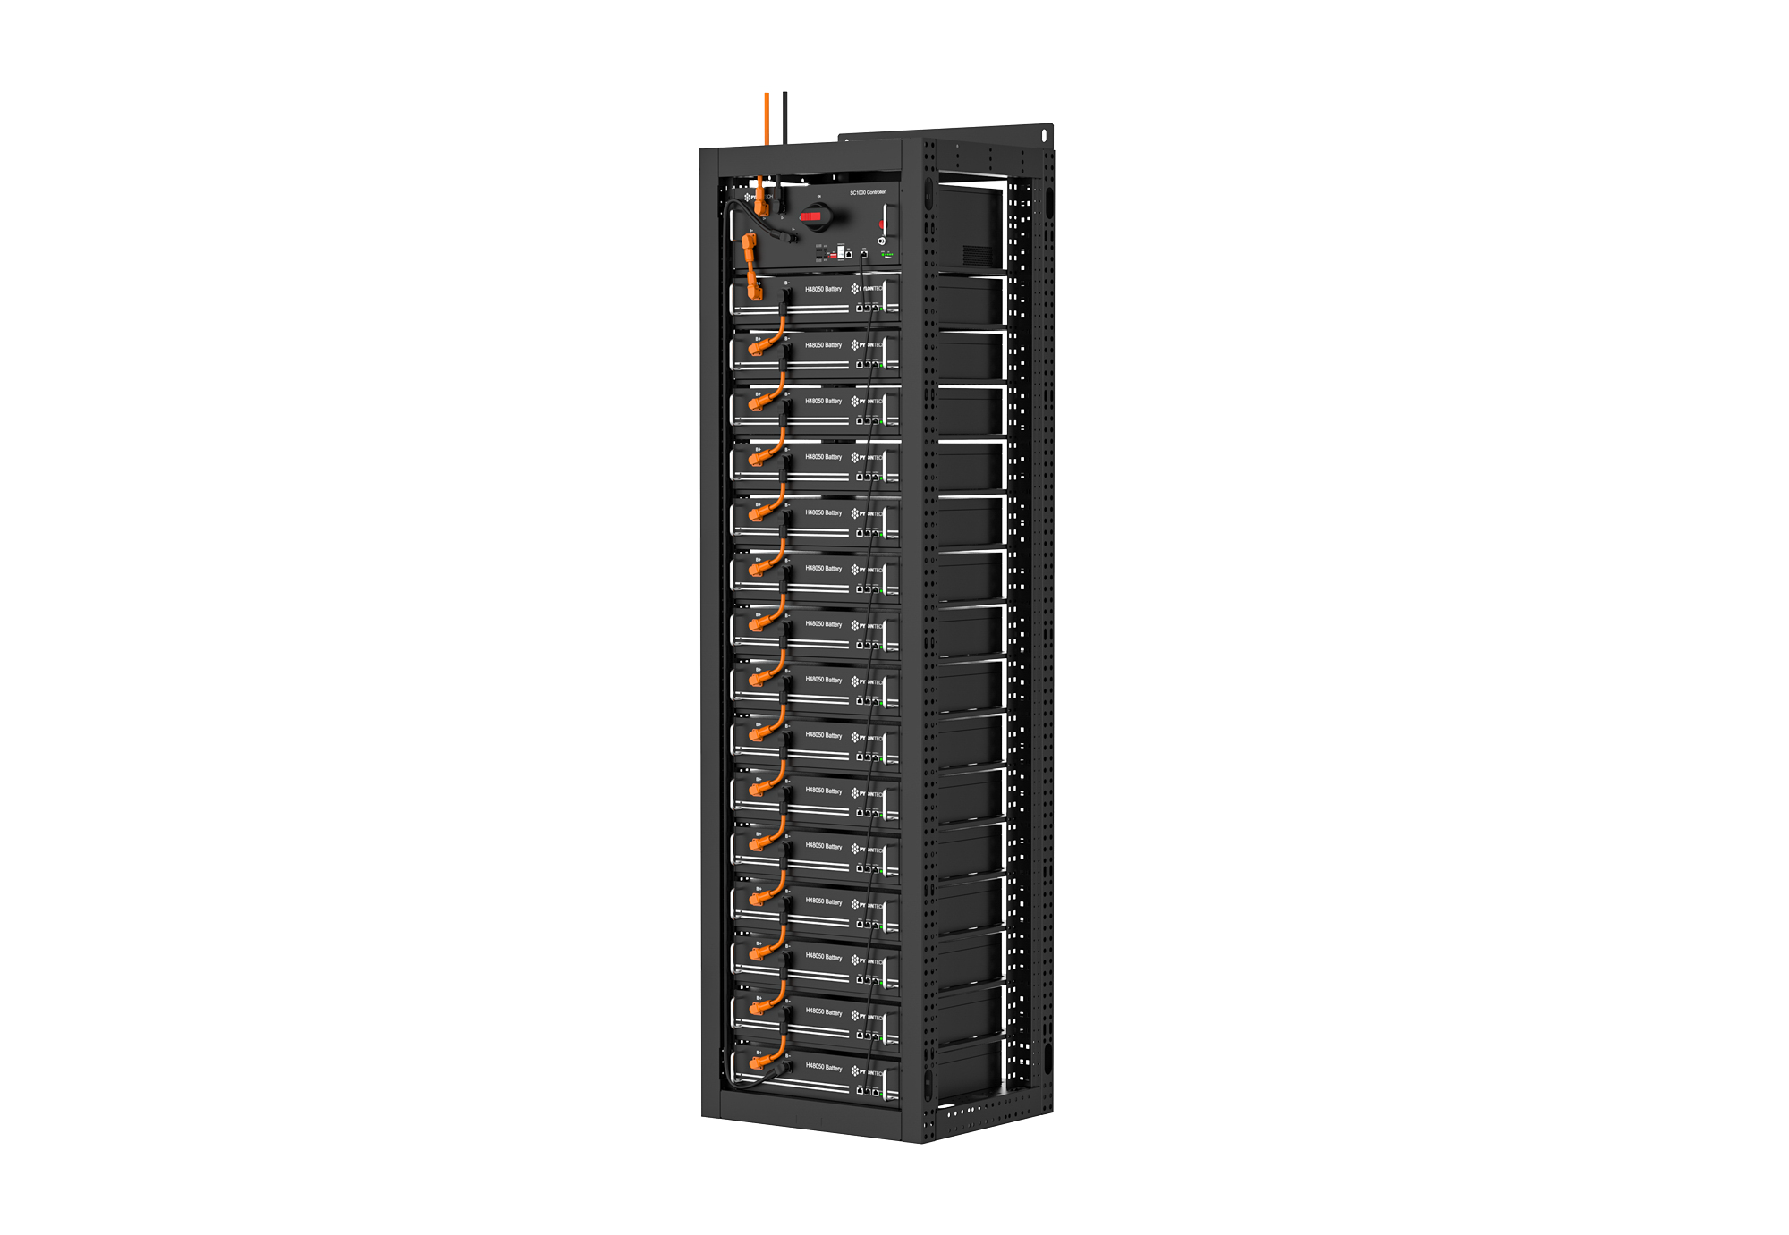
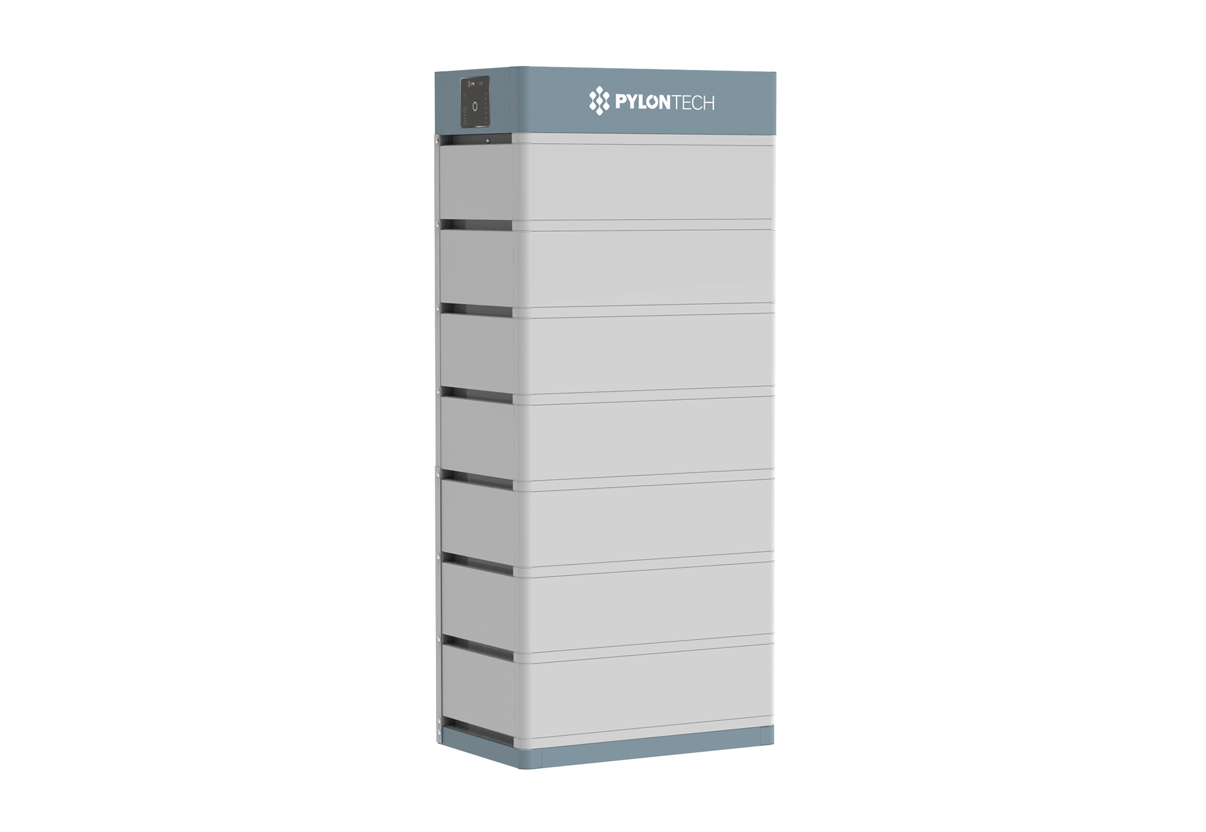
C&I Solutions
Force H1
Powercube X
Powercube H
Powercube M
Solinteg + Pylontech
H1-V2
1 Rack:
14.2-24.9kWh
6 Racks：
Up to 149.4kWh
X1-V2
1 Rack:
9.6-31.2kWh
6 Racks：
Up to 187.2kWh
H1-V2
1 Rack:
12-31.2kWh
6 Racks：
Up to 187.2kWh
M1
1 Rack:
28.4-94.8kWh
6 Racks：
Up to 568.8kWh
M2
1 Rack:
22.7-96.6kWh
6 Racks：
Up to 579.6kWh
H2-V2
1 Rack:
7.1-14.2kWh
6 Racks：
Up to 85.2kWh
X2-V2
1 Rack:
14.2-46.2kWh
6 Racks：
Up to 277.2kWh
H2-V2
1 Rack:
17.8-46.2kWh
6 Racks：
Up to 277.2kWh
M3
1 Rack:
22.7-96.6kWh
6 Racks：
Up to 579.6kWh
*: Recommended only. For specific matching capacity, please consult the relative company.
www.solinteg.com
academy@solinteg.com
Solinteg C&I Solution
21

Slide 22
C&I Solutions
Tower
HV1
HV2
HV4
Solinteg + Dyness
Not suggest to use with MHT 25-50kW
1 Rack:
9.6-31.2kWh
10 Racks：
Up to 312kWh
1 Rack:
14.4-46.8kWh
10 Racks：
468kWh
1 Rack:
20.5-66.6kWh
10 Racks：
Up to 666kWh
*: Recommended only. For the specific matching capacity, please consult the relative company.
www.solinteg.com
academy@solinteg.com
Solinteg C&I Solution
22

Slide 23
C&I Solutions
5K3XP
14K3XP
Solinteg+Weco
1 Rack:
20.8-62.4kWh
4 Racks
Up to 249.6kWh
1 Rack:
171.6-185.9kWh
4 Racks：
Up to753.6kWh
Weco
*: Recommended only. For the specific matching capacity, please consult the relative company.
www.solinteg.com
academy@solinteg.com
Solinteg C&I Solution
23

Slide 24
C&I Solutions
LV-BST-H2.56
LV-BST-H5.12
LV-IESS
Solinteg+Lithium Valley
1 Rack:
7.68-25.6kWh
1 Rack:
15.36-30.72kWh
1 Rack:
30.72-143.36kWh
4 RACKS
Up to 573.44kWh
*: Recommended only. For the specific matching capacity, please consult the relative company.
www.solinteg.com
academy@solinteg.com
Solinteg C&I Solution
24

Slide 25
END
Visit Solinteg website to find out more
www.solinteg.com
academy@solinteg.com
Solinteg C&I Solution
END
Notes:
1. 尽量讲全；
2. 自信；
3.

