Slide 1
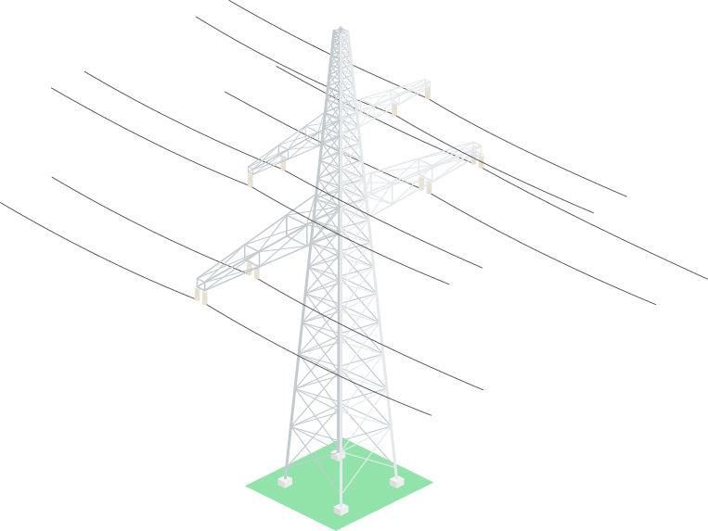
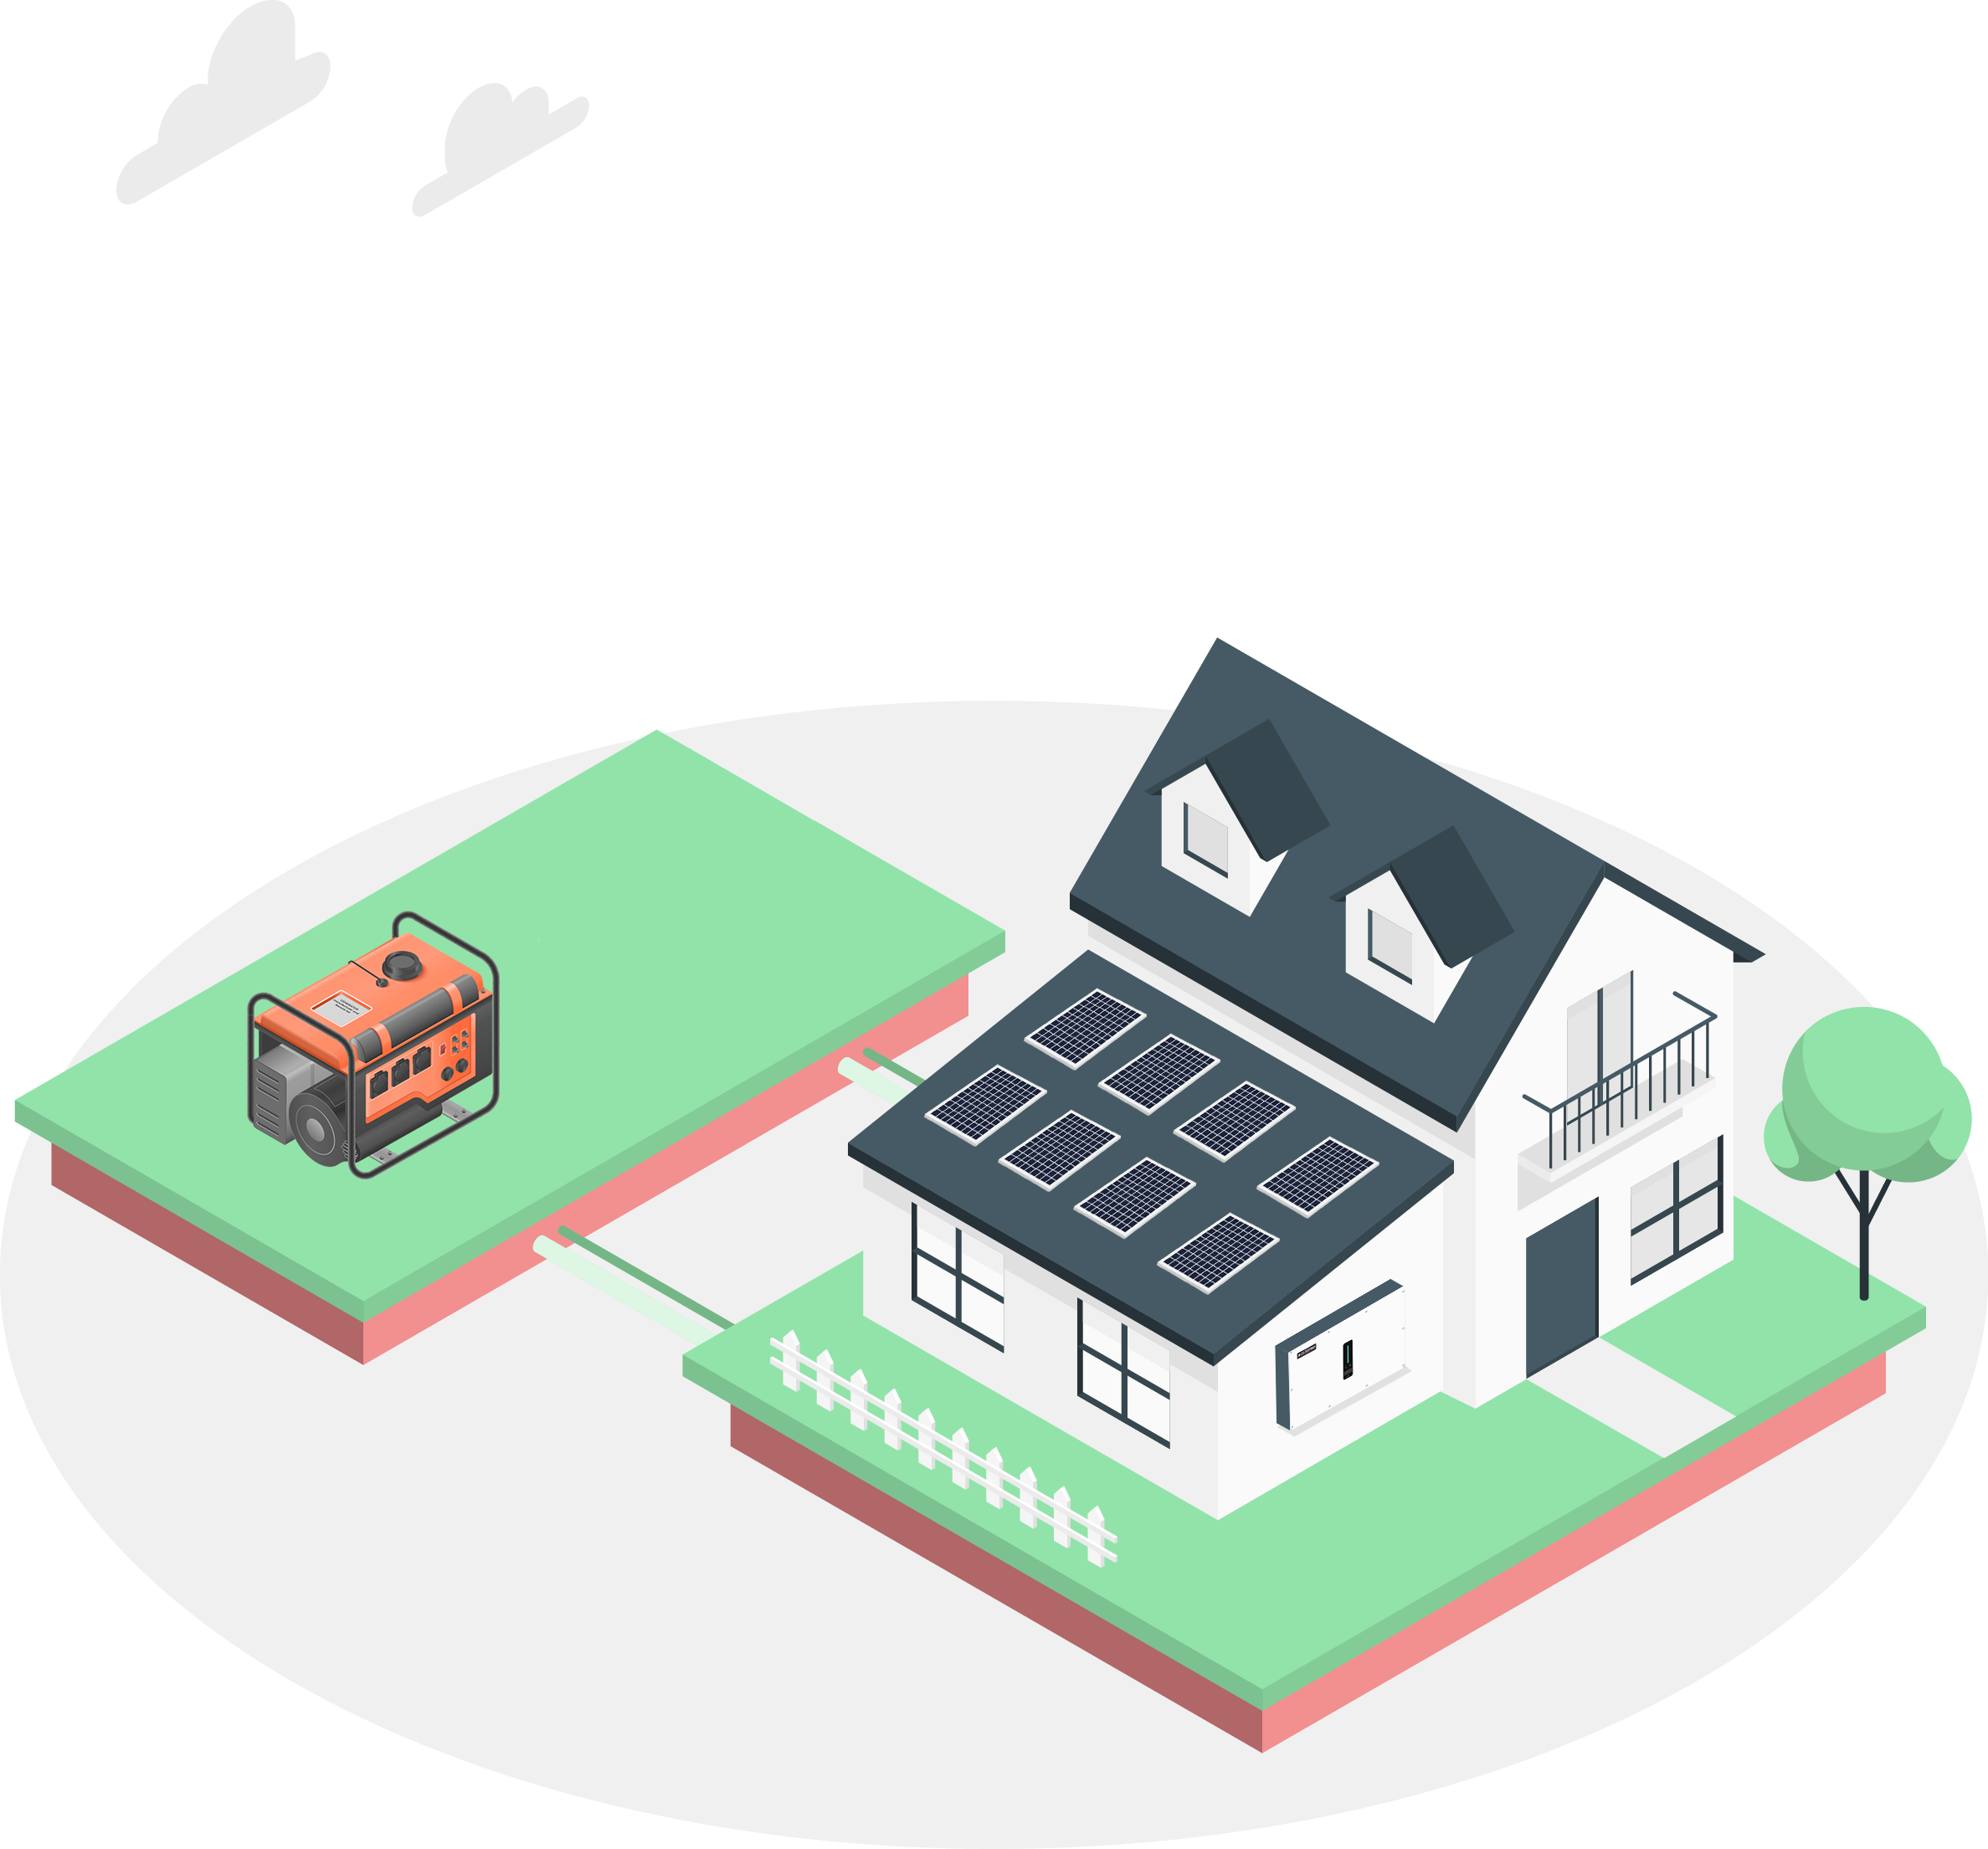
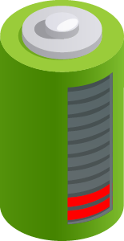
SOLINTEG DIESEL GENERATOR CONNECTION SOLUTION
www.solinteg.com
academy@solinteg.com
Solinteg Diesel Generator Connection Solution

Slide 2
Brief Introduction
Why do we need a diesel generator in a PV system?
A diesel generator is used in a PV system as a backup power source to ensure a continuous power supply in case of a long - time grid power failure or insufficient power generation. Currently, Solinteg 25-50kW inverters support connecting the diesel generator to provide full backup for your energy security. And it can automatically start the generator when other power sources are insufficient.
Reliable
Ensure the energy security for your critical loads when the power grid goes off for a long period.
Intelligent
Operate your diesel generator remotely and automatically
Friendly
Integrate the control strategy and DG connector inside the inverter,
no need for any extra configuration.
www.solinteg.com
academy@solinteg.com
Solinteg Diesel Generator Connection Solution
02
Notes:
创新型去中心化解决方案
传统的工商业方案：并离网逆变器+并离网切换柜+PCS+EMS；
旧：受限多 防护等级低，仅能室外安装并须加装防护设施；复杂性 系统设备多安装运维复杂，协同性差；不稳定 设备运维复杂，系统可靠性降低；成本高 设备多，安装、运输及运维成本高；效率低 协同性低、设备间能源损耗高，系统效率低
新：灵活化 IP65 保护等级，满足室内和室外安装要求；一体化 一体化控制器，开发协同性好，性能强；高可靠 得益于魔睿开发平台的模块化设计理念；成本低 易运输, 产品运维成本低；效率高 多电平拓扑，新一代半导体器件，系统效率高

Slide 3
Application
Who will need this
With this function it would be easier to handle these situations:
Isolated areas without grid;
Regions with frequent geological disasters, such as earthquakes, typhoons, etc;
Places with frequent power outages;
Island or remote regions;
......
No grid
Geological disasters
Frequent
power outages
Island
www.solinteg.com
academy@solinteg.com
Solinteg Diesel Generator Connection Solution
03

Slide 4
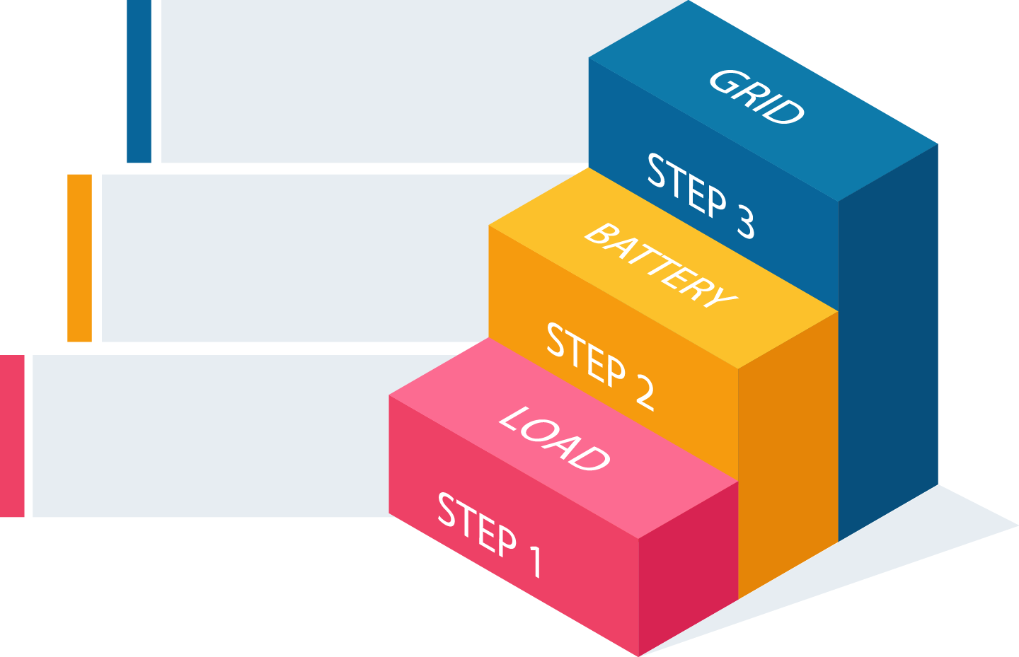
Strategy
Solinteg DG strategy
Act as the grid
Solinteg DG solution has been divided into three stages*, and each stage will be developed independently.
Stage 1: Use the DG to power home loads automatically when the power grid fails and PV and battery power is insufficient.
Stage 2: Use the DG to power loads and charge the battery.
Step 3: In addition to the functions of stage 1&2, you can use the DG as the grid, allowing you to run a microgrid in isolation.
*Note: We have completed the development of stage 1. For more information about the status of stage 2&3, please consult us. The remaining details will be released before Q4 2024.
Charge the battery
Power the loads by DG automatically
www.solinteg.com
academy@solinteg.com
Solinteg Diesel Generator Connection Solution
04

Slide 5
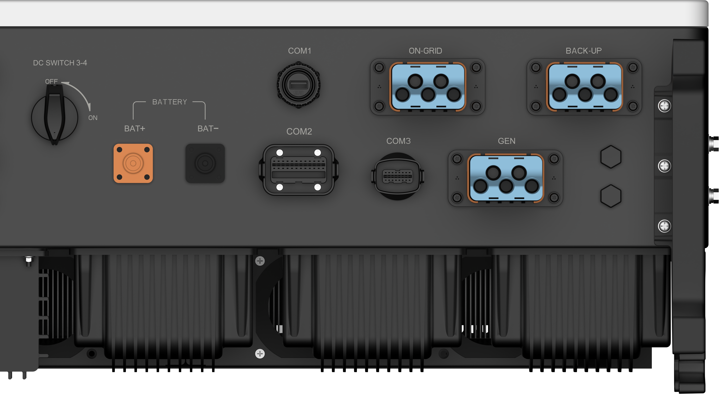
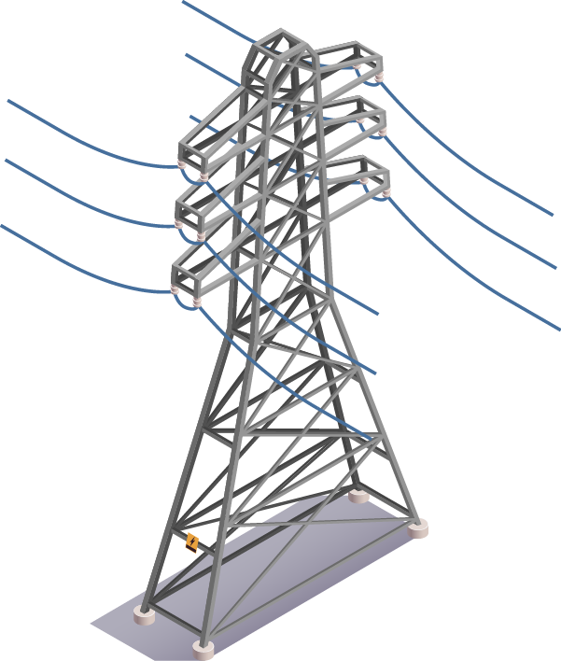
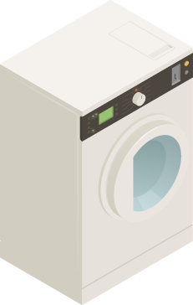
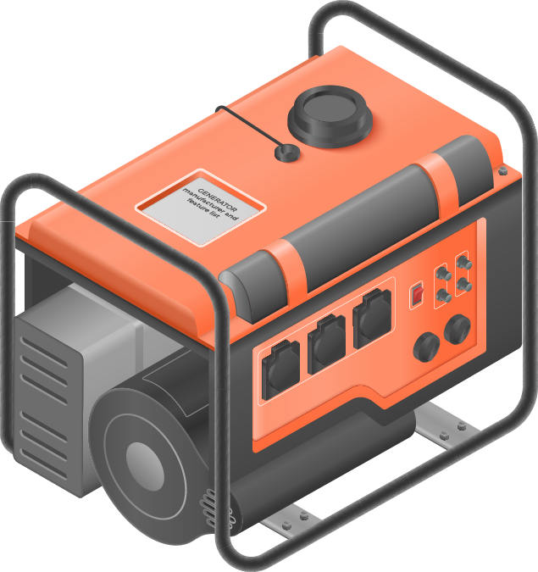
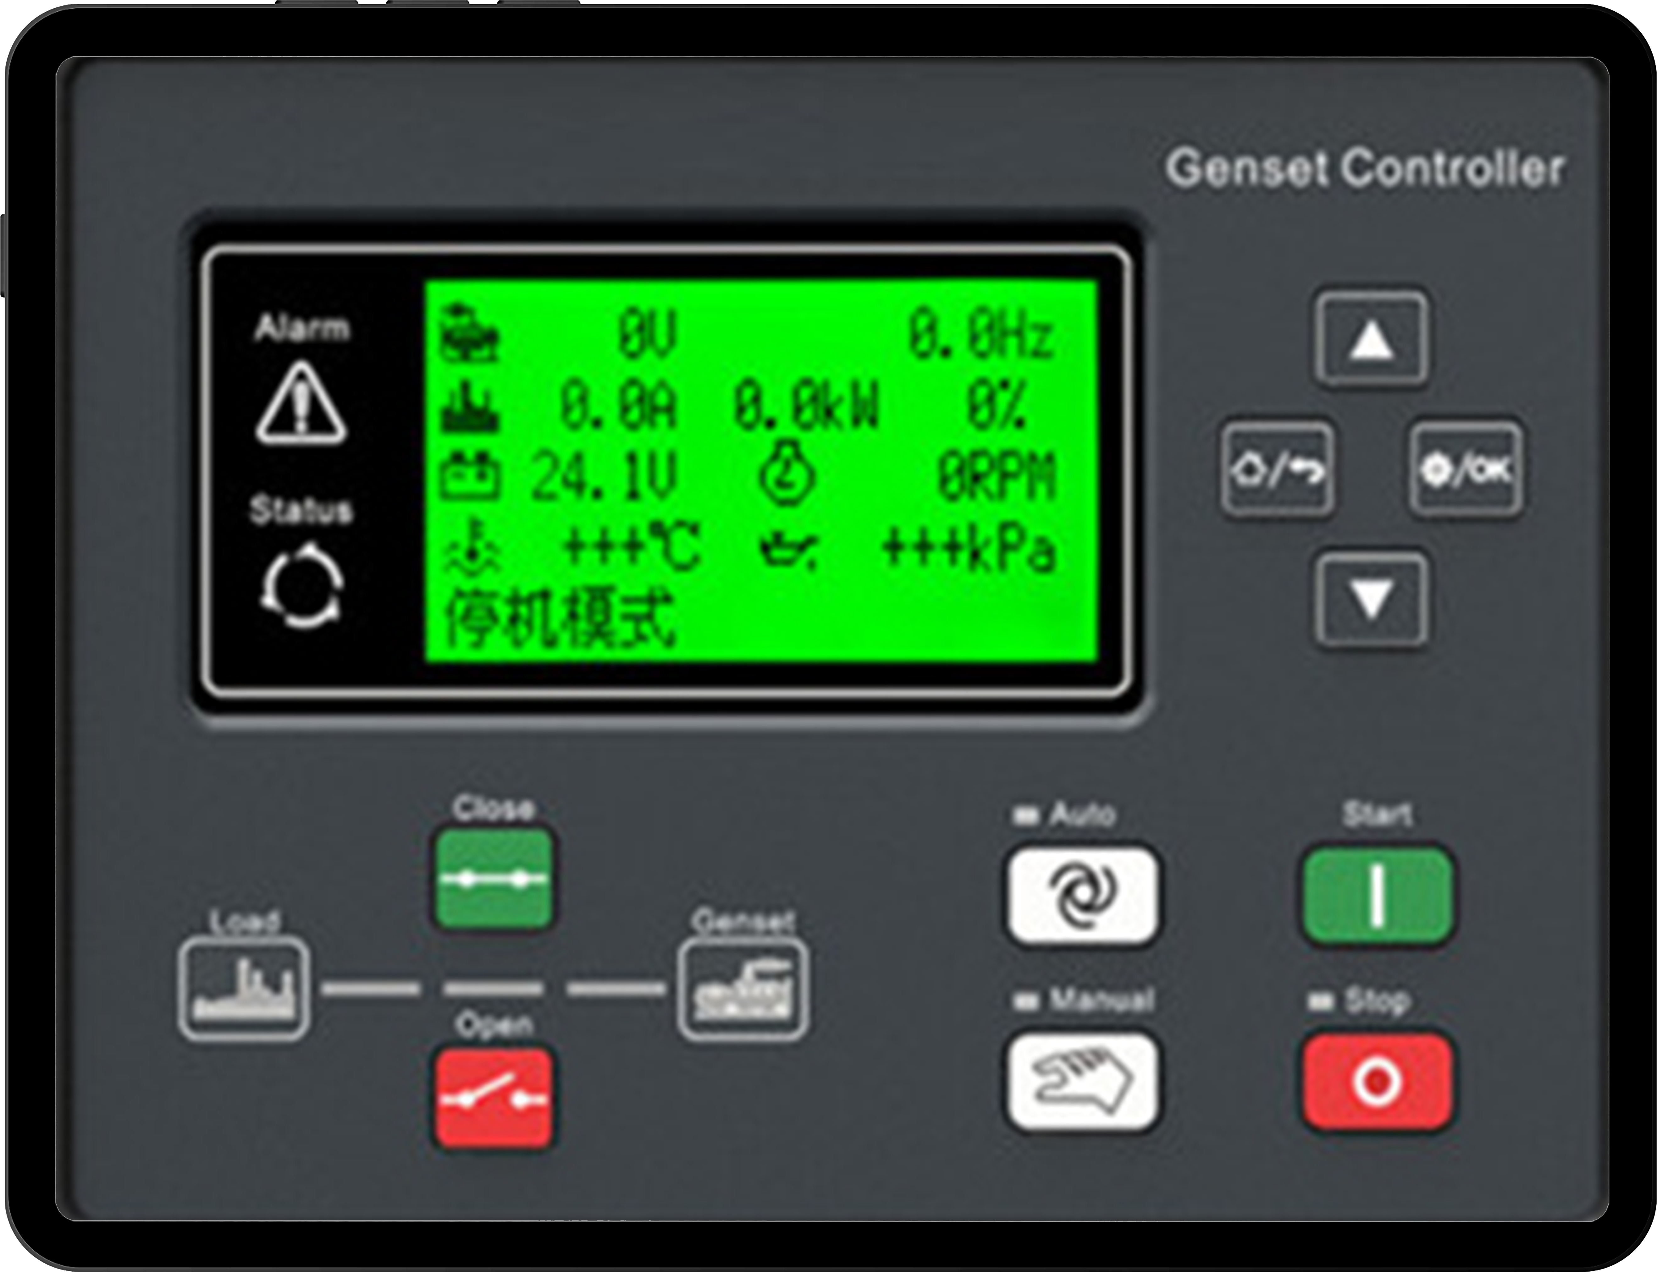
Connection
How to wire
Grid
As the diagram shown on the left:
Connect the DG controller to the COM3 Pin 11&12;
Connect the DG controller to the DG;*
Connect the output of DG to the inverter GEN port;
Connect the battery, back-up loads and other necessary devices;
*: The connection between DG and DG controller please refer to the user manual of the controller manufacture strictly.
On-grid load
Back-up load
Battery
DG controller
DG
www.solinteg.com
academy@solinteg.com
Solinteg Diesel Generator Connection Solution
05

Slide 6
Logic
P
Grid Outage
How it works
PV
PV+Battery
When the grid fails and is not recovered:
Point 1: Grid outages occur.
Point 2: PV power is lower than P_{load}, and the battery starts to discharge.
Point 3: The battery State of Charge (SOC) drops to 25%, and the DG enters standby status.
Point 4: If SOC is lower than 20% or remains lower than 25% for over 10 minutes, the inverter will switch the loads to be powered by the DG.
Point 5: When PV power recovers, the battery starts to charge.
Point 6: Once SOC recovers to 50%, the inverter begins detecting the battery status.
Point 7: If SOC remains higher than 50% for over 5 minutes, the inverter switches the loads back to be powered by the battery and PV, then closes the DG.
Point 8: PV power is higher than P_{load}.
DG
1
Load Consumption Source
PV Power
P_{Load}
20
T
25
4
5
3
Battery SOC
50
6
8
7
DG Start
DG Working
Checking
DG Off
SOC
2
10 minutes maximum
5 minutes
www.solinteg.com
academy@solinteg.com
Solinteg Diesel Generator Connection Solution
06

Slide 7
Logic
P
Grid Outage
PV
How it works
PV+Battery
DG
When the grid fails and is recovered after a while:
Point 1: Grid outages occur.
Point 2: PV power is lower than P_{load}, and the battery starts to discharge.
Point 3: The battery State of Charge (SOC) drops to 25%, and the DG enters standby status.
Point 4: If SOC is lower than 20% or remains lower than 25% for over 10 minutes, the inverter will switch the loads to be powered by the DG.
Point 5: When PV power recovers, the battery starts to charge.
Point 6: Once the grid is recovered, the inverter begins detecting the grid status.
Point 7: If the grid is stable for over 5 minutes, the inverter switches the loads back to be powered by the grid and PV, then closes the DG.
Point 8: PV power is higher than P_{load}.
Grid+PV
1
Load Consumption Source
PV Power
P_{Load}
20
T
25
4
5
3
Battery SOC
6
7
8
Grid Recovered
DG Off
DG Start
DG Working
SOC
2
10 minutes maximum
5 minutes
The power dispatching order priority is related to the inverter work mode.
www.solinteg.com
academy@solinteg.com
Solinteg Diesel Generator Connection Solution
07

Slide 8
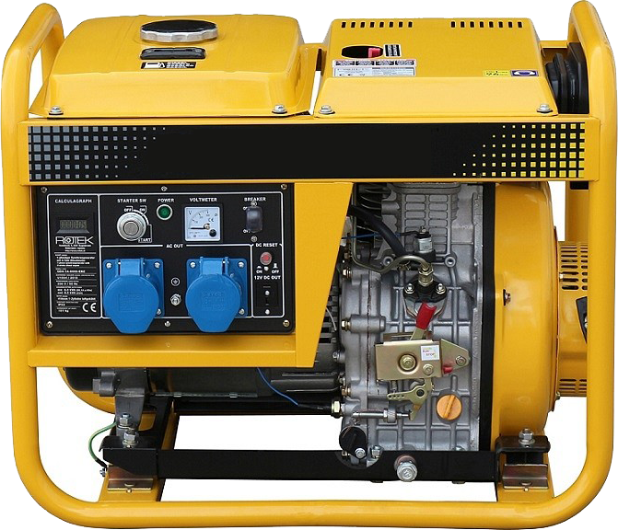
Requirements
Requirements
How to select the devices
Products
Requirements
All the devices selected just as the recommendation;
*: For the firmware upgrade please contact us at service@solinteg-power.com;
**: Please make sure the DG controller has the DO input port before you purchase it;
***: Please make sure the DG supports the connection with the controller you purchased;
DG output: The output power parameter we take a 50kW inverter as an example. Solinteg 50kW inverter max DG input apparent power is 60kW, so the DG’s rated output power should be within 60kW;
For more parameters, please refer to the inverter datasheet.
Inverter
MHT 25-50K
(Special firmware is needed, please contact us.)*
DG Controller
DO input port integrated**
1. DG controller connection available；
2. Three phase DG only;
3. Output power within the limitation of the inverter***；
DG
www.solinteg.com
academy@solinteg.com
Solinteg Diesel Generator Connection Solution
08

Slide 9
END
Visit Solinteg website to find out more
www.solinteg.com
academy@solinteg.com
Solinteg Diesel Generator Connection Solution
END
Notes:
1. 尽量讲全；
2. 自信；
3.

