Slide 1
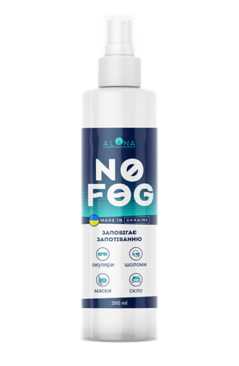
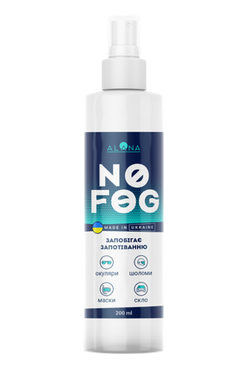
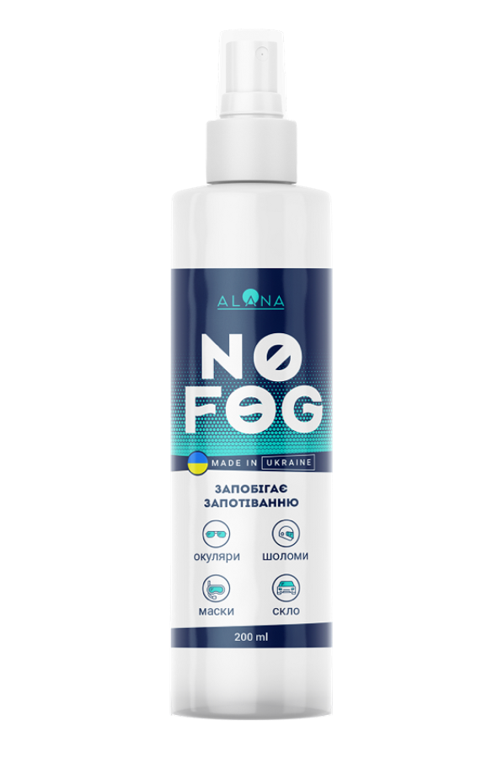


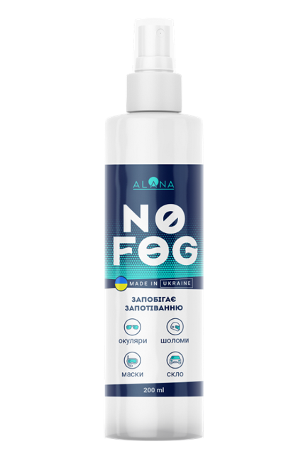
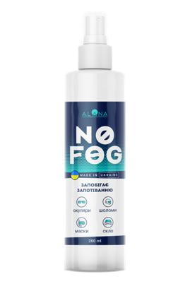
NO FOG
STOP WATCHING THE WORLD THROUGH FOG

Slide 2
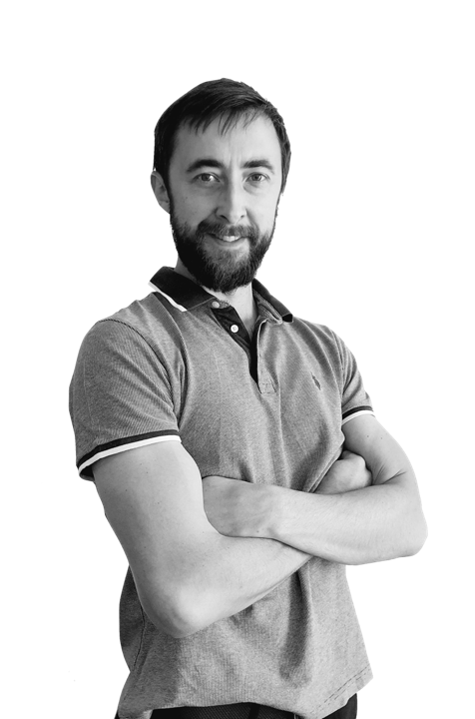

Lets meet?
My name is Serhii Budyak!
I am the director of manufacturing company
LLC Scientifically-Technical Union
Since 1997, we have been producing professional chemical products for various purposes in Ukraine.
We have our own research center and patents and certificates for the developed solutions.
We are pleased to introduce our new anti-fogging product to your attention
ALANA NOFOG
for use by professionals and ordinary users in everyday life during
Swimming
Engaged in sports with glasses
Professionals wearing protective masks, shields or anti-fog goggles when working

Slide 3
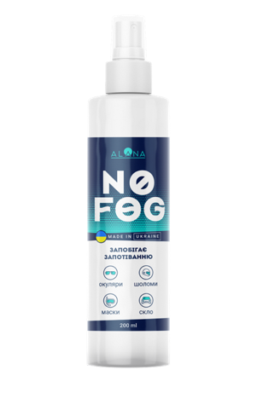
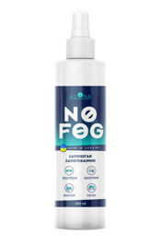
Advantages of the NOFOG solution against fogging from ALANA for the Customer
Lasting effect for up to 36 hours
Convenient 200ml, 50ml or 30ml bottle
Economical spending
Has no smell, does not contain alcohol
Shelf life 36 months
3 in 1 – antifog, cleaning, antistatic effect

Slide 4
Advantages of the NOFOG solution against fogging from ALANA for the Partner
High margin over 100%
Can be used as a premium souvenir for partners
Convenient packaging of 6, 12, 24, 48 bottles
Always in stock - Ukrainian production
High quality and safety - confirmed by tests
A reliable partner - a manufacturer with 20+ years of experience!
Shelf life 36 months

Slide 5
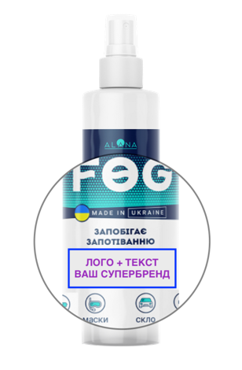
Advantages of the NOFOG solution against fogging from ALANA for the Partner
The possibility of ordering branding
  Logo with text on main label
  A completely individual label
Possibility of delivery of the product without a label for further marking at your production
Other sizes of bottles and packaging as needed
Contact us, we will find a convenient option for you

Slide 6


Benefits from cooperation with Us
    Quality, Quality, Quality!
    We always check quality starting from raw materials selection and controlling their quality and finishing with consulting of end user with methods and the best way of wood impregnation.
    Focused on result
    We consult and train you, and your managers to achieve best results in bio and fire protection of wooden constructions which will turn back your customers with new orders
    Cost effective
    Effective pricing for your supplies which is flexibly depends on amount, quotes and with retro bonus program. Games for dealers to have even more.

Slide 7
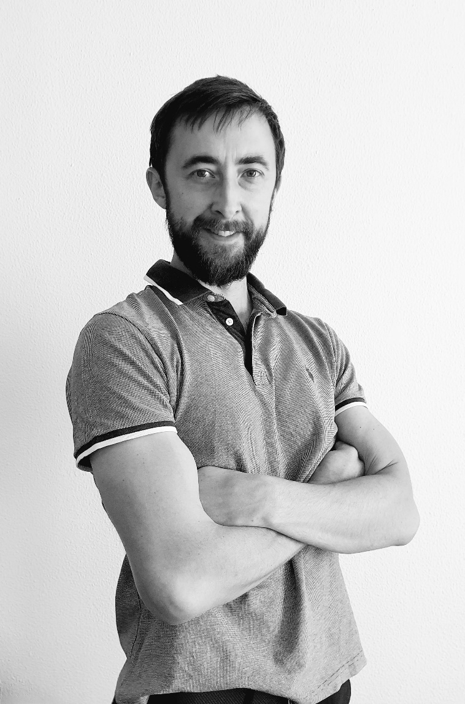
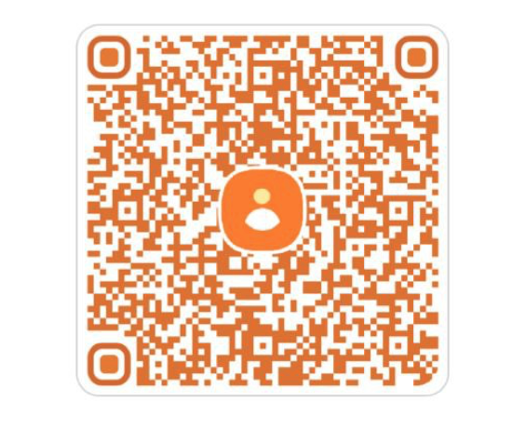
Contact us today,
and receive your special offer!
Serhii BUDIAK
LLC «Scientifically-Technical Union»
ALANA TM
https://biozahyst.com.ua
email: biozahyst@gmail.com
tel.: +380679087319

