Slide 1

P&D Conference 2026 / 15-17 October, Prague
https://pdconference.org
The Paradigm of the Military Ecotone:
Theoretical and Methodological Foundations for the Study of War-Related Environmental Pollution
Dmitry Nikolaenko, PhD, Dr. Habil.
Editor-in-Chief, Pollution and Diseases
Czech Republic · Ukraine · RSA

Slide 2
These guidelines are intended to support clarity and consistency,
while allowing authors the flexibility to present their work
in a way that best reflects their research and perspective.
Presentations may be prepared using any software (PowerPoint, PDF, Keynote, etc.).
The provided slides are intended as examples and guidance,
not as a strict template.
Authors are encouraged to follow the structure and clarity guidelines,
while maintaining flexibility in design and format.

Slide 3
The following font settings should be used:
Headings: Segoe UI Semibold — 36 pt
Subheadings: Segoe UI — 24 pt
Body text: Segoe UI — 20 pt
Presentation structure (mandatory):
Problem → Theory → Method → Results → Key Takeaways
This structure is mandatory.
The conference is non-political in nature.
All issues must be addressed using a strictly scientific approach.

Slide 4
Guidelines for speakers:
• Max 5 bullets
• Short sentences
• No paragraphs
• Use visuals
Use a simple and consistent visual style.
Recommended colors: black, blue, burgundy.

Slide 5
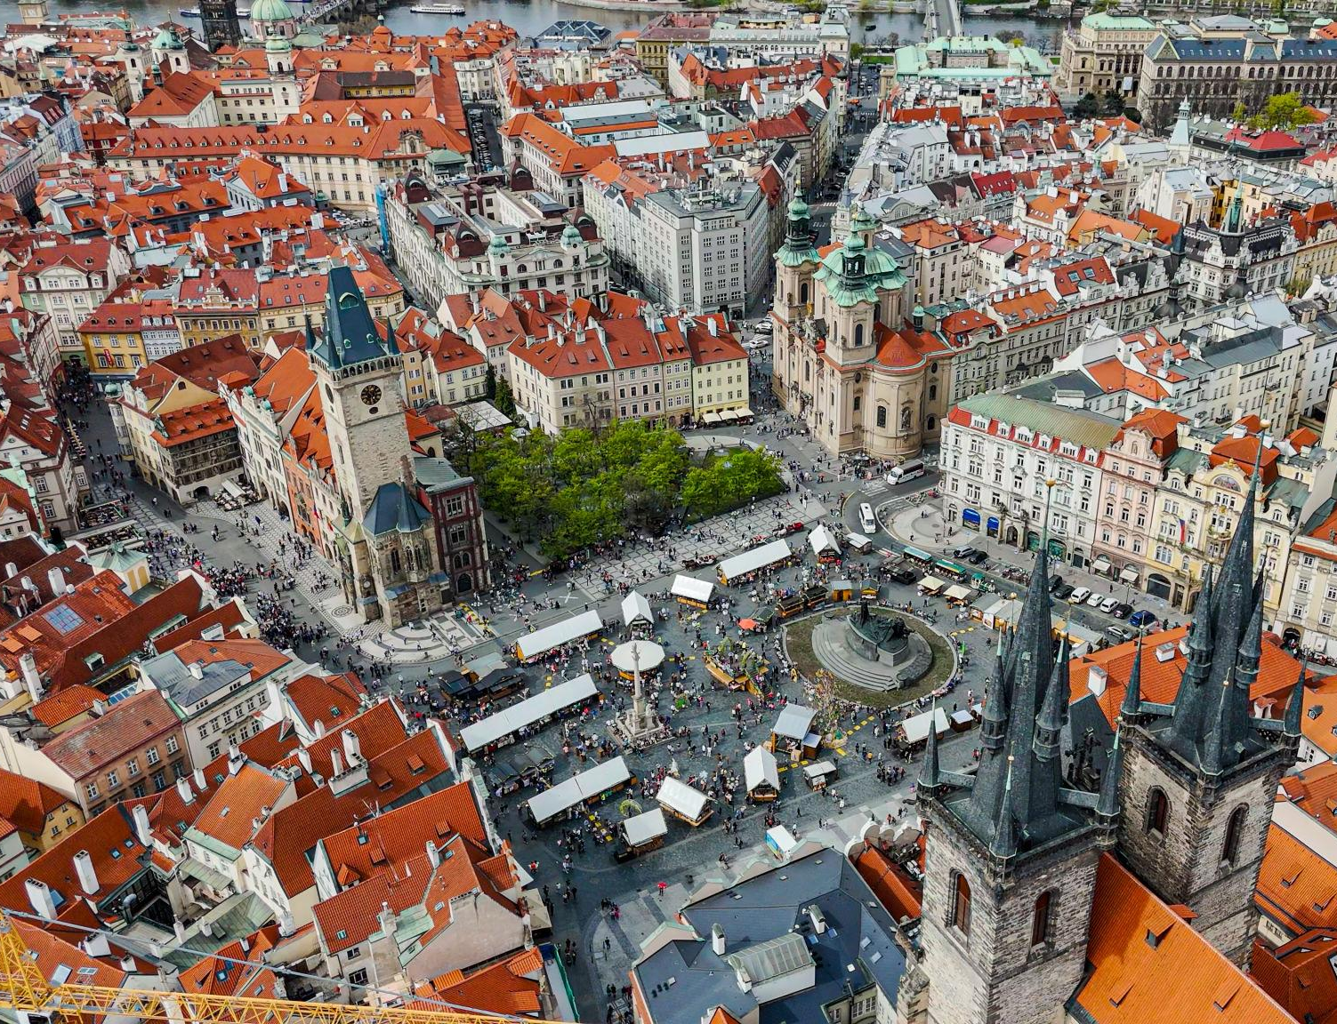
Image slide
Please choose the format that best suits your presentation.

Slide 6
Quote slide
e.g. War creates new ecological realities faster than science can measure them.
A wide selection of slide types is available.

Slide 7
This presentation explores:
1. Why this problem matters

Slide 8
2. Theoretical framework

Slide 9
3. Research approach

Slide 10
4. Key findings

Slide 11
5. Key Takeaways
• Insight 1
• Insight 2
• Insight 3
(3–5 key conclusions or one main message)

Slide 12
References
• 3-5 references
• QR code

Slide 13
QR to the full list
Clarification
Please prepare the most comprehensive list of publications possible.
It should provide a detailed overview of your approach and the body of research available on your topic.
We maintain a repository:
https://pd-repository-ojs.org/index.php/repository
A dedicated volume will be created in the repository specifically for this conference.
It will include publications regardless of their original place or date of publication.
The goal is to systematize knowledge on specific conflicts and their consequences, as well as to organize research according to scientific approaches related to the study of the environmental impacts of military activity.
Publication is free of charge. All costs are covered by the journal Pollution and Diseases.
All publications without a DOI will be assigned one via Crossref.
There is no limit on the number of publications.
There are no language restrictions — submissions can be in any language.
Please note that this process requires time from the journal’s editorial team, so we recommend starting well in advance.

Slide 14
Thank you for your attention!
The Paradigm of the Military Ecotone
Dmitry Nikolaenko
dn@pollution-diseases.org
QR code – include the most relevant information based on the specifics of your work.

