Slide 1
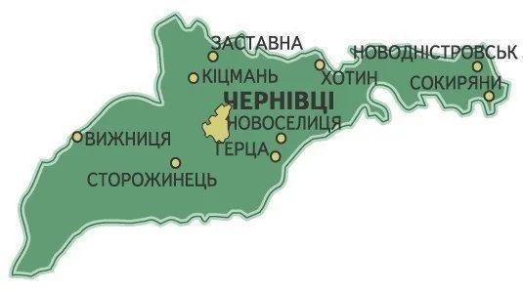
EcoMulcher of Bukovina
The initiator of the project is ECO PERSPECTIVE LLC. The company proposes to implement an investment project for the purchase of a self-propelled mulcher and other necessary equipment for clearing agricultural land, old gardens, shrubs and cluttered lands in the Chernivtsi region, which are currently not used for their intended purpose, which will be used in cooperation with Korean companies.
Legal address
Head
Chernivtsi region, Kitsman district, Shishkivtsi village
Vizniuk Maria Yuryivna

Slide 2
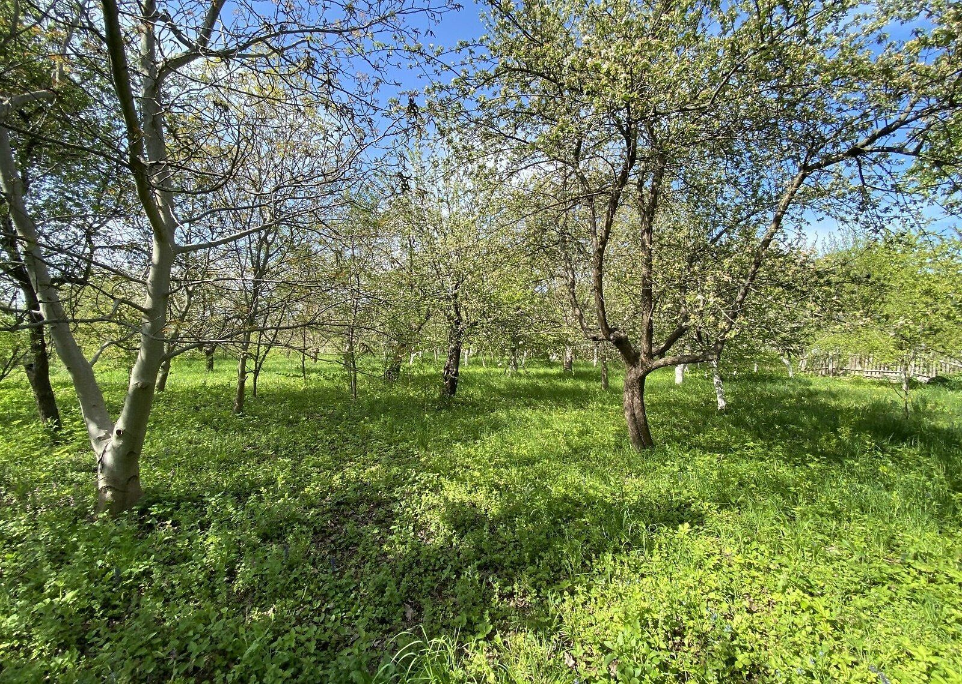
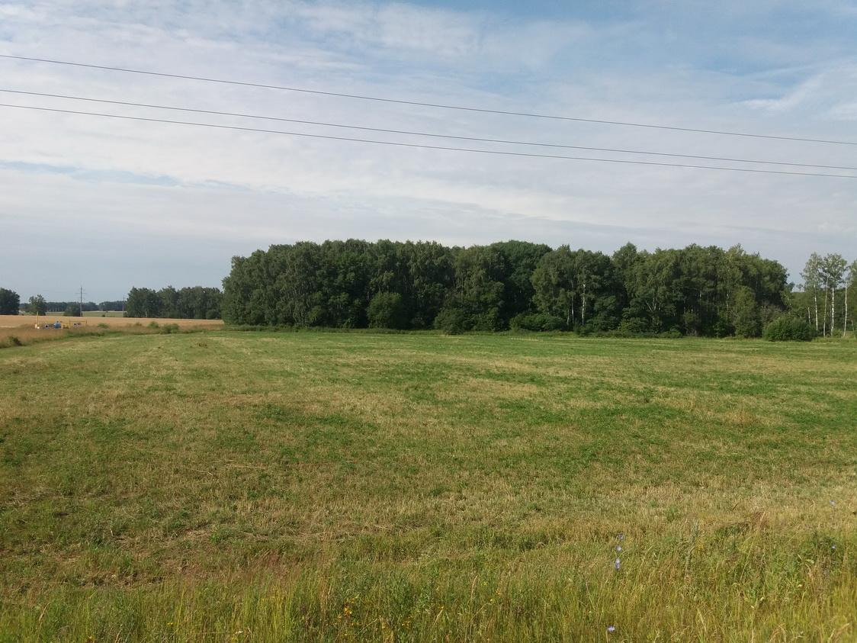

Brief history and idea of the project
The EcoMulcher of Bukovyna project arose as a response to the problem of abandoned agricultural land in the Chernivtsi region.
There are many plots of agricultural land in the region that are not used and are gradually overgrown with shrubs. Because of this, land loses economic value, and communities lose possible income.
Project Team
Chief specialist (hiring) – site assessment, work planning, reclamation quality control.
Mulcher operators (2 people) – equipment management, daily maintenance.
Driver – repair, maintenance, logistics.
Accountant-coordinator (part-time) – financial statements, preparation of documents for grantors
The first stage of work is planned in the Kitsman, Putilskyi, Vyzhnytskyi and Novoselytsia communities, and in the future — throughout the Chernivtsi region.

Slide 3

The problem that the cooperative solves
In the three target communities, the area of cluttered land is more than 1,500 hectares. In total, there may be 5,000 hectares or more of such land in the Chernivtsi region.
According to calculations, each hectare of cluttered land annually does not give the community about UAH 25,000 in net profit.
Main problems
Soil degradation and loss of fertility
Increased risk of fires due to dead wood and shrubs
Spread of pests and diseases in old gardens
Deterioration of the ecological state of coastal areas
Reduced opportunities for small farmers and communities

Slide 4
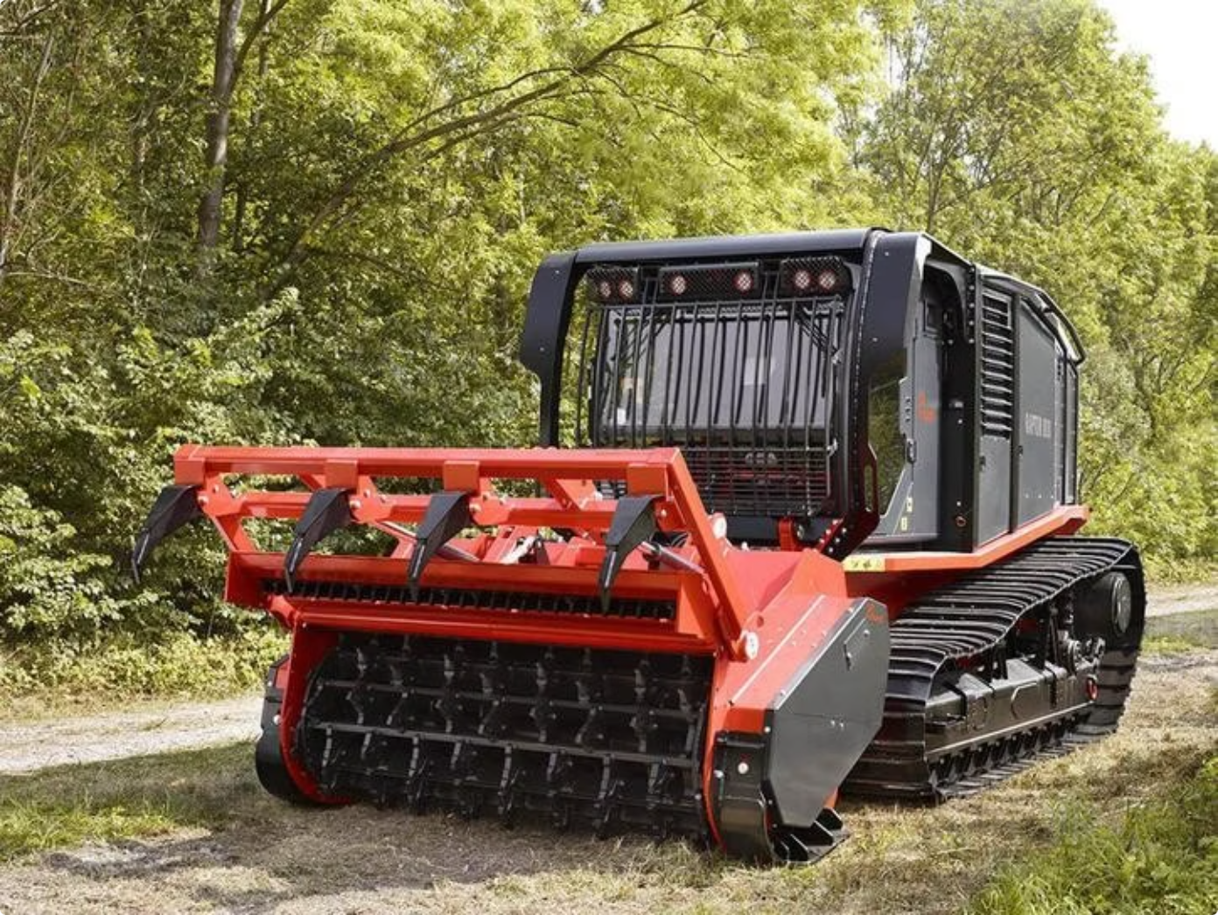
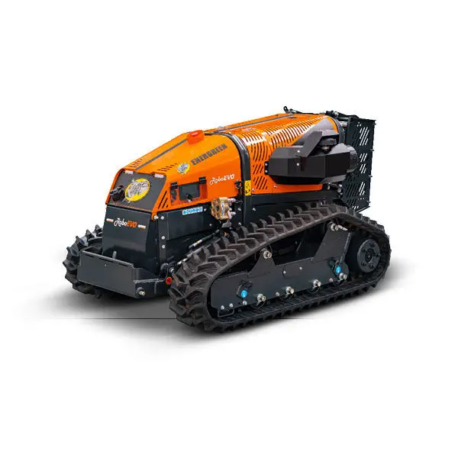

Solution: self-propelled mulcher
To solve the problem, it is proposed to purchase a professional self-propelled tracked mulcher, such as the PRINOTH Raptor 300 or a similar model.
Advantages of a mulcher
Can clear up to 3–5 hectares per day
Works on difficult areas, slopes and wet soils
Grinds trees, stumps and shrubs into mulch
Mulch stays in the field as organic fertilizer
The method is more environmentally friendly than burning or rough uprooting
This technique allows not only to remove thickets, but to return the land to agricultural use.

Slide 5

Implementation plan and budget
The project is designed for a quick launch during the first year.
Phase 1
Phase 3
Закупівля, доставка, митне оформлення, навчання
Scaling in target communities
Phase 2
Phase 4
Pilot launch; clearing 150 hectares
Extension to the area level
The main stages of the project include the purchase of equipment and training of operators, a pilot launch with the clearing of the first 150 hectares, scaling up work in target communities, and reaching the regional level.
Project funding
25M
20M
Total budget
Requested funding
UAH
UAH
5M
3-4
Own contribution
Payback
UAH
years

Slide 6

Expected results and impact
In the first year, it is planned to clear at least 800 hectares of land. In three years, 1,800-2,200 hectares are expected to be cleared in different districts of the Chernivtsi region.
Expected impact of the project
Land in circulation
Jobs
Ecology
Return of abandoned land to agricultural use
Creation of 5 permanent and more than 10 seasonal jobs
Improvement of the ecological condition of territories and reduction of fire danger
Community support
Cooperative income
Support for small farmers and local communities
Estimated income — UAH 7-8 million per year
The project has not only economic, but also environmental and social significance for the Chernivtsi region.

