Slide 1

Smart Agro-Hub: The Future of Agrologistics in Ukraine
An innovative project that transforms traditional agriculture in the Chernivtsi region with the help of advanced technologies and sustainable development.

Slide 2
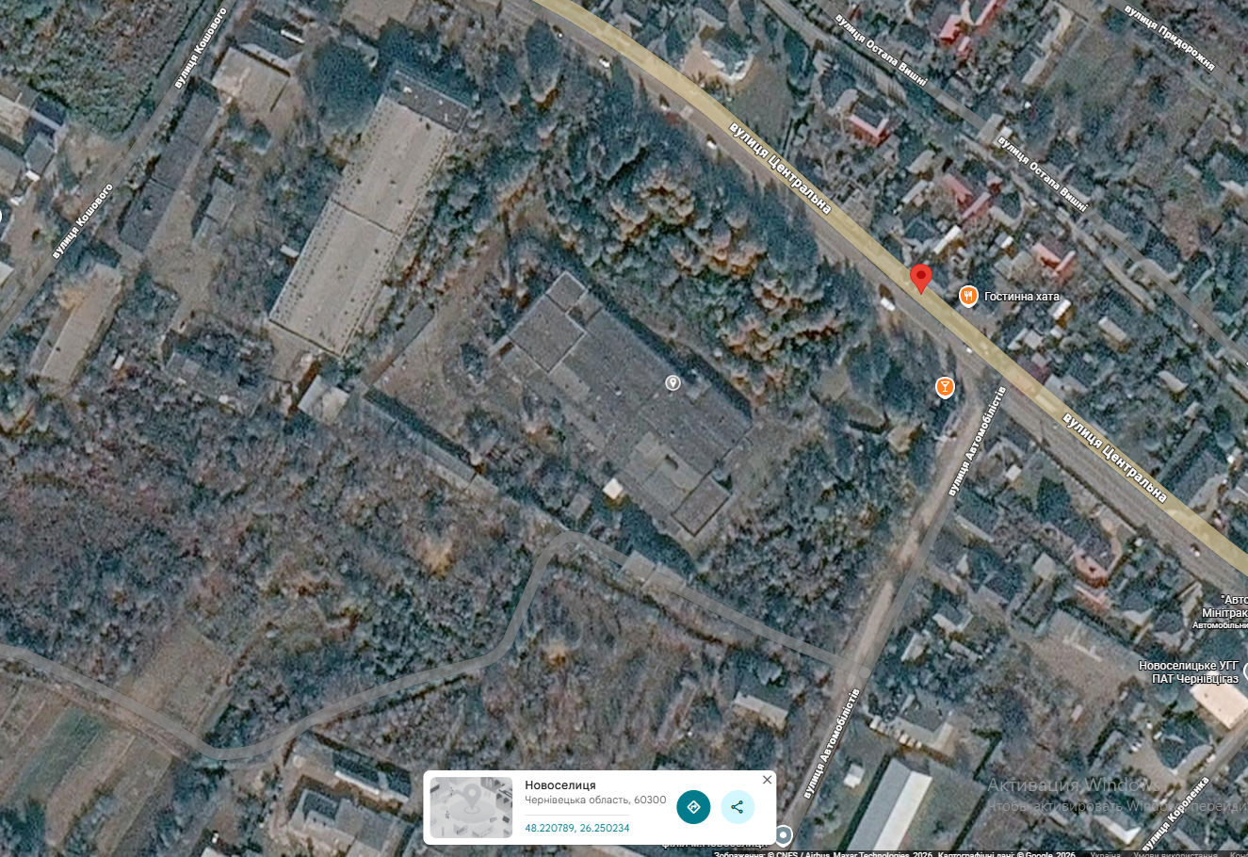
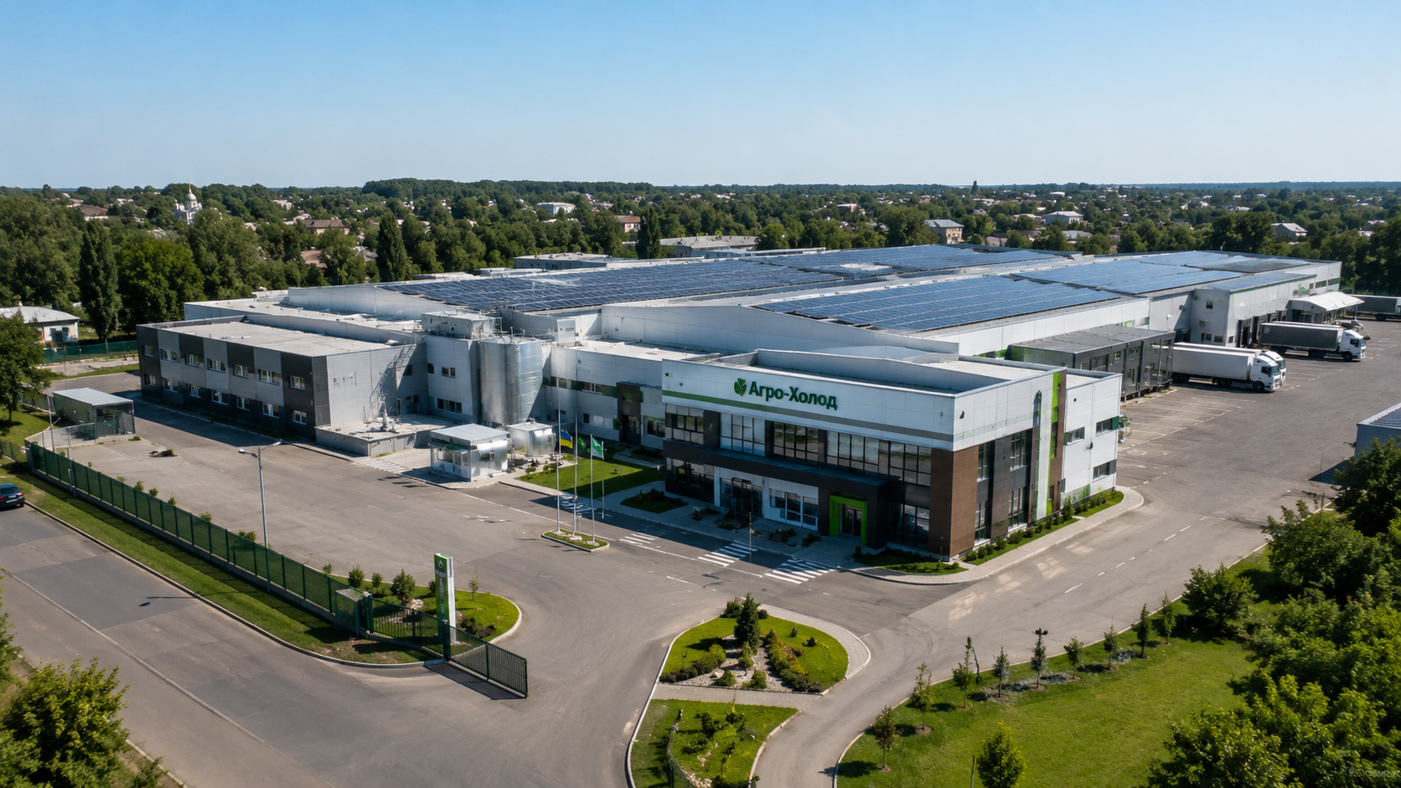
Introduction
From Cheese Plant to Agro-Hub
The project provides for the reconstruction of the existing cheese factory with an area of 5500 m². Instead of an obsolete production facility, it is planned to create an autonomous agricultural complex that will operate on the principle of "smart infrastructure".
This means that the building does not just perform the function of a warehouse. It becomes a technological environment where every process — from temperature in chambers to product quality — is controlled by digital systems.
The peculiarity of the project is that it preserves the historical basis of the building, but fills it with new meaning. The old cheese factory is turning into a modern center for agro-processing, logistics, innovation and training.

Slide 3
Architectural and technological concept
1
2
3
Bio-climatic design
Central atrium
Zonality of the complex
The use of heat recovery from refrigeration units to heat office spaces, as well as a green area on the roof to improve the microclimate and phytoremediation.
The core of the complex with an integrated AI monitoring system to control all processes, ensuring maximum efficiency.
North: Shock freezing chambers with nano-insulation (aerogels).
East: Cold rooms (-2°C...+4°C) with smart gas nanosensors.
South: Sorting and packing with sorting robots.
Event: Energy center with solar and wind generators.

Slide 4
Key Technology Solutions
Direction
Technology
Effect
Energy
Perovskite solar panels (efficiency 28%) + Vertical wind turbines
110% autonomy, surplus to the network
Isolation
Sandwich panels with nanoaerogel (λ=0.013 W/m·K)
45% reduction in energy consumption
Quality Control
IoT sensors with carbon nanotubes for ethylene detection
Spoilage prediction in 72 hours
Product processing
Antimicrobial Nanocoatings (Ag/Cu) on Conveyors
Reducing bacterial load by 100 times
Management
AI platform based on a digital twin (Digital Twin)
Real-time storage optimization

Slide 5
Economic Model and Payback
The project has a clear economic logic. Total capital expenditures are estimated at USD 22.3 million.
Main costs:
Profitability
Refrigeration equipment
Main income: Storage and freezing of products ($1.2 million/year)
Nanotechnology solutions
Reconstruction of the building
Additional income:
RES generation
Sale of surplus energy ($50 thousand/year)
Operating Expenses (OPEX): $85K/year
AgTech consulting ($100k/year)

Slide 6
Formation of the project ecosystem
Scientific Partners
Business Model
AgTech Sandbox
The Institute of Nanotechnology of the National Academy of Sciences of Ukraine will provide technology validation, and Chernivtsi Technical University will train highly qualified personnel.
It is planned to develop franchise models for replicating the Agro-Hub in other regions of Ukraine.
Creating a unique platform for testing and implementing the latest agricultural technologies, fostering innovation in the industry.

Slide 7
Why is it revolutionary?
Game-changing innovations
1
Full energy autonomy
2
Predictive product quality
Due to hybrid RES generation, which ensures independence.
Through AI and nanosensors that allow you to predict and prevent spoilage.
3
Zero losses
4
Technology Export
Thanks to preventive management and optimization of storage.
Development of a business model that will allow scaling Ukrainian agro-innovations around the world.

Slide 8


Our challenges
Minimizing Risks for Sustainable Development
Technological risks
Market risks
Regulatory risks
Technological risks are associated with possible equipment breakdowns or the complexity of implementing new solutions. To minimize them, equipment insurance and redundancy of critical systems are provided.
Market risks relate to stable demand for storage and freezing services. To reduce these risks, the project focuses on long-term contracts with farms.
Regulatory risks may arise due to the need for permits or special status. To solve them, it is proposed to obtain the status of a pilot AgTech project.

Slide 9
The future begins today
Smart Agro-Hub is not just an infrastructure facility. This is a model of the future for the Ukrainian agricultural sector.
The project combines storage, recycling, energy autonomy, digital technologies, science, education and an environmental approach.
Our next steps:
The next steps include preparing a detailed feasibility study, negotiating with potential tenants and partners, and applying for EU grant programs, including Horizon Europe and the Green Deal.
In the future, this hub can become an example of how Ukraine is able not only to restore old infrastructure, but also to create new technological solutions for the agricultural sector.

