Slide 1
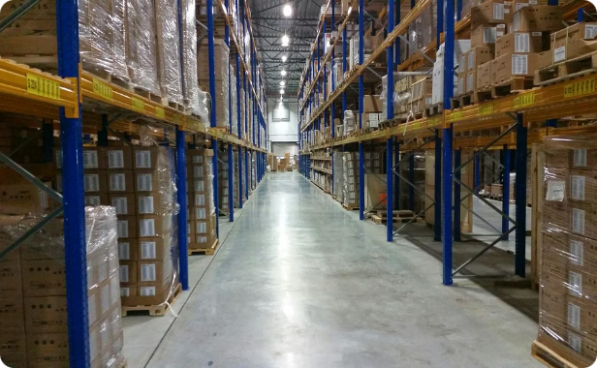
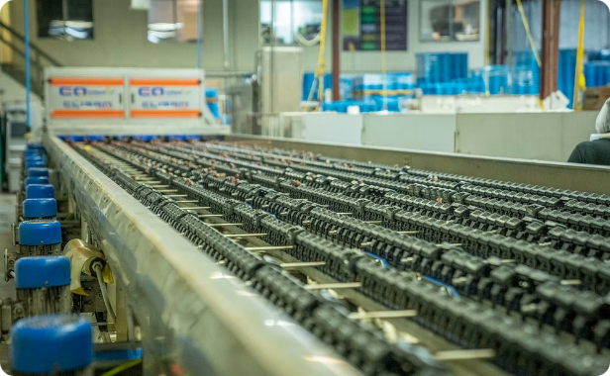
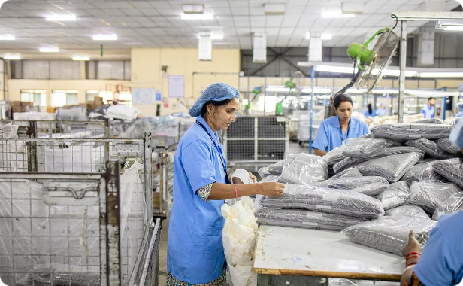
Project "AI-Driven Universal Robotic Fruit and Vegetable Warehouse"
Location: Chernivtsi region. Format: a modern agrologistics complex with an area of approximately 5,500 m². The project combines refrigeration capacity, blast freezing, sorting, packaging, logistics, and digital monitoring to ensure a stable chain of storage and delivery of products from farmers to Ukrainian markets and exports.
Storage and cooling
Temperature and moisture control, zoning for different types of products, minimizing losses.
Shock freezing
Low-temperature processing to preserve the quality of berries, vegetables and semi-finished products.
Sorting and packaging
Automated calibration and packaging lines to improve productivity and export standards.

Slide 2
Goal of the project
To create a modern center of agrologistics, which simultaneously solves the operational, economic and environmental problems of the region. Specific objectives:
Reduction of crop losses
Support for farmers and cooperatives
Improving product quality
Export Development and Value Added
Optimized storage conditions and fast processing reduce percentage losses during storage and transportation.
Access to logistics, storage and technology for small and medium-sized manufacturers.
Quality control systems, laboratory and packaging standards according to export requirements.
Processing, packaging and labeling will allow you to enter new markets and form products with higher costs.
Energy independence
Integrated renewables and energy storage systems will ensure stable operation in the event of outages.

Slide 3
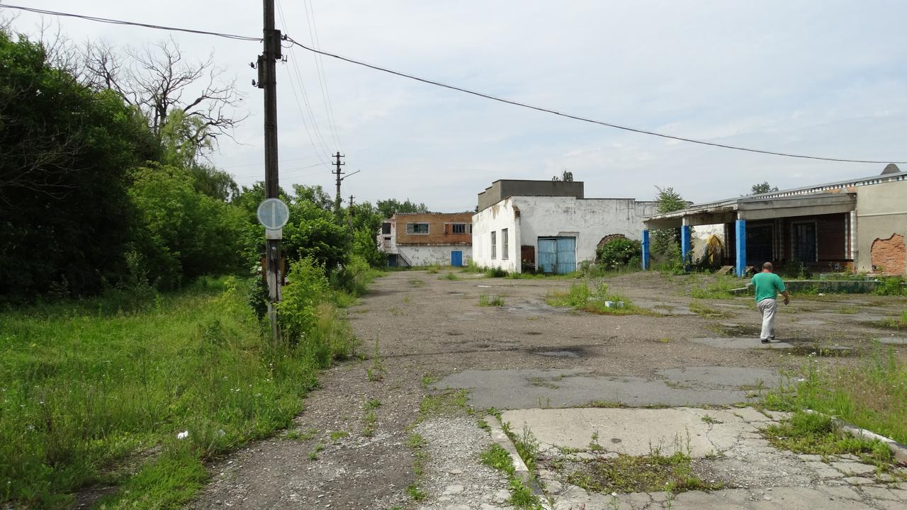
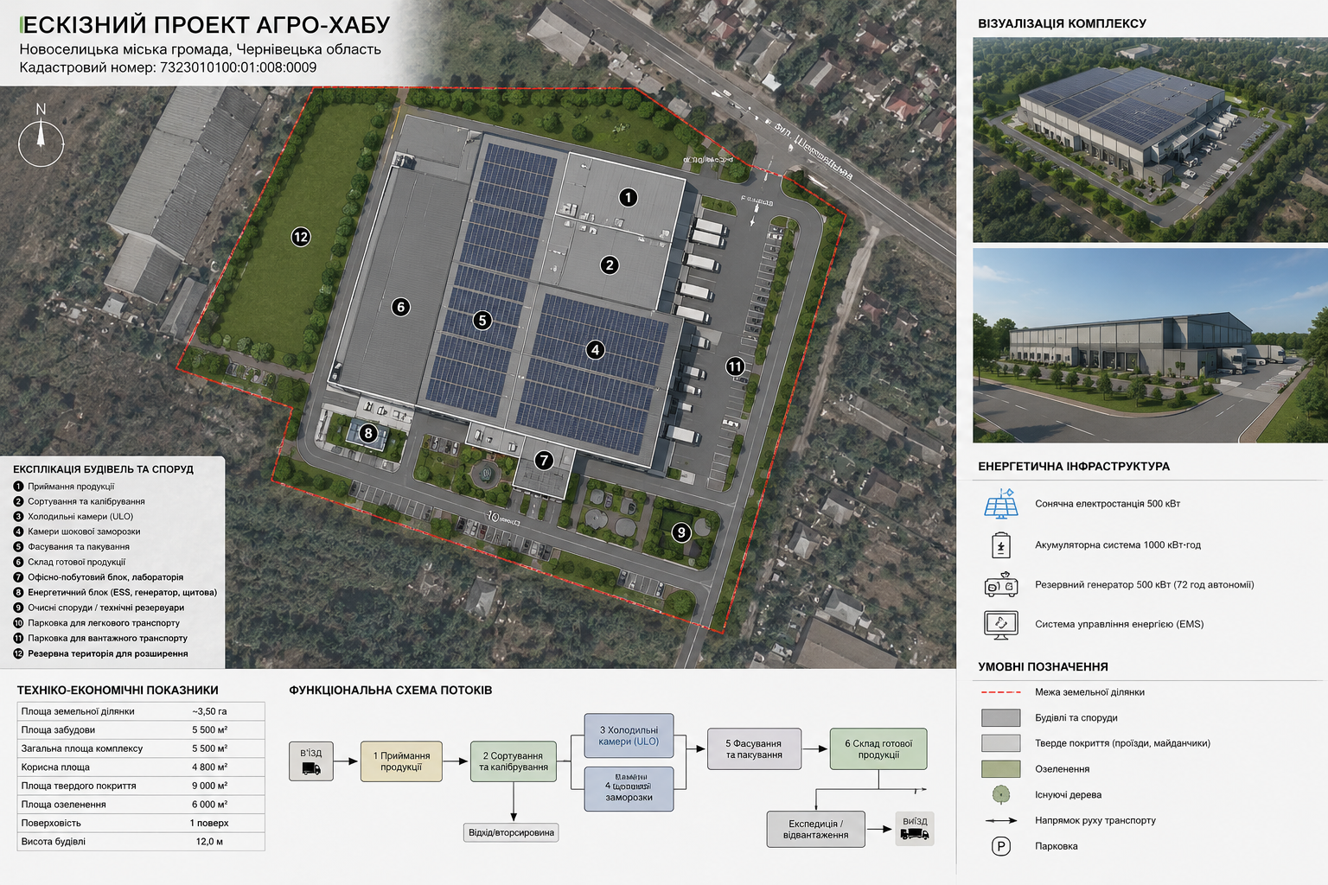
Implementation options
Two strategic ways to launch the project are being considered. Each option has its own advantages in terms of timing, costs, and future development.
Option 2 - New construction
Option 1 — Reconstruction
The complex is designed from scratch for modern technologies: maximum energy efficiency, automation, space for scaling and integration of renewable energy.
Use of the existing building of the former cheese factory. Advantages: faster start-up, lower capital costs, existing infrastructure and entrances. Ideal for a quick start and market confirmation.
The choice depends on the time frame, available funding and long-term development strategy.

Slide 4
Main functional areas
Each zone is designed for efficient technological flow and food safety standards:
Product acceptance
Sorting and calibration
Quality control upon receipt, unloading and initial audit of batches.
Automated and manual stations for sorting by size, weight and quality.
Cold storage
Shock freezing
Zones with different temperatures for optimal storage of vegetables, fruits and berries.
Separate chambers to preserve the structure and taste of the product.
Packaging and packaging
Composition of finished products
Flexible lines for different packaging formats — from wholesale to final retail packaging.
Organized storage space for packaged goods before shipment.
Quality Control Laboratory
Power Unit
Safety testing, pesticide residue testing, batch certification for export.
Integration of solar power plants, ESS and generators for uninterrupted power supply and cost optimization.

Slide 5
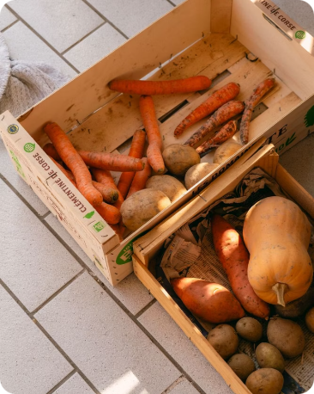
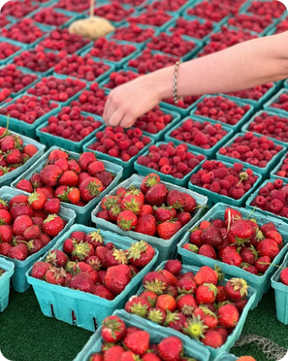
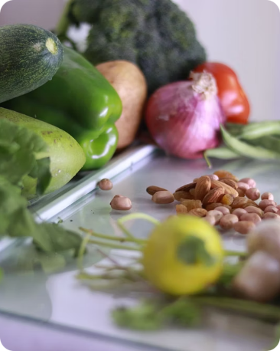
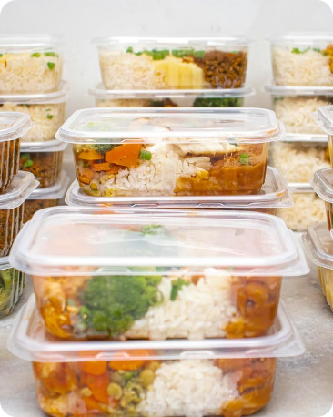
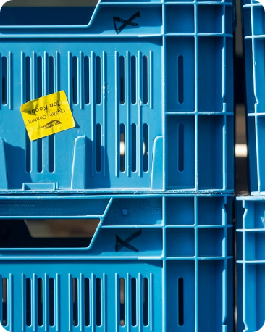
Product Model
We focus on several key product lines that provide a combination of volume and added value:
Vegetables
Berries and fruits
Products for freezing
Ready-made mixes and semi-finished products
Organic and niche products
Potatoes, carrots, onions, cabbage — long-term storage and supply to the market. A separate strategic direction is the storage of onions and their processing into noodles for the Korean ramen market (ramyeon), where onions are the main ingredient.
Strawberries, raspberries, apples are careful processing and quick freezing for export.
Broccoli, peas, mushrooms, peppers — shock freezing to preserve quality.
Premium mixtures for retail and HoReCa are added value on site.
High margin segment: certified organic production and local crops.

Slide 6
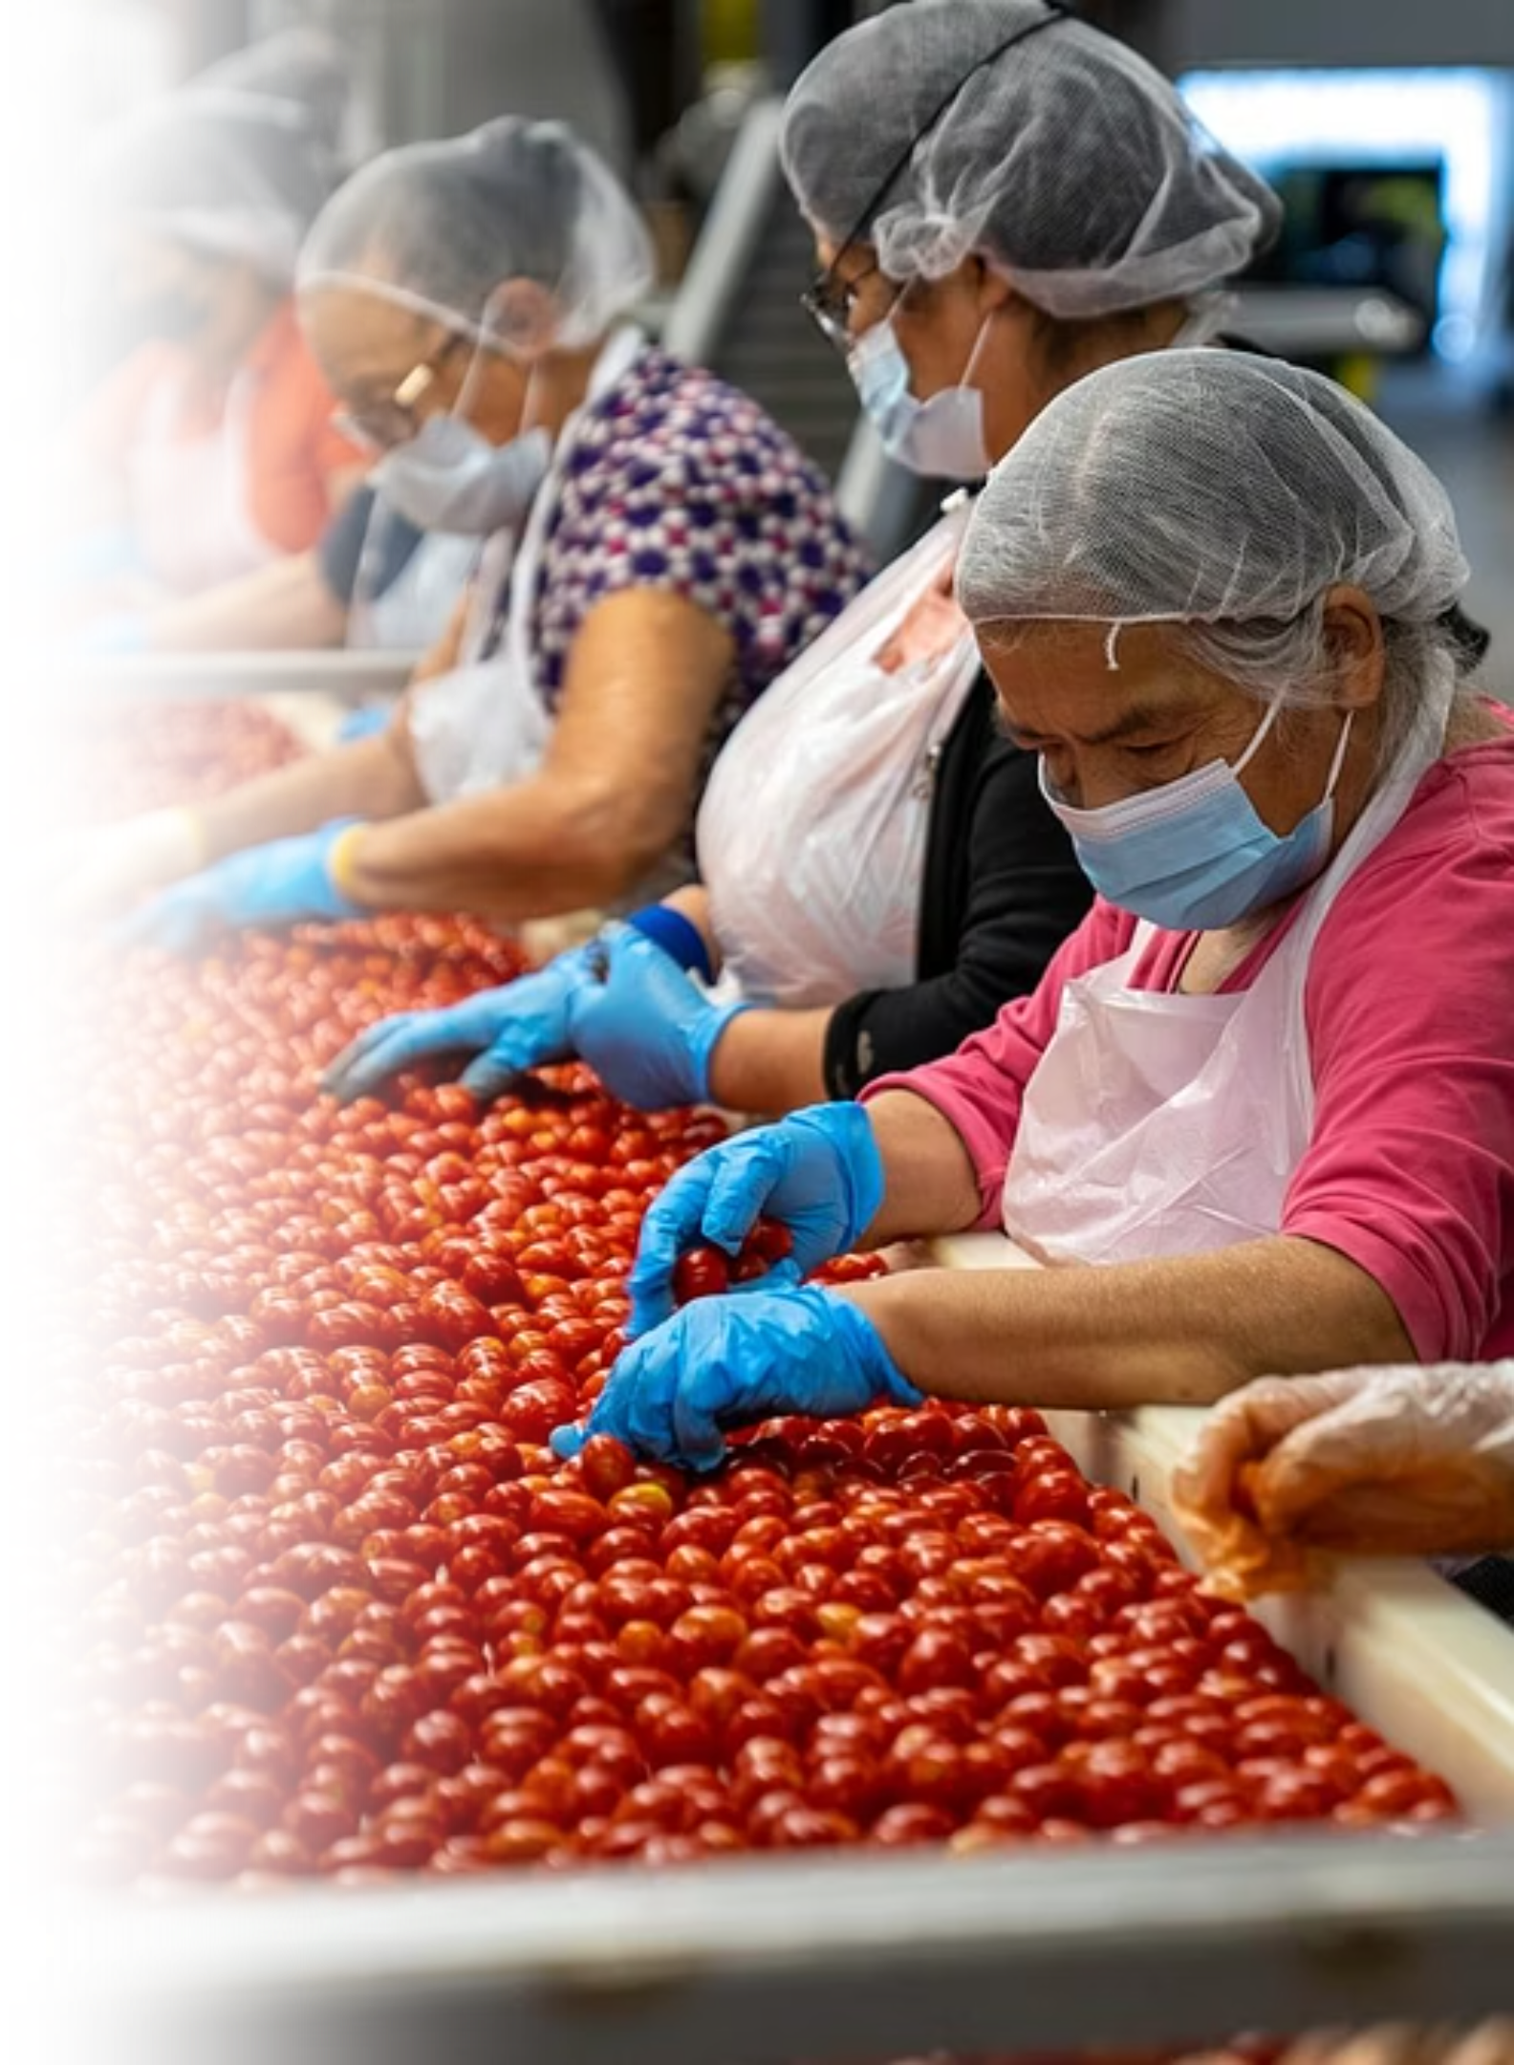
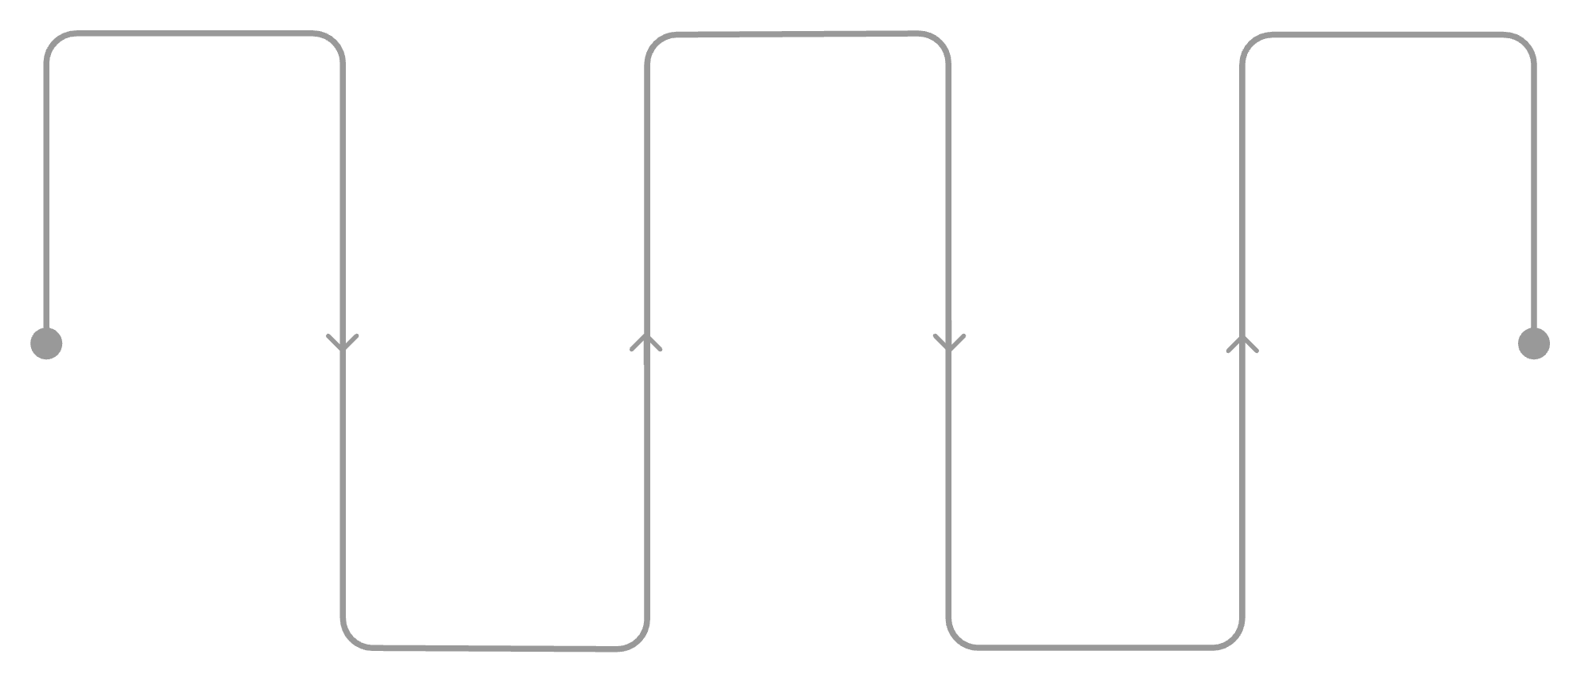
Technological cycle
Farmers
Sorting
Composition of the finished
Collection of raw materials in the field
Separation by category
Storage before shipment
Acceptance & CT
Cold/Packaging
Quality assessment and reception
Cooling, freezing, packaging
The sequence of processes ensures that the time from collection to storage is minimized, which reduces losses and improves the quality of the final product. The key result is an increase in added value and economic returns for farmers.

Slide 7
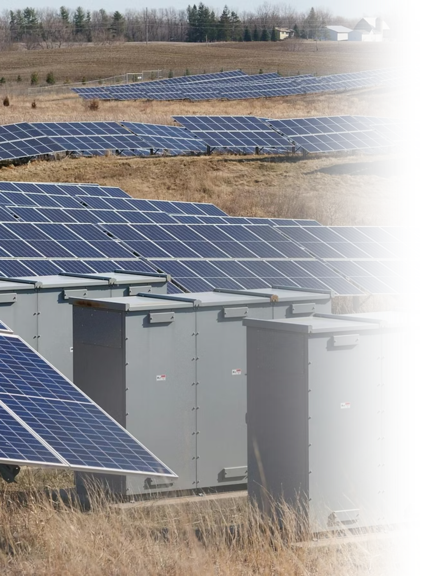
Energy autonomy
To ensure the uninterrupted operation of the refrigeration complex, a comprehensive energy subsystem is provided, combining renewable sources and reserve capacities. This is critical for maintaining the quality of products during emergency network outages.
Solar Power Plant
Batteries (ESS)
Backup generator
Power: 500 kW — base load coverage, reduced operating costs and CO₂ emissions.
Capacity: 1,000 kWh — buffer for night mode and peak loads.
Power: 500 kW — for emergency power supply of critical systems.
EMS — Energy Management System
Automatic balancing of sources, optimization of the use of SPP/ESS/generator for guaranteed operation of refrigeration equipment.

Slide 8
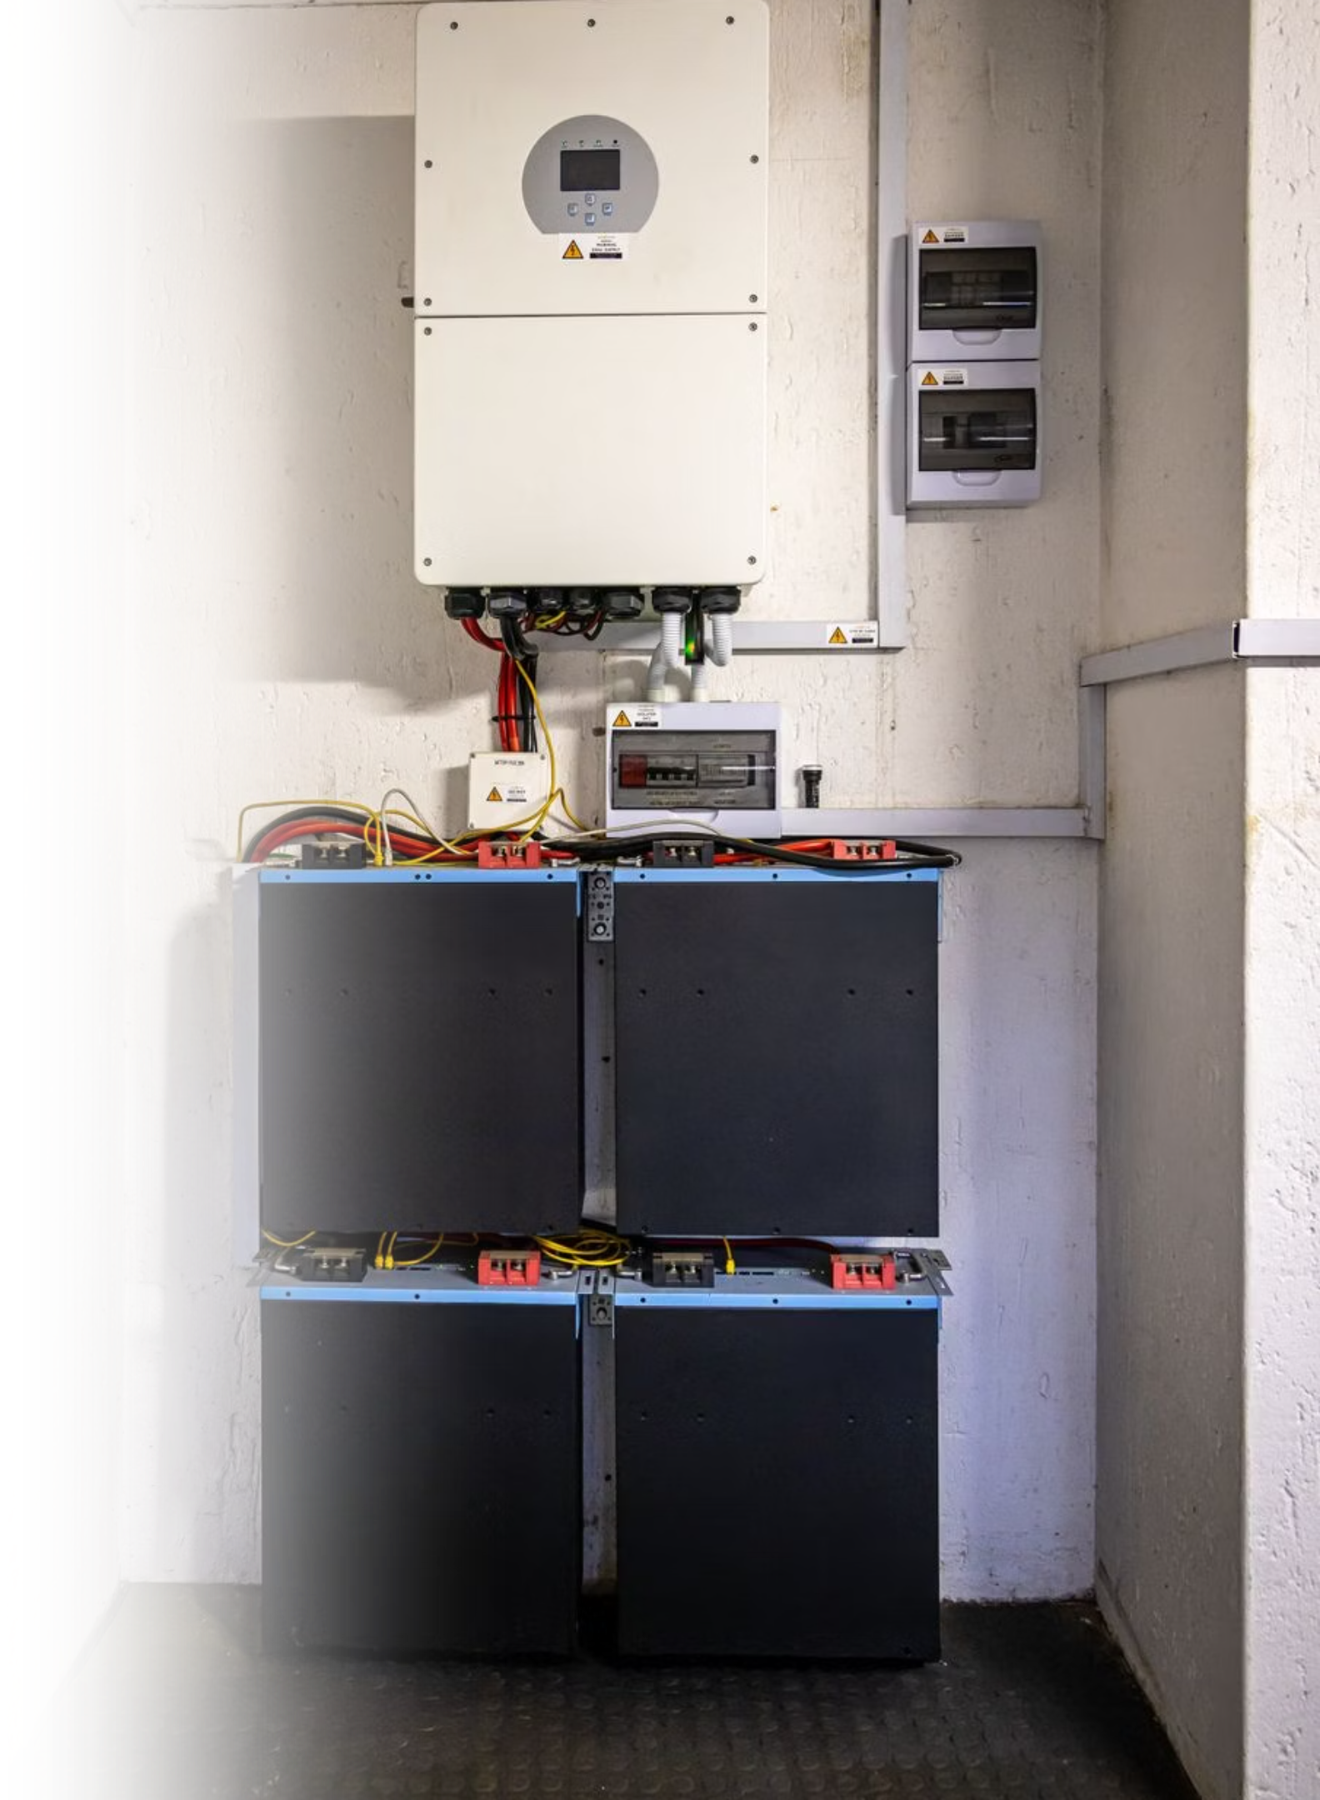
Technical diagram of power supply
System structure: 500 kW solar power plant → inverters → EMS, which coordinates the supply of energy to the ESS, generator and consumers. EMS automatically switches power supplies, prioritizing renewable energy and reserves to maintain the temperature conditions of cold rooms.
Key Features of EMS
Real-time monitoring of consumption and generation
Battery Charge/Discharge Optimization
Renewable energy priority
Automatic switching to the generator if necessary

Slide 9
Project budget
Approximate structural calculation of the project cost, formed for pre-financing and planning:
1 | Construction / reconstruction of the main complex | $11.9 million | Building, cold rooms, shock freezing, logistics, industrial floors, façade, roof
2 | Energy autonomy | $3.1–3.2 million | CES 500 kW, ESS 1000 kWh, Generator 500 kW, EMS, delivery, installation
3 | AI, automation, and digital circuit | $1.2–1.5 million | WMS, TMS, SCADA, AI analytics, Digital Twin, sensors, hardware integration
4 | Onion direction for ramyeon | $1.8–2.4 million | Separate onion storage rooms, line for cleaning, cutting, drying, packaging
5 | Korean EPC / Integration Package | $0.7 - 1.0 million | Design, technical support, training, commissioning, service
6 | Provision for risks and refinements | $1.5–2.0 million | Price fluctuations, logistics, course, additional construction work
Cost estimates include construction work, refrigeration, automation, power systems, and initial operating costs. An accurate estimate is formed after choosing an implementation option (reconstruction or new construction) and a detailed engineering project.

Slide 10
Expected result
The project will create a modern agro-hub that will increase the efficiency of agricultural production in the region and become a catalyst for the local economy. Main expected effects:
Farmers' Association
High-quality storage and freezing
Increasing competitiveness
Expanding export opportunities
Example of non-volatile infrastructure
Cooperation, centralized access to infrastructure and logistics and storage services.
Reducing losses, improving the quality of goods and meeting export standards.
The new infrastructure increases the attractiveness of products in the domestic and foreign markets.
Certified batches, standardized packaging and logistics to enter international markets.
The integration of SPP, ESS and EMS makes the complex resistant to energy risks and reduces operating costs.
As a result, a modern agro-hub will become a catalyst for the sustainable development of the agricultural sector of the Chernivtsi region, strengthen local supply chains and contribute to the growth of exports of Ukrainian products.

