Slide 1

LANGUAGE COLLEGE 4.0 — EDUCATION WITHOUT BORDERS
Language College 4.0 is not just about language courses. This is a modern educational hub in Chernivtsi that combines live learning, online platforms, artificial intelligence, international teachers, and inclusive technologies.
The idea of the project is to make quality language education accessible to everyone: children, students, specialists, residents of remote communities, foreigners, and people with disabilities.
This is a model of education of a new generation, where language becomes not only a subject of study, but a tool for international cooperation, professional development and reconstruction of Ukraine.

Slide 2
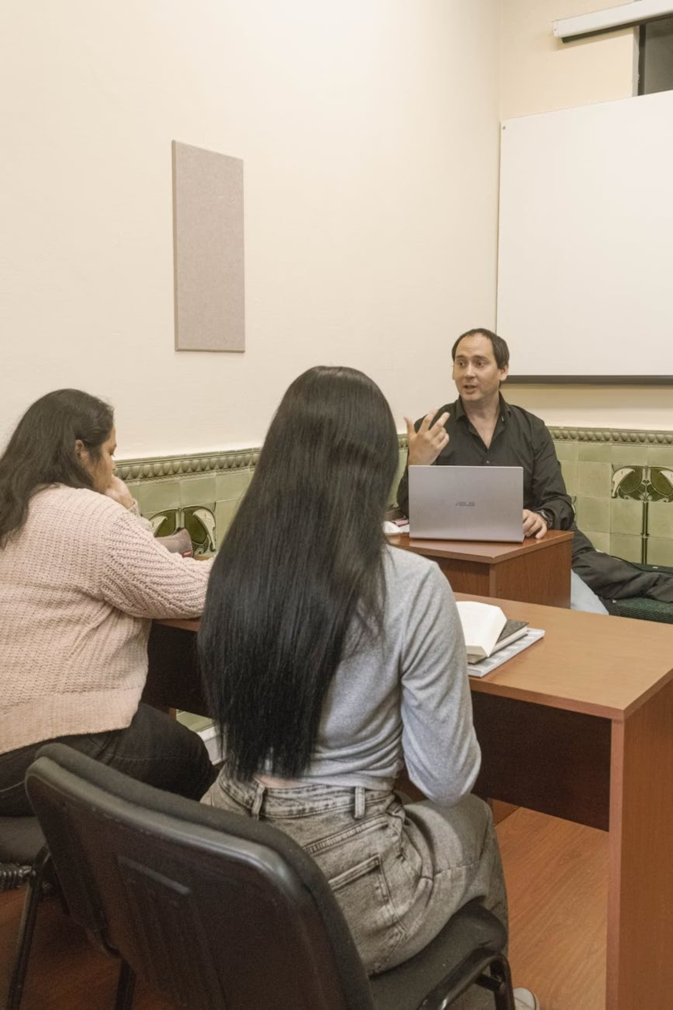

WHO IS BEHIND THE PROJECT
The project is implemented by the PE "Priority Language College", a language center from Chernivtsi, which has been operating for more than 20 years.
The college has expertise in three important areas:
CHILDREN'EDUCATION
INTERNATIONAL EXAMS
Teaching children from preschool age
Preparing students for international exams
PROFESSIONAL LANGUAGE
Language training for doctors, engineers, manufacturers and cultural workers
The peculiarity of the college is that it forms a complete educational path: from the first steps in learning a language to professional mastery of it. That is why Language College 4.0 can become not just a local educational project, but a pilot model for other regions of Ukraine.

Slide 3
THE UNIQUENESS OF THE PROJECT
Language College 4.0 stands out for combining traditional education with modern technology.
LANGUAGES OF INSTRUCTION
KOREAN IS A SPECIAL DIRECTION
Within the framework of the project, it is planned to teach the following languages:
The Korean language occupies a special place, because it opens up new opportunities for Ukrainian-Korean cooperation. Through the distance format, the college can attract native speakers directly from the Republic of Korea.
This makes the project exclusive: students from Chernivtsi and other communities will be able to access the international level of education without leaving Ukraine.
English
German
French
Spanish
Korean
Ukrainian for foreigners

Slide 4

INCLUSIVITY AS A CORE VALUE
One of the most important ideas of Language College 4.0 is that education should be accessible to everyone. The project provides for the creation of an inclusive educational system for people with different needs: hearing, vision, musculoskeletal and other functional disabilities.
The system will be adjusted for those who cannot physically be present in the classroom for training, but have a desire to learn.
TECHNOLOGICAL SOLUTIONS
Real-time subtitling of classes
Audio description of educational materials
Platform compatibility with screen readers
Braille displays
Specialized keyboards
FM systems for people with hearing impairments
This is not just a technical solution. This is an approach in which a person does not have to "adapt" to the system — on the contrary, the system is created so that everyone can learn comfortably.

Slide 5
TECHNOLOGIES THAT MAKE LEARNING MODERN
Guided by the principle of Smart Reconstruction and taking into account the acute shortage of professional teachers in Ukraine, we have begun to implement a hybrid learning model that combines:
LMS PLATFORM
AI-ASSISTANTS
Online training, video conferencing, and class recordings
Language training with artificial intelligence, interactive tests with automatic verification
VR/AR-COMPONENTS
INTERACTIVE EQUIPMENT
VR scenarios for professional fields: medicine, engineering, manufacturing
Interactive panels, tablets, laptops, digital exercises and simulation dialogues
Especially interesting is the use of VR scenarios for professional fields, such as medicine, engineering, and manufacturing. This will allow you not only to learn words, but to train real communication situations.
This model makes language a practical tool that can be immediately applied in work, study and international cooperation.

Slide 6
UKRAINIAN-KOREAN COOPERATION AND FUTURE RESULTS
The Language College 4.0 project is related to the development of Ukrainian-Korean cooperation within the framework of the ideas of the Seoul Declaration. The college offers Korean partners a pilot platform in Ukraine for testing educational technologies, EdTech solutions, AI tools, VR training, and inclusive solutions.
EXPECTED SUPPORT
EXPECTED RESULT BY THE 18TH MONTH
Hardware and software
Korean Language Teachers
Educational materials
Grant funding
Opportunities for student exchanges and internships
Launch of a full-fledged hybrid platform with 7 languages
Training of at least 300 students
Trained personnel for future Smart Villages in Bukovyna with knowledge of English, Korean and other languages.
Training of at least 50 people with disabilities
Creation of an educational model that can be scaled to other regions of Ukraine
Language College 4.0 is a project about the future, where education becomes accessible, technological, international and truly human.

